Slide 2
Conscious Organisations
Seminar 6, Module 4: Organisations as Living Systems

Slide 3
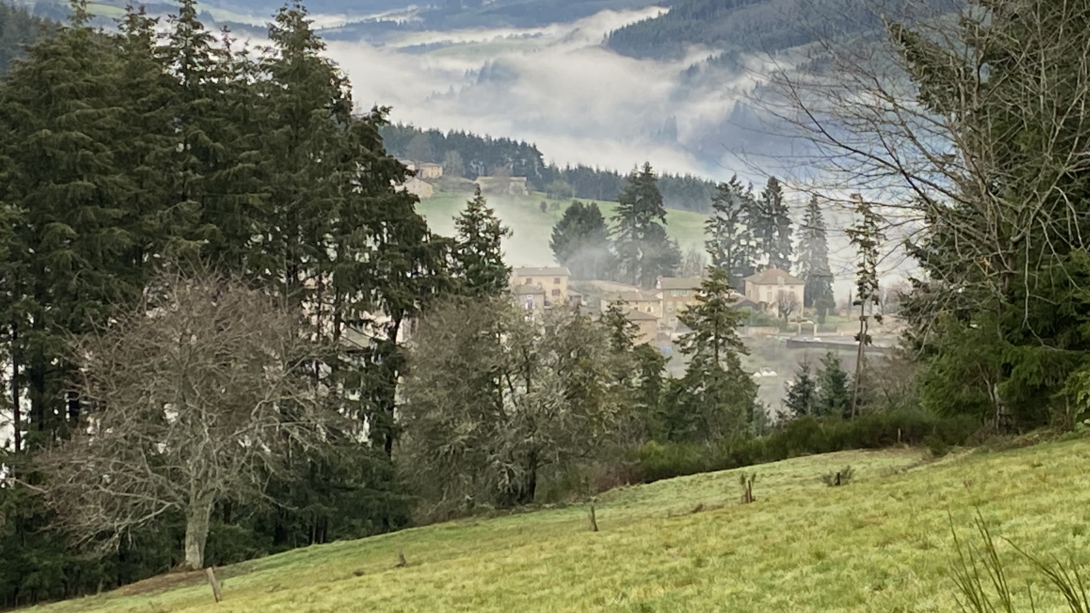
Centering Moment of Mindfulness
Photo credit: Dorianne Cotter-Lockard
Notes:
If the instructor is not trained in mindfulness practices, the following two apps provide “how to” videos and guided meditations:
https://insighttimer.com/
https://www.headspace.com/
Alternatively, choose one of these simple mindfulness practices (each takes less than 3 minutes):
Breathing
Invite students to breath in for 4 counts, hold 4 counts, breath out 4 counts, and hold 4 counts. Count slowly to guide the process. Repeat the cycle 2 – 3 times.
Listening in Silence
Invite students to sit in silence listen to the sounds around them. If there is a clock ticking in the room, they can focus on that first. After 30 seconds invite them to listen to the sounds outside the room. After an additional 30 seconds invite them to listen to the sounds of their breathing or other sounds within their bodies. Finally invite them to be open to hearing all sounds within and around them.

Slide 4
Organisations as Living Systems
“System transformations require interconnected changes to technologies, social practices, business models, regulations, and societal norms, an intentional process designed to fundamentally alter the components and structures that cause the system to behave in its current unsustainable ways, a paradigm shift enabling the transition to sustainability.”
Voulvoulis et al. (2022). Systems thinking as a paradigm shift for sustainability transformation. Global Environmental Change, 75, 102544.
This Photo by Unknown Author is licensed under CC BY
Notes:
Beginning quote to center the class.

Slide 5
Class Purpose
Add the class purpose here – revisit each class session

Slide 6
Conscious Organisations Agenda Seminar 6, Module 4: Organisations as Living Systems
SDG Initiative Poster Presentations
Introduce Living Systems, Systems Thinking, Organisational Learning
Activity: Understanding Systems
Transforming Organisations
Closing Reflections & Appreciations

Slide 7
Poster Presentations
Each self-managing team will present their final group project, maximum 10 minutes per presentation.
Notes:
Note to Instructor: Unless the class is delivered virtually, the students should create the poster by hand, on large flipchart sized paper. The intention is to have a gallery of posters at the last session of the course, for the presentations.
The Posters should be hung on the walls of the classroom in advance of the class session. The students can walk around the room to view the posters as if they were in an art gallery.

Slide 8
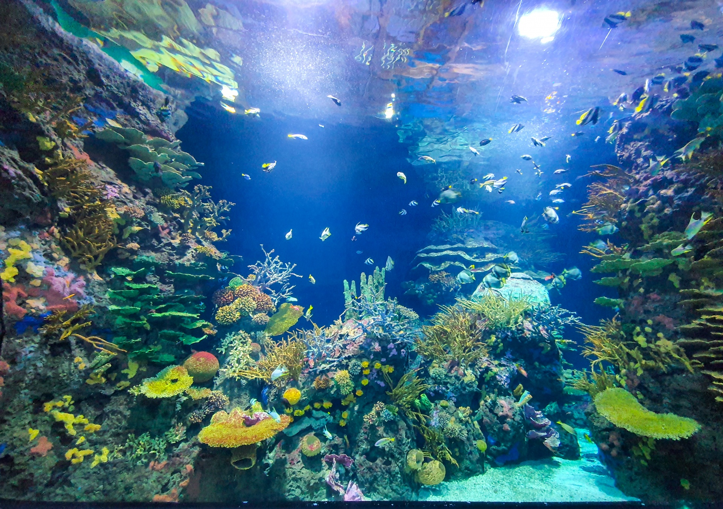
System
Per Merriam-Webster Online Dictionary:
“a regularly interacting or interdependent group of items forming a unified whole”
This Photo by Unknown Author from www.publicdomainpictures.net
Notes:
Read the standard dictionary definition

Slide 9
System
“A system is an interconnected set of elements that is coherently organized in a way that achieves something … a system must consist of three kinds of things: elements, interconnections, and a function or purpose.”
Meadows, D. H. (2008). Thinking in systems: A primer, p. 11. Chelsea Green publishing.
This Photo by Unknown Author is licensed under CC BY-SA-NC
Notes:
Introduce the definition from Donella Meadows' ground-breaking work on Systems
Ask the class to identify elements in the image, then identify interconnections between the elements, and finally the purpose of the item represented in the image.

Slide 10
Living Systems
“Dividing a cow in half does not make two small cows. A person might be said to be comprised of a head, a torso, and limbs; or of bones, muscles, skin, and blood; or of the brain, lungs, heart, liver, and stomach; or of a digestive system, circulatory system, respiratory system, and nervous system; or of many, many cells. No matter what distinctions we choose, we cannot grasp what it is to be human by looking at the parts.”
Kleiner, A., Smith, B., Roberts, C., Senge, P. M., & Ross, R. (2011, p. 25). The Fifth Discipline Fieldbook: Strategies for Building a Learning Organization. Hachette UK.
This Photo by Unknown Author is licensed under CC BY-SA
Notes:
Read the quote.
Ask the question, what aspects of being human are not included in this illustration?

Slide 11
Living Systems
Monbiot, G. (2022a). How wolves change rivers [remastered HD]. [Video]. Sustainable Human. https://sustainablehuman.org/stories/how-wolves-change-rivers/
Interdependence
Impacts felt throughout the system
Cannot be separated into pieces and parts
Notes:
Play this video to the class.
Ask class to give examples from the video of interdependence, impacts throughout the system, whole vs. parts

Slide 12
Systems Thinking
What is Systems Thinking?
“Systems thinking is a set of synergistic analytic skills used to improve the capability of identifying and understanding systems, predicting their behaviors, and devising modifications to them in order to produce desired effects. These skills work together as a system.”
Arnold, R. D., & Wade, J. P. (2015). A definition of systems thinking: A systems approach. Procedia computer science, 44, p. 675.
This Photo by Unknown Author is licensed under CC BY-SA-NC
Notes:
Instructor to facilitate dialog:
What is Systems Thinking?
“a way of thinking about, and a language for describing and understanding, the forces and interrelationships that shape the behavior of systems.” From Kleiner et al. (2011, p.6). The Fifth Discipline Fieldbook: Strategies for Building a Learning Organization. Includes:
Mental models
Distinctions
Relationships
Perspective

Slide 13
What is Organizational Learning?
https://www.solonline.org/
Notes:
Shared Vision and Personal Mastery are the base of the leg of Aspiration.
Personal mastery helps people develop a coherent picture of desired results by balancing the tension between their vision and their reality.
Through shared vision people learn to nourish a sense of commitment in a group by developing shared images of the future they seek to create, and the practices by which they hope to get there.
These two disciplines allows groups and individuals to shift from a reactionary mindset to a creative mindset.
Mental Models and Team Learning are the base of the leg of Working Collaboratively.
Mental Models are focused around developing awareness of the attitudes and perceptions that influence thought and interaction.
Team Learning transforms a group’s collective thinking, and mobilizes their collective energies. Upon mastering these disciplines, individuals will shift from knowing to learning.
The third leg of Dealing with Complexity is based on Systems Thinking.
Systems thinking: interdependency and change – the butterfly effect.
With mastery in Systems Thinking people will see connections instead of parts and shift from blaming to understanding.

Slide 14
The Learning Organisation
Common vision
Open sharing
Feedback loops
Personal mastery
Prototyping
Best practices
Systems thinking
This Photo by Unknown Author is licensed under CC BY-SA-NC
Notes:
Instructor to facilitate dialog:
What are key characteristics of the learning organisation?
Common vision
Open culture & sharing, mistakes are learning opportunities
Feedback loops – 360 surveys, after-project feedback, record customer interactions, etc.
Personal mastery – continual learning and self-improvement, embedded education
Prototyping - Intelligent fast failure
Best practices – steal, copy, borrow ideas
Systems thinking

Slide 15
Understanding Systems
Activity – Self-Managing Teams
Start with re-presencing your team values. Each person on the team shares one value that is important to them as you work together today.
Consider your self-managing team as your initial system
Draw concentric circles to illustrate the systems your team is embedded in, label them
How does your team impact the first system you are embedded in? How does that system impact your team?
How does the first system impact the next largest system? How does the larger system impact the smaller system? (and so on…)
Thinking of the largest system your team is embedded in, how can your team impact that system for good?
Notes:
20 minutes for this activity within teams
Read the instructions – ask if there any clarifying questions related to the activity.
20 minutes for plenary – sharing – student teams show their systems drawings – 2 minutes per team

Slide 16
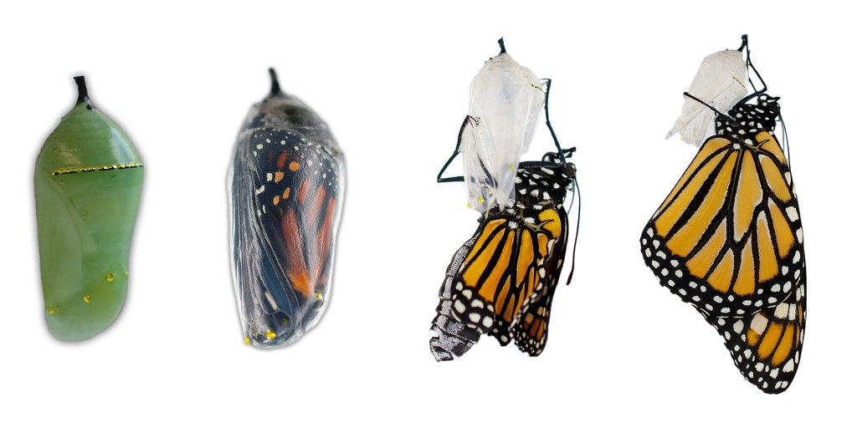
Transforming Organisations
“To improve the culture of an organisation, the leaders must change, or you must change the leaders.”
Barrett, R. (2016). Building a winning organisational culture. Barrett Values Centre.
This Photo by Unknown Author is licensed under CC BY-NC
Notes:
Read quote – ask the class their reactions and interpretations of this quote.

Slide 17
Transforming to a Conscious Culture
Discussion:
What happens within the chrysalis that turns a caterpillar into a butterfly?
How is the chrysalis process similar to transforming an organisation with an established culture?
What steps would you take to transform an organisation to a conscious culture?
This Photo by Unknown Author is licensed under CC BY-NC
Notes:
Class Discussion
What happens within the chrysalis that turns a caterpillar into a butterfly?
The caterpillar dissolves into “imaginal cells” – looks like goo. Then the cells reform into the butterfly.
How is the chrysalis process similar to transforming an organisation with an established culture?
The people within an organisation need to dissolve old ways of thinking, habit patterns, and adopt new values, a new mindset, and new ways of working
There will be a period of time that is messy, and will feel like everything is turning into goo
What steps would you take to transform an organisation to a conscious culture?
Relate to the 4 tenets: define a shared purpose and values, develop approaches to honor and integrate the perspectives of all stakeholders, leaders develop their ability to be more conscious leaders, everyone in the organisation learns together, etc.

Slide 18
Closing Reflections & Appreciations
In what ways did the class fulfill its purpose? Has our purpose shifted or expanded?
What did you learn about the culture of your self-managing team? Which values became most important during your work on the final project?
What will you take with you from this course?
What did you appreciate about this course and/or your classmates?
Image by Laura from Pixabay
Notes:
If the class is large, you can break up into 3-4 groups of students for sharing. Or if the class is virtual, people can enter their responses into the chat.

