Slide 2
Conscious Organisations
Seminar 5, Module 3: Conscious Leadership & Management

Slide 3
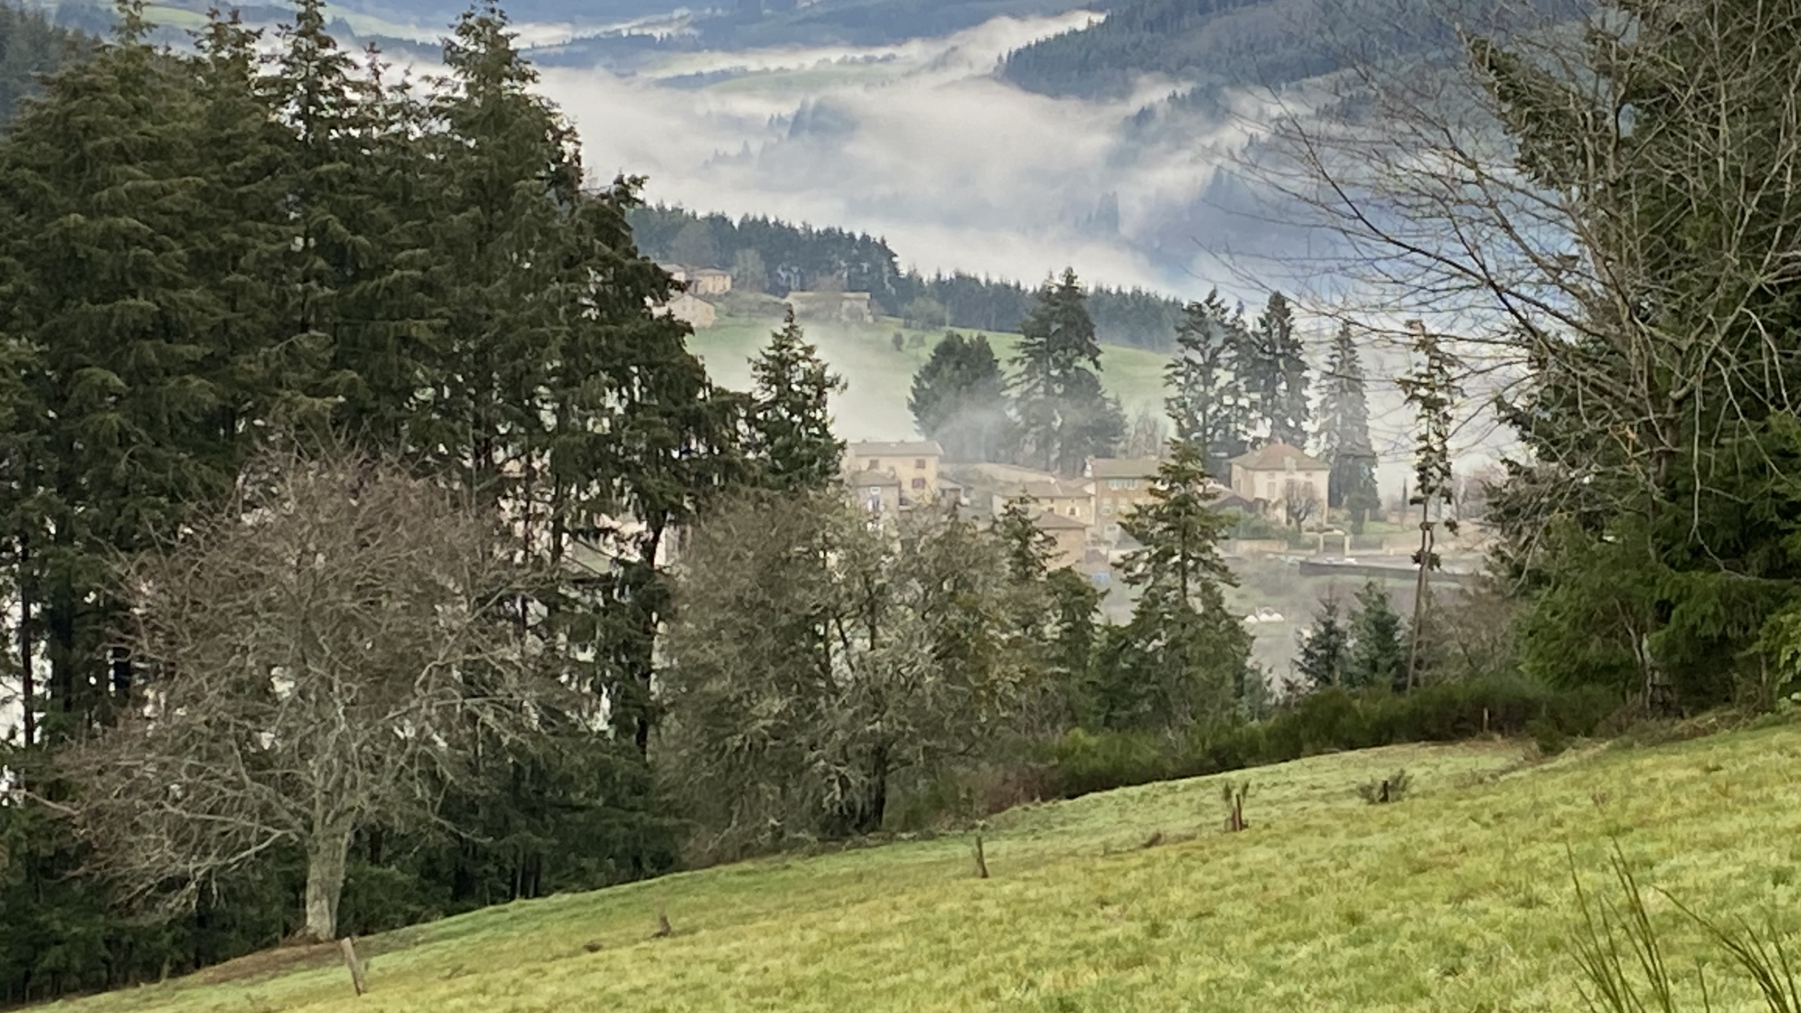
Centering Moment of Mindfulness
Photo credit: Dorianne Cotter-Lockard
Notes:
If the instructor is not trained in mindfulness practices, the following two apps provide “how to” videos and guided meditations:
https://insighttimer.com/
https://www.headspace.com/
Alternatively, choose one of these simple mindfulness practices (each takes less than 3 minutes):
Breathing
Invite students to breath in for 4 counts, hold 4 counts, breath out 4 counts, and hold 4 counts. Count slowly to guide the process. Repeat the cycle 2 – 3 times.
Listening in Silence
Invite students to sit in silence listen to the sounds around them. If there is a clock ticking in the room, they can focus on that first. After 30 seconds invite them to listen to the sounds outside the room. After an additional 30 seconds invite them to listen to the sounds of their breathing or other sounds within their bodies. Finally invite them to be open to hearing all sounds within and around them.

Slide 4
Conscious Leadership & Management
“The role of management in a conscious business … managers must create, sustain, and strengthen the conditions whereby team members operate primarily from intrinsic motivation.”
Mackey & Sisodia (2014, p. 236). Conscious capitalism: Liberating the heroic spirit of business.
This Photo by Unknown Author is licensed under CC BY-NC-ND
Notes:
Opening quote to center the class.

Slide 5
Class Purpose
Add the class purpose here – revisit each class session

Slide 6
Conscious Organisations Agenda Seminar 5, Module 3: Conscious Management
Reflection on our cultural lenses within self-managing teams
Management vs. Leadership
Introduce Concepts: Extrinsic & Intrinsic Motivation, Centralization & Decentralization, Empowerment & Autonomy, Collaboration & Innovation
Activity: World Café Discussion of Concepts

Slide 7
Our Cultural Lens
Group Activity Within Self-Managing Teams
Review the values defined by your self-managing team.
Share your reflections on what influences your cultural lens with your self-managing teammates (3 minutes each). In your sharing, answer this question: Which aspects of your worldview support your team’s values?
Discuss:
What are the commonalities? How will they support a positive team culture?
What are the differences? How will they contribute to team innovation and collaboration?
Notes:
45 minutes for this activity

Slide 8
Management vs. Leadership: What’s the difference?
Management
Delegation
Problem solving
Decision making
Project planning
Day to day supervision
Hiring/training
Give feedback on performance
Teambuilding
Leadership
Set vision and purpose
Align & engage the organisation
Establish & maintain culture
Establish trust
Communication with all stakeholders
Relationship building
Support execution of the vision
Influencer & Role model
Notes:
Questions to discuss with students:
Do leaders take on some management activities? Which ones? (most of them)
Do managers take on some leadership activities? Which ones ? (most of them)
Can you be a leader without the title?

Slide 9
Concepts of Conscious Leadership & Management
Extrinsic vs. Intrinsic motivation
Centralisation vs. Decentralisation
Empowerment & Autonomy
Collaboration & Innovation
Notes:
For the content related to this slide, see pp. 235 – 249, Mackey & Sisodia (2014). Conscious capitalism: Liberating the heroic spirit of business.

Slide 10
Concepts of Conscious Leadership & Management
Extrinsic Motivation: “carrot & stick,” rewards & punishments
Intrinsic Motivation: comes from an internal desire to accomplish something, aligned with purpose and values
Notes:
For the content related to this slide, see pp. 235 – 249, Mackey & Sisodia (2014). Conscious capitalism: Liberating the heroic spirit of business.

Slide 11
Concepts of Conscious Leadership & Management
Centralisation: hierarchical, well-defined roles, decisions made centrally, standardized processes, economies of scale
Decentralisation: decision made locally, different processes based on local needs, entrepreneurial
Notes:
For the content related to this slide, see pp. 235 – 249, Mackey & Sisodia (2014). Conscious capitalism: Liberating the heroic spirit of business.

Slide 12
Concepts of Conscious Leadership & Management
Empowerment: distributed decision making authority, individual power to take action
Autonomy: ability to work on one’s own, without external oversight
Notes:
For the content related to this slide, see pp. 235 – 249, Mackey & Sisodia (2014). Conscious capitalism: Liberating the heroic spirit of business.

Slide 13
Concepts of Conscious Leadership & Management
Collaboration: sharing ideas, working together toward a goal
Innovation: experimentation, creating novel solutions, products, and services
Notes:
For the content related to this slide, see pp. 235 – 249, Mackey & Sisodia (2014). Conscious capitalism: Liberating the heroic spirit of business.

Slide 14
Concepts of Conscious Leadership & Management
World Café Discussion:
Each table will have a facilitator + 2 or 3 participants
Each table is assigned 1 concept to explore
Answer the questions through dialog, writing the answers and ideas on the “tablecloth”
After 10 minutes, rotate 1 person to another group
After 10 minutes, rotate a person who has not rotated, to a group which has all new participants for the rotating person.
Notes:
See World Café facilitator guidance in the Instructor’s Notes and in the Toolbox, and speaker’s notes in the following slides.

Slide 15
Concepts of Conscious Management
World Café Discussion:
For concepts #1 & #2, what are the upsides of each aspect? What are the downsides?
For concept #3, what are the upsides of empowerment & autonomy? How do you balance empowerment & autonomy with collaboration?
For concept #4, in what ways does collaboration stimulate innovation? What factors might inhibit collaboration?
Extrinsic vs. Intrinsic motivation
Centralization vs. Decentralization
Empowerment & Autonomy
Collaboration & Innovation
Notes:
See World Café facilitator guidance in the Toolbox (in English and Spanish)
After two 10-minute rounds, bring the group together for a debrief
After the debrief, ask the question on the next slide

Slide 16
Concepts of Conscious Leadership & Management
What are the intersections and interdependencies of the following aspects of conscious leadership and management?
Intrinsic motivation
Decentralisation
Empowerment
Innovation
Collaboration
Notes:
Final question for this activity – posed to whole class

Slide 17
Homework: Team Project
Continue working with your team to create a poster to present to the class about your chosen SDG:
Create a visual representation of the SDG
Find 1 inspirational organisation that has an initiative to address the SDG – learn all you can about the organisation and the initiative.
Create a visual representation of the organisation and the initiative
Create a list of information sources/ references for your content
Express why this organisation and initiative are inspiring to you
Practice co-presenting with your team – maximum 10 minutes.
Notes:
Continue working with your team to explore an initiative to address your chosen SDG. See assignment in Module 4 for further instructions.
Note to Instructor: Unless the class is delivered virtually, the students should create the poster by hand, on large flipchart sized paper. The intention is to have a gallery of posters at the last session of the course, for the presentations.

