Slide 1


Slide 2
Master: “Conscious Entrepreneurship”
Course Overview for Conference on Conscious Business Education
Barcelona, Spain, 27 – 28 June 2023
Notes:
Replace with the name of your course and the level (bachelor or graduate)

Slide 3






CONSCIOUS BUSINESS CURRICULUM
 | General & Strategic Management | Marketing | Supply Chain & Manufacturing | Finance | Organization & Culture | Leadership
Bachelor | Introduction to Conscious Business | Conscious Marketing and Communications |  | Integrated Reporting | Conscious Organizations | Conscious Leadership Principles
 |  |  |  |  | Cross-cultural Management and Leadership
Graduate | The 4 Tenets of Conscious Business | Conscious Brand Leadership | Conscious Logistics and Supply Chain Management | Sustainable Finance | Conscious Organizations and Transformation | Conscious Entrepreneurship
 | Performance and Progress |  |  | Financial Management | Integrative Law | Impact Entrepreneurship
 | Strategic Risk and Governance; An ethical approach |  |  | Impact Investing |  | Conscious Leadership
 | Impact Assessment through Theory of Change |  |  | Values-based Banking
 | The Empirics of Conscious Business
 | Essence of Graduate Courses with real life examples and conscious business cases
Executive Education
Notes:
Move the circle to highlight your course

Slide 4

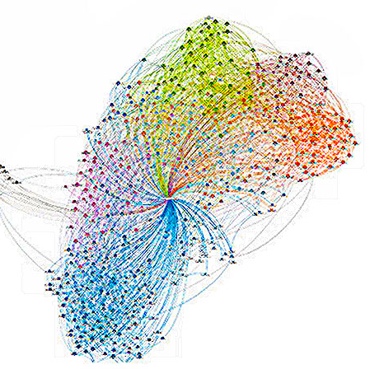
“Conscious Entrepreneurship”
The focus of this innovative entrepreneurship course is to create a deep understanding for the impact of one’s own actions on nature and thus on people as an entrepreneur. Parts of the course take place in nature or in transitional spaces, such as abandoned factories. The students consciously learn how nature solves challenges itself and how it has developed the perfect "circular economy". Students are encouraged to tap into the wisdom of nature to develop a valid business idea that has a positive impact on nature and people.
Students learn to use tools from a range of concepts: Cradle-to-Cradle, Biomimicry, Nature-based Solutions and Conscious Capitalism. Using a “Conscious Entrepreneurship Impact Matrix” they created themselves, the students develop their product and business ideas. As part of practical course elements, the students develop a prototype for their idea. In this process they are constantly accompanied by a preceptor.
Throughout the course, after each course element, students keep a self-reflective journal to document their personal development throughout the course and how they again and again connected with the immersive experience at the beginning of the class.
This Photo by Unknown Author is licensed under CC BY
Notes:
Replace with the key information related to what is unique to both your courses.

Slide 5

Graduate: “Conscious Entrepreneurship”
This Course is Unique Because:
Students spend the initial class in nature or a transitional space (full day)
Students make use of analogue photography documentation
The course includes teachings in nature based principles (e.g. biomimicry, nature based systems, …)
Students continuously work with a “Conscious Entrepreneur Impact Matrix” as well as a self reflection journal
Notes:
Replace with the key information related to a particular course.

Slide 6

Overview - Master:
Master: “Conscious Entrepreneurship”
(3 ECTS)
6 Modules
One full day outdoors kick-off-seminar (Module 1)
Four 2 to 3-hours classroom seminars (Module 2-4)
One full day (or 2x half days) prototyping (Module 5)
2-3 hours final pitch presentation (Module 6)
Assignments
Observation presentation (after day 1)
Conscious Entrepreneur Impact Matrix design
Self-reflection journal
Assessments
Individual class assignments (20%)
Prototype and impact presentation (40%)
Final exam (40%)
Notes:
Replace with the key information related to your course.

Slide 7
Modules
Master: “Conscious Entrepreneurship”
(3 ECTS)
1
Awareness
Creating insights and connecting with frameworks
Creating a “Conscious Entrepreneur Impact Matrix”
Conceptualization and practical prototype development
Business aspects
Pitching the prototype – and the impact
2
3
4
5
6
Notes:
Replace with the key information related to your course.

Slide 8

Questions?
Feedback Welcome

