Slide 2
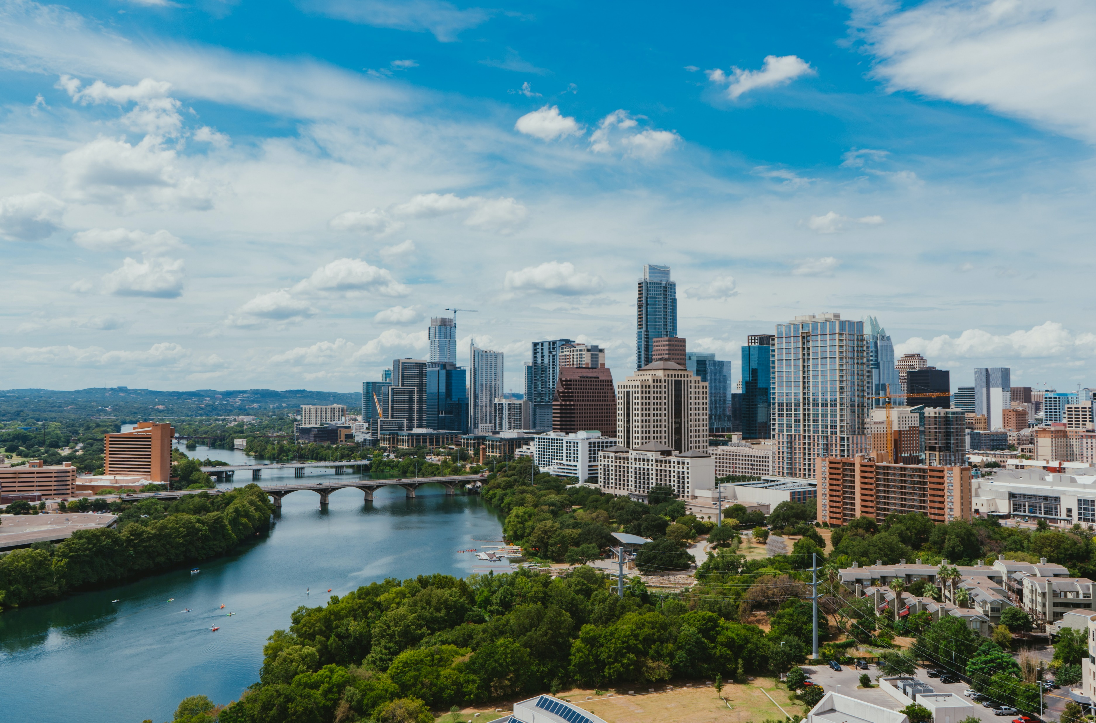
Conscious Entrepreneurship

Slide 3
1. Awareness

Slide 4
Awareness
This module is held outdoors. Students and lecturer immerse into nature or a transitional space such as an abandoned factory. In this module students…
… immerse into a natural environment
… learn from a naturalist/farmer/forester/architect about the interdependencies in nature
… become aware of the solutions nature provides to challenges and learn how to see them
… learn and experience awareness through conscious practices
… observe and document what strikes them.
Notes:
Teaching notes:
Please find additional teaching notes for this chapter in the respective documents (syllabus etc.) – there are no slides to be prepared for this chapter

Slide 5
2. From observations to insights

Slide 6
From observations to insights
This module explores concepts that are crucial for developing a conscious business idea, which only can benefit nature.
Understand of the “Cradle-to-Cradle” (C2C) concept
Understand how Biomimicry feeds into the C2C concept.
Make use of databases such as AksNature as well as Miniwiz
Introduction of the “Nature-based solutions” (NBS) concept
Broadening the perspective with the four tenets of Conscious Capitalism
Create insights from the observations made in nature, based on the introduces concepts
Notes:
Teaching note:
Share the overview of today’s class with the students

Slide 7
Nature doesn’t know trash.
In nature any natural growth leads to utility for the whole system.
Source: https://cradle-mag.de/artikel/cradle-to-cradle-prinzip.html
Notes:
Teaching note:
Discuss with students where they noticed approaches like this during their outdoor day.

Slide 8
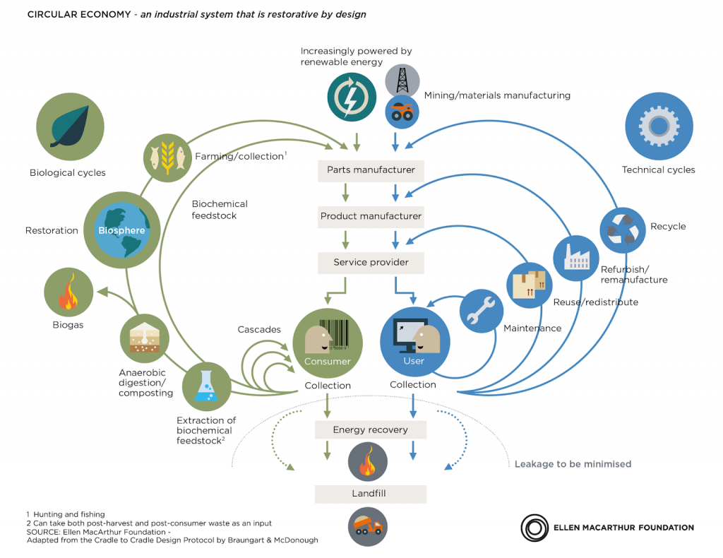
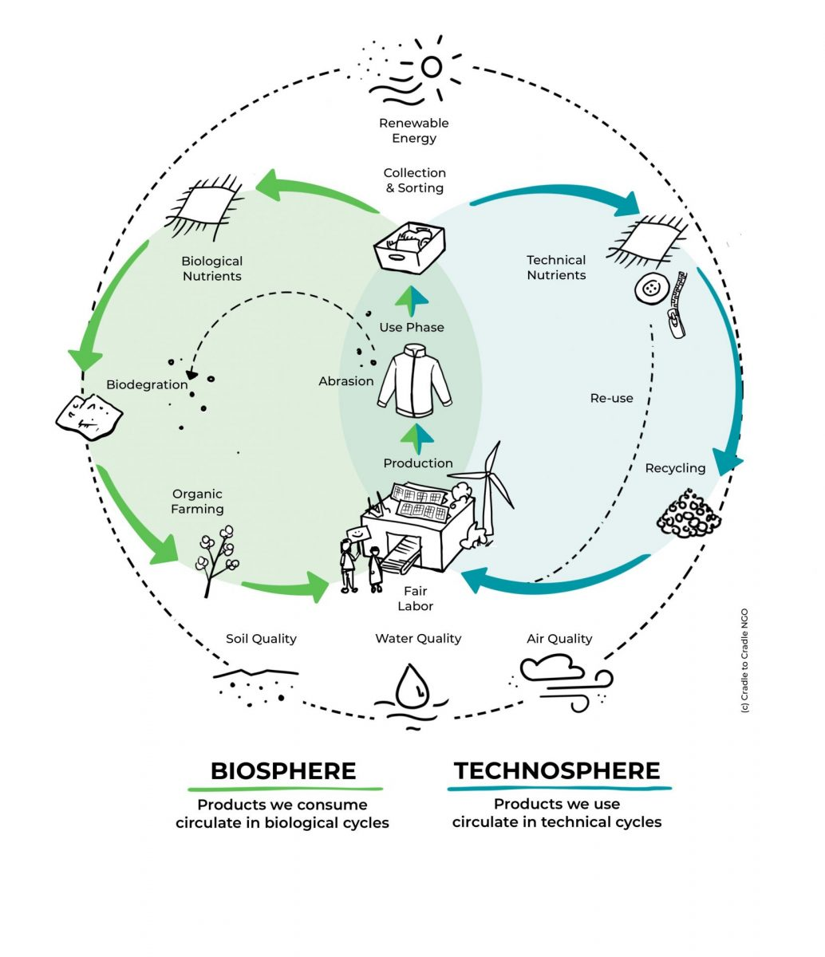
“Cradle-to-Cradle”
The Cradle-to-Cradle concept promotes a shift away from the traditional linear model of production and consumption, which relies on the extraction of finite resources and the generation of waste, towards a regenerative circular model that mimics the natural world (architect William McDonough and chemist Michael Braungart, 2002). It promotes the creation of products and systems that are regenerative and restorative through...
… rethinking
… reinventing
… redesigning
Source: https://c2c.ngo/en/redesign-c2c-design-concept/
Notes:
Teaching note:
Introduce the C2C principle to the students. Discuss where they can see connections with what they experienced in the outdoor module of this course.

Slide 9
Main ideas of the C2C approach
Waste equals food: The concept proposes that all materials used in products should be viewed as nutrients and kept in a continuous cycle of use and reuse. This means that waste from one process becomes food for another process, creating a closed-loop system that mimics nature's circular economy.
Renewable energy: The Cradle-to-Cradle concept emphasizes the use of renewable energy sources, such as solar and wind power, to power production processes and reduce the carbon footprint of products and services.
Material health: The concept advocates for the use of materials that are safe and healthy for people and the environment. This includes eliminating toxic materials and chemicals from products and using materials that can be safely reused or recycled.
Design for disassembly: Products should be designed for easy disassembly and reuse or recycling. This means that products should be made with modular components that can be easily taken apart and reassembled.
Celebration of diversity: The Cradle-to-Cradle concept recognizes the value of diversity in ecosystems and applies this principle to design. It encourages the use of a variety of materials and processes to create diverse, resilient products and systems.
Continuous improvement: The concept advocates for continuous improvement of products and systems, using feedback loops and data to identify areas for improvement and optimize resource use and environmental impact over time.
Notes:
Teaching note:
Discuss the main ideas of the C2C approach with the students – ask to give examples per “idea”

Slide 10
Eco-efficiency vs. Eco-effectiveness
Eco-efficiency
Eco-effectiveness
Achieving more with less, or using resources more efficiently to reduce environmental impacts
Minimizing waste and pollution and maximizing resource productivity and value creation
Focusing on improving the efficiency of production processes and reducing the environmental impacts of products and services throughout their lifecycle
Aiming to achieve a sustainable balance between economic growth, environmental protection, and social development
Developed by the World Business Council for Sustainable Development (WBCSD) in the 1990s
Creating products, services, and systems that have a positive impact on the environment and society
Designing products and systems that are regenerative and create value and regenerate natural resources rather than deplete them
Focusing on the design of products and systems that are environmentally beneficial throughout their lifecycle, from the extraction of raw materials to the disposal or reuse of waste
Aiming to create closed-loop systems that generate value from waste and promote the regeneration of natural resources
Introduced by William McDonough and Michael Braungart in their book "Cradle to Cradle" in 2002
Source: Amomng others https://cradle-mag.de/artikel/cradle-to-cradle-prinzip.html
Notes:
Teaching note:
Discuss with students the differences between eco-efficiency and eco-effectiveness

Slide 11
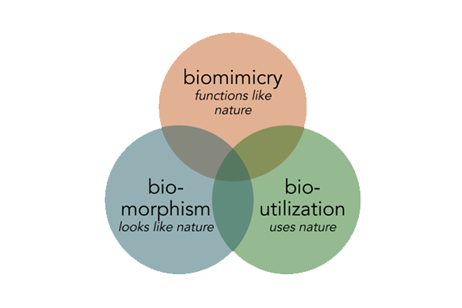
Introducing Biomimicry
“Biomimicry is about valuing nature for what we can learn, not what we can extract, harvest, or domesticate. In the process, we learn about ourselves, our purpose, and our connection to each other and our home on earth.”
The 3 Essential Elements of Biomimicry Emulate Ethos (Re)Connect
“Biomimicry is one type of bioinspired design, but not all bioinspired design is biomimicry.”
Source: https://biomimicry.org/what-is-biomimicry/
Notes:
Teaching note:
Introduce the concept of Biomimicry based on the definitions by the “Biomimicry Institute” at https://biomimicry.org/what-is-biomimicry/

Slide 12
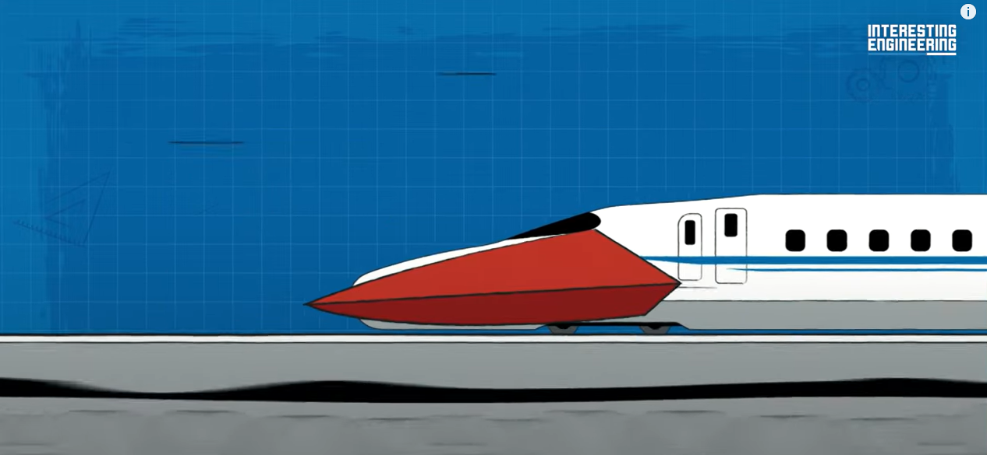
“How Kingfisher Inspired Bullet Trains”
Source: https://www.youtube.com/watch?v=poNUiJ7x2CE
Notes:
Teaching note:
Watch the clip and discuss with students other approaches of Biomimicry which they might have heard of.

Slide 13
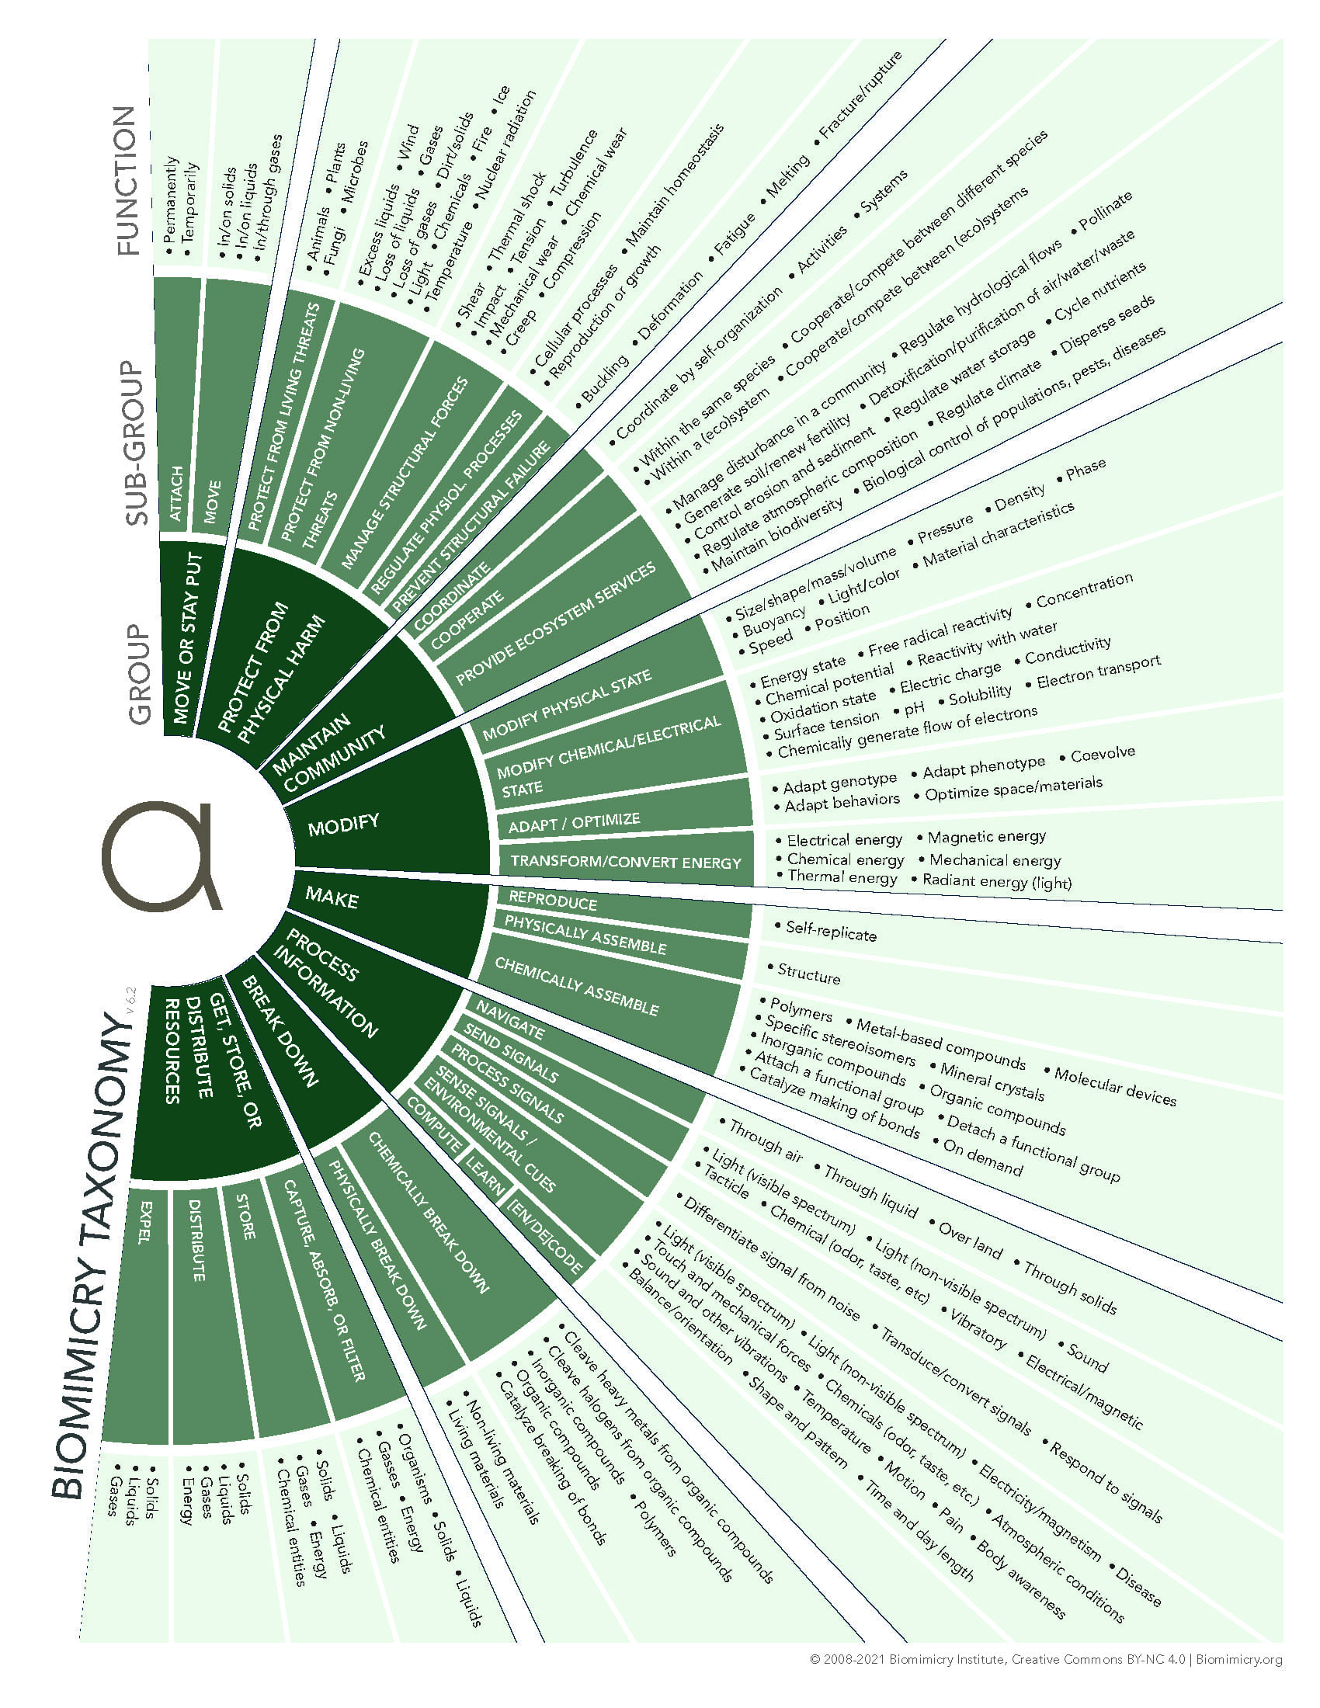
Asknature – learning from nature – Biomimicry database
Database: https://asknature.org/?s=&page=0&hFR%5Bpost_type_label%5D%5B0%5D=Biological%20Strategies&is_v=1
Taxonomy: https://asknature.org/resource/biomimicry-taxonomy/
Notes:
Teaching note:
Introduce the “Ask nature” database to the students. You can make use of the scavenger hunt exercise as introduced on the next slide. Also: Share the Taxonomy with the students and explain how it works and why it is important.

Slide 14
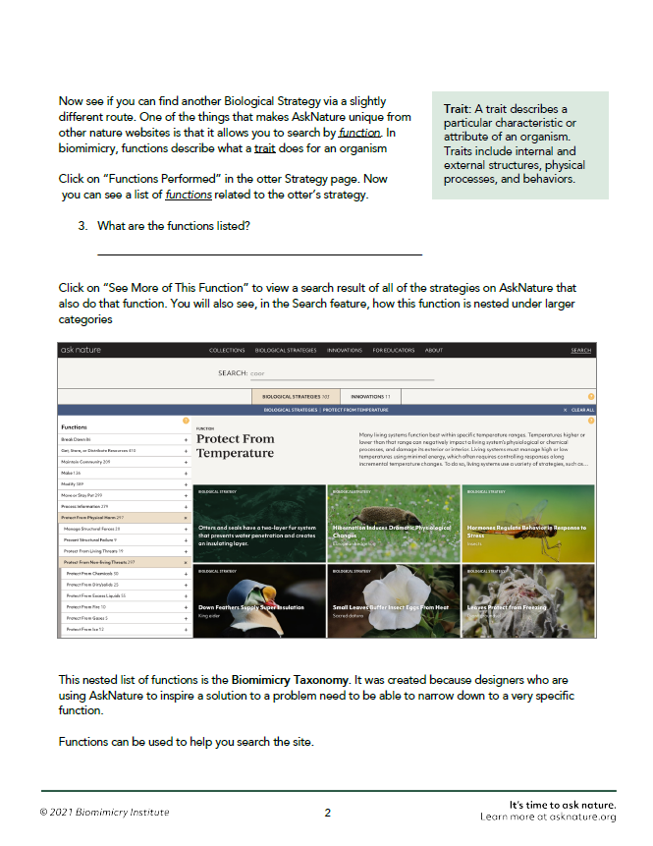
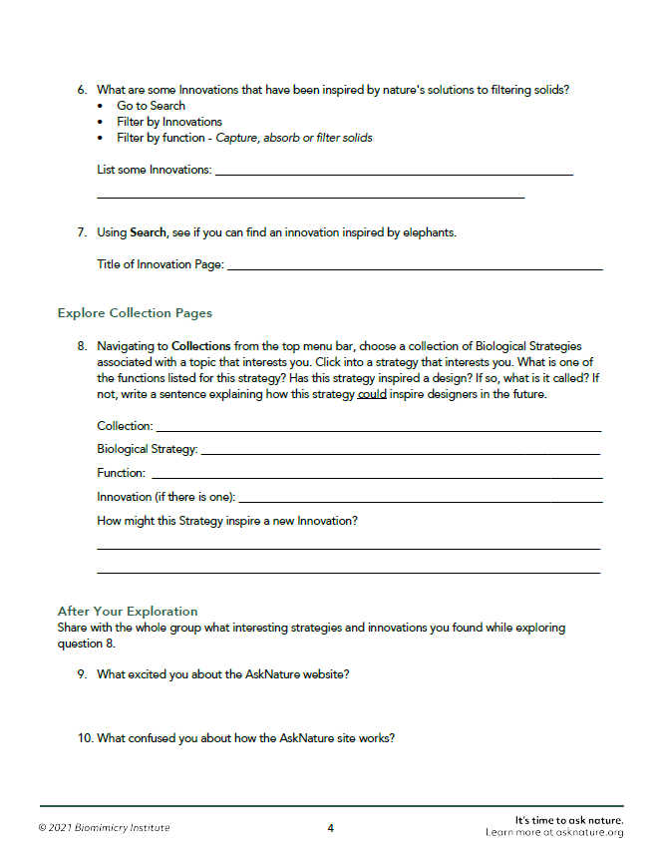
Activity: “Biomimicry scavenger hunt”
Source: https://asknature.org/resource/asknature-scavenger-hunt/
Notes:
Teaching note:
Hand out the “AskNature Scavenger Hunt” template as provided at https://asknature.org/resource/asknature-scavenger-hunt/ and let students in small teams of 2 or 3 go through the exercise.

Slide 15
Activity: Miniwiz material database
“The earth is like a fish-bowl. Nothing goes away. There is no (throwing things) away.” (Arthur Huang, structural engineer and architect)
Explore the work of Miniwiz which melds sustainability, recycling and eco-consciousness at https://www.miniwiz.com/work.php
Explore some new materials developed by Miniwiz https://www.miniwiz.com/solution_list.php?id=7
Make yourself familiar with the “Miniwiz Material Database” at https://materialdb.miniwiz.com/
Notes:
Teaching note:
Ask the students to explore the Miniwiz material database (https://www.miniwiz.com/) as well as the Concept Store https://concepts.miniwiz.com/ Ask them to share what they found and how they believe that this database could help them with their entrepreneurial project.

Slide 16
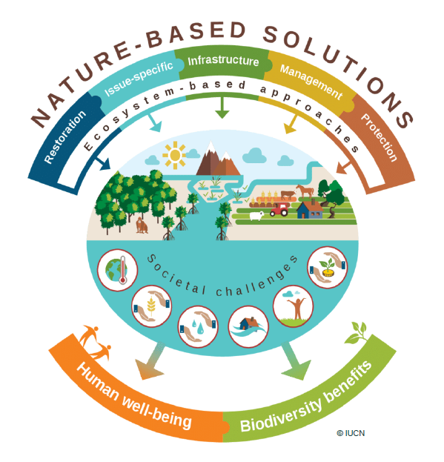
“Nature-based solutions” (NBS)
Definition by the European Union (2000)
“Solutions that are inspired and supported by nature, which are cost-effective, simultaneously provide environmental, social and economic benefits and help build resilience.
Such solutions bring more, and more diverse, nature and natural features and processes into cities, landscapes and seascapes, through locally adapted, resource-efficient and systemic interventions.
Nature-based solutions must therefore benefit biodiversity and support the delivery of a range of ecosystem services.”
Source: https://rea.ec.europa.eu/funding-and-grants/horizon-europe-cluster-6-food-bioeconomy-natural-resources-agriculture-and-environment/nature-based-solutions_en
Notes:
Teaching note: Introduce the concept of Nature Based Solutions to the students. Make sure to discuss the illustration on the right in detail.

Slide 17
Main challenges and benefits of NBS
Important Challenges
Funding NBS projects often require long-term investment and have limited profitability in the short term.
Implementation Implementing NBS requires collaboration between multiple stakeholders, including governments, private sector, and local communities. Coordination and communication between these parties can be difficult, particularly in areas with conflicting interests.
Monitoring and Evaluation: Measuring the effectiveness of NBS projects can be challenging, as they often have long-term outcomes and indirect impacts. Accurately tracking progress and evaluating success requires specialized skills and resources.
Important Benefits
Environmental Benefits: NBS can have significant environmental benefits, including reducing greenhouse gas emissions, enhancing biodiversity, and improving water quality.
Social Benefits: NBS can provide social benefits, including creating “green jobs”, improving community health, and increasing access to green spaces.
Economic Benefits: NBS can provide economic benefits, including creating new markets and opportunities for small businesses, improving property values, and reducing healthcare costs.
Notes:
Teaching note:
Ask students what could be challenges and benefits of NBS – discuss any mentioned and share the ones on this slide.

Slide 18
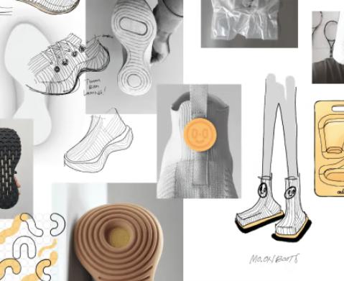
Best practice for NBS application in material development for consumer products
Source: https://www.allbirds.eu/pages/moonshot-zero-carbon-shoes
Notes:
Teaching Note
Explain how this shoe can contribute to the regeneration of nature and is a NBS according to the information provided by Allbirds (see below).
Announcement from https://www.allbirds.eu/pages/moonshot-zero-carbon-shoes

Slide 19
3. Hypothesize

Slide 20
Conscious Capitalism & Entrepreneurship
My Conscious Entrepreneur Credo:
__________________________
__________________________
__________________________
__________________________
__________________________
Stakeholder integration
Conscious leadership
Higher purpose
Conscious culture and management
Source: Mackey, Sisodia (2013)
Notes:
Teaching Note:
Ask students to create their personal Conscious Entrepreneur Credo by noting down 5 points related to the Conscious Capitalism Tenets as well as what has been discussed and experienced in class up to this point. Ask students to share and create a course wide Credo that all students support. Share the class credo with all students.

Slide 21
4. Prototyping and conceptualization

Slide 22
Particular attitudes required during the prototyping sessions as a conscious entrepreneur
Responsibility Recognize that as designers and innovators, you have a responsibility to minimize the negative impact of the product or service on nature and humans.
Awareness Be aware of the environmental and social impacts of the materials and processes used to create the prototype and final product. Understand the life cycle of the product and consider how it will be disposed of or recycled.
Proactivity Take a proactive approach to sustainability and ethical considerations. Incorporate these considerations into the design process from the beginning, rather than as an afterthought.
Empathy Consider the needs and concerns of all stakeholders, including customers, employees, and the broader community. Strive to create a product or service that is beneficial to everyone, not just a select few.
Collaboration Collaborate with others who share your commitment to sustainability and ethical considerations. Work together to identify and address environmental and social challenges.
Notes:
Teaching Note
Make sure that students understand the particular attitude toweards the prototyping sessions as conscious entrepreneurs.

Slide 23
General attitudes required during the prototyping sessions as an entrepreneur
Open-mindedness Be open to ideas and feedback from others. This can help to improve the prototype and make it more effective.
Flexibility Be flexible in your approach to building the prototype. Be willing to change your plans or adjust your ideas as needed.
Attention to detail Pay close attention to the details of the prototype, including its design and functionality.
Persistence Be persistent in your efforts to build a prototype, even if it takes multiple attempts to get it right. Use setbacks as opportunities to learn and grow.
Curiosity Be curious and eager to learn. Ask questions and seek out information to better understand the problem you are trying to solve.
Collaboration Be open to collaborating with other students and working as part of a team. This can help to generate new ideas and perspectives.
Creativity Be creative and innovative in your approach to building the prototype. Think outside the box and consider new and unconventional solutions.
Reflection Reflect on your experiences and the learning process. Consider what worked well, what didn't work, and what you would do differently next time.
Notes:
Teaching Note
These are general attitudes towards prototyping, which can be shared with the students to avoid disappointments in progress while building the prototype.

Slide 24
Today’s playlists during class
https://open.spotify.com/playlist/37i9dQZF1DWWn6teJIIcfG?si=92ed6e602ae14f15
https://open.spotify.com/playlist/37i9dQZF1DZ06evO4izRja?si=54c45e328a2545d1
https://open.spotify.com/playlist/37i9dQZF1DX0x3hhpH7R9I?si=338fef2c6b164a64
Notes:
Teaching Note:
Play music and/or nature sounds during the creative prototyping sessions.

Slide 25
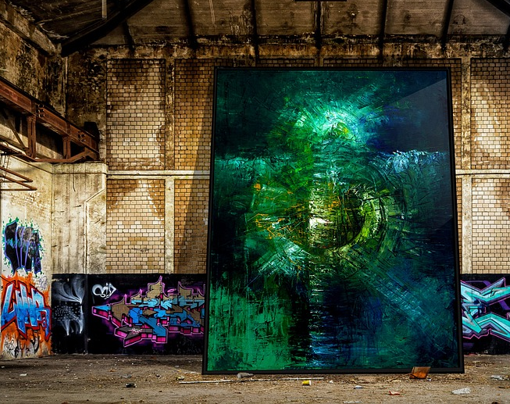
Prototyping
Notes:
Teaching note
The prototyping sessions should not require any slides. You can use this slide for pure illustration purposes e.g. while music is played.

Slide 26
Notes:
Teaching note
The prototyping sessions should not require any slides. You can use this slide for pure illustration purposes e.g. while music is played.

Slide 27
Prototyping
Notes:
Teaching note
The prototyping sessions should not require any slides. You can use this slide for pure illustration purposes e.g. while music is played.

Slide 28
5. Business aspects

Slide 29
Intro to co-operative as a form of business in Australia
Show https://www.youtube.com/watch?v=inc9y3doqGc
Notes:
Teaching note:
This chapter can be extended with own slides as much as appropriate for the amount of time that is set aside to talk about general business aspects. The slides here provide insights into topics that are generally not covered in classic entrepreneurship courses, such as co-operatives as a form of business.
Watch the video together with the students and discuss the main characteristics of a co-op as well as the advantages and disadvantages.

Slide 30
Main characteristics of a cooperative as a form of business
Membership: Members are the owners of the cooperative, and usually each member has an equal vote in decision-making, regardless of their financial investment.
Profit-sharing: Profits are distributed to members based on their level of participation or usage of the cooperative's products or services.
Democratic control: Members have a say in the management and operation of the cooperative, with decisions made through a democratic process. They e.g. elect the board of directors.
Social responsibility: Cooperatives often prioritize social responsibility and community engagement, and may prioritize environmental or social sustainability over profit maximization.
Notes:
Teaching note:
Some core aspects that should have been mentioned during the discussion (previous slide) – can be used as a summary slide.

Slide 31
Advantages and disadvantages of a cooperative as a form of business
Cooperative
Advantages
Equal ownership and decision-making
Shared risk and benefits
Shared values towards social and environmental responsibility
Effective way for customer retention since customers can become members, too
Disadvantages
Potentially limited access to capital if members are involved
Potentially less flexibility due to democratic processes inside the company
Potential for conflict due to differences in opinions and priorities among members
Notes:
Teaching note:
Some core aspects that should have been mentioned during the discussion (previous slides) – can be used as a summary slide.

Slide 32
REI (Recreational Equipment, Inc.) as a cooperative
Show: https://www.youtube.com/watch?v=JTnXmdXfdf4&t=83s
Notes:
Teaching note:
As a case study explain the discussed aspects with the example of REI and this video https://www.youtube.com/watch?v=JTnXmdXfdf4&t=83s

Slide 33
Financing a conscious start-up
Popular financing sources for conscious entrepreneurs:
Impact investors: Impact investors are investors who are committed to generating social and environmental impact alongside financial returns. They typically provide funding to companies and organizations that are dedicated to creating positive change in society and the environment.
Crowdfunding: Crowdfunding platforms such as Kickstarter and Indiegogo can provide a way for socially and environmentally conscious entrepreneurs to raise funds directly from their community and supporters.
Sustainable banks: Some banks, such as Triodos Bank, GLS Bank and Amalgamated Bank, specialize in financing sustainable and socially responsible businesses. They prioritize investments that align with their values and mission.
Government grants and loans: Many governments offer grants and loans to support environmentally and socially responsible businesses. Check with your local government to see what funding opportunities may be available.
Angel investors: Angel investors are individuals who provide funding to startups in exchange for equity in the company. Some angel investors prioritize socially and environmentally responsible investments.
Venture capital firms: Some venture capital firms specialize in investing in socially and environmentally responsible companies.
Notes:
Teaching note:
As a second aspect apart from ownership structure financing models could be discussed in class. All aspects should be covered with a special focus on responsible financing methods.

Slide 34
Exercise: Examples of Impact Investors
The following (early stage) impact investors networks are often times mentioned as networks with a focus on creating an impact.
Evaluate the background, compliance with values and ethical standards, the portfolio as well as the impact based on their Websites:
Omidyar Network - https://omidyar.com/
Acumen - https://acumen.org/
Blue Haven Initiative - https://www.bluehaveninitiative.com/
Global Partnerships - https://www.globalpartnerships.org/
Bridges Fund Management - https://www.bridgesfundmanagement.com/
Calvert Impact Capital - https://www.calvertimpactcapital.org/
ImpactAssets - https://www.impactassets.org/
Notes:
Teaching note:
Ask students to evaluate these impact investors networks especially based on conscious business principles.

Slide 35
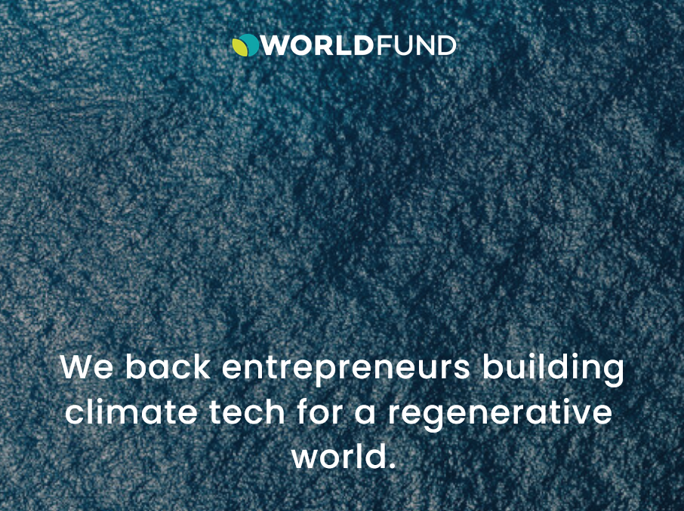
Exercise: Examples of Venture Capital Firms
The following companies are often times mentioned as Venture Capital Firms that focus on creating an impact.
Evaluate the background, compliance with values and ethical standards, the portfolio as well as the impact based on their Websites:
DBL Partners - https://www.dbl.vc/
Impact Engine - https://www.theimpactengine.com/
True Ventures - https://trueventures.com/
Social Capital - https://www.socialcapital.com/
Worldfund - https://www.worldfund.vc/
Notes:
Teaching note:
Ask students to evaluate these VCs especially based on conscious business principles.

Slide 36
6. The pitch

Slide 37
Prototype pitch
Source: https://mizuma-art.co.jp/en/artists/du-kun/
Notes:
Teaching note:
Use your general instructions for pitching a prototype. Make sure that students understand to particularly focus on the conscious elements of their projects when pitching.

Slide 38
Prof. Dr. Christian Schmidkonz
Munich Business School
Elsenheimerstraße 61 80687 München GERMANY
Phone: +49 (0)89 54 76 78 - 14 Fax: +49 (0)89 54 76 78 - 29
Christian.Schmidkonz@munich-business-school.de www.munich-business-school.de LinkedIn: http://de.linkedin.com/in/schmidkonz/

