Slide 1
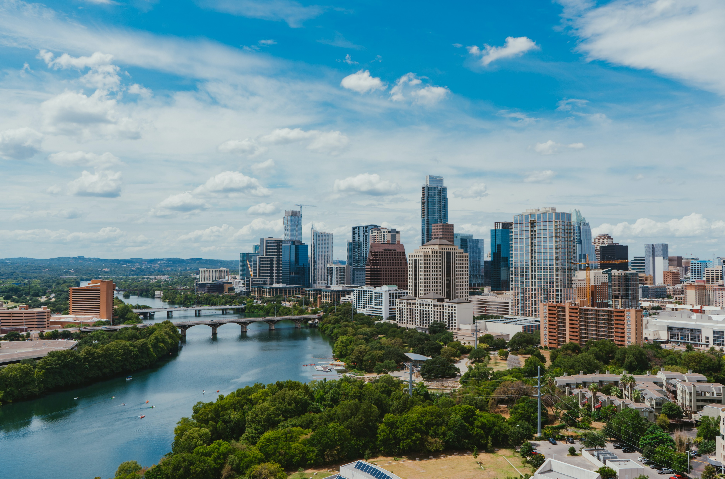
CONSCIOUS BUSINESS EDUCATION

Slide 2
Instructions
You will see 15 words each in different colours for 1 second each.
Call out the colour that you see.

Slide 3
BLUE
GREEN
GREEN
ORANGE
GREEN
BLUE
RED
BLACK
BLUE
PURPLE
RED
ORANGE
BLACK
GREEN
BLUE

Slide 4
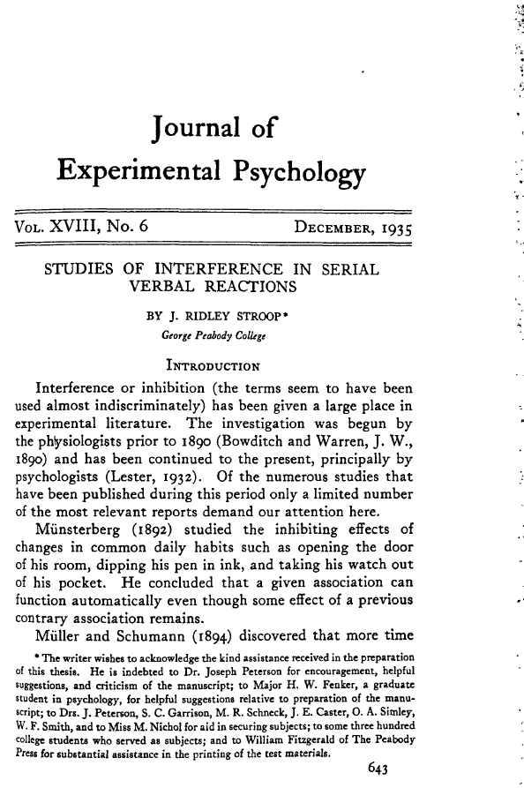
The (John Ridley) Stroop effect (1935)
Based on a series of incongruent stimuli
Two main areas in the brain that are involved in the processing of the Stroop task: dorsolateral prefrontal cortex assists in memory (here: color perception) anterior cingulate cortex is used to select an appropriate response (here: decision, which answer to give)
Explanation theories: Automaticity, processing speed, selective attention – recognition of words faster than of colors

Slide 5
Prof. Dr. Christian Schmidkonz, Munich Business School

