Slide 1
Conscious logistics and supply chain management © 2023 by Oriol Montanya is licensed under CC BY-NC-SA 4.0

Slide 2
Introduction into Conscious Business Education
Our purpose is to educate the current and next generation of business leaders and entrepreneurs in Europe to conduct business consciously.​ Consciously refers to conducting business in a way that is purpose-driven, ethical, human-centered, sustainable, and inclusive, and where all Business Stakeholders (not only shareholders and managers) benefit. For the last 10-15 years, researchers are increasingly demonstrating that consciously led companies create benefits for all stakeholders while prospering financially above and beyond shareholder-driven companies in many cases. Consciously led companies break through the false choice of either you are financially successful, or you do good. Conscious businesses have shown to be financially highly successful and generate benefits for all stakeholders at the same time. ​However, the practices of conscious business – and what might be different from a traditional view of business – is not yet an explicit part of business education in Europe. The current economic system is under rising pressure because of unsustainable exploitation of resources and increasing pollution of our planet. Climate change, resource exhaustion, societal inequalities in wealth and access to opportunities are rising. These problems are not separate crises – they can all be rooted in fundamental flaws of the current economic system. A conscious business approach implies a fundamental change towards an economy that is sustainable, circular, prosperous, and inclusive. Many of the challenges Europe faces require businesses, or support from businesses to create innovative solutions​. Businesses are the dominant drivers for innovation, jobs, and economic wealth, which in turn address real problems of real people. Conscious businesses can do this while making healthy profits and without causing ‘collateral’ damage to nature, employees, health, equality, or local communities.​ Currently, too many businesses are still operating in the old paradigm of material gain while depleting resources, making them (major) contributors to some of our biggest problems such as climate change, inequality, public health, and loss of biodiversity. We believe businesses can be drivers of good, if they design, organize, and create their business consciously. Therefore, it is of paramount importance to educate current and future business leaders regarding how to manage more consciously so that potential damage is eliminated or minimized, and to increase benefits to society and the planet. We aim to address this challenge by creating and teaching an innovative business syllabus which includes Conscious Business Practices for bachelor-, master- and executive-level education.​ Based upon the Syllabus, Conscious Business Education trains current business teachers how to incorporate the Syllabus into their business education courses and/or programs.​

Slide 3
Goals for the complete syllabus on Conscious Business (21 courses):
Describe and teach innovative methodologies to help business students become more conscious leaders.
Understand tools and methodologies for conscious business.
Apply tools and methodologies to manage businesses better.
Embed ethics and ethical dilemmas in every course.
Stimulate reflection and development of leaders to become more system-oriented, ethical, inclusive, and conscious.
Highlight the superiority of purpose-driven companies.

Slide 4
Consciousness
What does it mean to be conscious?
To be conscious means to be aware of our inner and outer worlds, to be fully awake.
It includes self-reflection on one’s own beliefs, emotions, motives, values, goals and impact.
Consciousness also includes the capacity for abstraction which allows humans to manage complexity.
This Photo by Unknown Author is licensed under CC BY-NC
Key Source:
Kofman, F. (2008). Conscious business: How to build value through values (Vol. 1). ReadHowYouWant. Com.

Slide 5
Definition of Conscious Business
In the context of "conscious business," being conscious generally refers to an approach to business that takes into consideration the direct and indirect impacts of business practices on all stakeholders, including employees, customers, the environment, and society at large.
Being conscious in the context of conscious business also involves cultivating a culture of mindfulness and awareness among employees, promoting collaboration and empathy, and encouraging personal and professional growth and development.
Ultimately, conscious business aims to create a more equitable, resilient and flourishing world by using the power and resources of business to contribute to the greater good.
Key Source:
Kofman, F. (2008). Conscious business: How to build value through values (Vol. 1). ReadHowYouWant. Com.
Notes:
Other sources:

Slide 6
Notes:
This course is a skill-training part of Conscious Business Education, co-funded by the Erasmus+ Programme of the European Union. This Programme contains 21 courses, founded on the believe that businesses can be drivers of good, if they design, organize, and create their business consciously. Therefore, it is of paramount importance to educate current and future business leaders regarding how to manage more consciously so that potential damage is eliminated or minimized, and to increase benefits to society and the planet. In order to address this challenge, they have created and teach an innovative business syllabus which includes Conscious Business Practices for bachelor-, graduate- & executive-level education. Based upon the Syllabus, Conscious Business Education trains current business teachers on how to incorporate the Syllabus into their business education courses and/ or programs.

Slide 7
WELCOME TO THE COURSE

Slide 8
COURSE
CONSCIOUS SUPPLY CHAIN
Conscious logistics and supply chain management © 2023 by Oriol Montanya is licensed under CC BY-NC-SA 4.0

Slide 9
TABLE OF CONTENTS
Introduction
Customers and processes
Triple transformation
Organization and objectives
Conclusions

Slide 10
LEARNING OBJECTIVES
Understand the historical evolution of supply chains.
Understand the importance of designing operations that balance the needs of all stakeholders.
Learn how to manage processes with a continuous improvement mentality.
Identify the three transformations that affect value chains and to learn strategies to face them.
Master two of the main aspects of running operations effectively: organization and objectives.

Slide 11
1. INTRODUCTION

Slide 12
LOGISTICS
LOGISTIKOS, from Greek “relating to calculation”
Or
LOGER, from French "to lodge”

Slide 13
A BIT OF HISTORY…
1838
1900s
1920s
2000s
Nowadays
Antoine-Henri Jomini (Swiss general fighting in Napoleon Bonaparte's army) references military logistics in his work "Compendium of the Art of War“.
Logistics is limited to a technical perspective aimed at planning distributions and optimizing costs.
Logistics is seen as a set of people, methods, machines and facilities that are combined to ensure efficient supply of goods and services.
The concept of “supply chain” is born.
Logistics is seen as a strategic activity with the potential to satisfy customers and gain competitive advantages.

Slide 14
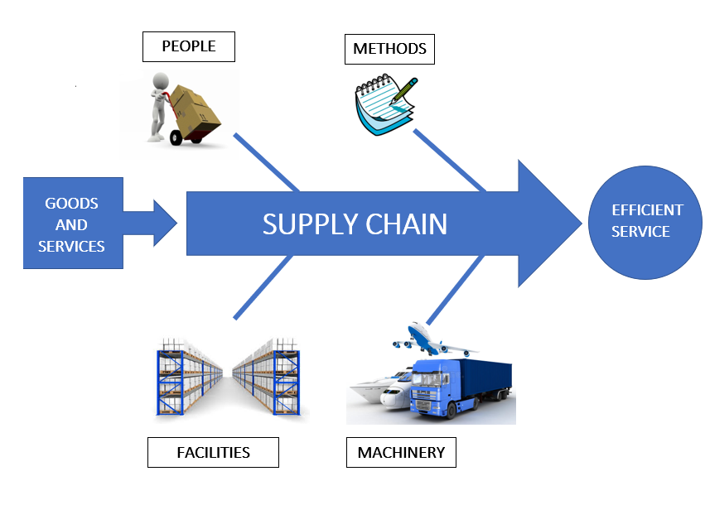
Graphical representation of the logistics process

Slide 15
THE SUPPLY CHAIN
“The chain encompassing the planning and management of all activities related to sourcing and procurement, conversion and all logistics management activities” - Council of Supply Chain Management Professionals (2013)
It aims to make a quantitative and qualitative leap in the management of the entire value chain, providing a more global vision of all the links that make it up…
Quantitative: expand the limits that delimit the field of action of logistics, incorporating activities such as purchasing from suppliers, demand forecasting, or the last mile.
Qualitative: become an effective transforming agent and make up for the shortcomings and dysfunctions of logistics.

Slide 16
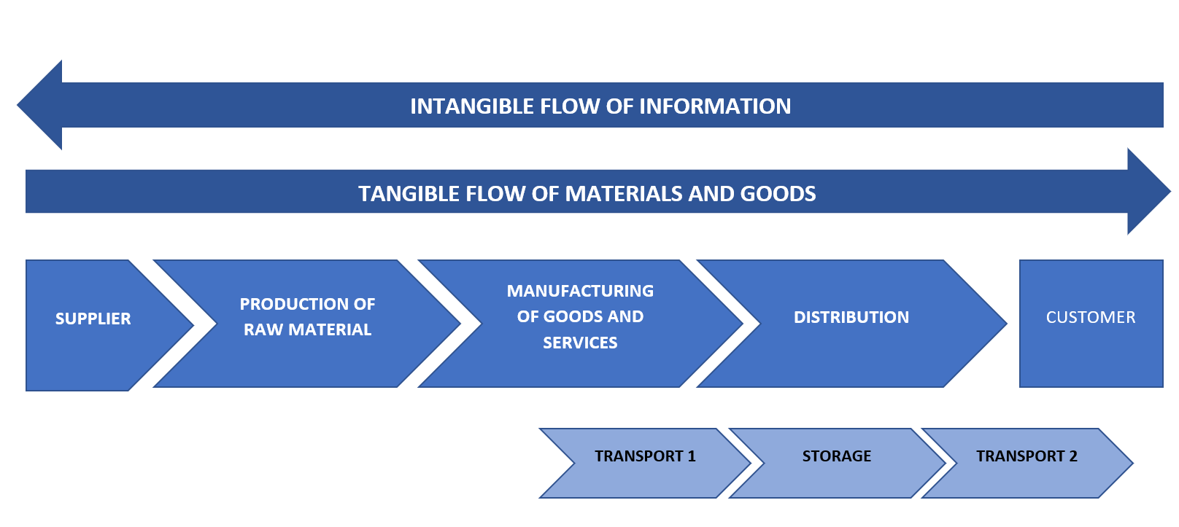
Standard supply chain, with links.

Slide 17
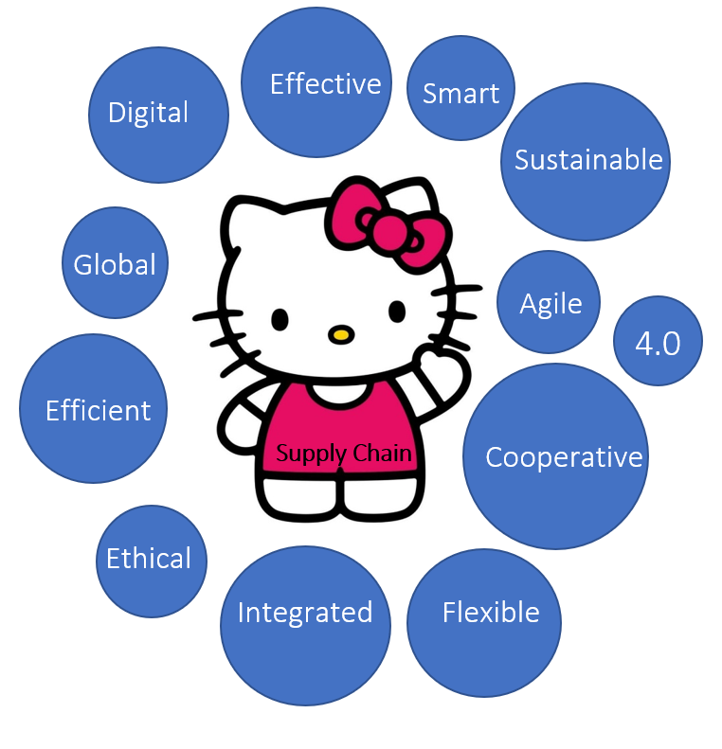
THE REQUIREMENTS OF THE SUPPLY CHAIN

Slide 18
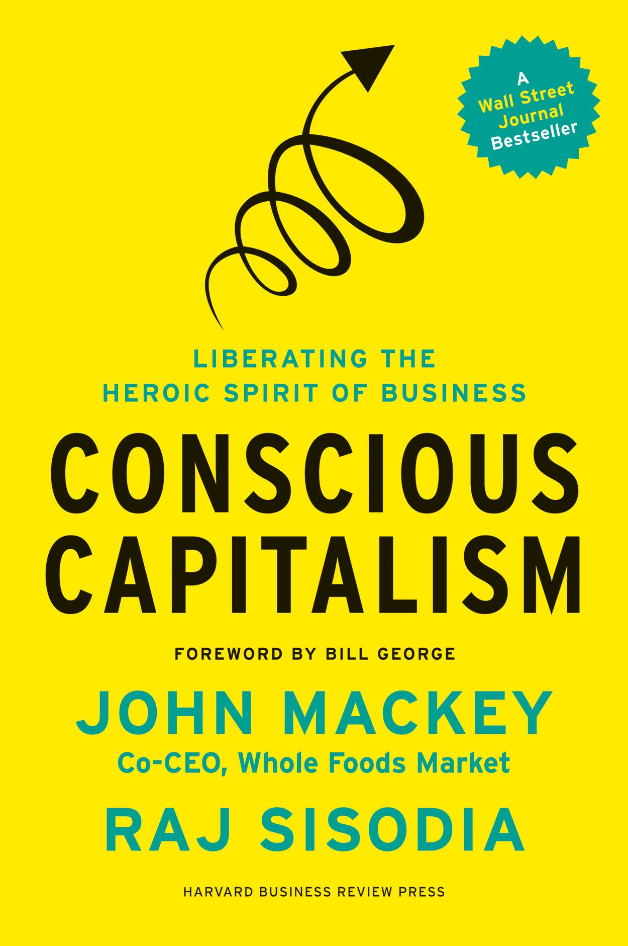
A CONSCIOUS STRATEGY
"The main purpose of this book is to inspire the creation of more conscious companies: companies driven by a higher purpose that unites the interests of all stakeholders, with conscious leaders working for the purpose of the company, the people they affect and the planet as a whole, with close and enduring cultures that turn work into a source of joy and fulfillment. We sincerely believe that this will lead to a better world for all of us“
John Mackey & Raj Sisodia

Slide 19
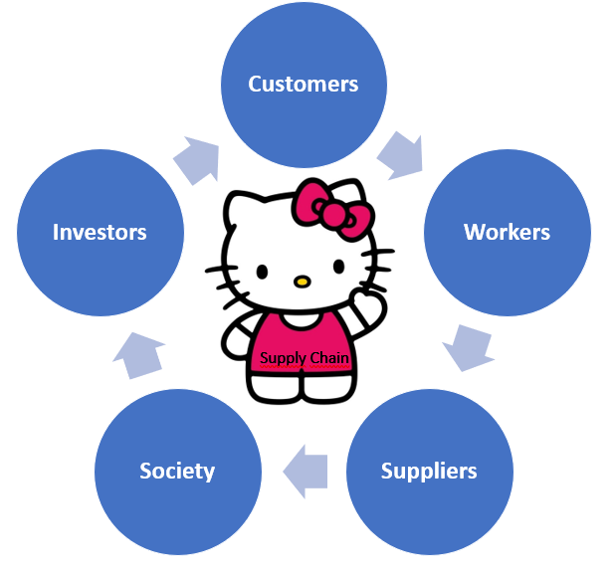
A CONSCIOUS STRATEGY
Any supply chain should always keep its stakeholders in mind in order to devise strategies that can aid in meeting their expectations.
It should be able to differentiate itself by providing real value to customers, workers, suppliers, society and investors.

Slide 20
2. CUSTOMERS AND PROCESSES

Slide 21
A NEW EFFICIENCY PARADIGM
In the traditional logistics field, EFFICIENCY and COST OPTIMIZATION were seen as inseparable.
However, being highly efficient is not about reducing costs, but it has to do with good management of resources to…
Create value to customers, employees, suppliers, society and investors.
Fulfil objectives.
The outdated perspective of operations management often explains (sadly common) effects such as damaged goods, untimely delivery, stock-outs and dissatisfied workers.

Slide 22
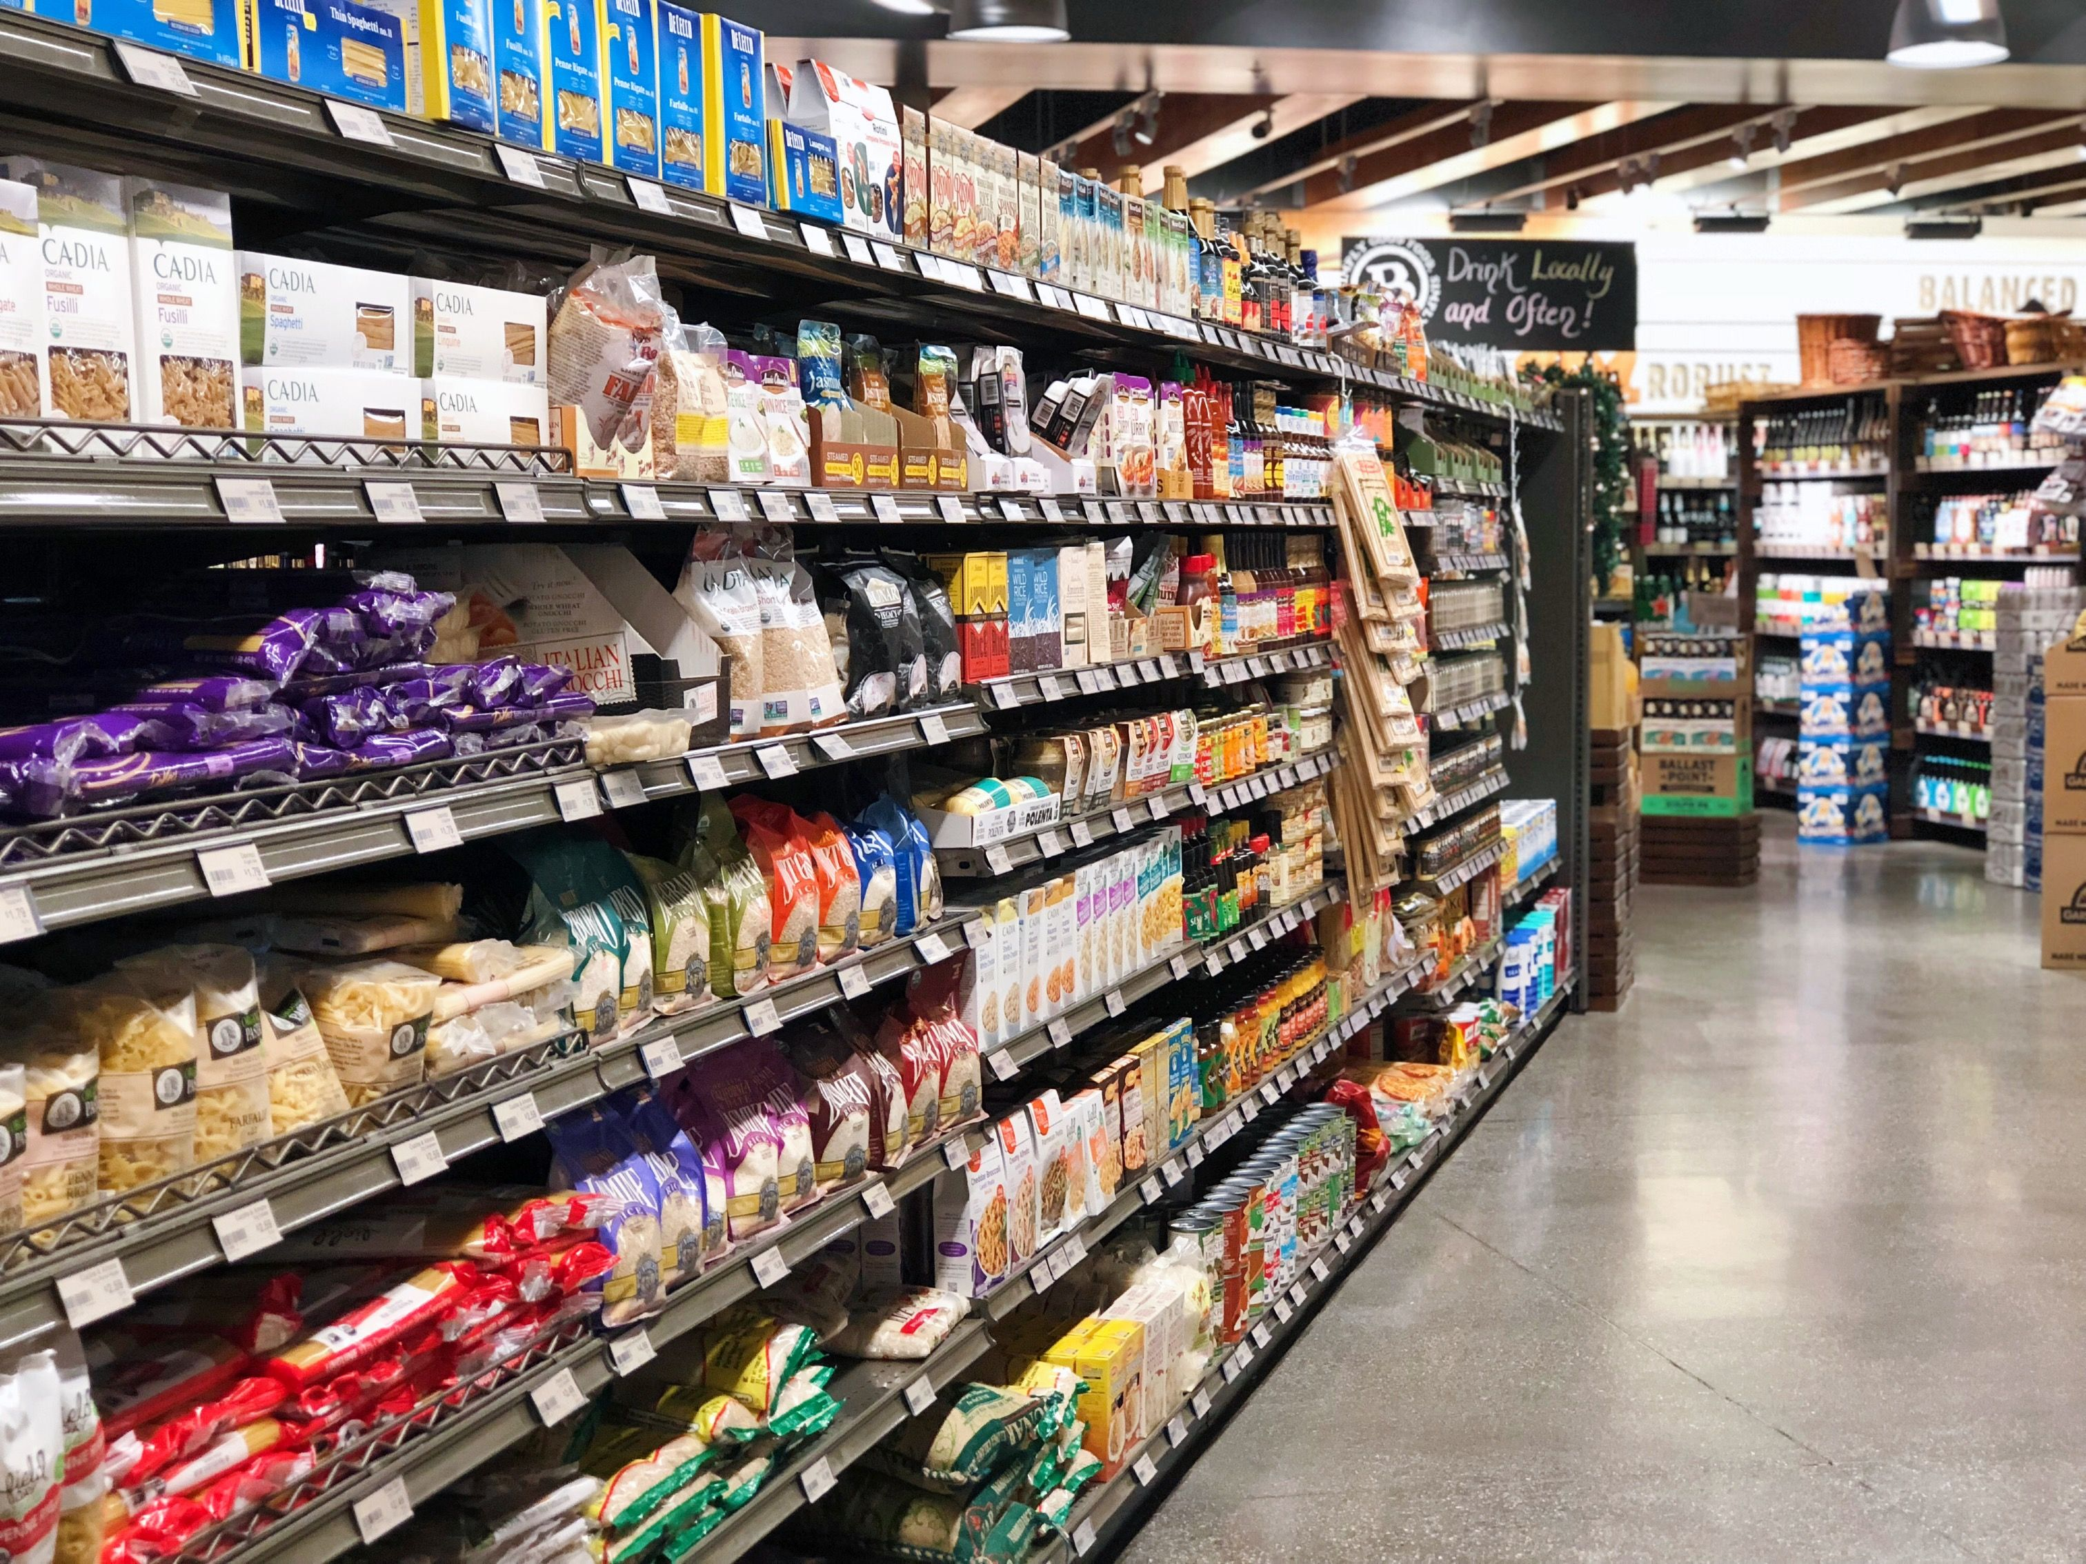
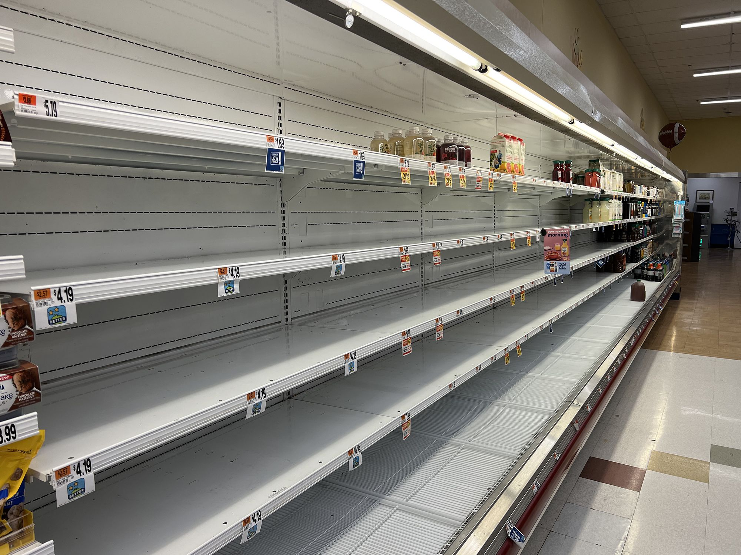
THE NEW PARADIGM IN PRACTICE
RESILIENCE
WEAKNESS
Supply chain models that rely on:
- Close collaboration between players
- Robustness of their procurement system
- Short flows (proximity)
- Reasonable level of stocks
Supply chain models based on:
- Misunderstood efficiency (driven by cost savings)
- Building longer and narrower supply chains
- Locating production in distant countries
- Reducing stocks to illogical limits.

Slide 23
CUSTOMER-ORIENTED OPERATIONS
The customer is the agent with the most power over the life or death of a company.
If we can keep our competitors focused on us, while we stay focused on the customer, we'll do well in the end".
Jeff Bezos
founder of Amazon

Slide 24
CUSTOMER-ORIENTED OPERATIONS
In the logistics field, the strategic priorities must be changed:
A CONSCIOUS SUPPLY CHAIN should not only be about….
IMPROVING WAREHOUSES
REDUCING COSTS
GAINING PRODUCTIVITY
But, also, about…
SATISFYING CUSTOMERS
ADDING VALUE
MEETING CUSTOMER EXPECTATIONS

Slide 25
CUSTOMER-ORIENTED OPERATIONS
In order to make this qualitative leap to a conscious supply chain that has the customer at the center of decisions, there are three major strategies that should be incorporated into the DNA of any organization:
CAPTURE: establish channels of regular and systematic contact with customers to identify strong and weak points, as well as possible changes in market trends. See: yo-yo technique!
REJECT: we must choose the needs that the supply chain has to cover and the value it needs to provide. Remember… In a demanding environment, specialization is more highly valued than diversification.
REACT: in such changing contexts as the one nowadays, the ability to analyze and rapidly transform is an essential element of survival of the supply chain.

Slide 26
PROCESS MANAGEMENT
Any process change we consider in order to improve our supply chain should go through a very important question before being implemented:
How does the new strategy affect each of the company's five stakeholders (customers, employees, suppliers, society and investors)?
IF THE STRATEGY
IS GOOD OR NEUTRAL FOR STAKEHOLDERS
CAN HARM STAKEHOLDERS
INCORPORATE IT
THINK ABOUT HOW TO IMPROVE IT OR REJECT IT

Slide 27
PROCESS MANAGEMENT
Good process management consists in the harmonious and balanced management of the different agents that make up the value chain, avoiding negative relationships that generate unfavorable dynamics.
To achieve it, we should follow three steps:
Detail process
Analyze process
Improve process

Slide 28
PROCESS MANAGEMENT
Detail process
Identify and detail all processes and sub-processes under our responsibility, with the aim
Having a very clear vision of the value chain, from start to finish
Finding ways of optimizing all of them.
It is important to represent them in a simple and graphic way, following a sequential logic that allows us to easily see the flow of goods or services we provide.

Slide 29
PROCESS MANAGEMENT
Analyze process
About each process that makes up the supply chain we should ask ourselves: “Does it add value”?
If a process adds value, we should continue with the improvement step.
If it does not, we should modify it or eliminate it.

Slide 30
PROCESS MANAGEMENT
Improve process
When a process adds value, we should subject it to a second question: "Is it possible to improve it?” → YES! Every process is susceptible to improvement!
Therefore, the decision-making action should focus on prioritizing efforts throughout the supply chain, via two types of action.
KAIZEN: incorporating the habit of constant review of processes and implementing small optimizations that, added together and sustained over time, guarantee that a good level of competitiveness is maintained.
REENGINEERING: visualizing and executing the changes that allow us to adapt to a constantly evolving reality, avoiding the risks of obsolescence that can put us out of the game. Project management is a must!

Slide 31
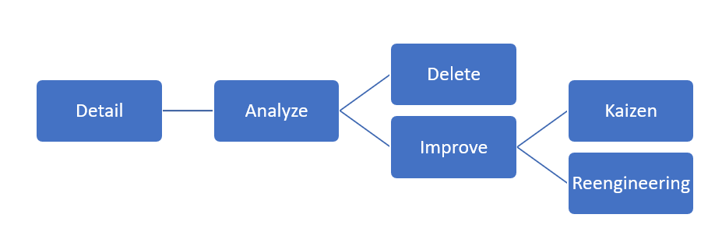
To summarize…
Process management diagram

Slide 32
3. TRIPLE TRANSFORMATION

Slide 33
Explicit changes that occur in a short period of time.
Profound changes that come quietly and over a longer period of time.
Not as apparent as revolutions, so companies run the risk of ignoring the need for change.
Obvious adjustment needed.
VS.
TRANSFORMATIONS
REVOLUTIONS
Easier for companies to adapt to them.
Do not convey a sense of urgency but end up leading to a major metamorphosis and renewal.
Example: the COVID-19 pandemic changed the established order in a very short time and forced all companies to make decisions to face the new reality.
Force all economic players to visualize the necessary movements to be progressively left out.

Slide 34
THE TRIPLE TRANSFORMATION
We can identify up to three major transformations of a cross-cutting nature, which have become major challenges of adaptation for a supply chain increasingly forced to move out of its comfort zone.
TECHNOLOGY
SUSTAINABILITY
RESILIENCE

Slide 35
1. TECHNOLOGY
Technology is a great ally, as it can provide us with quality information to make better decisions, algorithms that anticipate demand, increase productivity, the potential to automate the most difficult tasks in a warehouse, optimize transport routes, establish agile and effective communications, among many others.
But the key challenges are:
To correctly select the applications that really fit our needs, and…
To specify the value we expect to obtain.

Slide 36
2. SUSTAINABILITY
"Corporate Social Responsibility (CSR) is the set of obligations and commitments (legal, ethical, national and international) to stakeholders derived from the impact that the activity and operations of organizations produce in the social, labor, environmental and human rights spheres". - Cuesta and Valor (2003) .
The concept was born between the 1950s and 1960s, with the rapid increase in the size and power of American companies.
European ones joined later (1990s) combining economic competitiveness with more ethical and committed attitudes.

Slide 37
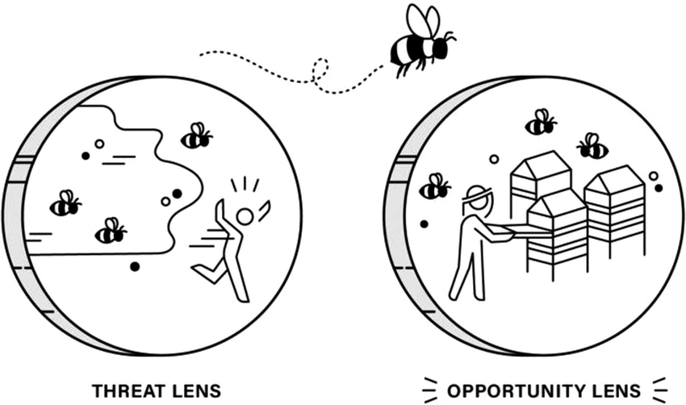
2. SUSTAINABILITY
CSR is an essential pillar of any business, as it participates in the definition of strategies to satisfy stakeholders.
It should NOT be perceived as a THREAT, but as an OPPORTUNITY!
To adapt to the needs of stakeholders, to strengthen the foundation of the business and, consequently, to differentiate the firm from competitors
Source: Wiseman and Hancock (2022)

Slide 38
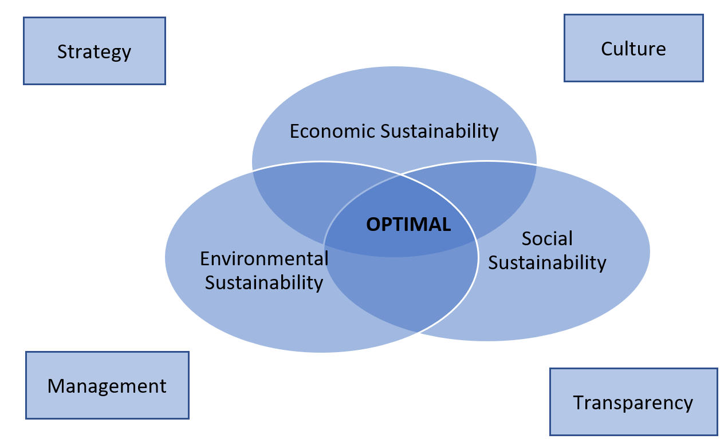
2. SUSTAINABILITY
Finally, any supply chain should balance sustainability at three specific levels:

Slide 39
2. SUSTAINABILITY
LEVEL 1: SOCIAL SUSTAINABILITY
Focused on identifying and managing (positive and negative) business impacts to stakeholders, fostering quality in relationships and engaging with them.
A supply chain should:
Create and maintain quality employment.
Protect people's health and safety.
Reduce poverty and inequality
Eliminate situations of social exclusion
Prevent corruption
Have access to traceability
Source: Carter and Rogers (2008)

Slide 40
2. SUSTAINABILITY
LEVEL 2: ENVIRONMENTAL SUSTAINABILITY
Focused optimizing the management of natural resources and developing alternative sources of energy, while reducing pollution and environmental damage caused by the execution of logistics processes, especially transportation.
To establish a legal framework to enable member countries to combat climate change, in recent years several agreements have been signed in the European political arena, such as the "Transport White Paper", the "Paris Agreement" or the "Green Pact“.
Source: Carter and Rogers (2008)
Source: Carter and Rogers (2008)

Slide 41
2. SUSTAINABILITY
LEVEL 3: ECONOMIC SUSTAINABILITY
Focused on creating the foundations of a profitable business model, with a short-term reaction capacity, but with a clear long-term vocation, in order to:
Generate economic value, and
Distribute it among the agents involved.
Source: Carter and Rogers (2008)
Source: Carter and Rogers (2008)

Slide 42
These activities should always be developed with the support of 4 key facets:
Source: Carter and Rogers (2008)

Slide 43
3. RESILIENCE
In a context that is highly susceptible to changes that can disrupt the normal functioning of supply chains (environmental, political, economic situation, etc), resilience is a must.
Resilience of the supply chain is usually measured on the basis of two major variables:
Its ability to resist unforeseen events
Its ability to recover the usual level of service.

Slide 44
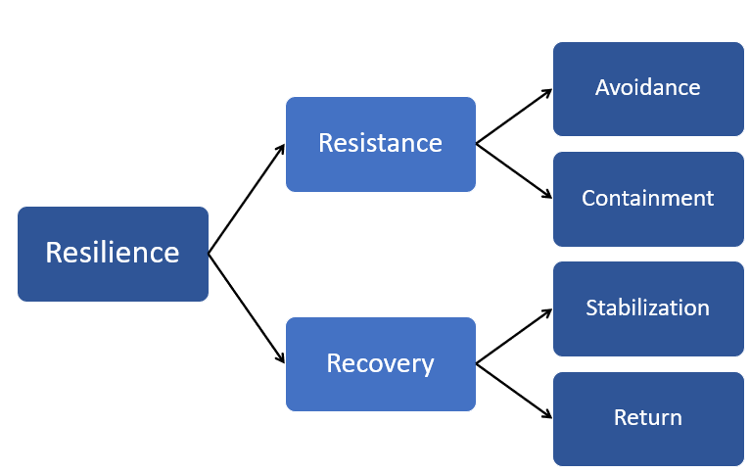
Resilience in Supply Chains

Slide 45
3. RESILIENCE
Further, to increase the resilience parameters, supply chains must be equipped with elements that favor the so-called triple A:
3A
Agility: With flexible methods and containment plans that allow responding to changes.
Adaptability: With constant monitoring of processes to update them and provide them with innovation.
Alignment: With a collaborative mentality and shared objectives that facilitate the joint efforts of the different links in the chain.

Slide 46
4. LEADERSHIP IN OPERATIONS

Slide 47
LEADERSHIP IN OPERATIONS
In order to develop good strategies to adapt to changes in an agile way, manage processes efficiently, we must know about the management of people, who are the only engine capable of making all the above possible.
Specifically, we should know about…
SETTING EFFECTIVE OBJECTIVES
ORGANIZING DAILY WORK

Slide 48
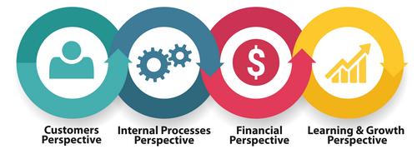
SETTING EFFECTIVE OBJECTIVES
Reflect the supply chain’s objectives in the company’s balanced scorecard.
Convert the strategies into operational goals, with corresponding indicators.
Tips:
Avoid the confirmation bias
Avoid confusing means and end
3. Follow the strategy mirror
4. Segment and integrate scorecards

Slide 49
SETTING EFFECTIVE OBJECTIVES (TIPS)
1. Avoid the confirmation bias
Confirmation bias: serious error of logic that we commit when, consciously or unconsciously, we only seek the piece of information that corroborates our previously established ideas, ignoring any data that may contradict the theories we wish to validate.
When building a scorecard, we must focus on all indicators, even those that will showcase the weak points of our supply chain.
Source: NN Group (2022)

Slide 50
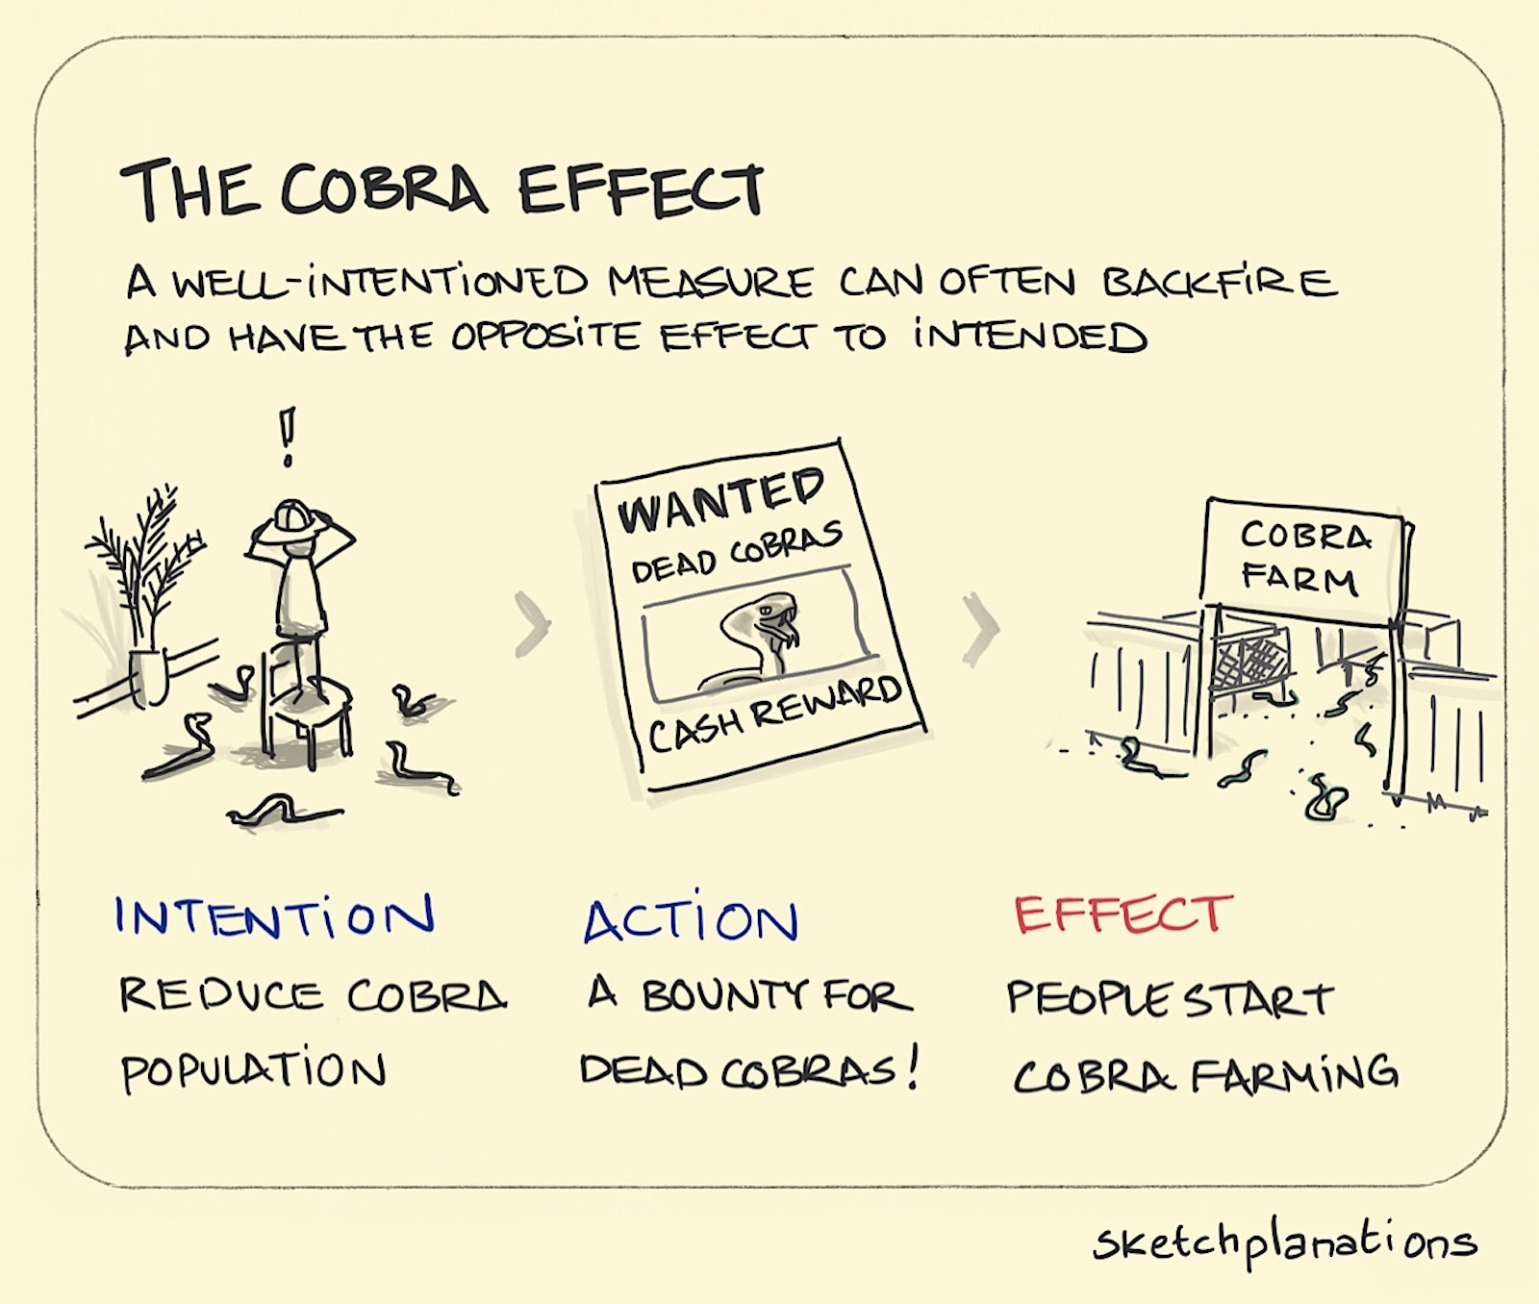
SETTING EFFECTIVE OBJECTIVES (TIPS)
2. Avoid confusing means and end
"Being fixed on a goal can end up being an obstacle to evolution“ – François Jullien
We should not project objectives with such force that they end up diverting us from our true purpose.
Beware of the Cobra Effect!
Source: Sketchplanations (2022)

Slide 51
SETTING EFFECTIVE OBJECTIVES (TIPS)
3. Follow the strategy mirror
The scorecard must reflect as closely as possible the strategic objectives we have set, since this will be the only effective way of achieving them.
Any objective, whether individual or collective, should have its starting point in the company's strategic goals and, from there, identify their contribution and the best way to measure them.
Consider using both quantitative and qualitative indicators to measure the completion of the strategic goals,
and use KPIs that truly reflect the value that the supply chain brings to its stakeholders (see example in next slide)

Slide 52
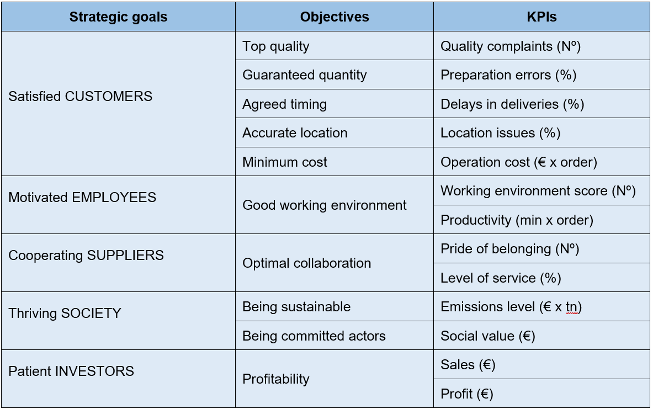
Example of a scorecard based on strategic goals

Slide 53
SETTING EFFECTIVE OBJECTIVES (TIPS)
4. Segment and integrate scorecards
Each person in the organization should have his or her own scorecard, with corresponding objectives and focused expectations.
Aim:
To guarantee that the sum of individual efforts will result in the collective goals we have set.
To supervise that each team member contributes his or her fair share, avoiding situations of injustice.

Slide 54
ORGANIZING DAILY WORK
One of the main worries for Supply Chain managers is how to make daily work (highly demanding and highly variable) compatible with preparation for future challenges (which also require dedication).
If this challenge is not addressed constantly, we usually end up prioritizing the urgent (getting today's work done) and postponing the important (preparing to survive tomorrow), thus falling into the so-called Boiling Frog syndrome.
Metaphor used to describe people’s inability or unwillingness to react to the threats that gradually arise… if a frog is placed in cold water that is then slowly brought to a boil, it will not perceive the danger and will be cooked to death.

Slide 55
ORGANIZING DAILY WORK
The best tool we know to combine present and future challenges is the matrix organization, where two teams share the workload.
Specialist team: people in charge of the continuous monitoring of the processes, with the aim of analyzing their evolution and identifying possible areas for improvement. They are responsible for innovation.
Functional team: people in charge of the continuous execution of the processes, with the objective of guaranteeing their planning and taking out the daily work.
This organization is highly recommended when dealing with projects and transformations (rather than using it permanently)

Slide 56
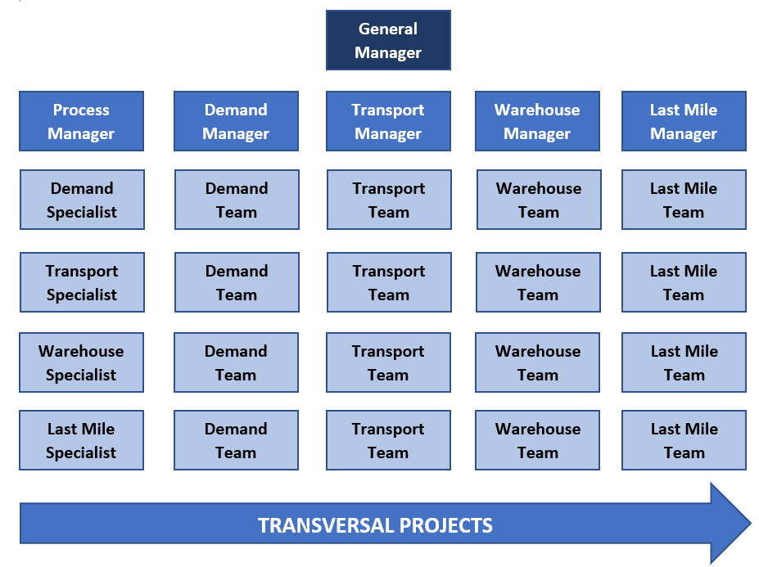
Example of an organization integrating the functional and specialist teams

Slide 57
5. CONCLUSIONS

Slide 58
Main takeaways
The "supply chain" concept was born to make a quantitative and qualitative leap from traditional logistics management that allow competitive advantage due to giving greater control on both quality and costs.
The new supply chains cannot revolve exclusively in terms of cost reduction, but must satisfy the 5 main stakeholders (customers, workers, suppliers, society, and investors).
Supply chains are undergoing a triple transformation that forces their reinvention. Processes must be strengthened to make them more resilient, sustainable manner, and incorporate technology.
There are two crucial keys to supply chain team management in order to address all the points described above:
The implementation of collective and individual objectives that are aligned with the strategy of conscious capitalism
The construction of an organization that has a clear division between specialists and functional teams

Slide 59
COURSE
CONSCIOUS SUPPLY CHAIN
Conscious logistics and supply chain management © 2023 by Oriol Montanya is licensed under CC BY-NC-SA 4.0

