Slide 1
Couscious Financial Management © 2023 by Luz Parrondo is licensed under CC BY-NC-SA 4.0

Slide 2
Introduction into Conscious Business Education
Our purpose is to educate the current and next generation of business leaders and entrepreneurs in Europe to conduct business consciously.​ Consciously refers to conducting business in a way that is purpose-driven, ethical, human-centered, sustainable, and inclusive, and where all Business Stakeholders (not only shareholders and managers) benefit. For the last 10-15 years, researchers are increasingly demonstrating that consciously led companies create benefits for all stakeholders while prospering financially above and beyond shareholder-driven companies in many cases. Consciously led companies break through the false choice of either you are financially successful, or you do good. Conscious businesses have shown to be financially highly successful and generate benefits for all stakeholders at the same time. ​However, the practices of conscious business – and what might be different from a traditional view of business – is not yet an explicit part of business education in Europe. The current economic system is under rising pressure because of unsustainable exploitation of resources and increasing pollution of our planet. Climate change, resource exhaustion, societal inequalities in wealth and access to opportunities are rising. These problems are not separate crises – they can all be rooted in fundamental flaws of the current economic system. A conscious business approach implies a fundamental change towards an economy that is sustainable, circular, prosperous, and inclusive. Many of the challenges Europe faces require businesses, or support from businesses to create innovative solutions​. Businesses are the dominant drivers for innovation, jobs, and economic wealth, which in turn address real problems of real people. Conscious businesses can do this while making healthy profits and without causing ‘collateral’ damage to nature, employees, health, equality, or local communities.​ Currently, too many businesses are still operating in the old paradigm of material gain while depleting resources, making them (major) contributors to some of our biggest problems such as climate change, inequality, public health, and loss of biodiversity. We believe businesses can be drivers of good, if they design, organize, and create their business consciously. Therefore, it is of paramount importance to educate current and future business leaders regarding how to manage more consciously so that potential damage is eliminated or minimized, and to increase benefits to society and the planet. We aim to address this challenge by creating and teaching an innovative business syllabus which includes Conscious Business Practices for bachelor-, master- and executive-level education.​ Based upon the Syllabus, Conscious Business Education trains current business teachers how to incorporate the Syllabus into their business education courses and/or programs.​

Slide 3
Goals for the complete syllabus on Conscious Business (21 courses):
Describe and teach innovative methodologies to help business students become more conscious leaders.
Understand tools and methodologies for conscious business.
Apply tools and methodologies to manage businesses better.
Embed ethics and ethical dilemmas in every course.
Stimulate reflection and development of leaders to become more system-oriented, ethical, inclusive, and conscious.
Highlight the superiority of purpose-driven companies.

Slide 4
Consciousness
What does it mean to be conscious?
To be conscious means to be aware of our inner and outer worlds, to be fully awake.
It includes self-reflection on one’s own beliefs, emotions, motives, values, goals and impact.
Consciousness also includes the capacity for abstraction which allows humans to manage complexity.
This Photo by Unknown Author is licensed under CC BY-NC
Key Source:
Kofman, F. (2008). Conscious business: How to build value through values (Vol. 1). ReadHowYouWant. Com.

Slide 5
Definition of Conscious Business
In the context of "conscious business," being conscious generally refers to an approach to business that takes into consideration the direct and indirect impacts of business practices on all stakeholders, including employees, customers, the environment, and society at large.
Being conscious in the context of conscious business also involves cultivating a culture of mindfulness and awareness among employees, promoting collaboration and empathy, and encouraging personal and professional growth and development.
Ultimately, conscious business aims to create a more equitable, resilient and flourishing world by using the power and resources of business to contribute to the greater good.
Key Source:
Kofman, F. (2008). Conscious business: How to build value through values (Vol. 1). ReadHowYouWant. Com.
Notes:
Other sources:

Slide 6
Notes:
This course is a skill-training part of Conscious Business Education, co-funded by the Erasmus+ Programme of the European Union. This Programme contains 21 courses, founded on the believe that businesses can be drivers of good, if they design, organize, and create their business consciously. Therefore, it is of paramount importance to educate current and future business leaders regarding how to manage more consciously so that potential damage is eliminated or minimized, and to increase benefits to society and the planet. In order to address this challenge, they have created and teach an innovative business syllabus which includes Conscious Business Practices for bachelor-, graduate- & executive-level education. Based upon the Syllabus, Conscious Business Education trains current business teachers on how to incorporate the Syllabus into their business education courses and/ or programs.

Slide 7
WELCOME TO THE COURSE

Slide 8
COURSE
CONSCIOUS FINANCIAL MANAGEMENT
Couscious Financial Management © 2023 by Luz Parrondo is licensed under CC BY-NC-SA 4.0

Slide 9
Presentation
Introductory course on Conscious Financial Management for understanding the relevance of accounting information and its consequences when it is distrustful and misleading.
In this course. students will be introduced to conscious financial decision-making as an approach to determine the weaknesses and strengths of financial disclosure. They will realize the significance of earnings management. as the financial task of providing advantageous information for the company while remains trustworthy. reliable. and efficient for decision-making.
Objectives
The objective of this course is to refresh basic accounting concepts for students who are already familiar with the subject and to provide basic knowledge for students without prior knowledge of accounting.
Objectives:
Learn and understand the basic concepts of value and money
Learn and understand the basic elements of the ethical dimension of financial decision-making
Learn and understand the basic elements of Earning management vs Fraud.
Understand how to be a conscious financial manager
Understand the implications of financial information for stakeholders

Slide 10
1 The relevance of accounting information
Valuation of assets (specially intangibles)
Money vs value
2 Conscious dimension of finance
Ethical dimension of the finance
Financial information full of grey areas
Valuation of intangibles
Assessing financial health of a company
Corporate governance and managerial ethics
3 Earnings management vs Accounting Fraud
Financial frauds and Accounting frauds. how to detect manipulation
Ethical and economic dimension of earnings management
Managing earnings within legality
4 Conscious management of earnings
How to be a conscious financial manager
The impact of these decisions on financial ratios and financial disclosure
Presenting good information vs presenting truthful information
The impact of not truthful information to stakeholders (being truthful to them)
Internal vs external stakeholders

Slide 11
1- Relevance
Accounting information is considered "value relevant" if it has the ability to change the expectations and behaviours of decision makers.

Slide 12
Decline in the value relevance of accounting information
Factors:
The lower persistence of earnings due to special components, such as one-time events or non-recurring charges.
The shift in the economy from traditional, industrial firms to "new economy" firms, whose values are largely based on intangible assets like brand and intellectual property.
The increase in the number of losses reported by companies, which may reduce the ability of earnings to predict future returns.
The value relevance of accounting measures may vary depending on the economic environment.
The subjectivity of accounting information management, which can range from mild earnings management to aggressive fraud.

Slide 13
1.1. Valuation of assets (specially intangibles)
First, asset valuation helps identify the right price for an asset, especially when it is offered to be bought or sold. It is beneficial to both the buyer and the seller because the former won’t mistakenly overpay for the asset, nor will the latter erroneously accept a discounted price to sell the asset.
Second, in the event that two companies are merging, or if a company is to be taken over, asset valuation is important because it helps both parties determine the true value of the business.
Third, when a company applies for a loan, the bank or financial institution may require collateral as protection against possible debt default. Asset valuation is needed for the lender to determine whether the loan amount is covered by the assets as collateral.
Forth, all public companies are regulated, which means they need to present audited financial statements for transparency. Part of the audit process involves verifying the value of assets.

Slide 15
1.1 Valuation of assets
The complexity of valuating intangible assets, such as goodwill, can lead to a high degree of subjectivity in the decision-making process. Financial agents and accountants make numerous small decisions that directly or indirectly impact the valuation of these assets, and this subjectivity results in a grey and ambiguous area in financial reporting.

Slide 16
1.2. Money vs value
Adequate valuation, and therefore adequate financial disclosure, are highly dependent on the underlying interests of financial managers in their decision making.
Conscious financial management is becoming essential nowadays, when subjectivity is increasing, and intangibles are becoming the main assets for companies.
The value of a company's fixed assets – which are also known as capital assets or property plant and equipment – are based on their book values and replacement costs. On the other hand, how can investors exactly know how much the company's brand and its intellectual property are worth.
For example, it is important to understand that a company cannot value is own brand, know-how, or any other “subjective” intangible. The goodwill, which is the intangible that includes all these concepts, can only be accounted as the difference between the book value and the acquisition price of a purchased company.

Slide 17
Conscious dimension of finance
Section 2
Ethical dimension of the finance
Financial information full of grey areas
Valuation of intangibles
Assessing financial health of a company
Corporate governance and managerial ethics
Ethics
Compliance

Slide 18
Two dimensions
Ethics: to behave distinguishing between right and wrong; in a way that is consistent with the organisation’s values.
Compliance: ensures that managers and employees conform to law and a set of required behaviors.

Slide 19
2.1. Ethical dimension of the finance
Clarity:
Financial statements be easy to read and easy to understand
Relevance
Accountants certainly have a challenge to meet when it comes to applying the IFRS principle of relevance.
Reliability
Financial statements are a reflection of the company’s economic reality.
Prudence:
Financial managers must exercise judgment in dealing with the inevitable uncertainties of valuation and materiality.
Comparability
Ability to compare financial statements from year-to-year, company-to-company, and industry-to-industry.

Slide 20
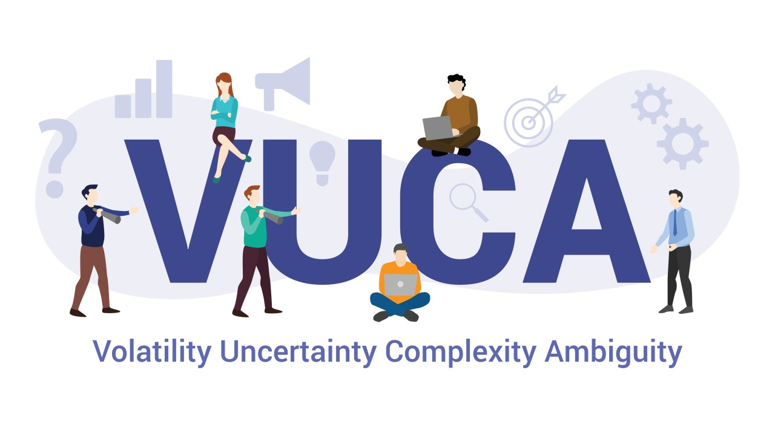
2.2. Financial information full of grey areas
James Hollis (Psycologyst)
Learning to leve with ambiguity is leaning to live how life really is, full of complexities and strange surprises.

Slide 21
2.2.Financial information full of grey areas
However, perception is ambiguous and subjective, as it is value. We all have heard the famous Warren Buffet quote: “Price is what you pay. Value is what you get.” Price is precise, value is not. Many are the factors that affect stakeholders’ perception of a company, we want to highlight some of the most relevant ones:
Valuation of intangibles. This might be a complex challenge; Steve Jobs once said that “brand in a company is like reputation of a person” (talking about subjectivity).
Financial health of a company may be hard to determine
Corporate governance and managerial ethics

Slide 22
2.2.1. Valuation of intangibles
Trust in managment
Employees
Governance, ESG, culture and intangible assets

Slide 23
2.2.2. Assessing financial health of a company
Liquidity
Solvency
Asset Management
Profitability

Slide 24
2.2.3. Corporate governance and managerial ethics
Transparency
Accountability

Slide 25
2.5 Corporate governance
The system by which business corporations are directed and controlled.
The governance structure specifies the distribution of rights and responsibilities among different participants in the corporation, such as, the board, managers, shareholders, and other stakeholders and spells out the rules and procedures for making decisions in corporate affairs.
By doing this, it also provides the structure through which the company objectives are set and the means of attaining those objectives and monitoring performance.

Slide 26
2.5 Corporate governance
From this definition, we see that corporate governance includes:
the relationship of a company to its shareholders and society
the promotion of fairness, transparency, and accountability
reference to mechanisms that are used to ‘‘govern’’ managers and to ensure that actions taken are consistent with the interests of key stakeholder groups
DEBATE:
LNR CASE

Slide 27
Legal Framework
Section 3
The difficulty with legal compliance mechanisms is that many cases of abuse that have enraged the public are entirely legal,.
For example, companies can file misleading accounting statements that are in complete compliance with accounting regulations.
Accounting regulation is in many cases ambiguous, and well-counselled executives have plenty of tricks for distancing themselves from responsibilities
(Enron and the individual officers all deny they have broken any laws), and the fact that criminal law applies only to extreme cases. As a result, violations are hard to enforce.

Slide 28
Based upon in-depth interviews with 30 graduates of the Harvard MBA program, Badaracco, and Webb (1995) revealed several disturbing patterns.
First, young managers received explicit instructions from their middle-manager bosses or felt strong organizational pressures to do things that they believed were sleazy, unethical, or sometimes illegal.
Secondly, legal compliance mechanisms (corporate ethics programs, codes of conduct, mission statements, hotlines, and so on) provided little help in such environments.
Thirdly, many of the young managers believed that their company’s executives were out-of-touch with ethical issues; either they were too busy or they sought to avoid responsibility.
Finally, the young managers resolved the dilemmas they faced largely based on personal reflection and individual values, not through reliance on corporate credos or company loyalty.

Slide 29
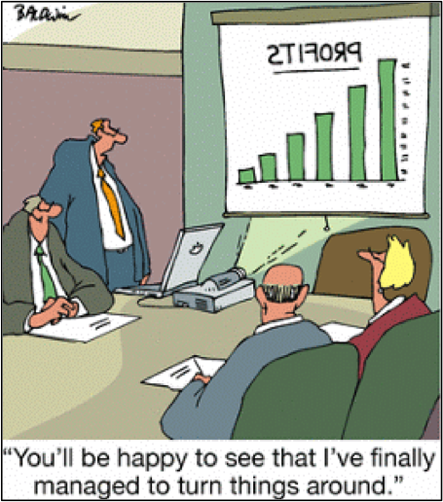
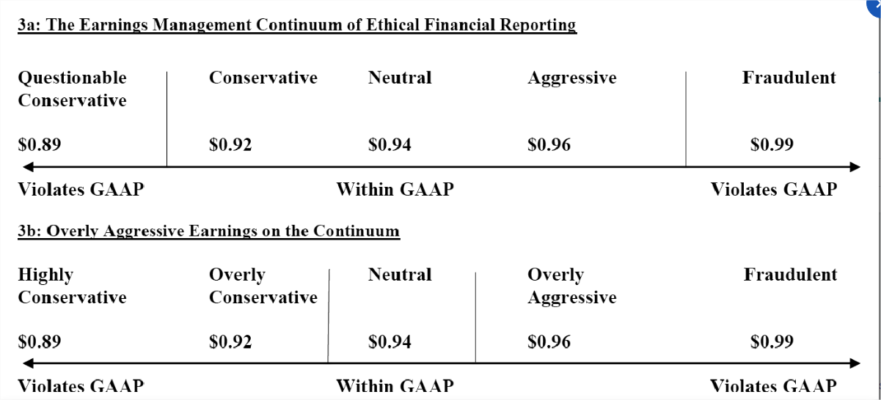
3.1 Earnings management vs Accounting Fraud

Slide 30
Academics have no consensus on what earnings management is. There have been at least three attempts at defining earnings management:
Managing earnings is “the process of taking deliberate steps within the constraints of generally accepted accounting principles to bring about a desired level of reported earnings.” (Davidson, Stickney, and Weil, 1987, cited in Schipper, 1989, p.92).
Managing earnings is “a purposeful intervention in the external financial reporting process, with the intent of obtaining some private gain (as opposed to say, merely facilitating the neutral operation of the process).” ... “A minor extension of this definition would encompass “real” earnings management which are the opportunistic decisions that affect business transactions, but the underlying intention is the “image” of the financial statements.
“Earnings management occurs when managers use judgment in financial reporting and in structuring transactions to alter financial reports to either mislead some stakeholders about the underlying economic performance of the company or to influence contractual outcomes that depend on reported accounting numbers.” (Healy and Wahlen, 1999, p.368).
Beneish, M. D. (2001). Earnings management: A perspective. Managerial finance.
Earnings management definition and detection (the role of auditors)

Slide 31
Earnings management definition and detection (the role of auditors)
We need to be aware that under IFRS managers operate with a relatively high level of flexibility in defining accounting policies that may have caused an increase in the managerial use of real activities for firms that have strong incentives for upward earnings management.
The role of auditors in detecting the management of earnings has been highly debated but is still more relevant to their failure to identify financial problems at several high-profile corporations. Insufficient skepticism has been considered a recurring finding, where the Big 4 auditors have failed to attain a target of “limited improvement requirement”.

Slide 32
Earnings management definition and detection (the role of auditors)
To identify ex-ante companies that might be carrying out accounts’ manipulation authors have focused on qualitative and, to a lesser extent, quantitative information.
Qualitative indicators usually rely on personal traits and environmental factors prompting managers to manipulate the accounts, see Cressey (1953) and (1986).
Quantitative indicators look for traces of manipulation in the financial statements of the company.
Some of the most relevant quantitative indicators are the M-score (Beneish, 1999), the Sloan ratio (Sloan, 1996), and the Z-score (Vladu, Amat, & Cuzdriorean, 2017) inspired, to a certain extent, by Altman (1968).
Alternatively, the Accounting Quality & Risk Matrix developed by Audit Analytics, for example, is an online investment tool that monitors companies for “indicators of potential earnings management and other accounting quality issues.”
There’s also the Accounting and Governance Risk (AGR) Metric, offered by MSCI Inc. It assigns a score ranging from 1 (representing a “very aggressive” company) to 100 (representing a “conservative” company) that acts as a composite measure reflecting the risk associated with a company’s financial reporting and corporate governance practices.

Slide 33
Differently from earnings management, financial fraud can be defined as “the intentional use of illegal methods or practices to obtain financial gain.”
There are many different types of financial fraud, as well as a variety of data mining methods, and research is continually being undertaken to find the best approach for each case. The common financial fraud categories are three:
Bank Fraud (Credit card fraud. Mortgage fraud and Money Laundering)
Corporate Fraud (Financial Statement Fraud and Securities and Commodities fraud)
Insurance Fraud (Automobile Insurance Fraud and Health care Fraud)
Other (Mobile fraud. identity and social fraud…)
Financial Fraud definition and detection

Slide 34
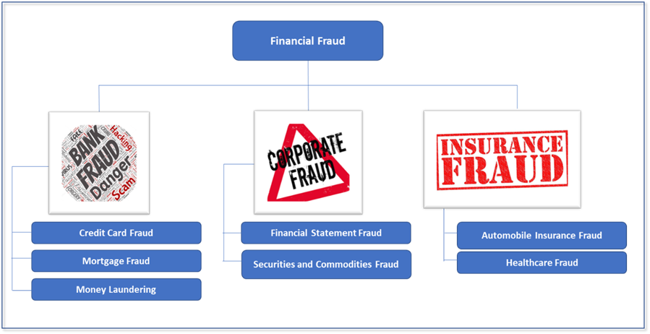
Financial Fraud definition and detection

Slide 35
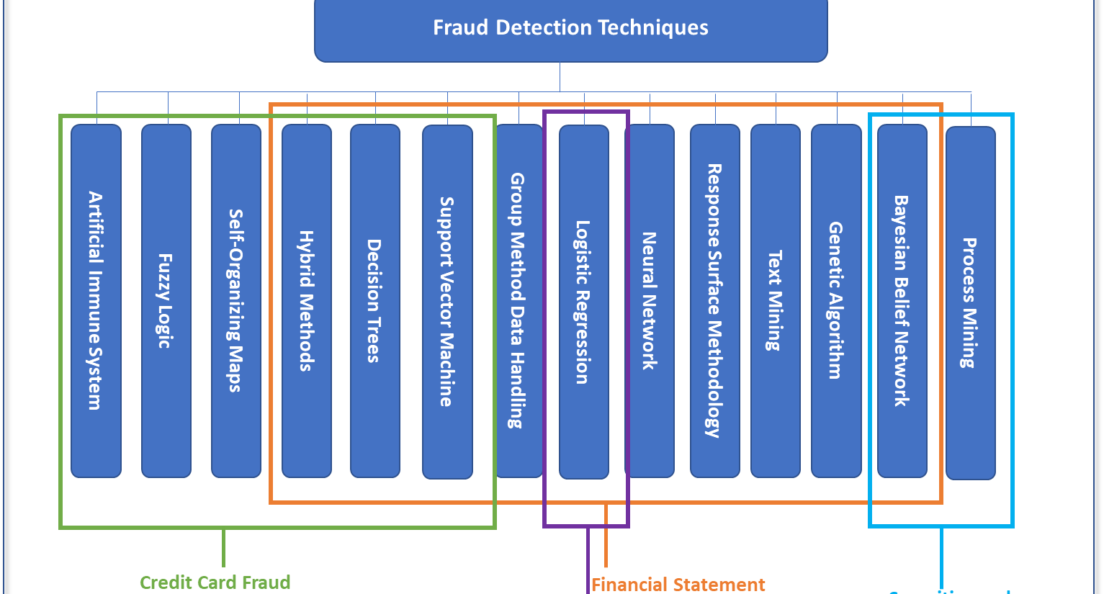

Slide 36
Warning Signs
Median loss per Fraud Scheme
Unusual percentage changes in account balances and financial ratios year over year
Accounting practices or financial ratios that are inconsistent with those of industry peers
Volatility in account balances over a two-year period
Unusual level of discretionary accruals (for example sales return allowance)
A one-time adjustment, such as a change in accounting estimate, or an out-of-period adjustment
Unusually complex financial disclosures or unusual levels of disclosure compared to industry peers
Open regulatory case, especially when brought by a regulatory entity, such as the SEC or Department of Justice
Receipt of a qualified or going concern audit opinion
Restatement of a financial statement
Late filing of financial statements
Deficiency (such as material weakness) in internal controls over financial reporting
Auditor change, especially more than once in a two-year period
High CEO or CFO turnover
Executives (such as CEO or CFO) with a high proportion of incentive-based compensation compared to overall compensation
Meeting or beating earnings targets (such as EPS forecasts) consistently every period
A large number of off-balance-sheet transactions or non-GAAP measures as compared to industry peers
Significant accounting policies are changed frequently or applied inconsistently year over year

Slide 37
3.2. Selected examples of Fraud and Earnings Management

Slide 38
The Microsoft Case
In April, Xerox Corp. agreed to pay a record $10 million civil penalty and revise its financial statements back to 1997 to settle the SEC's allegations of accounting fraud. The SEC said the office-equipment maker used "accounting tricks" and "accounting opportunities" to boost its earnings by some $1.5 billion and hide its true performance from investors.
Notes:
https://www.cbsnews.com/news/microsoft-settles-with-sec/
Following the anti-trust investigation by the U.S. attorney general, Microsoft failed to recognize revenue as earned. This is perhaps an example of unacceptable highly conservative earnings management showing that not all earnings management practices involve overstatements. The Securities and Exchange Commission (SEC) alleged that Microsoft’s accounting practices from July 1994 through June 1998 caused its income to be substantially misstated. Microsoft failed to accurately report its financial results, causing overstatements of income in some quarters and understatements of income during other quarters. The SEC said that Microsoft enhanced its financial results by setting aside artificially large reserves to reduce revenues. with the idea of reversing that procedure to record the revenues in less profitable times. This can give investors an inaccurate picture of the company’s current financial performance. Under the settlement. Microsoft neither admitted nor denied wrongdoing and no fine was imposed (USA Today, 2002).

Slide 39
The Time Warner Case
Time Warner established reserves of $2,253 billion and $2,229 billion on December 31, 2009, and 2008, respectively.
These estimates represent about 30 percent of gross accounts receivable in both years.
Management explains that this is an “area of judgment affecting reported revenues and net income”
This is perhaps an example of conservative to neutral earnings management.
Notes:
Based on management’s analysis of sales returns and allowances and uncollectible accounts. Time Warner established reserves of $2,253 billion and $2,229 billion on December 31, 2009, and 2008, respectively. These estimates represent about 30 percent of gross accounts receivable in both years. Management explains that this is an “area of judgment affecting reported revenues and net income” and is based on analysis of “vendor sell-off of product, historical return trends, current economic conditions, and changes in customer demand” (Times Warner Inc., 2010). This is perhaps an example of conservative to neutral earnings management.

Slide 40
The Southwest Airlines
Southwest Airlines changed the estimated lives of its airplanes from 22 years to 27 years under the reasoning that improved maintenance methods enabled the company to get more useful years out of the aircraft.
This change in accounting estimate, which does not require a consistent disclosure in the auditor’s report, had the effect of enabling Southwest to continue to show year-to-year earnings growth.
The change of estimate and its effect were disclosed in a note to the financial statements.
This is perhaps an example of acceptable neutral to aggressive (not overly aggressive) earnings management
Notes:
Case Following the 9/11 crisis. Southwest Airlines changed the estimated lives of its airplanes from 22 years to 27 years under the reasoning that improved maintenance methods enabled the company to get more useful years out of the aircraft. This change in accounting estimate, which does not require a consistent disclosure in the auditor’s report, had the effect of enabling Southwest to continue to show year-to-year earnings growth. The change of estimate and its effect were disclosed in a note to the financial statements. This is perhaps an example of acceptable neutral to aggressive (not overly aggressive) earnings management (Southwest Airlines Inc.. 2003).
https://study.com/academy/lesson/cost-accounting-case-study-decision-making-at-southwest-airlines.html

Slide 41
AT&T Inc. and Verizon Communications
In 2008–2009, these companies incurred very large losses: $23 billion for AT&T and $12 billion for Verizon.
Rather than recognize these losses, the companies elected by current U.S. standards to amortize them over future years (Rapoport 2011).
In the 2010 financial statements, these companies decided to change their accounting for pension funds to mark-to-market accounting in line with international standards and to restate prior years’ financial statements.
The effect of this change is that the large losses in 2008–2009 will never be reflected in the current year’s financial statements, and 2010 earnings will be much better than they would have been
Notes:
Some companies, including AT&T Inc. and Verizon Communications Inc., are changing their accounting for pension plans in 2010 by shifting to market-to-market accounting. In the market meltdown from the financial crisis in 2008–2009, these companies incurred very large losses: $23 billion for AT&T and $12 billion for Verizon. Rather than recognize these losses on their income statements in 2008–2009 the companies elected by current U.S. standards to amortize them over future years (Rapoport 2011). In the 2010 financial statements, these companies decided to change their accounting for pension funds to mark-to-market accounting in line with international standards and to restate prior years’ financial statements. The effect of this change is that the large losses in 2008–2009 will never be reflected in the current year’s financial statements, and 2010 earnings will be much better than they would have been. The companies justify the change as making the financials more transparent for investors in current and future years by reflecting changes in the market value of pension assets and obligations. An AT&T spokesman says it improves accounting clarity so “everyone can understand where the gains and losses that get recognized in our income statement at the end of each year are tied to real economic events.” And a Verizon spokesman says the new approach “actually is a preferable accounting method and one that aligns with the fair value accounting concepts and current [IASB] proposal” (Burr. 2011). This is perhaps an example of acceptable aggressive earnings management.

Slide 42
The Enron Case
Enron operated several SPEs fraudulently by raising off-balance sheet financing.
In 1997, Enron planned to buy a stake from a partner in a joint venture and to avoid having to consolidate the debt from the acquisition.
Enron formed an SPE called "Chewco“ and Chewco took out huge amounts of debt, which were guaranteed by Enron.
Enron then sold financial assets to this SPE, using secret contracts.
Consequently, Enron's balance sheet undervalued its debt and overstated its revenue and equity, inflating several important financial ratios and making the company look extremely attractive to (potential) investors.
Notes:
A major reason for Enron's failure lies in its use of Special Purpose Entities for accounting and financing purposes. Special Purpose Entities (short: SPEs) are companies that are created solely to fulfill a single objective. Tax benefits, raising capital, risk isolation, and reducing debts are among the common reasons for creating SPEs. While the creation of an SPE is, when certain conditions are met, and completely legal, it can expose the company to significant risk, with Enron being a perfect example of this.
Enron used hundreds of different SPEs, but unlike most other companies using SPEs, many were operated fraudulently by raising off-balance sheet financing. Chewco is one of the most prominent examples of such fraudulent uses of SPEs in Enron’s history. In 1997, Enron planned to buy a stake from a partner in a joint venture and to avoid having to consolidate the debt from the acquisition. Enron formed an SPE called "Chewco". Chewco took out huge amounts of debt, which were guaranteed by Enron. Enron then sold financial assets to this SPE, using secret contracts. Under the American financial reporting standard US GAAP, SPEs financials did not have to be consolidated into the reports of the mother company. Consequently, Enron's balance sheet undervalued its debt and overstated its revenue and equity, inflating several important financial ratios and making the company look extremely attractive to (potential) investors.
Enron violated SPE rules by not having an independent investor owning at least 3% of the entity. In total, Enron hid more than $700 million in debt on its balance sheet.
In 2001, the audit company Arthur Andersen (then still part of the big five) suddenly discovered evidence for Chewco not qualifying as an SPE after approving previous annual reports. After informing the SEC, Enron was forced to reinstate its balance sheets reaching back to 1997. Enron’s shareholders started to lose confidence in the company and other investors began shorting the stock. Together with rating agencies downgrading Enron’s shares, the stock price began to rapidly decline.
Enron changed its accounting system after the employment of Jeffrey Skilling as president and chief operating officer. Instead of keeping the traditional system, the company switched to mark-to-market accounting, becoming the first non-financial company to introduce this system. Skilling justified this switch by emphasizing how it would show the true economic value of the company. True economic value is because, in mark-to-market accounting, future cash flows are estimated, discounted to present value, and booked as revenue. Costs and future costs were also estimated and discounted to present value, then booked as an expense. When certain cash flows did not occur, they had to be reported at the point they were not realized as expected.
Using this method. Enron was able to inflate earnings by large numbers. A well-known example involves a 20-year deal with the movie lending company Blockbuster. Based only on smaller pilot studies. Enron projected profits of over $110 million, which in consequence appeared on the company’s income statement. This example particularly demonstrates the lack of strict rules for the estimation of future earnings, giving companies using the mark-to-market system great freedom regarding financial reporting.
The main challenge that comes along with the usage of this system is to keep up the numbers. To avoid reporting significantly lower numbers in the years following big earnings, the company must land more and more deals, further inflating its numbers and significantly increasing its risk.
Due to Enron’s fraudulent schemes, an enormous number of workers lost their jobs, and their pension plans, and the shareholders lost billions of US dollars. Eventually, one suicide occurred about Enron’s turbulence. Enron has made history and is the biggest financial fraud in modern history. Ken Lay was convicted on all 10 courts and Jeff Skilling on 19 out of 28 courts. It was another example of extreme corporate greed in the heart of the corporate USA.

Slide 43
FTX case
FTX reached its peak in 2021 when it was reported that the company was averaging 10$ billion a day in trading volume. It was involved in every corner of the crypto space.
In 2022 it was announced that digital US crypto tokens were to be released, not only by the government but also by one of the biggest banks. And FTX was going to be at the centre.
However, the reality was far from those expectations.
By the fall of 2022, FTX collapsed.
The reason behind the fall was the manipulation of the market price of the FTT
Insider information trading, wrongful accounting, no consolidation, and misuse of customer custodied assets.
Notes:
A major reason for Enron's failure lies in its use of Special Purpose Entities for accounting and financing purposes. Special Purpose Entities (short: SPEs) are companies that are created solely to fulfill a single objective. Tax benefits, raising capital, risk isolation, and reducing debts are among the common reasons for creating SPEs. While the creation of an SPE is, when certain conditions are met, and completely legal, it can expose the company to significant risk, with Enron being a perfect example of this.
Enron used hundreds of different SPEs, but unlike most other companies using SPEs, many were operated fraudulently by raising off-balance sheet financing. Chewco is one of the most prominent examples of such fraudulent uses of SPEs in Enron’s history. In 1997, Enron planned to buy a stake from a partner in a joint venture and to avoid having to consolidate the debt from the acquisition. Enron formed an SPE called "Chewco". Chewco took out huge amounts of debt, which were guaranteed by Enron. Enron then sold financial assets to this SPE, using secret contracts. Under the American financial reporting standard US GAAP, SPEs financials did not have to be consolidated into the reports of the mother company. Consequently, Enron's balance sheet undervalued its debt and overstated its revenue and equity, inflating several important financial ratios and making the company look extremely attractive to (potential) investors.
Enron violated SPE rules by not having an independent investor owning at least 3% of the entity. In total, Enron hid more than $700 million in debt on its balance sheet.
In 2001, the audit company Arthur Andersen (then still part of the big five) suddenly discovered evidence for Chewco not qualifying as an SPE after approving previous annual reports. After informing the SEC, Enron was forced to reinstate its balance sheets reaching back to 1997. Enron’s shareholders started to lose confidence in the company and other investors began shorting the stock. Together with rating agencies downgrading Enron’s shares, the stock price began to rapidly decline.
Enron changed its accounting system after the employment of Jeffrey Skilling as president and chief operating officer. Instead of keeping the traditional system, the company switched to mark-to-market accounting, becoming the first non-financial company to introduce this system. Skilling justified this switch by emphasizing how it would show the true economic value of the company. True economic value is because, in mark-to-market accounting, future cash flows are estimated, discounted to present value, and booked as revenue. Costs and future costs were also estimated and discounted to present value, then booked as an expense. When certain cash flows did not occur, they had to be reported at the point they were not realized as expected.
Using this method. Enron was able to inflate earnings by large numbers. A well-known example involves a 20-year deal with the movie lending company Blockbuster. Based only on smaller pilot studies. Enron projected profits of over $110 million, which in consequence appeared on the company’s income statement. This example particularly demonstrates the lack of strict rules for the estimation of future earnings, giving companies using the mark-to-market system great freedom regarding financial reporting.
The main challenge that comes along with the usage of this system is to keep up the numbers. To avoid reporting significantly lower numbers in the years following big earnings, the company must land more and more deals, further inflating its numbers and significantly increasing its risk.
Due to Enron’s fraudulent schemes, an enormous number of workers lost their jobs, and their pension plans, and the shareholders lost billions of US dollars. Eventually, one suicide occurred about Enron’s turbulence. Enron has made history and is the biggest financial fraud in modern history. Ken Lay was convicted on all 10 courts and Jeff Skilling on 19 out of 28 courts. It was another example of extreme corporate greed in the heart of the corporate USA.

Slide 44
3.3. Managing earnings within legality

Slide 45
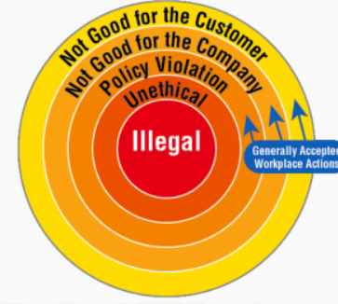
Managing earnings within legality
Some regulators take a conservative approach by cautioning against inherently “bad” earnings management, arguing that it distorts a company’s true earnings and misleads the investing public.
Others regard the discretion inherent in reported earnings as a valuable tool that can be used to incorporate management’s private information and company-specific circumstances into accounting transactions. These proponents argue that financial statements are more useful when such discretion is incorporated.
Finally, some take a middle-of-the-road approach by recognizing that earnings management falls along a continuum ranging from justifiable interpretations of accounting standards to outright fraud with many accounting choices falling within a grey area that’s neither completely good nor bad.

Slide 46
Implications for CFOs
While managers generally view earnings management as unethical, managers who have worked at companies with cultures characterized by fraudulent financial reporting believe earnings management is more morally right and culturally acceptable than managers who have noy worked in such an environment.
This suggests the ethical tone that characterizes a manager’s work environment, such as the unethical actions of co-workers and superiors, has the potential to influence how managers perceive the ethicality of earnings management.
Managers also appear to be concerned with the public’s perceptions of earnings performance and the possibility that accounting choices will be perceived as overly aggressive (or potentially fraudulent).
Managers fear that the public will lose trust in the company, causing negative long-term consequences to the company’s reputation..

Slide 47
Ethical Framework
Section 4
Research has suggested that specific characteristics of legal compliance programs matter less than broader perceptions of the management orientation toward values and ethical aspirations.
This line of research finds that what is most helpful is the consistency between policies and actions as well as dimensions of the organization’s ethical climate such as conscious leadership, fair treatment of employees, and open discussion of ethics

Slide 48
4.1. How to be a conscious financial manager

Slide 49
How to be a conscious financial manager
Act with honesty and integrity.
Avoid conflicts of interest in professional relationships. More importantly, avoid the appearance of such conflicts.
Comply with all rules and regulations governing your position and your company.
Act with good faith and independent judgment. Do not allow self-interest or other factors to sway your recommendations.
Never share confidential information or use it for personal gain.
Maintain an internal control system to guard against unethical behaviour.
Report anyone you see violating the code.
Provide people with accurate, objective, and understandable information.
Disclose all relevant information, positive and negative, so that your listeners have an accurate picture.

Slide 50
How to be a conscious financial manager
Act with honesty and avoid conflict of interest: Underlying the role of ethics in financial management is a fiduciary duty. Managers must act in the interests of their clients and employers, not their own. In the event of a conflicting interest, where your interest comes at the expense of harming others (customers, employees, or any stakeholder), do not follow your survival instinct.
Internal controls are essential: Bernie Madoff, for example, served as both a broker for his clients and a custodian for their money. With both roles combined. there was no independent auditing of his operations, which made it easier to defraud his clients of millions.
Security and Information: In the networked 21st century, ethical conduct includes how you handle and secure information. The security breach at the Equifax credit bureau, for example, may have affected confidential credit and personal data belonging to 143 million Americans. Strategic CFO magazine suggests that a proper code of ethics could have led to better protection of people's data and more transparency after the breach occurred.
Reputation and Ethics in Finance: Another role of ethics in financial management is to guard your and your employer's reputation. If you act ethically, you are in the clear. However, cross the lines, and you can destroy your company's good name as well as your own.

Slide 51
How to accomplish this code of conduct
Alignment of reward and values
One problem with living up to a code of ethics in finance is that the system sometimes rewards unethical behaviour.
If an organization rewards financial managers for making decisions that benefit the company, not the clients, some financial managers will stumble.
Wells Fargo, for example, wound up in trouble when it turned out employees had opened accounts without customers' permission to meet sales targets.
In the banking industry, misselling to customers is a serious breach of ethics. If the rewards system prioritizes targets over ethics, it's too tempting for some to pass up.
Strong governance principles
In a recent speech (September 2022) the president of CaixaBank (J.I. Goirigolzarri) stressed that the real recipient of the award "is not me but the whole company’s team" because "I do not believe in personalist or charismatic leadership".
This type of leadership, although it can have results at specific times, entails "dangers for the sustainability of the projects." Therefore, he opted for "institutional leadership, a culture based on strong values that inspire the company's strategy".
"There are no sustainable projects without deep-seated values" although he agreed that also these projects must be profitable, as well.

Slide 52
4.2. The underlying reasons (Image)
To hide financial distress, as to protect its reputation or appear attractive to potential investors or creditors
To evade debt contract violations, evading technical default on debts agreements
To favour agreements from employees, lenders, customers, or suppliers
To hide bad performance
To evade tax
To show better financial performance than past
To avoid negative earnings
To beat the expectations of the analysts
To ensure better securities price

Slide 53
4.3. The impact of UNtruthful information to external stakeholders
to establish community ties and become socially integrated and build reputation capital, improving their ability to negotiate more attractive contracts with suppliers and governments
to charge premium prices for goods and services
to reduce their cost of capital
to gain support from its different stakeholders: employee commitment, customer loyalty, and collaboration from partners
to obtain more favourable regulatory treatment
to obtain endorsements from activist groups
to obtain legitimacy from the community
to obtain favourable coverage from the media
to avoid the eventual detrimental impact of government actions

Slide 54
Consequences of illegal (and unethical) financial fraud
Loss of shareholders and debt holders’ investments
Loss of employees and top executives’ jobs
Criminal and civil litigations resulting in penalties and imprisonment
Companies delisted and businesses closed down - It may affect associated businesses such as suppliers
Loss of employees’ pension benefits
Loss of tax revenue to the government

Slide 55
Conclusions
Critical role of CFO
Transparency is key
Responsibility of CFO
Regulatory compliance
Ethical compliance

Slide 56
CONSCIOUS FINANCIAL MANAGEMENT
Couscious Financial Management © 2023 by Luz Parrondo is licensed under CC BY-NC-SA 4.0

