Slide 1
This material is dated 13-12-2023 and is licensed under Creative Commons ‘Attribution-NonCommercial-ShareAlike 4.0 International (CC BY-NC-SA 4.0)

Slide 2
COURSE
IMPACT ASSESSMENT THROUGH THEORY OF CHANGE
This material is dated 13-12-2023 and is licensed under Creative Commons ‘Attribution-NonCommercial-ShareAlike 4.0 International (CC BY-NC-SA 4.0)

Slide 3
Lecture 6:
FINAL PRESENTATIONS
Course:
IMPACT ASSESSMENT THROUGH THEORY OF CHANGE
This material is dated 13-12-2023 and is licensed under Creative Commons ‘Attribution-NonCommercial-ShareAlike 4.0 International (CC BY-NC-SA 4.0)
Notes:
Welcome to the 2nd lecture of the course Impact Assessment through Theory of Change! The course is hands-on and requires active engagement of all participants. It teaches you a scientifically grounded approach to impact assessment by use of the logic model ‘Theory of Change’.

Slide 4
PROGRAM OF TODAY
Welcoming and Introduction
Presentations by the groups of students
Final reflections about the collaboration and closing
Celebrations, Awards* and Networking drinks & bites

Slide 5
Presentation order:
<group name>
<group name>
<group name>
<group name>
<group name>
<group name>
…
We want to avoid running late.
Therefore:
Presentation can be max. 20 minutes
You are given a sign by <name> when you have
2 minutes left
1 minute left
when time is running low
Afterwards, there is time for Q&A (from the jury and audience)

Slide 6
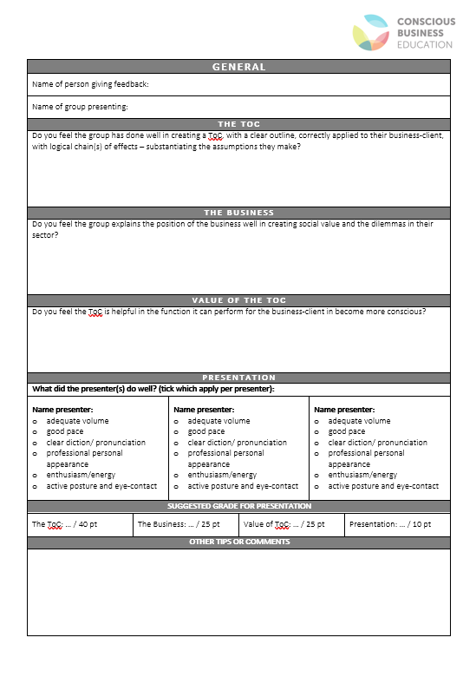
Jury
The jury consists of
Business representative of your group
Your mentor
Another teacher
Business representative of another group
The jurors will grade on the clarity of the ToC itself, the explanation of the social value assessment of the enterprise, and choices made in the assumptions around dilemma’s for the enterprise.
The teacher(s) of the course will combine the feedback from the 4 jurors to set the final grades per group and announce the two best groups.

Slide 7
THANKS TO ALL PRESENTORS!
Picture by Adrien Milcent

Slide 8
REFLECTIONS & INSIGHTS Go to <website>
Picture by Vladislav Klapin
Notes:
We often use mentimeter to get some quick reflections. Think of questions such as:
What is your main take-away from today’s presentations? (short-answers)
What will you do different tomorrow because of this project? (short-answers)
Three main things you've gained from this collaboration (wordcloud)

Slide 9
This material is dated 13-12-2023 and is licensed under Creative Commons ‘Attribution-NonCommercial-ShareAlike 4.0 International (CC BY-NC-SA 4.0)

