Slide 1
This material is dated 12-12-2023 and is licensed under Creative Commons ‘Attribution-NonCommercial-ShareAlike 4.0 International (CC BY-NC-SA 4.0)

Slide 2
COURSE
IMPACT ASSESSMENT THROUGH THEORY OF CHANGE
This material is dated 12-12-2023 and is licensed under Creative Commons ‘Attribution-NonCommercial-ShareAlike 4.0 International (CC BY-NC-SA 4.0)

Slide 3
Lecture 2:
Knowing your social value (Theory of Change)
Course:
IMPACT ASSESSMENT THROUGH THEORY OF CHANGE
This material is dated 12-12-2023 and is licensed under Creative Commons ‘Attribution-NonCommercial-ShareAlike 4.0 International (CC BY-NC-SA 4.0)
Notes:
Welcome to the 2nd lecture of the course Impact Assessment through Theory of Change! The course is hands-on and requires active engagement of all participants. It teaches you a scientifically grounded approach to impact assessment by use of the logic model ‘Theory of Change’.

Slide 4
PROGRAM FOR TODAY
PART 1
Understanding the Theory of Change
PART 2
Matching with businesses!

Slide 5
PART 1
Understanding the Theory of Change

Slide 6
Impact thinking often takes an organization centric perspective: are the organizations goals achieved?
Organizations rarely look at wider picture of how they can contribute most
Usually, they choose a social challenges because they find it important or it suits their resources, personal values, etc.
How to find relevant issues for existing organizations
Inside-out
Outside-in
Notes:
Previous lecture, we discussed how more and more organizations are wanting to have an impact. But how do you as an organization decide what impact to strive for?
According to Porter and Kramer (2006), a company should first look inside out to map the social impact of its value chain and identify the positive and negative effect of its activities on society and then focus on the ones with the greatest strategic value.
After that, the firm should look outside in to understand the influence of their social context on their productivity and on the execution of its business strategy (Porter and Kramer 2006).
Both perspectives are important.

Slide 7
Social value creation through business
Bolt-on and built-in value creation
Maas & Boons (2010) mention three ways in which firms can add value:
Value creation: innovation of products/services that create more economic, ecological and social value
Value integration: integration of stakeholder values into a business’s activities and organizational routines
Value redistribution: creation of more distribution of ecological, economic and social value in the value chain
Notes:
In addition to the inside-out and outside-in way of looking at the creation of social impact, Maas & Boons offer another perspective in their 2010 article about the different ways in which a business might want to add value.
Bolt-on/built-in: ASK THE GROUP TO GIVE SOME EXAMPLES; which organizations have built-in sustainable value creation? And which are more bolt-on?
What do students think about this? Is one better than the other? And why?
Maas & Boons (2010) mention three ways in which firms can add value:
Value creation: innovation of products/services that create more economic, ecological and social value
Value integration: integration of stakeholder values into a business’s activities and organizational routines
Value redistribution: creation of more distribution of ecological, economic and social value in the value chain

Slide 8
IN-CLASS ASSIGNMENT
What type of value do the businesses we’re meeting today want to have?
Built-in or bolt-on? Creation, integration and/or redistribution?
QUESTION

Slide 9
Core components of social performance
Value proposition
Accountability
Social change model
What do we seek to achieve?
How will we bring about change?
How will we hold our feet to the fire?
Source: adapted from Ebrahim (2021) by Impact Centre Erasmus
Notes:
Another model is given by Ebrahim from development studies (2019, in his book: Measuring Social Change - Performance and Accountability in a Complex World; which is a more detailed account than the article the students need to read). He says each organization wanting to create social change, faces three key questions:
What do we seek to achieve? This is the value proposition, which can be build-in or bolt-on.
How will we bring about change? This is the social change model, which shows how the value is created and delivered.
How will we hold our feet to the fire? This is an accountability question meant to assess if the value is being delivered through the social change model.
This question can be asked both from the perspective to PROVE – for example to external funders –
but more importantly to IMPROVE: how can be become better at creating and delivering social value?
Here it is important to establish their own performance goals = an accountability based on strategy rather than on compliance.

Slide 10
From purpose to impact
Impact is the (additional) effect* of the organization on society (including stakeholders) on the economic, environmental and social dimension
Context
Purpose
(mission, vision)
Strategy & Policy
(who, what, how, when)
Implementation / Activities
(execution)
Output
(KPI’s)
Outcomes/ Impact
?
Organization
Society
Source: Impact Centre Erasmus
* positive and negative, direct and indirect, intended and unintended
Notes:
Last lecture, we got a quick look at this impact value chain. Where we give the definition of impact as the additional effect of the organization on society on the economic, environmental and social dimension. Both positive and negative, direct and indirect, and intended and unintended. Today we’ll take a closer look; especially at the most difficult part → measuring outcomes and impact. On the definition: Why additional effect? - You can only talk about impact if you look at the difference (so 'what would have happened anyway’). That implies that we look at your added value positively and negatively. Directly and indirectly. Intentional and unintentional.
Are there any questions on this? → important that students grasp this before moving on.
The Impact Value Chain is not the only way to portray the value an organization can have. Other models are the Logic model and the Theory of Change.
The definition and model is of course an oversimplification of impact but gives us a good insight into what we call the impact value chain.

Slide 11
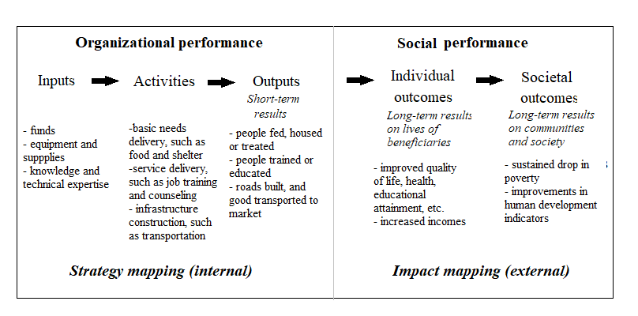
Logic model
Source: adapted from Ebrahim (2021)
Notes:
LOGIC MODEL
The Logic Model makes the division between internal strategy mapping, in which the inputs, activities and outputs are listed.
Inputs are the funds, manhours, equipment, etc. that are used.
Activities are what is actually being done. So this could be production of goods or services, transportation, etc.
Outputs are seen as short-term, often countable results. So the number of products produced, or how many people attended the training, or the number of roads build, etc.
The Logic Model then looks towards impact mapping which needs an external viewpoint.
What might be outcomes (longer term effects) of the activities and outputs for individual beneficiaries of the products and services provided. This can be increased skills from a training, or increased incomes.
The societal outcomes are the long term effect these individual outcomes might have on communities or society at large. These are often considered “public good outcomes” – outcomes which are beneficial for the general public and often in line with goals governments are stating to wanting to achieve. Reducing poverty, improving public health, etc.

Slide 12
Theory of Change
Source: Impact Centre Erasmus
Notes:
THEORY OF CHANGE
A Theory of Change is more fine-grained then the Impact Value Chain and the Logic Model. A Theory of Change details the precise steps, containing many of the same elements of the logic model but in a way that creates a chain of interconnected effects.
A theory of change is often exactly that: A THEORY. It details how an organizations thinks they are having which effects. For societal outcomes, it is often needed to reach several intermediate and/or individual outcomes that build-up towards the “final” societal impact.
A theory of change is a tool or framework which can be applied on multiple levels. Larger organization might want to make a ToC per programme or department, which can be portrayed together to account for their mission impact. Smaller organization might just need one ToC to display what they are doing.
A ToC can start with input. But more often it starts with the activities, detailing the projects or programmes executed.
Often the ToC states the short-term effects of the activities. These can be more output-oriented (# of people trained) or effect-oriented (increased skills of participation through the training). This often depends on what the organization values about the activities and wants to monitor.
The ToC then makes a chain of effects. The chain can be more sequential, meaning one effect leading to another. For example: I need to first need to be aware of an issue, before I can understand it, and change my behavior). But effect can also take some time to take place. For example: After the training, I need to practice my gained skills more and only then they will lead to a betterment of my position on the labor market.
The ToC “ends” the main goal(s) the organization want to attain.
An important value of the ToC lays in the detail placed on HOW change occurs or is theorerized to occur. This also means it gives you the most clues on what and where you should assess the effectivity of your intervention.

Slide 13
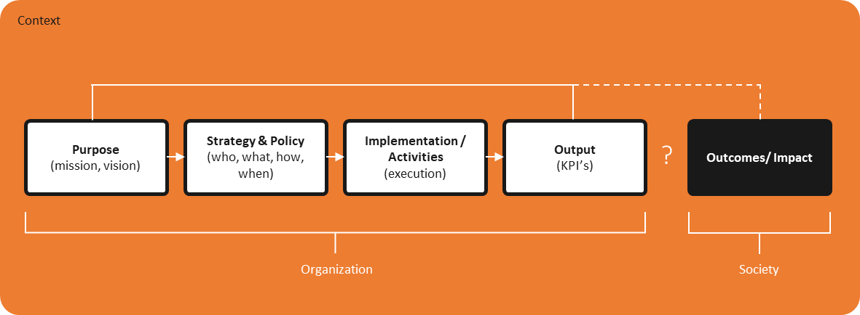
Impact value chain
Theory of Change
Logic model
Notes:
The impact value chain, the logic model and the theory of change are all models used to portray the route to impact, each with their own unique value and benefits.
There can be some confusion about these models and terms. Some scholars believe one model to be superior to the other for certain tasks. For example that a ToC is better for visualizing change while an impact value chain is better for making strategic decisions.

Slide 14
For this course we’ll focus on the
Theory of Change
Notes:
For this course, we will use the Theory of Change because it is the most detailed framework to know how and where to assess impact.

Slide 15
The elements of the Theory of Change framework A simplified example…
External influences
Ambition
Inputs
Activities/ Throughputs
Outputs
Outcomes
Impact
Investment needed to implement activities
Activities needed to attain ambition
Direct results of the activities
Effects that occur as a result of the activities (positive, negative, (un)intended, (in)direct)
Effects – what would have happened anyway
Healthy foods for all students
FTE
Volunteers
Knowledge
Money
Program ‘Health in Schools’
# students
# fruits
# vegan
Etc.
Students eat healthier at school
Students make healther food choices
Better public health
Assumptions
Notes:
A ToC contains the elements of the impact value chain: ambition, inputs, outputs, outocmes, impact.
Supplemented with assumptions you make and any external Influences.
*explain what everything is – all elements are on slide through animation* *Give examples*
The elements assumptions, external influences and unintended effects are often overlooked so we’ll take some more time here on those.

Slide 16
IN-CLASS ASSIGNMENT
Activity, output or outcome
Knowledge
Number of participants
Self-confidence
Number of schoolbooks
Workshop
Talent development
Social-emotional skills
Number of workshops
Future perspective
Future perspective
Talent development
Outcome
Self confidence
Social emotional skills
Knowledge
Output
Number of participants
Number of schoolbooks
Number of workshops
Activity
Workshop

Slide 17
Three things make a ToC difficult
Assumptions
External influences
Unintended effect

Slide 18
Assumptions
Training
Participants obtain their certificates
Participants find a job
Participants receive a higher income
The training meets the needs of participants
There is a need for the knowledge/skills that participants acquire
The training material is relevant/up to date
Companies hire people
There is a group to compare participants to

Slide 19
External Influences
Other organizations
Political context
Inputs
Activities
Outputs
Macro-economic context
Black box
Direct environment
Outcomes
Impact
Laws and regulations
Public opinion
Etc.

Slide 20
Unintended Effects
What could go wrong?
Macro effects
What happens to non-participants?
Local Markets?
Spill-over effects
Spin-off effects
Source: markmanson.net

Slide 21
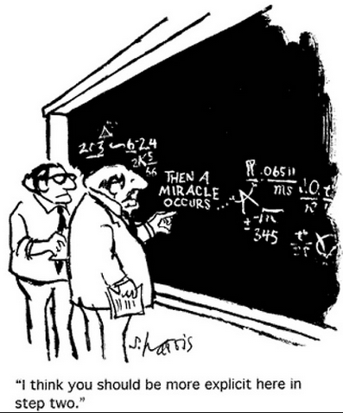
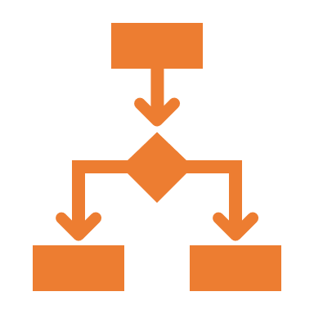
Insight in impact
A ToC is a theory about how you make impact
Four functions of a ToC
1. Think about change
2. Visualize change
3. Measure change
4. Make strategic choices
Source: S. Harris
Notes:
A theory of change is exactly that: A THEORY. It is the logic which explains how your activities add up to the impact you want to achieve.
Toc has four functions
thinking out changes; if I want to achieve THIS, WHAT must be done? For example: a campaign that focuses on smoking prevention. It is an illusion to think that hearing a presentation / participating in a workshop immediately leads to smoking cessation.
Visualizing change: the whole story of all the steps that must occur is quite extensive. Visualizing makes it easy to understand the effects. It also shows “wholes” – where you need to be more specific about HOW change takes place.
Measure change: you measure at impact level. But what if you measure that there is no impact? if you have made visual you can measure on multiple levels and this will give insights, the given insight on which buttons to turn. For example; a child is still being bullied. What is that about?
Making strategic choices: in dialogue with each other and with stakeholders. Do we expect this to work? Are we strategically focusing on all these steps? Should we do that? Is it realistic what we aim for, or is it true what we claim? Are we actually sending it?
I’m going to go through these functions with you.

Slide 22
Function 1. Think about change
Source: unit4.com
Notes:
This function focuses on the explanatory value of a ToC. It challenges the organization to spell out their assumptions. This steps sounds easy, but many organization struggle to really explain well WHY they do what they do. Why do you believe this training will make young people better suited for the labor market? It contains many assumptions about the training itself as well as what the participants attain from the training AND do with it. Making these assumptions explicit and really challenging ourselves on HOW we think the value is created, often gives rise to insights on whether you are doing the things write.
An example on the next slides…

Slide 23
Target group:
unemployed young people with (great) distance from the labor market
Notes:
Explanation BuzinezzClub: Focuses on young people who are at a (large) distance from the labor market.
Little network or incentive to get started, but debts, and little self-knowledge about what they want, can do and what they are good at.
For example, young people come into contact with the BuzinezzClub via the youth counter or on their own initiative.
Stimulate the entrepreneurial spirit of young people to find their own place in the labor market.
Wants to guide young people in 18 months to a life where they can use their talents

Slide 24
1. Young people gain insight into their own capacities and how they fit into the labor market
5. Younger has a work rhythm and works on assignments about the labor market
2. Young person is in education, has a job or is an entrepreneur
6. Young people are self-reliant and feel part of society
3. Structured day program: training & coaching aimed at labor market orientation
7. Young people gain insight into the labor market
4. Young people can make a motivated choice for a next step in the labor market
Outcomes (long term)
Determine the “order” of the value chain: from activities to long-term outcomes.
Name at least 2 assumptions made
Outcomes (short term)
ASSIGNMENT
Outputs
Activities
* This is a very simplified version and not the real ToC chain for Businezzclub
Notes:
Excercise! What would a BC ToC chain look like?
Note: this is an example, not literally from BC (just mention it, it's more complex and the goals are slightly different)
2 counts: 3 minutes to make the chain. And: 2 assumptions to make.
-------- You are actually creating a chain of results (effects). What will change & for whom?

Slide 25
6. Young people are self-reliant and feel part of society
OUTCOMES (LONG TERM)
2. Young person is in education, has a job or is an entrepreneur
4. Young people can make a motivated choice for a next step in the labor market
OUTCOMES (SHORT TERM)
1. Young people gain insight into their own capacities and how they fit into the labor market
ToC chain
ORDER:
3, 5, 7, 1, 4, 2, 6
7. Young people gain insight into the labor market
OUTPUTS
ACTIVITIES
5. Younger has a work rhythm and works on assignments about the labor market
3. Structured day program: training & coaching aimed at labor market orientation
Notes:
ATTENTION: contains many assumptions!
Answer! Also: Your claim may change – maybe you're too high? What exactly do you want as the main claim? Could also be about getting to know yourself + empowerment; solving urgent problems; creating more jobs through entrepreneurship. Or the simple fact that you have a job and earn an income. What assumptions are in it? Young people can function in a regular workplace, education, etc. Is the young person able to work independently/entrepreneurially
Young people are motivated to get further from the trajectory
What was this like to do?

Slide 26
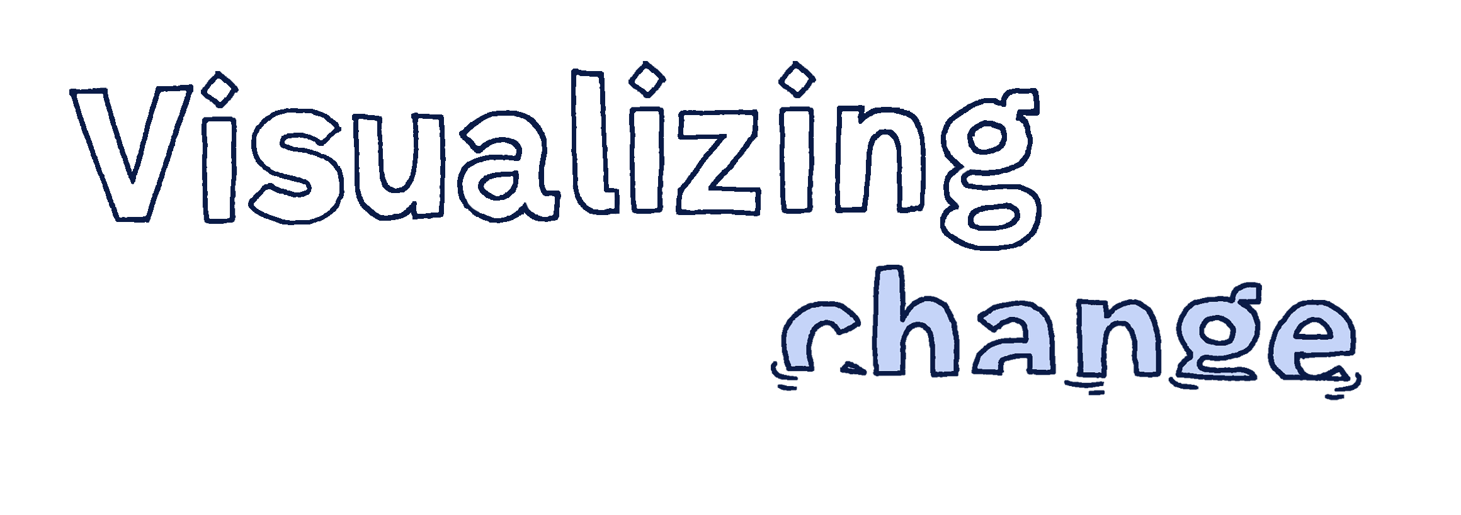
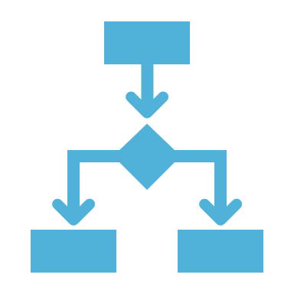
Function 2. Visualize change
Source: vizchange.net
Notes:
Another function of the ToC is visualization of change. Often visualization helps us get the story clearer and makes you able to communicate your story better. This is needed when working with many stakeholders and determine with them how a change might look for them.
Many templates of a theory of change are linear. This often makes sense from the perspective of a chain of events over time. However, a ToC is always a simplification of (an often messy) reality. Don’t be fooled by all the linear models. ToC visualization can take the form best suited with the goals of the organization with the visualization.
Some examples on the next slide.

Slide 27
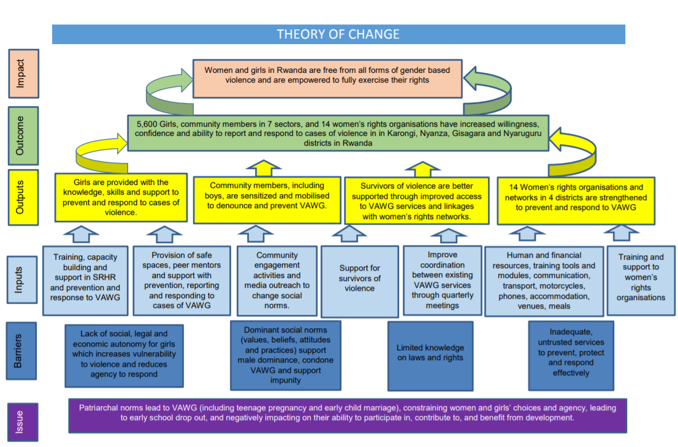
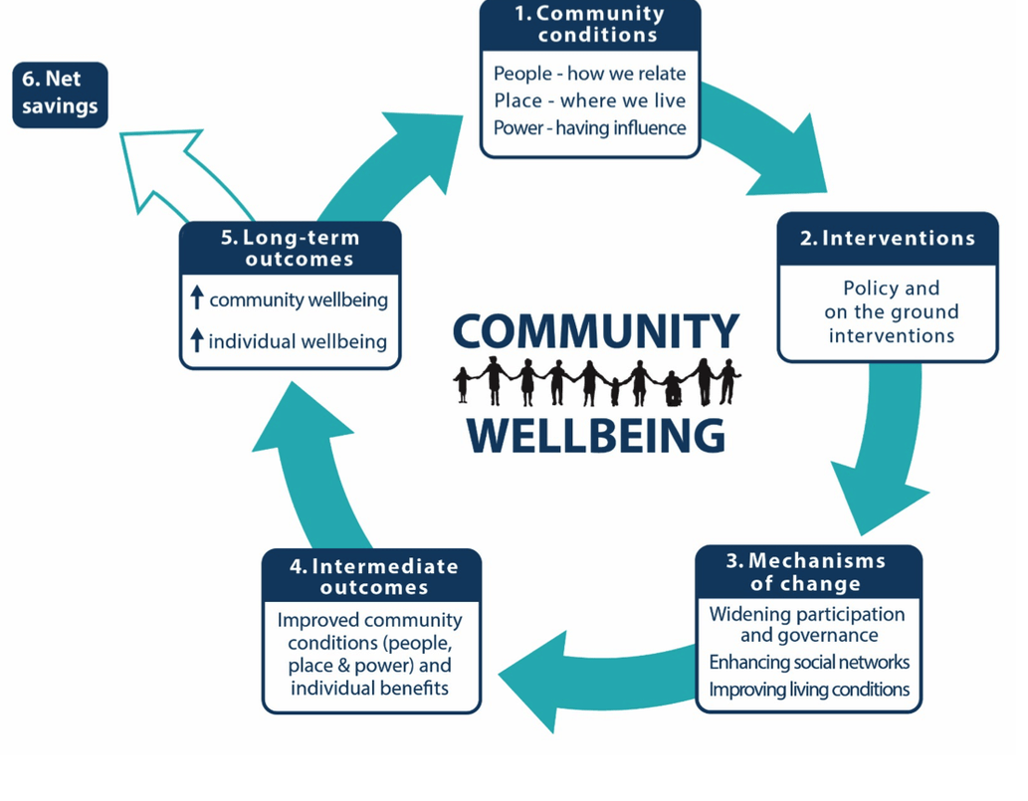
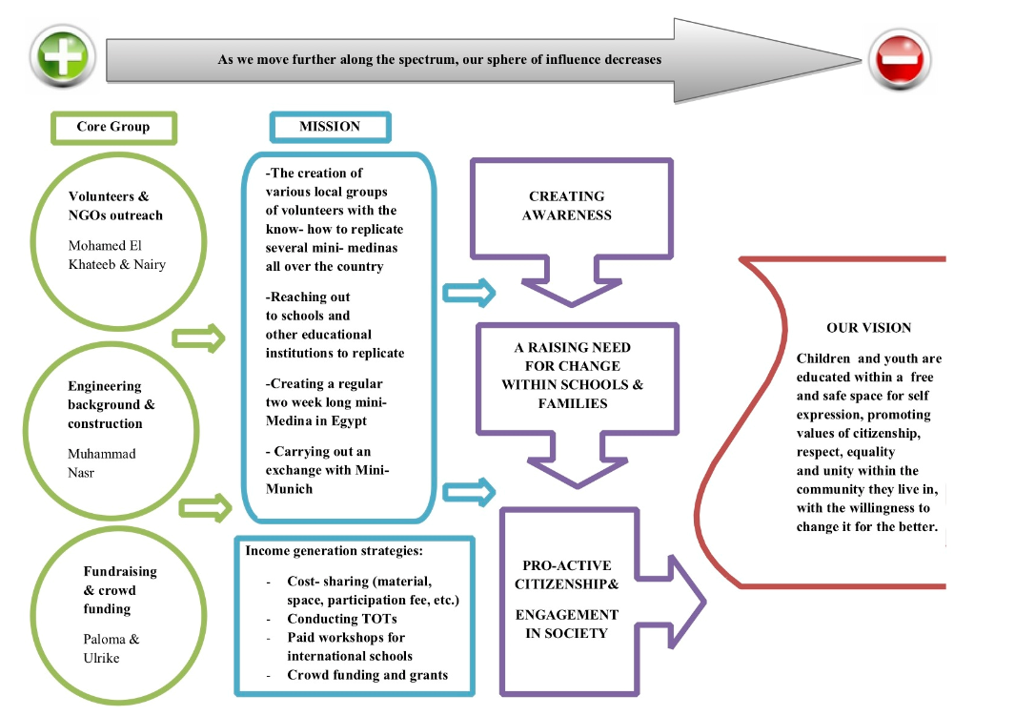
ToC to visualize change
Source: contact course creator

Slide 28
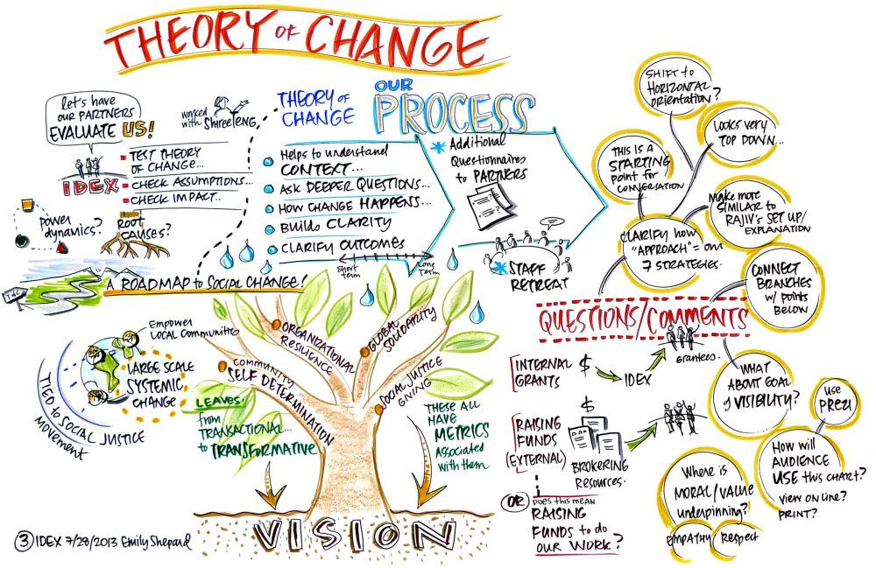
Source: hgnetwork.org

Slide 29
Theory of Change visualisation
There are no prototypes
Participation of stakeholders is essential
The core is showing change logic
Not suitable for very simple or very complex uncertain situations
Dynamic document

Slide 30
Function 3. Measure change
Source: aihr.com
Notes:
There is an increasing demand for measuring impact
Organizations can no longer get away with beautiful stories.
In the past it used to be enough to say that you spent your money, and then to say what you did with your money, now there is a tendency to be asked about the impact of the projects
HOWEVER, what should you measure? As you saw, ToC’s can get large and complex. How can they support impact measurement?

Slide 31
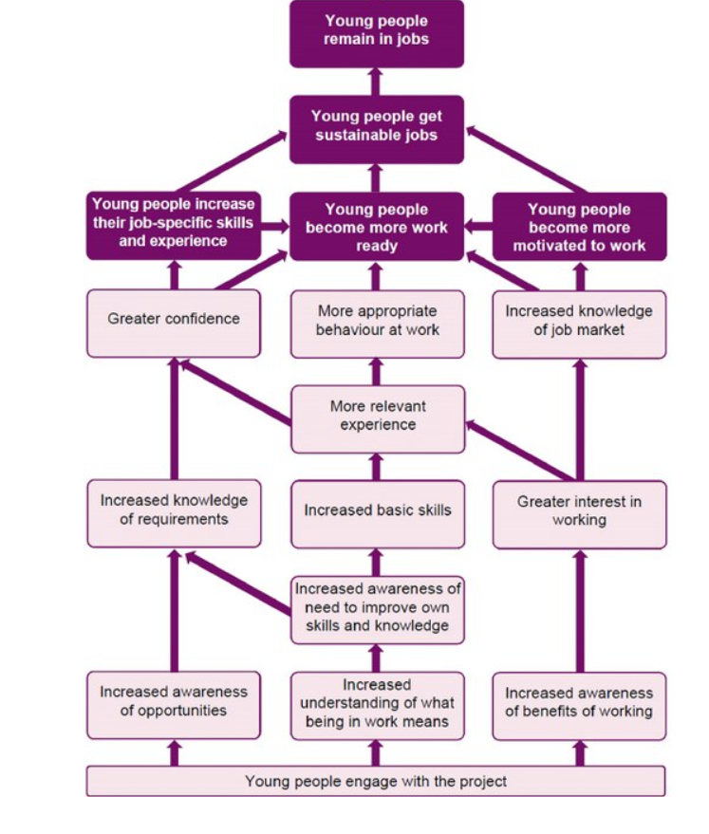
MEASURE to prove
MEASURE to improve
Notes:
A Theory of Change often “ends” with the desired impact. It makes sense to state that you want to measure that exact thing. So in this example, whether young people actually remain in jobs.
However, what do you learn from that?
If yes, young people remain in jobs, what have you learned? <debate with students>
If no, young people don’t remain in jobs, what have you learned? <debate with students>
Often this is the difference between measuring to prove, and measuring to improve.
When I measure to improve, I might want to measure some of the other effects in the chain that I think are vital for my theory to work. So I might measure that participants indeed have increased awareness, and increased basic skills, but they are not more work ready. This tells me where I need to improve my intervention. Or it might show me what is working well in my intervention, and increase that or build a best practice out of it for others to use. Since I don’t only know THAT it works, I know WHY and HOW it works.

Slide 32
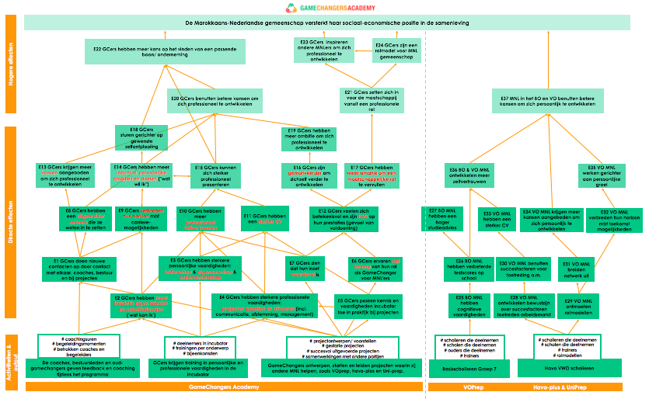
Interviews
Literature
Questionnaire
Monitoring
Notes:
Measurement give people the idea of quantitative questionnaires. This is just one part. Often you can highlight in your ToC which areas you want to investigate in what way. I might do a literature review to see how plausible the effects are based on previous research. I might do some interviews on the experiences of participants on certain effects. I might monitor others in my internal systems and have a questionnaire on outputs and shortterm effects.
Often times, it will not be feasible to measure EVERYTHING in your ToC. The ToC helps you determine where and what to measure.

Slide 33
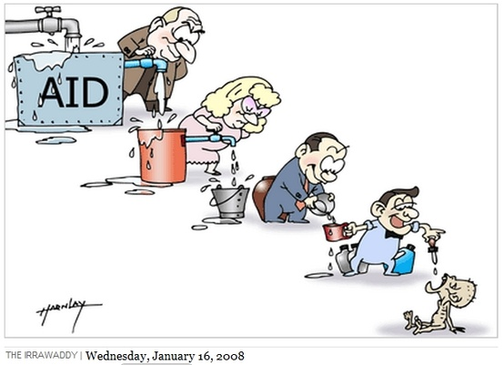
Function 4. Make strategic choices
Source: irrawaddy.com
Notes:
The last function of the ToC is how the ToC helps make strategic choices.
It can highlight whether the desired effects are attainable. Organizations using the ToC in this way will often realize that many of their activities are not contributing (much) to the desired outcomes. This enables organization to make sure they are putting their efforts towards what they expect to create the most value.

Slide 34
Three “spheres”
CONTROL
INFLUENCE
INTEREST
Input
Activities
Outputs
Outcomes
Impact
Timeframe
Notes:
This also adds to the desire to often measure long term impact. While this can be interesting, for most organization this can both be out of their sphere of control and even out of their sphere of influence, in addition to very long research-timelines. While it’s admirable to theorize certain societal impact from activities, it often makes more sense to leave that as a theory and improve on the effect that are controlled and influenced by the organization.

Slide 35
IN-CLASS ASSIGNMENT
5-minute essay: write down based on the reading and the lectures thus far what you consider to be valuable about making a Theory of Change. How can it help in assessing impact?
QUESTION

Slide 36
Summary
Key take-aways from today
There are different ways organizations create value
Impact is the additional effect an organization has on society (including stakeholders) on the economic, environmental and social dimension
A theory of change (ToC) can help you in visualizing the impactpath of your organization or intervention
A ToC has four functions
Think about change
Visualize change
Measure change
Make strategic decisions
MEETING THE BUSINESSES AFTER THE BREAK!
Notes:
lecture 11 (Measuring value creation) gaat ook nog over impact measurement

Slide 37
Part 2
Matching with businesses!
Source: itarian.com
Picture by Markus Spiske
Notes:
Welcoming to the business-representatives and quick introduction for them to the course
Ask each business-representative to quickly introduce themselves and their question
Explain the setup: meetings with the students' teams and businesses (in groups)
Next steps and Q&A

Slide 38
Some advice for meeting the businesses!
Ask questions. A lot!
What is the impact you aim to achieve with this activity/with your organization?
Which effects do you expect to achieve?
Why is this impact question relevant?
WHY do you expect that your activity leads to specific impacts?
HOW do you expect that this will occur?
Can you explain this?
What do you mean with this?
Who are your beneficiaries? And is the intervention similar for each person from the target group?
Are there important stakeholders involved?
Ask for access to information (websites, annual reports, policy documents…)
Ask for an email address/ contact information
Without good knowledge you cannot make a ToC!

Slide 39
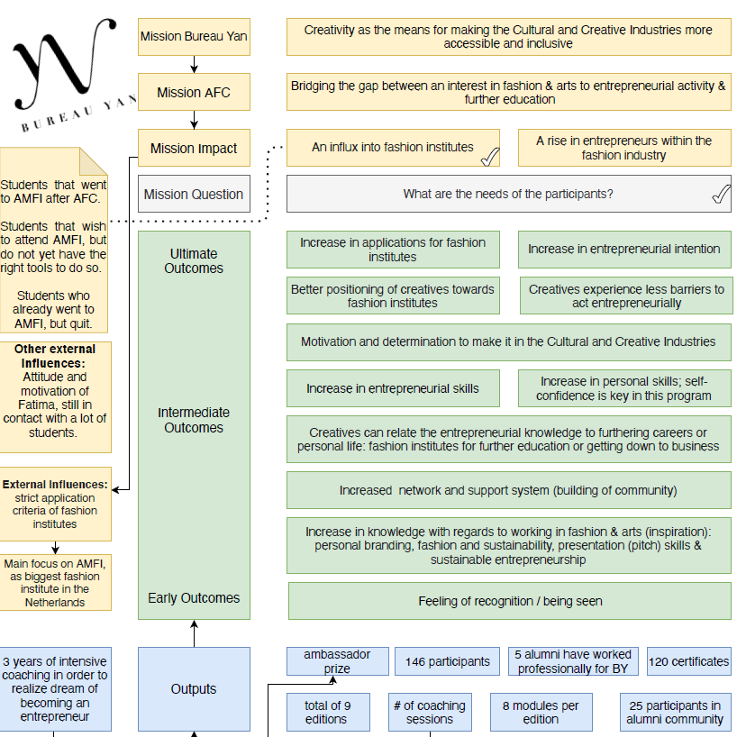
An example from a previous group
Source: Impact Centre Erasmus
Notes:
Before they go their own way, some inspiration from when this course was given as part of Erasmus University course Assessing the impact of culture and creativity in society.

Slide 40
Getting to know each other! Find your group and business representatives and a place to discuss somewhere. Be back around <time> for plenary questions and closing.
Photo by Ian Barsby

Slide 41
Q&A What did you discuss?
Photo by Stijn Hanegraaf

Slide 42
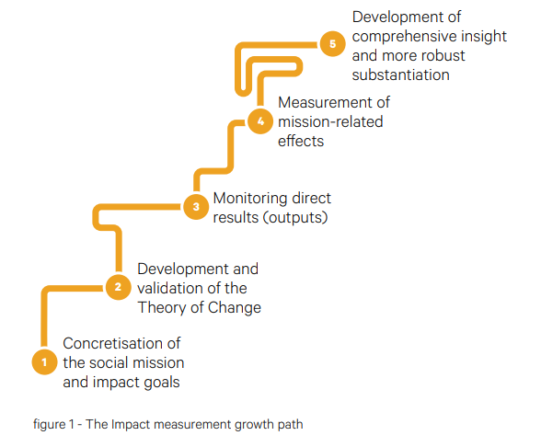
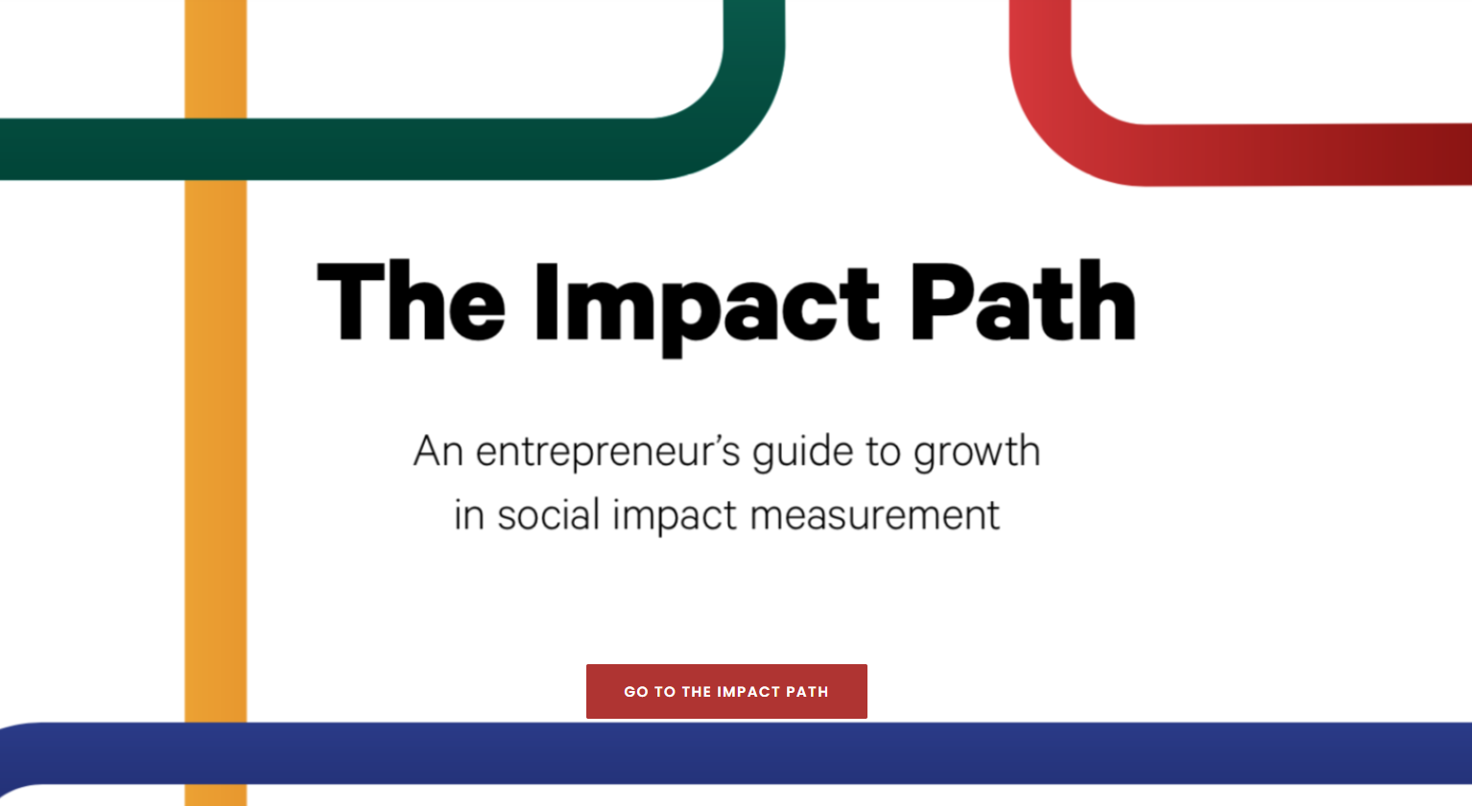
Tools: The Impact Path
Notes:
https://impactpad.nl/

Slide 43
This material is dated 12-12-2023 and is licensed under Creative Commons ‘Attribution-NonCommercial-ShareAlike 4.0 International (CC BY-NC-SA 4.0)

