Slide 1
This material is dated 13-12-2023 and is licensed under Creative Commons ‘Attribution-NonCommercial-ShareAlike 4.0 International (CC BY-NC-SA 4.0)

Slide 2
COURSE
INTEGRATED REPORTING
This material is dated 13-12-2023 and is licensed under Creative Commons ‘Attribution-NonCommercial-ShareAlike 4.0 International (CC BY-NC-SA 4.0)

Slide 3
Lecture 3:
DEEPDIVE INTO THE
<IR> FRAMEWORK
Course:
INTEGRATED REPORTING
This material is dated 13-12-2023 and is licensed under Creative Commons ‘Attribution-NonCommercial-ShareAlike 4.0 International (CC BY-NC-SA 4.0)
Notes:
Welcome to the 2nd lecture of the course Impact Assessment through Theory of Change! The course is hands-on and requires active engagement of all participants. It teaches you a scientifically grounded approach to impact assessment by use of the logic model ‘Theory of Change’.

Slide 4
PROGRAM FOR TODAY
PART 1
Different methods
PART 2
The <IR> Framework
Practical application
PART 3
Trends and developments
Assurance
Notes:
The second week dives deeper into one of the methods of Integrated Reporting: the <IR> Framework and the current trends and developments. The lecture is hands-on, with more interaction to challenge the students on their understanding of integrated reporting, demonstrating their application of the framework on several examples and arguing the levels of consciousness of the different integrated reporting framework-examples.

Slide 5
PART 1
Different methods

Slide 6
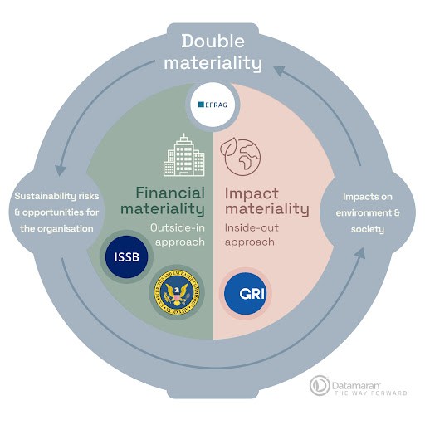
There is NO single, universally-accepted method for Integrated Reporting
Different methods exist and they can differ significantly
Some use only a single perspective
Some don’t use the 6 capitals
Some determine materiality only on non-financial topics and thereby still create some kind of non-comparability between financial and non-financial information.

Slide 7
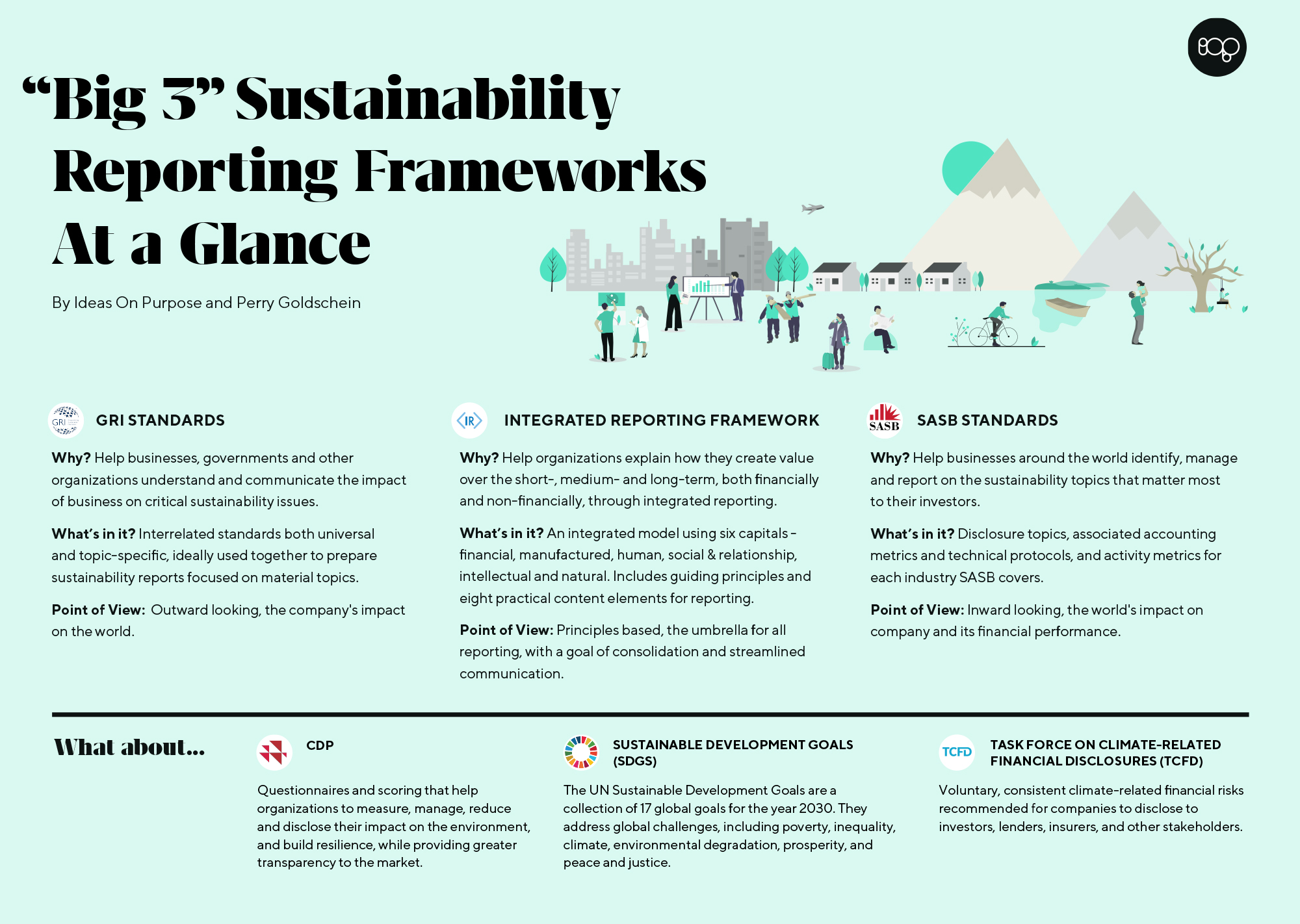
Source: Perry Goldschein
Notes:
USE ANIMATION IN SLIDE
The three main frameworks for Integrated Reporting are:
GRI
<IR> Framework
And SASB Standards
(the lower part will fly in) – There are many more. Like, CDP, SDGs and TCFD
(the orange block will fly in) – For this course will focus on the <IR> Framework. Primary reason is that in June 2021, the International Integrated Reporting Council and the Sustainability Accounting Standards Board announced their combination to form the Value Reporting Foundation (VRF). In November 2021, the IFRS Foundation announced it would consolidate the VRF and Climate Disclosure Standards Board with its own newly formed International Sustainability Standards Board by June 2022.
It is – with all the mergers and fusions of standards and standards organizations – hard to predict how specific frameworks will adapt to new legislation. This is the primary reason why in this course, we focus on the process of Integrated reporting as a strategic, integrated-thinking process, cumulating in a report, and not on training you in a specific methods. However, the <IR> framework contains some interesting principles and deserves a bit of a deep-dive.

Slide 8
PART 2
The <IR> Framework
Practical application

Slide 9
Guiding principles
Strategic focus and future orientation
Connectivity of information
Stakeholder relationships
Materiality
Conciseness
Reliability and completeness
Consistency and comparability
Seven Guiding Principles underpin the preparation and presentation of an integrated report, informing the content of the report and how information is presented:
Source: Integrated Reporting <IR> Framework (2021)
Notes:
Strategic focus and future orientation. An integrated report should provide insight into the organization’s strategy, and how it relates to the organization’s ability to create value in the short, medium and long term, and to its use of and effects on the capitals
Connectivity of information. An integrated report should show a holistic picture of the combination, interrelatedness and dependencies between the factors that affect the organization’s ability to create value over time
Stakeholder relationships. An integrated report should provide insight into the nature and quality of the organization’s relationships with its key stakeholders, including how and to what extent the organization understands, takes into account and responds to their legitimate needs and interests
Materiality. An integrated report should disclose information about matters that substantively affect the organization’s ability to create value over the short, medium and long term
Conciseness. An integrated report should be concise
Reliability and completeness. An integrated report should include all material matters, both positive and negative, in a balanced way and without material error
Consistency and comparability. The information in an integrated report should be presented: (a) on a basis that is consistent over time; and (b) in a way that enables comparison with other organizations to the extent it is material to the organization’s own ability to create value over time.

Slide 10
Content Elements
Organizational overview and external environment
Governance
Business model
Risks and opportunities
Strategy and resource allocation
Performance
Outlook
Basis of presentation
An integrated report includes eight Content Elements that are fundamentally linked to each other and are not mutually exclusive:
Source: Integrated Reporting <IR> Framework (2021)
Notes:
Organizational overview and external environment. What does the organization do and what are the circumstances under which it operates?
Governance. How does the organization’s governance structure support its ability to create value in the short, medium and long term?
Business model. What is the organization’s business model?
Risks and opportunities. What are the specific risks and opportunities that affect the organization’s ability to create value over the short, medium and long term, and how is the organization dealing with them?
Strategy and resource allocation. Where does the organization want to go and how does it intend to get there?
Performance. To what extent has the organization achieved its strategic objectives for the period and what are its outcomes in terms of effects on the capitals?
Outlook. What challenges and uncertainties is the organization likely to encounter in pursuing its strategy, and what are the potential implications for its business model and future performance?
Basis of presentation. How does the organization determine what matters to include in the integrated report and how are such matters quantified or evaluated?

Slide 11
Content elements integrated report
Source: Integrated Reporting <IR> Framework (2021)

Slide 12
<IR> Framework
Source: Integrated Reporting <IR> Framework (2021)
Notes:
Starts with context/society
You choose your position
Translate to policy and approach
Everything goes in there (capitals) = inputs
That goes through your business model
There should actually be an arrow back from society to society, as a continuous loop
Internally, your governance model is the connection
This complete model is the value creation model. How an organization uses their input to create value.

Slide 13
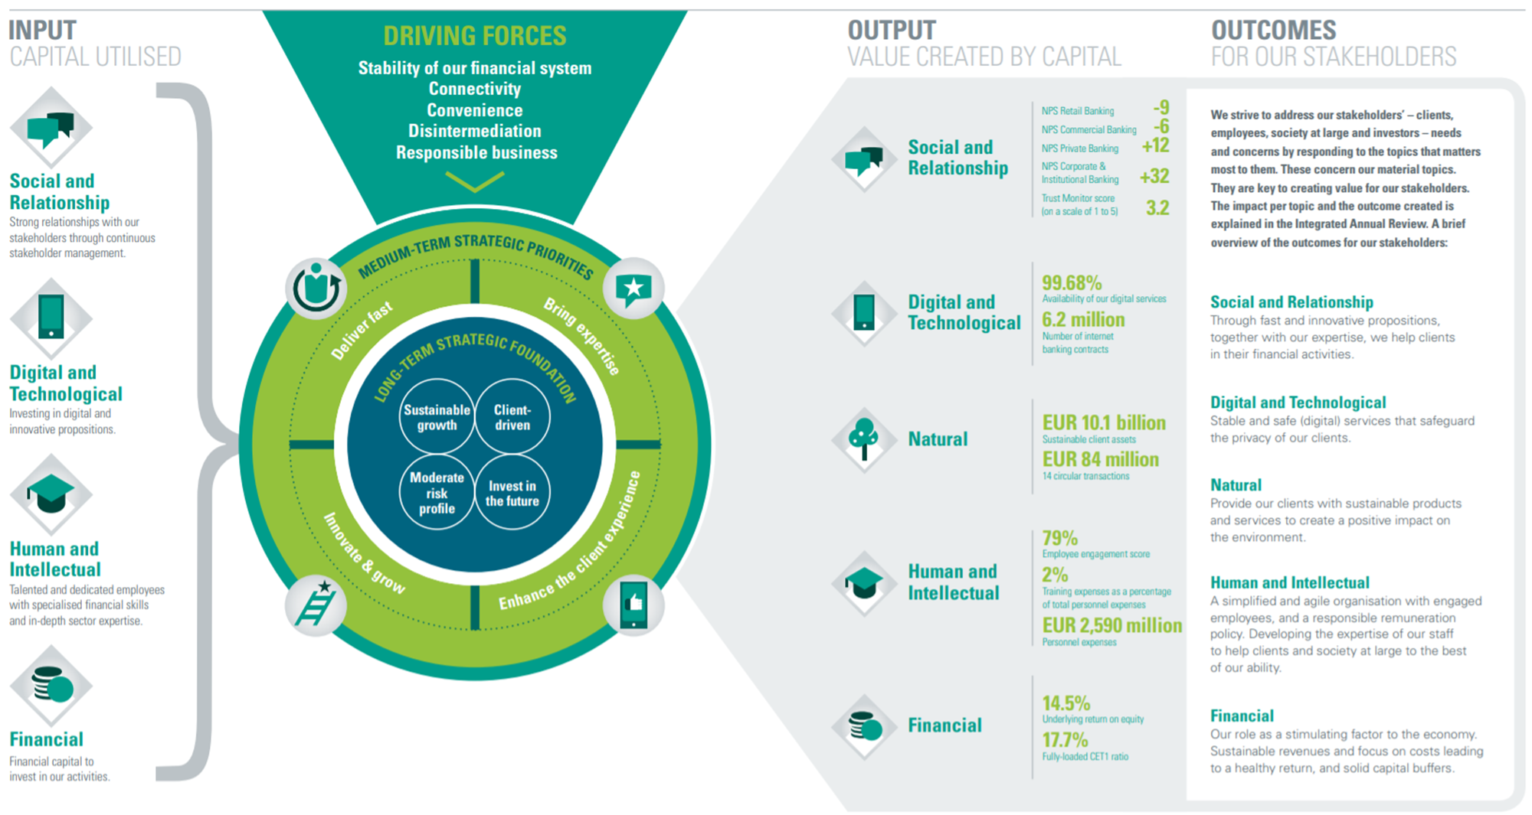
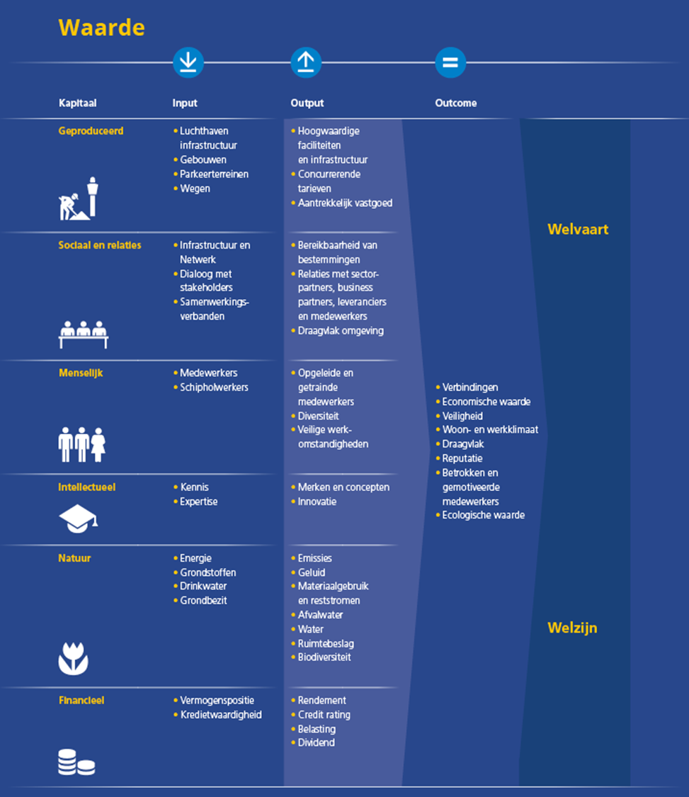
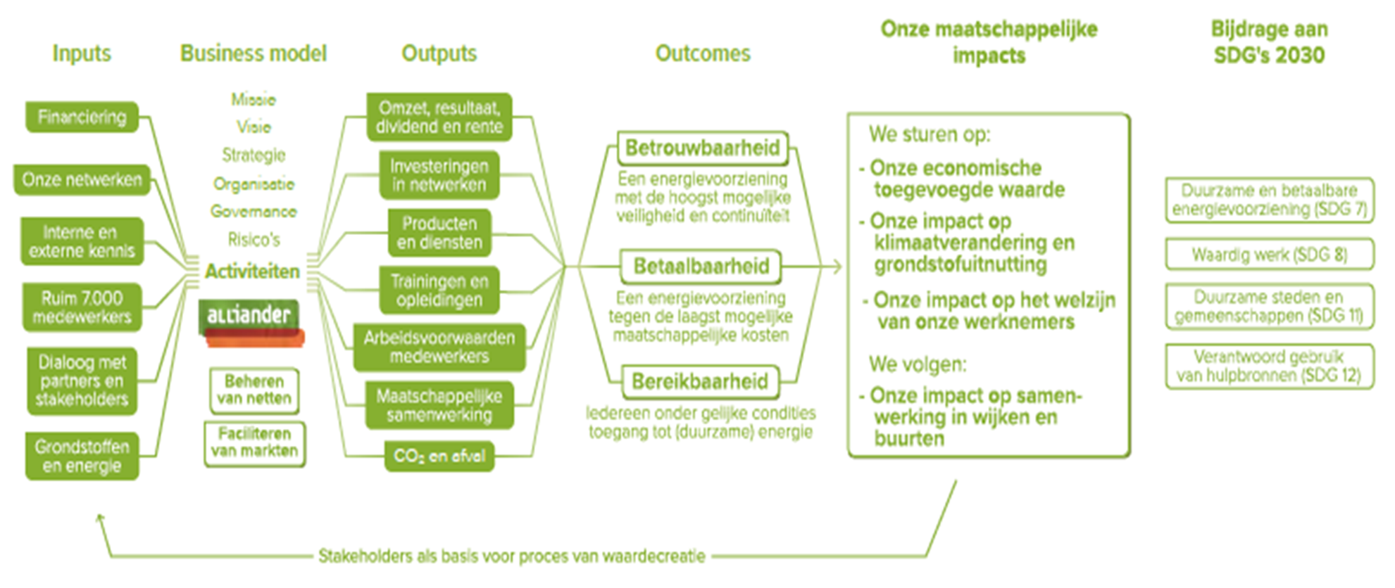
Practical application: three examples
Example 1: ABN AMRO
Example 3: Schiphol
Example 2: Alliander
Notes:
ABN AMRO – One of Holland’s largest banks
Alliander – One of Holland’s main energy providers
Schiphol – One of the world’s busiest airports
Print out the three examples on larger sheets for the students or go through them one by one.

Slide 14
IN-CLASS ASSIGNMENT
What do you think of the value chain(s)?
1
How do you understand the business model?
2
Is the business model aligned with the value model in your opinion (why/ why not)?
3
Notes:
In groups, answer these three questions.
<have sets of the the examples printed.>
After enough time (~15 minutes), walk through the examples one by one and discuss students’ ideas about the examples.

Slide 15
ABN AMRO (2015)
Notes:
PRINT
ABN
Nice that it contains figures; just what do these figures say? Relative to what? Does it have to improve every year, is there a target, etc.?
Not clear how it relates
Outcomes is still very general, e.g. 'through fast and …. Are we helping customers' – is that an outcome or is it just what you do?

Slide 16
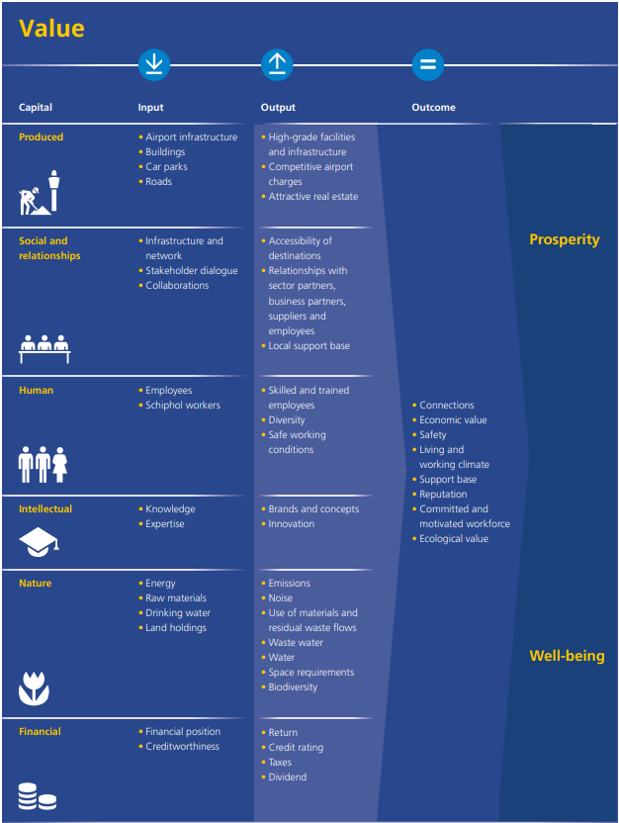
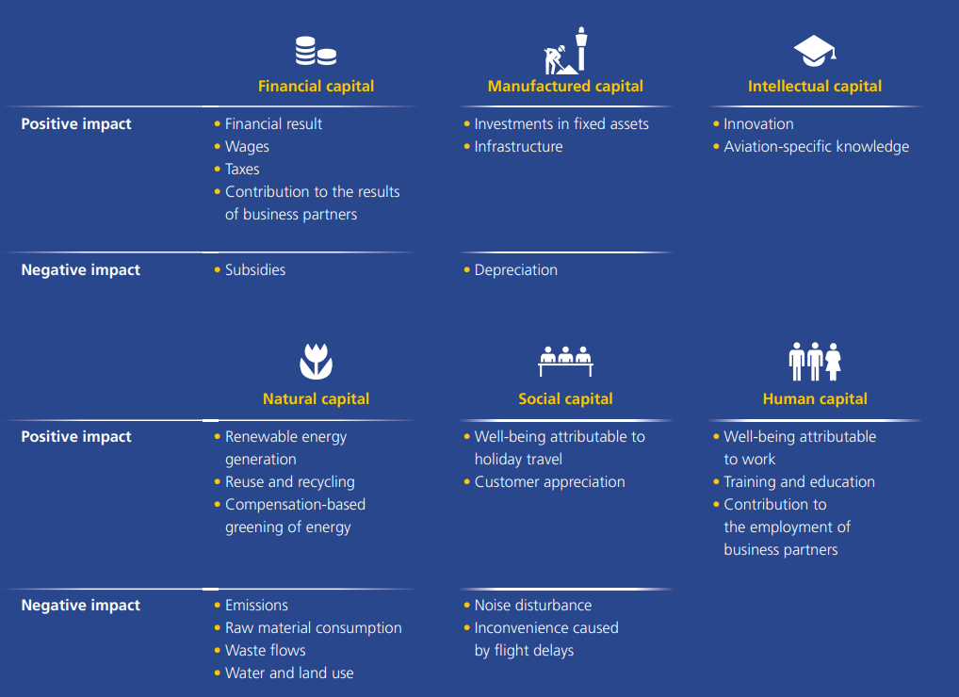
Schiphol 2015
Notes:
PRINT
Schiphol
Input down, output up; but there are also negative things in it that are confusing
Outcome = ecological value instead of ecological damage
Leads to prosperity and well-being, that is very general. HOW?
Airport infrastructure aside, you could plot this on almost any company

Slide 17
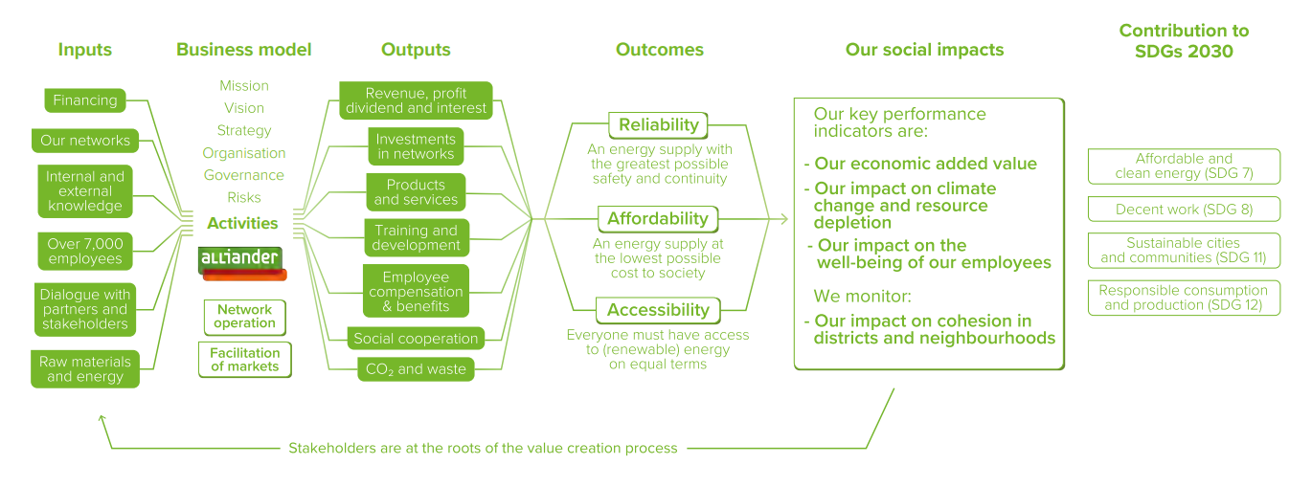
Alliander Annual report 2017 Connectivity Model
Notes:
PRINT
Alliander:
SDGs already included; as early as 2017. Pretty soon to include this one.
There is a clear return. We improve on the lessons according to our inputs.
Impacts that are mentioned are more ambitions, not what has been achieved. It is not a consequence of the things that preceded it.
Outcomes that are there are actually their core values; what they stand for. Still feels like a mistake. An organization that has a social role often replaces the value they are supposed to have with a direct outcome, but this should be a checks and balances; do you also achieve the value you say you want to achieve, instead of accepting it.

Slide 18
IN-CLASS ASSIGNMENT
What do you think of the value chain(s)?
1
How do you understand the business model?
2
Is the business model aligned with the value model in your opinion (why/ why not)?
3
These examples are somewhat older. On purpose, because development is going quickly. Let's see how they’re developing!
Notes:
In groups, answer these three questions.
<have sets of the the examples printed.>

Slide 19
Notes:
ABN from what had evolved to this. Show the impact with positive and negative effects, the larger the bubble the more impact and split into stakeholder groups.
This has generated a great deal of discussion, especially at the Executive Board. Especially because of the top left bubble: the greatest negative impact is related to their core task and core product. That really demands something from the strategy and transition that the organization has to go through.

Slide 20
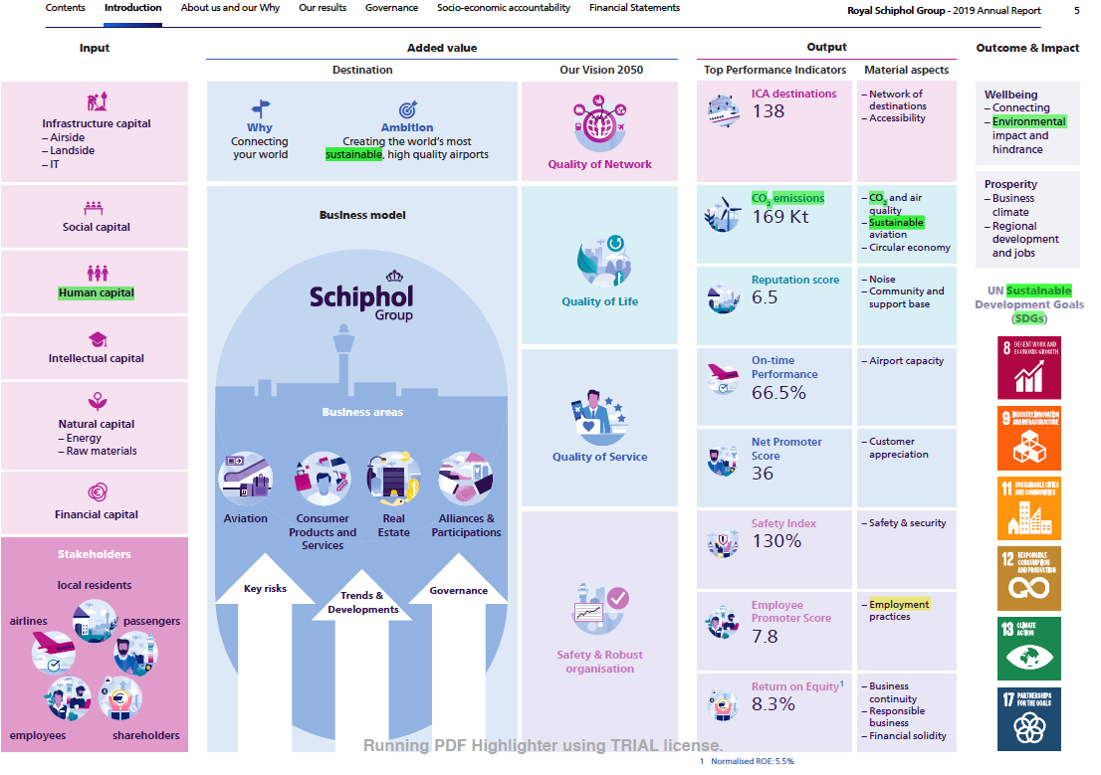
Notes:
Nice report. Especially online you can zoom in even more and find information. There are figures, but not linked to a standard or an ambition or a benchmark. Now name the SDGs.
Highlights is for an evaluation for the Erasmus Corporate Impact Index.
Often the framework is also the structure of the report and that is also what you want to see.

Slide 21
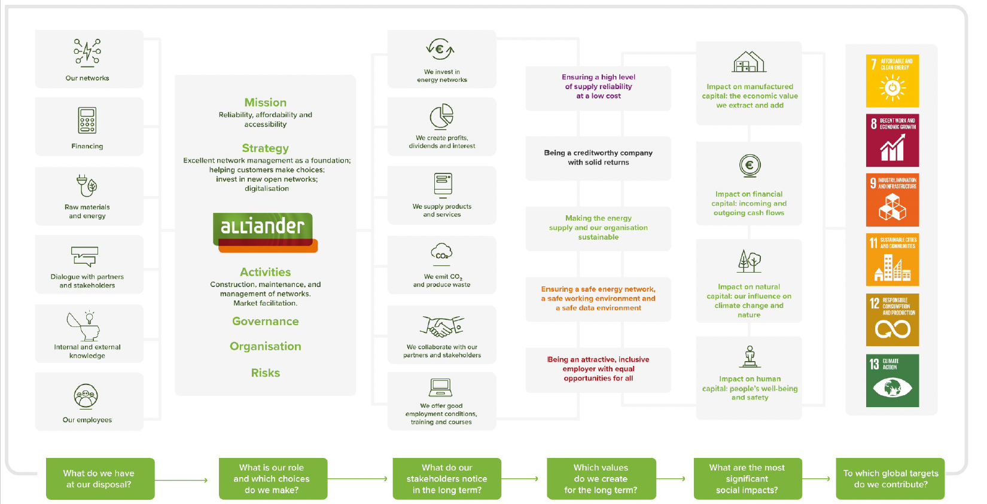
Notes:
Alliander 2020
Not for nothing the old given - development has been made quite quickly.
Great use on “loop back”
Still very vague on “impact”

Slide 22
Notes:
Sidenote on the use of SDGs. This is seen more and more and can be a good thing. The SDGs represent a great framework and language to talk about social and environmental issues. However, they were created mainly for nation state, meaning the goals are not always as applicable to organizations. In addition, organizations can use them to “SDG-wash” – the 17 goals are very high-level and abstract, but many are unfamiliar with the subsequent 169 targets and 247 indicators.
What we often see is that organizations label SDGs afterwards: everyone saves some energy, employs women, etc. But you want it to be a strategic choice up front, and you want to track on that. Let alone that they can substantiate how they contribute to the target of that SDG using the right indicators.
Own indicators don't have to be bad, but they shouldn't be a form of SDG washing and clearly linked to the targets of the goals, not just the high-level goal itself.

Slide 23
PART 3
Trends and developments
Assurance

Slide 24
From compliance to impact From ‘doing no harm’ to ‘doing good’
Impact
Shared Value
CSR
Compliance
Do good
Do no harm
Source: Impact Centre Erasmus
Notes:
So many organizations are claiming and aiming to move from mere compliance to do no harm, to doing good and making an impact according to their purpose. But this of course this also has a ‘downside’ for these companies: There is an increasing demand for measuring and reporting on this impact.
Organizations can no longer get away with beautiful stories that there is impact. In the past it used to be enough to say that you spent your money, and then to say what you did with your money, now there is a tendency to be asked about the impact of the projects. In other words: does it really make a difference in the lives of the people you are trying to touch? And what are the negative side effects?
Too often there seems to be a “gap” between the activities of the organization, and their purpose. HOW will the organization be able to achieve their mission statement? And how can they ‘proof’ they do so?

Slide 25
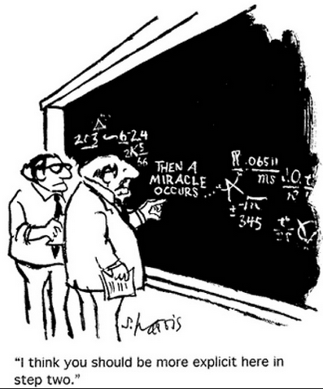
How do we match the mission to the activities?

Slide 26
Greenwashing claims now prosecuted
Source: r3.0 presentation (2022)
Notes:
The need for adequate measurement and reporting is growing. Several examples are rising of stakeholders no longer excepting green claims but wanting proof. Integrated report can be an answer for them.
The EU sees this potential as well.
Tip: update to recent and/or local examples.

Slide 27
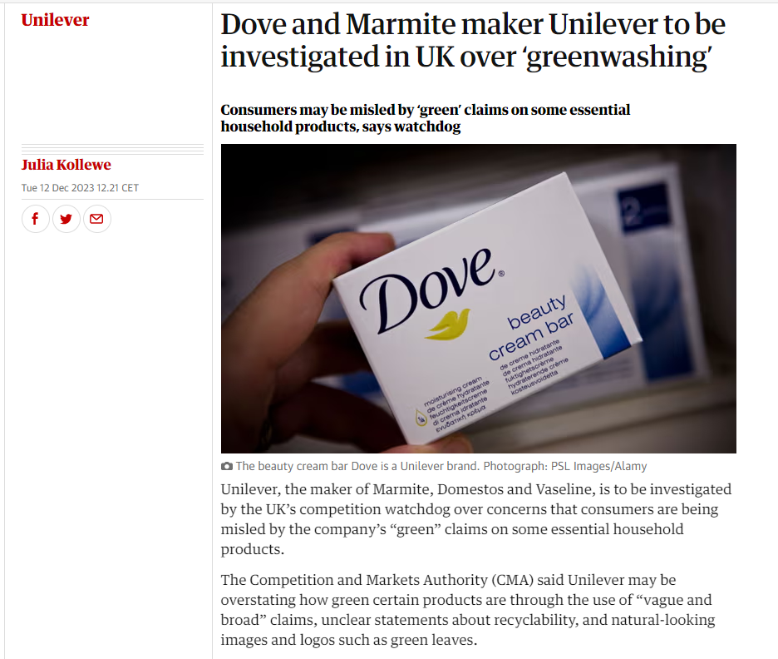
Notes:
https://www.theguardian.com/business/2023/dec/12/dove-marmite-unilever-investigated-uk-greenwashing

Slide 28
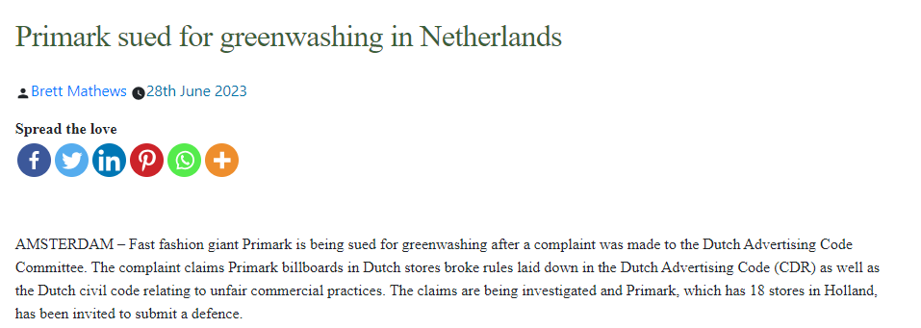
Notes:
https://apparelinsider.com/primark-sued-for-greenwashing-in-netherlands/

Slide 29
EU-Initiative on substantiating green claims
The European Green Deal states
“Companies making ‘green claims’ should substantiate these against a standard methodology to assess their impact on the environment”.
The 2020 Circular Economy action plan commits that
“the Commission will also propose that companies substantiate their environmental claims using Product and Organisation Environmental Footprint methods.”
It is important that claims on the environmental performance of companies and products are reliable, comparable and verifiable across the EU.
“
Today it is difficult for consumers, companies and other market actors to make sense of the many environmental labels and initiatives on the environmental performance of products and companies. There are more than 200 environmental labels active in the EU, and more than 450 active worldwide; there are more than 80 widely used reporting initiatives and methods for carbon emissions only. Some of these methods and initiatives are reliable, some not; they are variable in the issues they cover.
– EU website on the new initiave
Notes:
The EU has lanced their ‘Initiative on substantiating green claims’ - https://ec.europa.eu/environment/eussd/smgp/initiative_on_green_claims.htm
Next to this unclarity of labels, is another issue greenwashing – companies giving a false impression of their environmental impact or benefits. Greenwashing misleads market actors and does not give due advantage to those companies that are making the effort to green their products and activities. It ultimately leads to a less green economy.
It is important that claims on the environmental performance of companies and products are reliable, comparable and verifiable across the EU. Reliable environmental information would allow market actors – consumers, companies, investors – to take greener decisions.
This initiative has close links to other policies announced in the Circular Economy action plan:
the revision of EU consumer law to empower consumers for active participation in the green transition
a sustainable product policy initiative
the farm to fork strategy
AND – the Green Deal!
All these initiatives will seek to establish jointly a coherent policy framework to help the Union to make sustainable goods, services and business models the norm and to transform consumption patterns in a more sustainable direction. They aim to reduce significantly the environmental footprint of products consumed in the Union and contribute to the overall policy objective of EU climate neutrality by 2050.

Slide 30
Reporting on impact for businesses
There is not a mandatory standard for business
Many companies report on more than just their financial situation
According to EU legislation, from 2018 companies must also report non-financial information in their annual reports (NFRD/ from 2024 CSRD):
Notes:
First NFRD (Non-Financial Reporting Directive, >500 employees, certain level of turnover)
Converted to the CSRD (Corporate Social Reporting Directive, >250 employees, certain level of turnover)

Slide 31
EU LEGISLATION: FROM GREEN DEAL TO CSRD
GREEN DEAL
EU Sustainable Finance Action Plan
Plan to create a financial system that supports the goals of the EU Green Deal.
Sustainable Finance Disclosure Regulation (SFDR)
Directive that regulates the provision of information by financial market parties to their ultimate investors and asset owners.
EU Taxonomy
Classification system for ‘sustainable’ economic activities with the aim of scaling up in sustainable investments and preventing greenwashing.
Corporate Sustainability Reporting Directive (CSRD)
Directive that regulates information provision by companies.

Slide 32
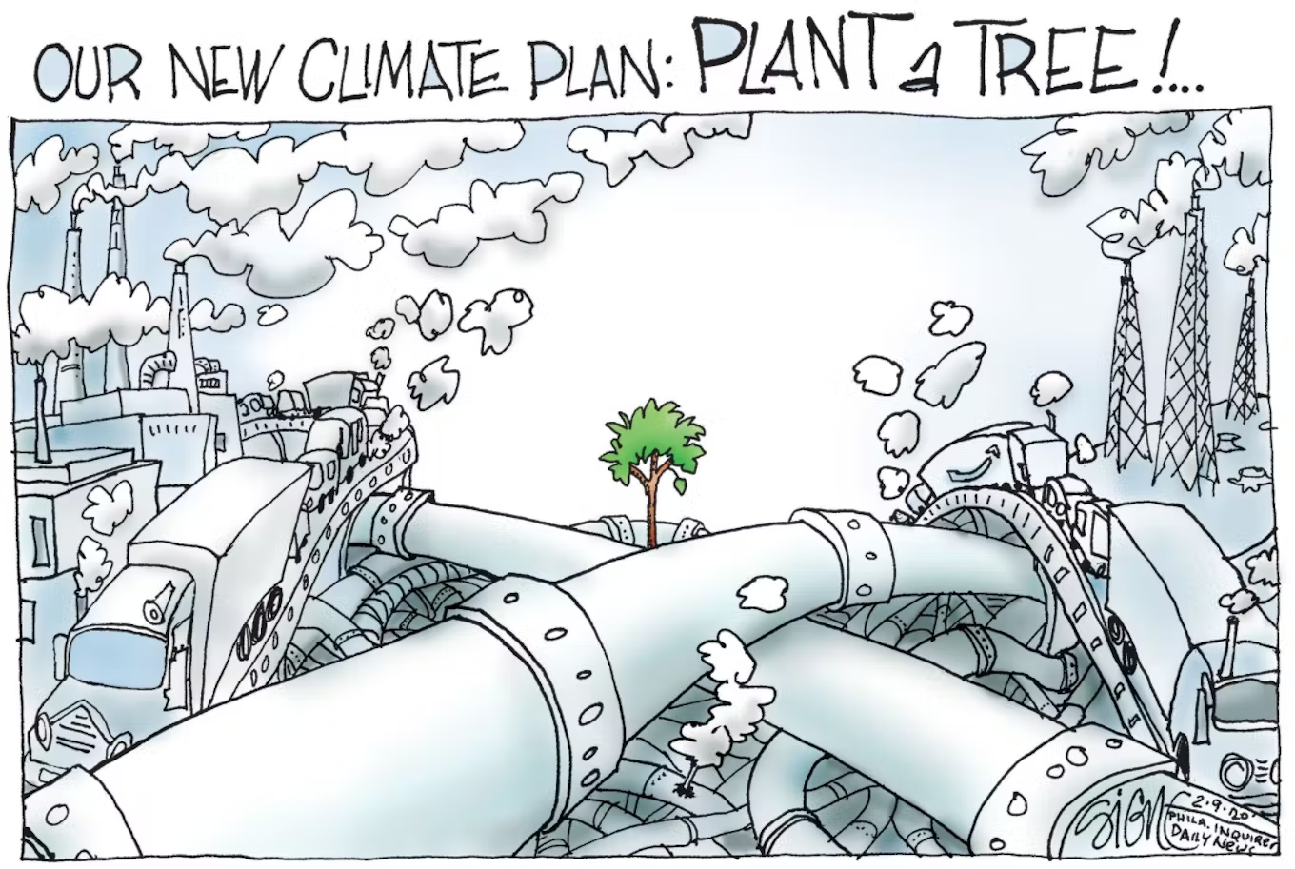
Can we believe what’s in the report?
Source: Philippine Daily Inquirer

Slide 33
Trends in reporting on non-financials
What should be reported on?
How should be reported?
Development:
Environmental aspects (environmental protection)
Social responsibility and treatment of employees
Respect for human rights
Anti-Corruption and Bribery
Diversity within the board and supervisory board (age, gender, professional background)
Separate report (including Global Reporting Initiative (GRI))
Separate Impact Report (including Framework for Impact statements (FIS))
Integrated Report (International Integrated Reporting Council (IIRC))
Report what matters? = impact
Report what’s mandated? = compliance
Capitals?
Materiality?
Notes:
Ask the group, which capitals do you see reflected? What should be reported on? → these elements reflect what is currently generally seen as material. However, it will depend on the specific guideline which is followed if for example the 6 capitals are obliged. And in addition, the thing about guideline is that it says WHAT you should report ABOUT, but not HOW you should do it or with specific (and comparable) indicators. So in general, if an organization works with the <IR> framework, they will use the 6 capitals. There are some effort to combine indicators to allow for better comparison and benchmarking, but currently none of the large frameworks are prescriptive in that sense.
What do they consider material that is not listed here?
How should be reported → this depends on the guideline that an organization follows. So there are different rules based on the different institutes. For example, GRI demands a separate report, whereas IIRC demands an integrated report.
FIS = from Impact Institute
Development:
From compliance to impact
From 'doing no harm' to 'doing good’
More attention to materiality.
HOWEVER, more legislation also means more compliance! If legislation fails to account for the things that are material and therefore account for the impact of an organization,

Slide 34
The age-old issue
Source: twitter.com/justinf3672
Notes:
For who do organisations write these report? Some are often very extensive.
Some frameworks, incl. the <IR> Framework try to create at least one-page with a visualization which can show the main points.

Slide 35
Assurance
Assurance = External, independent review to increase reliability
In Europe this is done in particular by the Big Four
EY, KPMG, Deloitte, PwC
In some countries, mainly outside of Europe this is done by
Certification institutes like DNV
No assurance, but critical co-reader:
External advisory panel (e.g. Shell)
Stakeholder groups
Assurance becomes mandatory in the CSRD
Many smaller organizations often have very limited assurance on reporting
Notes:
How truthful is the information I read?
“Assurance to a reasonable degree of certainty” – not found to contain incorrect information; only checks for false claims but not a comprehensive monitoring body.
In CSRD this is mandatory.
It seems that large firms also do assurance, such as Pwc, HSBC
DNV are more the certifying agencies instead of accountants who do assurance.
However, report review service offers:
SWOT of report
recommendations for improvement
but: no statement
no formal feedback consultation round

Slide 36
This material is dated 13-12-2023 and is licensed under Creative Commons ‘Attribution-NonCommercial-ShareAlike 4.0 International (CC BY-NC-SA 4.0)

