Slide 1
CONSCIOUS BUSINESS EDUCATION

Slide 2
Cross-cultural Management and Leadership
June 2023

Slide 3
Cross-cultural Management and Leadership
Seminar 8:
Conscious leadership in the cross-cultural workplace.
Ways of thinking and Ego.

Slide 4
A small reminder
What is the essence of Tony Fang's Yin Yang approach to national culture?

Slide 5
Duality
Duality presents another challenge to conscious leadership
Dualistic thinking assumes a universe where there are only two contrasting, mutually exclusive choices or realities
either/or, bad/ good, negative/positive …
Typical in western cultures
Source: Chamberlain, R. (2016). Conscious leadership in the workplace: A guidebook to making a difference one person at a time. Morgan James Publishing.

Slide 6
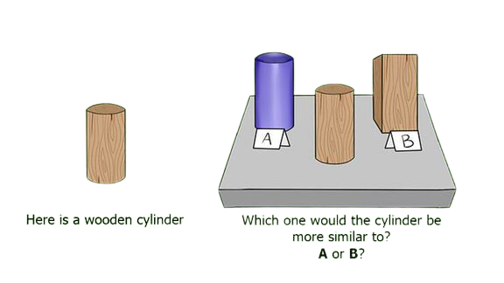
Source: West and east, cultural differences. Youtube (2012, December 5). https://www.youtube.com/watch?v=ZoDtoB9Abck

Slide 7
Dialectical thinking
Dialectical thought involves seeking a synthesis of two or more seemingly opposing viewpoints
It is both …. and way of thinking

Slide 8
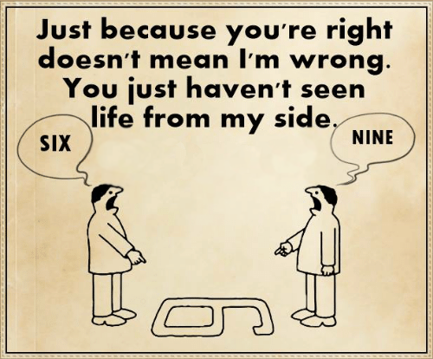
Source: Communication. (2018, August 24). Signs of Life. https://signsoflifeconz.wordpress.com/portfolio/communication/

Slide 9
Activity
What do you think are the pros and cons of dualistic and dialectical thinking?

Slide 10
Dualistic thinking encourages people to get territorial about their points of view
An inability to negotiate multiple possibilities can present obstacles to creating collaborative teams

Slide 11
Exercise 1 – Way of thinking
How can you tell if you tend to think in a dualistic or dialectical way?
How do you recognize duality at work in someone's thoughts?
Can you think of a situation that was influenced by dualistic thinking?
What happened, what was the outcome?
Would you recommend switching to a dialectical way of thinking? Why?
If so, what would you recommend to people to make it work?
What might be the outcome of the situation under consideration if it were handled dialectically?

Slide 12
Further practice
Both meditation and mindfulness can be useful tools that can help develop dialectic thinking
Some practices are available here https://ggia.berkeley.edu/#filters=mindfulness
Source: Greater good in action. (n.d.). Berkeley.edu. Retrieved August 16, 2022, from https://ggia.berkeley.edu/#filters=mindfulness

Slide 13
Healthy and Unhealthy Ego
Ego - a term that describes the sense of self that we have, a self that is separate from other people
Source: Chamberlain, R. (2016). Conscious leadership in the workplace: A guidebook to making a difference one person at a time. Morgan James Publishing.

Slide 14
Healthy Ego
A healthy ego is that which motivates us to develop and be authentic
It is able to understand and overcome fears
It is open to other's perspectives, ways, similarities, and differences
People realize that other perspectives exist beyond their own and do not feel threatened by them

Slide 15
Unhealthy Ego
An unhealthy ego (also little ego) is often ruled by fear
It is likely dualistic
It measures itself against others or situations
It contains negativity, unhealthy competition, and victimhood
It seeks to create a comfort zone around itself, setting up barriers to different perspectives or others

Slide 16
Leaders necessarily work in company with other people
When every member of a team has the opportunity to contribute their talent to the whole team and the entire organization, there is an elevated potential for greater success
An unhealthy ego can stand in the way of this success

Slide 17
Vicious Cycle in an atmosphere of fear and insecurity
Feeling devalued, uncertain, fear
Tension, nervousness
Impact on performance
Impact on ccommunication and relationships
Negative interaction
Source: Chamberlain, R. (2016). Conscious leadership in the workplace: A guidebook to making a difference one person at a time. Morgan James Publishing.

Slide 18
Exercise 2 – Meeting a healthy and an unhealthy ego
Think of a situation where you met a person who, in your opinion, had a healthy ego.
How did this healthy ego manifest itself, what did you learn from the situation?
Now think of a situation where you met a person who, in your opinion, had an unhealthy ego.
How did this unhealthy ego manifest itself, what did you learn from the situation?
Can the perception of one's ego be culturally biased?

Slide 19
Further pracitices
The development of a healthy ego is supported by growing self-awareness
Taking The VIA Survey of Character Strengths can help
https://www.viacharacter.org/
Use Your Strengths practice can help too
https://ggia.berkeley.edu/practice/use_your_strengths
Sources: VIA character strengths survey & character reports. (n.d.). Viacharacter.org. Retrieved August 16, 2022, from https://www.viacharacter.org/ (basic version for free)
Greater good in action. (n.d.). Berkeley.edu. Retrieved August 16, 2022, from https://ggia.berkeley.edu/practice/use_your_strengths

Slide 21
Sources:
Chamberlain, R. (2016). Conscious leadership in the workplace: A guidebook to making a difference one person at a time. Morgan James Publishing.
Communication. (2018, August 24). Signs of Life. https://signsoflifeconz.wordpress.com/portfolio/communication/
Greater good in action. (n.d.). Berkeley.edu. Retrieved August 16, 2022, from https://ggia.berkeley.edu/#filters=mindfulness
VIA character strengths survey & character reports. (n.d.). Viacharacter.org. Retrieved August 16, 2022, from https://www.viacharacter.org/
West and east, cultural differences. Youtube (2012, December 5). https://www.youtube.com/watch?v=ZoDtoB9Abck

