Slide 1



CONSCIOUS BUSINESS EDUCATION

Slide 2
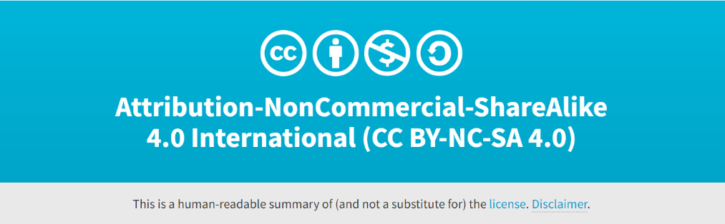
Cross-cultural Management and Leadership
June 2023

Slide 3
Cross-cultural Management and Leadership
Seminar 6:
Conscious leadership in the cross- cultural workplace.
Who are you, and what are your fears?

Slide 4
Consciousness
Consciousness is awareness, and awareness starts with our individual self
When we are aware, we can know that something (such as a situation, condition or problem) exists
We know and have a better understanding of what is happening in the world or around us
  We are more capable of effective decision-making and leadership
Source: Chamberlain, R. (2016). Conscious leadership in the workplace: A guidebook to making a difference one person at a time. Morgan James Publishing.

Slide 5
Conscious leaders are naturally inclusive and as a result, the organization benefits from the utilization of the rich and varied talents of the workforce
Each leader must do the work themselves to become more inclusive
  Leadership starts with ourselves

Slide 6
What qualities does a conscious leader have?
Discussion

Slide 7
What qualities does a conscious leader have?
  Appreciative of diversity
  Accessible / Approachable
  Beliefs are congruent with actions
  Clear
  Collaborative
  Compassionate
  Continual learners
  Courageous
  Curious
  Dependable
  Emotionally intelligent
  Empowering
  Focused
  Grateful
  Have integrity
  Have positive energy
  Honest
  Humility
  Inclusive
  Intuitive
  Intentional
  Learn from unintended outcomes
  Motivated
  Motivating
  Non-judgmental
  Open-minded
  Purposeful
  Self-aware
  Visionaries
  Willing to be vulnerable

Slide 8
Questions we need to ask ourselves if we want to develop self-awareness and consciousness
Am I clear about what I want?
  Are my actions congruent with my values and goals?
Do I learn from every outcome, whether I planned for it or not?
What is my intention and do I communicate it well, and am I moving forward with intent and commitment?
Do I understand the impact of my intention and actions?

Slide 9
Whether or not we are aware of the answers to these questions we broadcast this information about ourselves
The quality of our leadership shows up in the messages we broadcast
  It is better when we know ourselves

Slide 10
An important first step in self-awareness is that we need to recognize who and where we are in the present as a leader and as a person
Note: Are we all leaders?
  If nothing else, we need to lead ourselves

Slide 11
Exercise 1 – Who are You
It is helpful to discover, define and write down our goals and desired outcomes with respect to becoming self-aware, to see what it is we really want
Recognize who and where you are in the present, what your goal is.
  If you are not sure about your goal, try the Magic wand practice here: https://ggia.berkeley.edu/practice/magic_wand
Do you give the best toward your goal? If not, why?
What price are you willing to pay to achieve your desired goal?
Can you see some cross-cultural context in your goals and their possible achievement?
Source:
Chamberlain, R. (2016). Conscious leadership in the workplace: A guidebook to making a difference one person at a time. Morgan James Publishing.
Bronk, K. C. (n.d.). Magic wand. Berkeley.edu. Retrieved August 13, 2022, from https://ggia.berkeley.edu/practice/magic_wand

Slide 12
On a scale of 1-10, rate yourself with regard to your level of commitment to give your best to achieve your goal.
  If you are not at a 10, what would it take to move up the scale? What is one action you can take to move forward in that direction?

Slide 13
One element that could be keeping us from moving forward: Fear
Acting courageously requires an understanding of our anxieties
Fear can manifest itself in many ways: feeling vulnerable, uncertain, anxious…
  It shows up in various times, places and elements of life
We need to understand what our fears are and how we can transform them into success
Note: We are talking only about a conditioned response to a non-life threatening trigger!

Slide 14
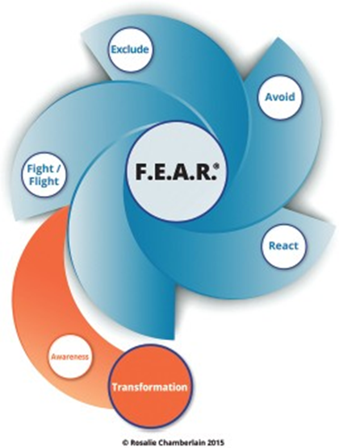
The victious cycle of fear
F – We are in Fight or Flight mode; we become defended and often defensive.
E – We Exclude; we can become isolated and separated from others and even ourselves.
A – We Avoid; we avoid seeing other perspectives or looking deeper into cause and effect.
R – We React; we react from our emotions, sometimes focusing on the past or a perceived future.

Slide 15
Transforming Fear
It is helpful to start asking questions about each of the components of F.E.A.R.©:
  F - Who and why do I want to fight or flight; how am I defended and what am I defending against?
  E - Who am I excluding and how am I isolating and separating from others and from myself?
  A - What are my beliefs and perceptions and what other ways of viewing a situation or person am I avoiding?
  R - What are my emotional reactions and where are they coming from within my experience?
Is there something culture-specific in your fears? Are there some beliefs or assumptions in your (or other) culture that relate to your fears, whether it is in a positive or negative way?

Slide 16
Exercise 2 - Overcoming fear
Think of a time when you were successful in moving through fear because you were confident in your abilities in that situation. Then, uncertainty or fear began tugging at you because the situation may have become more challenging or more of a risk. Remember how you moved right through the fear because your confidence and certainty kicked in.
  How did you step outside the F.E.A.R.© cycle?
  What questions did you ask yourself? Or, what statements did you tell yourself?
  What conclusions did you reach that allowed you to move forward?
  What awareness from that situation that helped you through the challenge can be available for future challenges?

Slide 17
To control our fears, we can also try Overcoming a Fear practice: https://ggia.berkeley.edu/practice/overcoming_a_fear
Source: Overcoming a Fear. Berkeley.edu. Retrieved August 13, 2022, from https://ggia.berkeley.edu/practice/ overcoming_a_fear

Slide 19
Sources:
Chamberlain, R. (2016). Conscious leadership in the workplace: A guidebook to making a difference one person at a time. Morgan James Publishing.
Bronk, K. C. (n.d.). Magic wand. Berkeley.edu. Retrieved August 13, 2022, from https://ggia.berkeley.edu/practice/magic_wand
Overcoming a Fear. Berkeley.edu. Retrieved August 13, 2022, from https://ggia.berkeley.edu/practice/ overcoming_a_fear

