Slide 1



CONSCIOUS BUSINESS EDUCATION

Slide 2
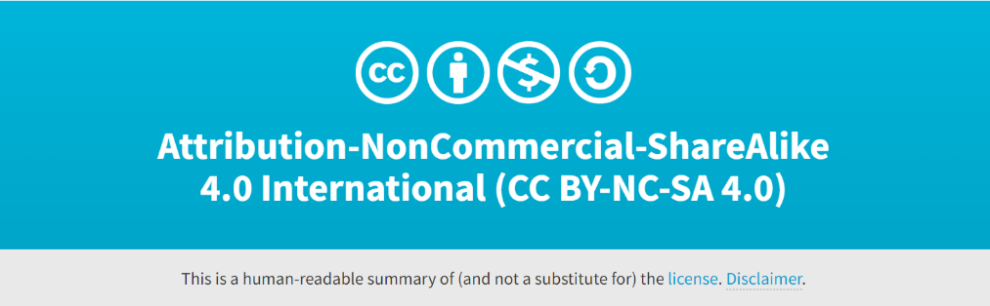
Cross-cultural Management and Leadership
June 2023

Slide 3
Cross-cultural Management and Leadership
Seminar 5: Diversity in global virtual teams (GVT)

Slide 4
Virtual team
A group of geographically, organizationally, and time dispersed workers brought together by information and telecommunication technologies to accomplish organizational tasks
Increase in virtual work as a result of the COVID-19 pandemic
Source: Sachdeva, R. (2021). Becoming Virtually Skilled: All About Working in Cross-Cultural Virtual Teams. In Birdie, A. K. (Ed.). Cross-Cultural Exposure and Connections (pp. 189-223). Apple Academic Press.

Slide 5
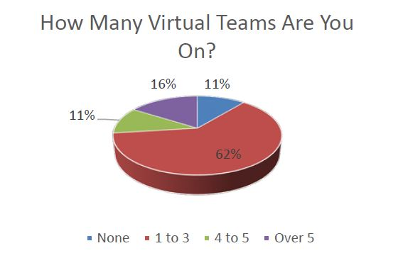
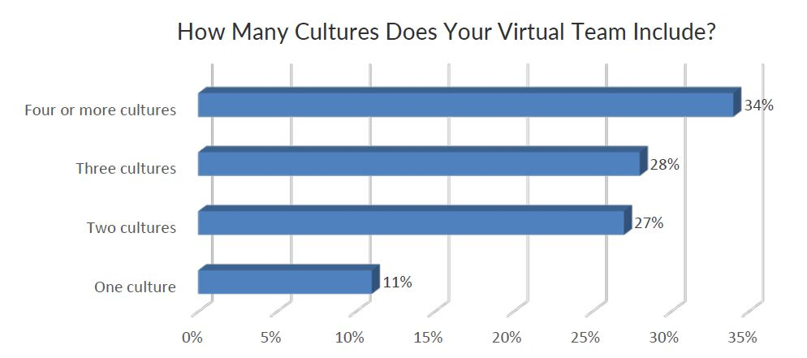
Global, i.e. cross-cultural, virtual teams are omnipresent
Source: 2018 Trends in High-Performing Global Virtual Teams. (2019). RW3 Culture Wizzard. https://content.ebulletins.com/hubfs/C1/Culture Wizard/LL-2018 Trends in Global VTs Draft 12 and a half.pdf
1,620 respondents from 90 countries

Slide 6
Activity
What do you think are the biggest challenges when working in cross-cultural virtual teams?
  What could be their causes?

Slide 7
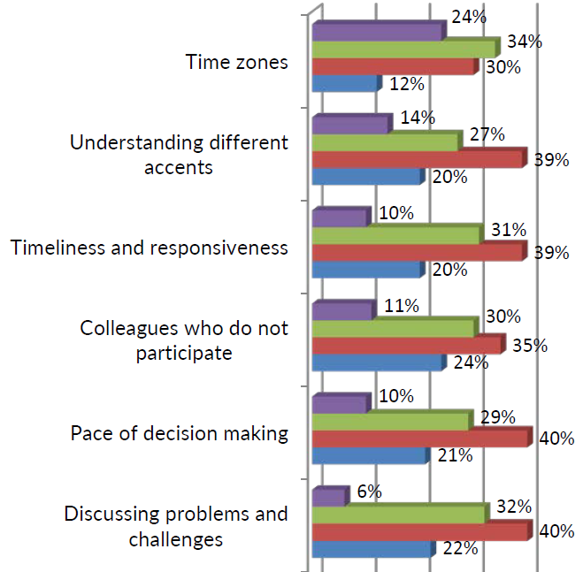
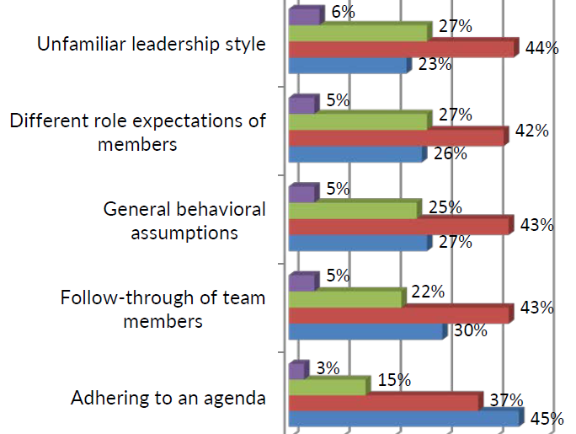
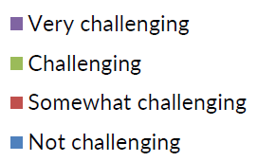
The Severity of Cultural Challenges for Virtual Teams

Slide 8
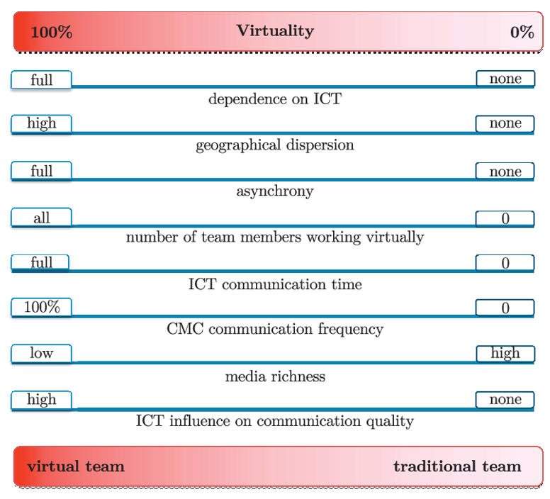
Traditional (on-site) and virtual team
Source: Krawczyk-Bryłka, B. (2017). Comparative study of traditional and virtual teams. TASK Quarterly, 21(3), 233-245.

Slide 9
Activity
What do you consider to be the (biggest) advantages and disadvantages of virtual teams?

Slide 10
Advantages of virtual teams
Cost savings
Leverage global talent
Fast responsiveness
High productivity
…

Slide 11
Disadvantages of virtual teams
Costs of technology
Trust levels between team members
Social isolation
Computer security

Slide 12
Activity
In your opinion, what are the (main) causes of virtual team failures?

Slide 13
Causes of virtual team failures
Interconnectedness of causes and consequences
  No acknowledgement of virtual team specifics (comparing to on-site teams)
  Role and process ambiguity – the members lack a clear understanding of their tasks and roles
  Ineffective leadership – leaders are not trained to lead a virtual team
  Lack of trust between team members – due to limited communication (comparing to on-site teams)
  Poor team engagement
  Absence of effective communication

Slide 14
The most important cross-cultural factors of virtual teams
Languague
Context
Time
Power distance in management
Information and knowledge flow

Slide 15
Language
Language usage differs across cultures
  E.g. the same words are interpreted differently in different cultures

Slide 16
Context
Problems in communication between team members from cultures with high-context and low-context communication

Slide 17
Time
The perception of time differs in different cultures - cf. polychronic and monochronic cultures

Slide 18
Power distance in management
Different approaches of team leaders and expectations of team members from cultures with high and low power distance indexs

Slide 19
Information flow and knowledge sharing
Different cultures have different approaches to information flow and knowledge sharing

Slide 20
Features of high-performing virtual teams
Sachdeva, R. (2021). Becoming Virtually Skilled: All About Working in Cross-Cultural Virtual Teams. In Birdie, A. K. (Ed.). Cross-Cultural Exposure and Connections (pp. 189-223). Apple Academic Press.

Slide 21
Critical success factors for cross-cultural virtual teams
Before and at the beginning of the teamwork
During the teamwork
At the organizational level

Slide 22
Before and at the beginning of the teamwork
Proper selection of team members and team leader
A good team leader - professional and personal qualities, experience
Training of team members and team leaders, including cross-cultural training
Opportunity for the team to meet in person or at least meet informally virtually
Clearly stated team purpose and goal
Clearly defined roles for team members

Slide 23
During the teamwork
Providing feedback to keep members motivated and engaged
Fostering trust and social connections

Slide 24
At the organizational level
Quality functional technology
Support from senior management
Quality HRM - performance appraisal, rewards, staff development, grooming, motivation...
Integration of VT into the structure of the organization, equal access to virtual and on-site staff (e.g. in terms of professional development opportunities)

Slide 25
Further reading
Remote management. https://remote.co/category/remote-management

Slide 27
Sources:
2018 Trends in High-Performing Global Virtual Teams. (2019). RW3 Culture Wizzard. https://content.ebulletins.com/hubfs/C1/Culture Wizard/LL-2018 Trends in Global VTs Draft 12 and a half.pdf.
Birdie, A. K. (Ed.). (2021). Cross-cultural exposure and connections: Intercultural learning for global citizenship. Apple Academic Press.
Krawczyk-Bryłka, B. (2017). Comparative study of traditional and virtual teams. TASK Quarterly, 21(3), 233-245.
Remote management. (n.d.). Remote.Co. Retrieved August 12, 2022, from https://remote.co/category/remote-management.
Sachdeva, R. (2021). Becoming Virtually Skilled: All About Working in Cross-Cultural Virtual Teams. In Birdie, A. K. (Ed.). Cross-Cultural Exposure and Connections (pp. 189-223). Apple Academic Press.

