Slide 2
Conscious Leadership
Module 3, Seminar 1: Stakeholder Theory & Relationship Building

Slide 3
Centering Moment of Mindfulness
Photo credit: Dorianne Cotter-Lockard
Notes:
If the instructor is not trained in mindfulness practices, the following two apps provide “how to” videos and guided meditations:
https://insighttimer.com/
https://www.headspace.com/
Alternatively, choose one of these simple mindfulness practices (each takes less than 3 minutes):
Breathing
Invite students to breath in for 4 counts, hold 4 counts, breath out 4 counts, and hold 4 counts. Count slowly to guide the process. Repeat the cycle 2 – 3 times.
Listening in Silence
Invite students to sit in silence listen to the sounds around them. If there is a clock ticking in the room, they can focus on that first. After 30 seconds invite them to listen to the sounds outside the room. After an additional 30 seconds invite them to listen to the sounds of their breathing or other sounds within their bodies. Finally invite them to be open to hearing all sounds within and around them.

Slide 4
Class Shared Values
Add the shared values with their definitions here – revisit each class session. Example:
Respectful Communication
To be free to speak honestly AND be heard without judgment & with receptivity, to be mindful & respectful of ALL

Slide 5
Conscious Leadership Agenda Module 3, Seminar 1: Stakeholder Theory & Relationship Building
Relational Awareness & Mirroring
Workshop: Emotional Intelligence & Empathy

Slide 6
Relational Awareness & Interpersonal connection
Mirroring Theatre Exercise
The Mirror Game by Laughter for a Change Published on YouTube May 30, 2013. Laughter for a Change (nonprofit) - YouTube
Notes:
This video clip comes from public domain Youtube.
It illustrates a mirroring technique from improvisational theater.
[Play the clip]
The objective is to focus students on relating to one another’s leadership and to trust it.
Introduce the concepts of initiating and reflecting vs. leading and following. Initiating and reflecting imply equality and mutual action between partners, whereas leading and following imply dominance and subservience.

Slide 7
Relational Awareness & Interpersonal connection
Mirroring Activity
Decide who is “A” and who is “B”
Follow instructor’s guidance regarding who is initiating and who is reflecting.
Asher, W. (Writer). (1955). Harpo Marx [Television]. In D. Productions (Producer), I Love Lucy. USA: Columbia Broadcasting System (CBS).
Notes:
Ask students to get into pairs. Ask them to decide who is “A” and who is “B”
Invite students to initiate and reflect each other’s energy, as illustrated in the video.
Instructor calls out “A initiate and B reflects” and after 30 seconds or so, “B initiate and A reflects.” Repeat the process 1 – 2 times more, then invite them to both initiate and reflect at the same time.
Debrief:
Ask students what they noticed. What was easy or hard about initiating? What was easy or hard about reflecting? What was easy or hard when both initiated at the same time?
Potential conclusions: this process requires focused attention and awareness.
Virtual Alternative Facilitation – Pairs in breakout rooms:
2 minutes – mirror facial expressions – take turns initiating and responding
Pause. Take a breath.
3 minutes – mirror body movements, facial expressions, add sounds - take turns initiating and responding

Slide 8
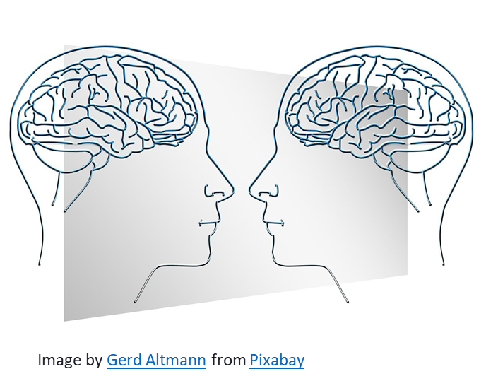
Mirroring: Face-to-Face Interactions Stimulate Similar Neural Resonances in Both Brains
Thus, your internal emotional state will be reflected in the other person’s brain …What you “give” is what you’ll receive!
Schulte-Rüther, M., Markowitsch, H. J., Fink, G. R., Piefke, M. (2007). Mirror neuron and theory of mind mechanisms involved in face-to-face interactions: a functional magnetic resonance imaging approach to empathy. Journal of Cognitive Neuroscience, 19(8),1354-72.
Notes:
Mirror Neuron research - preliminary studies suggest that generalized parts of the brain exhibit mirror-like activity when people interact with each other –
Unconscious calibration to each other:
Blood pressure, heart rate, respiration, body temperature (entrainment)
Facial expressions
Happy moods, and especially LAUGHTER are the most contagious

Slide 9
Trees communicate by releasing phytohormones
Photo by D. Cotter-Lockard at le Jardin Botanique, Parc Tête d’Or in Lyon, France, January 2021
Notes:
More recent studies show that trees and plants communicate via phytohormones.

Slide 10
EQ and Other-Awareness
This Photo by Unknown Author is licensed under CC BY-NC-SA
This Photo by Unknown Author is licensed under CC BY-SA
Notes:
Ideally students will continue with the same partner with whom they participated in the mirroring exercise. ​​

Slide 11
Safety and Confidentiality
Keep
Keep other’s sharing confidential
Respect
Respect different perspectives
Offer
Offer support, do not give advice unless permission is given
Notes:
Ideally students will continue with the same partner with whom they participated in the mirroring exercise. ​​
Remind everyone of the ground-rules for safety and confidentiality when sharing these reflections. ​​
Read them, and ask for everyone’s agreement to these ground-rules.​

Slide 12
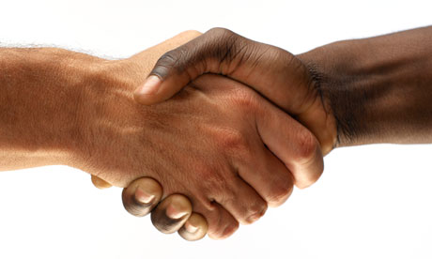
Other-Awareness & Empathy
PEER COACHING
Use Feelings & Needs Inventory Handout
Activity
7 minutes each person
Person A, tell a story that is emotional for you in some way…do not name the emotion
Person B, Listens, plays back what they heard, and then tries to name the emotion(s) until A agrees (see list)
Person A Writes down their emotions
Switch Partners and repeat the 3 steps
You will have 7 minutes each to tell your story and identify the emotions. The instructor will let you know when it’s time to switch. Stop when complete.
This Photo by Unknown Author is licensed under CC BY-SA-NC
Notes:
Introduce the activity:
In pairs, you will engage in a peer coaching activity to develop other-awareness and empathy.
Everyone has the handout (printed or electronic), “Feelings and Needs Handout” located in the Toolbox
Review the contents with students: Page 1 lists feelings when your needs are satisfied, Page 2 feelings when your needs are not satisfied, and Page 3 lists underlying needs. For this first activity, you will use pages 1 & 2 of the handout.
Explain the process by reading the slide.
Person A, tell a story that is emotional for you in some way…do not name the emotion. The story can be a joyful story or one the reflects sadness. anger, or multiple emotions. It’s important to tell the story but DO NOT name the emotions. The goal is for your partner to practice empathy in being able to identify the emotions.
Person B, Listens, plays back what they heard, and then tries to name the emotion(s) until A agrees (see list I handout)
Person A Writes down their emotions
Switch Partners and repeat the 3 steps

Slide 13
Other-Awareness & Empathy
PEER COACHING DEBRIEF
Notes:
Debrief
Without revealing anything about the story your partner told you, how easy or hard was it for you to identify their emotions?
What did you learn about yourself regarding your empathy skills?

Slide 14
Other-Awareness & Empathy
PEER COACHING
Use Feelings & Needs Inventory Handout
Activity
7 minutes each person
Focus on person A - look at the list of emotions from A’s prior story and the list of needs in the handout
B asks questions to help A identify the needs expressed in the story until A agrees that the needs have been identified
A Writes down the needs related to their emotions
Switch Partners and repeat the 3 steps
You will have 7 minutes each to identify the needs beneath the emotions. The instructor will let you know when it’s time to switch. Stop when complete.
This Photo by Unknown Author is licensed under CC BY-SA-NC
Notes:
Introduce the second part of the activity:
In the same pairs, using the handout, page 3, underlying needs.
You will stay with the same stories you told each other before.
This time you will go deeper to determine the needs underneath the feelings. These will either be needs that were met or needs that were not met.
Focus on person A - look at the list of emotions from A’s prior story and the list of needs in the handout
B asks questions to help A identify the needs expressed in the story until A agrees that the needs have been identified (this is the peer coaching)
A Writes down the needs related to their emotions
Switch Partners and repeat the 3 steps

Slide 15
Other-Awareness & Empathy
PEER COACHING DEBRIEF
Notes:
Debrief
Without revealing anything about the story your partner told you, how easy or hard was it for you to identify the needs underneath the emotions for either your story or your partner’s story?
What did you learn about yourself regarding your empathy skills?

Slide 16
Class Shared Values Reflection
Add the shared values with their definitions here – revisit each class session. Example:
Respectful Communication
To be free to speak honestly AND be heard without judgment & with receptivity, to be mindful & respectful of ALL
Notes:
Invite the class to reflect on which values they expressed themselves and that they observed others demonstrated in today's class (3-4 minutes in their journal or notebook).
Facilitate plenary sharing of a few examples from the reflection.

Slide 17
Homework (Continue): Mindfulness Practice
Continue regular practice and personal reflection of a daily mindfulness exercise oriented to cultivate greater awareness. Write notes in your journal regarding insights and experiences related to your daily mindfulness practice.
See Hougaard and Carter (2018), Training for Mindful Awareness, Chapter 2 - Understand Yourself, p. 54; and Training for Mindful Focus, Chapter 3 - Mindfully Lead Yourself, p. 73 for further guidance.

