Slide 2
Conscious Leadership
Module 1, Seminar 1: Foundations of Conscious Leadership

Slide 3
Centering Moment of Mindfulness
Photo credit: Dorianne Cotter-Lockard
Notes:
If the instructor is not trained in mindfulness practices, the following two apps provide “how to” videos and guided meditations:
https://insighttimer.com/
https://www.headspace.com/
Alternatively, choose one of these simple mindfulness practices (each takes less than 3 minutes):
Breathing
Invite students to breath in for 4 counts, hold 4 counts, breath out 4 counts, and hold 4 counts. Count slowly to guide the process. Repeat the cycle 2 – 3 times.
Listening in Silence
Invite students to sit in silence listen to the sounds around them. If there is a clock ticking in the room, they can focus on that first. After 30 seconds invite them to listen to the sounds outside the room. After an additional 30 seconds invite them to listen to the sounds of their breathing or other sounds within their bodies. Finally invite them to be open to hearing all sounds within and around them.

Slide 4
Conscious Leadership
“A new type of leadership is emerging. It turns the current business leadership paradigm of fear-based motivation on its head, creating a dynamic approach that is more purposeful, compassionate and humane.”
Olafsson, Allenby, & Tuck (2022). Beyond Ego - The Inner Compass of Conscious Leadership.

Slide 5
Modules
Foundations of Conscious Leadership
Leadership Models & Self-Mastery
Stakeholder Theory & Relationship-building
Leadership Presence & Conscious Action
1
2
3
4

Slide 6
Conscious Leadership Agenda Module 1, Seminar 1: Foundations of Conscious Leadership
Set Ground Rules for Respectful Class Participation
Concepts: Leadership, Consciousness, Conscious Business, Conscious Leadership
4 Tenets of Conscious Business
Conscious Leadership Principles

Slide 7
Setting Ground Rules for Respectful Class Participation
Confidentiality – we keep confidential the sharing of others in the class.
Attention – we bring our whole self to the time together in class. Tablets with a pen can be used for notes. Other electronic devices are not permitted as they inevitably distract and do not allow for an inner journey.
Authenticity – we bring our whole selves to this class
What else will ensure a respectful, safe environment for learning and sharing?
Notes:
Ask the class to agree to the first three in the list by nodding their heads or other form of showing agreement.
Invite students to add to this list. (Hopefully there will be a few of the following: no cell phones, do not interrupt when others speak, etc.)

Slide 8
Leadership
“Leadership is relational and embodied through one or more individuals who step into the space to encourage adaptability, collaboration, sustainability, and goal fulfillment within a group or organization.” ~ Dorianne Cotter-Lockard, PhD
Definition was derived from:
Cotter-Lockard, D. & Fortune, L. (2022). Syllabus: MBM5523 – Theories & Applications of Mindful Leadership. Saybrook University, College of Integrative Medicine and Health Sciences, Department of Mind Body Medicine.
Fortune, L. (2021). Syllabus: MBM5521 – Reflective Leadership. Saybrook University, College of Integrative Medicine and Health Sciences, Department of Mind Body Medicine.
Fortune, L. & Jamieson, K. (2022). Syllabus: MBM5521 – Reflective Leadership. Saybrook University, College of Integrative Medicine and Health Sciences, Department of Mind Body Medicine.
Goleman, D. (1998). What Makes a Leader? Harvard Business Review, Best of HBR 1998.
Wasylkiw, L., Holton, J., Azar, R., & Cook, W. (2015). The impact of mindfulness on leadership effectiveness in a health care setting: A pilot study. Journal of Health Organization and Management, 29(7), 893-911.
This Photo by Unknown Author is licensed under CC BY

Slide 9
Consciousness
What does it mean to be conscious?
To be conscious means to be aware of our inner and outer worlds, to be fully awake.
It includes self-reflection on one’s own beliefs, emotions, motives, values, goals and impact.
Consciousness also includes the capacity for abstraction which allows humans to manage complexity.
This Photo by Unknown Author is licensed under CC BY-NC
Key Source:
Kofman, F. (2008). Conscious business: How to build value through values (Vol. 1). ReadHowYouWant. Com.
Notes:
Selected quotes that might be useful for the discussion.
“This age of consciousness is not pushing us merely to indulge in new spiritual theories or play thought games that unite physics with Zen Buddhism. We are meant to move toward self-discovery and spiritual maturity, to be ready and able to live a life that matters to us and to those around us.” ~ Caroline Myss
"When consciousness is confronted by all that is not conscious, it is enlarged." ~ James Hollis, Jungian analyst
"Remain always true to yourself, but move ever-upward toward greater consciousness and greater love." ~ Teilhard de Chardin
“There is almost a sensual longing for communion with others who have a large vision. The immense fulfillment of the friendship between those engaged in furthering the evolution of consciousness has a quality impossible to describe.” ~ Pierre Teilhard de Chardin

Slide 10
Consciousness
Activity:
In small groups, answer the following questions to share with the larger group.
How does this definition of consciousness align with your idea of what it means to be conscious?
What are some of the indicators that human consciousness is evolving and rising around the world?
To be conscious means to be aware of our inner and outer worlds, to be fully awake.
It includes self-reflection on one’s own beliefs, emotions, motives, values, goals and impact.
Consciousness also includes the capacity for abstraction which allows humans to manage complexity.
Notes:
Give students 15 minutes to discuss the first question and brainstorm a list of indicators that human conscious is evolving around the world.
When they return, ask each group to present their list of indicators. Through class discussion, discover similarities and differences.
Indicators of rising consciousness:
Elimination of slavery
Equal rights regardless of gender, sexual orientation, race, religion, etc.
Declining violence
End of colonialism
Changing value systems
Article for reference on the definition of Consciousness:
Van Gulick, Robert, "Consciousness", The Stanford Encyclopedia of Philosophy (Winter 2022 Edition), Edward N. Zalta & Uri Nodelman (eds.) https://plato.stanford.edu/entries/consciousness/
From: https://www.merriam-webster.com/dictionary/consciousness
1:
the quality or state of being aware especially of something within oneself
the state or fact of being conscious of an external object, state, or fact
AWARENESSespecially : concern for some social or political causeThe organization aims to raise the political consciousness of teenagers.
2: the state of being characterized by sensation, emotion, volition, and thought : MIND
3: the totality of conscious states of an individual
4: the normal state of conscious liferegained consciousness
5: the upper level of mental life of which the person is aware as contrasted with unconscious processes

Slide 11
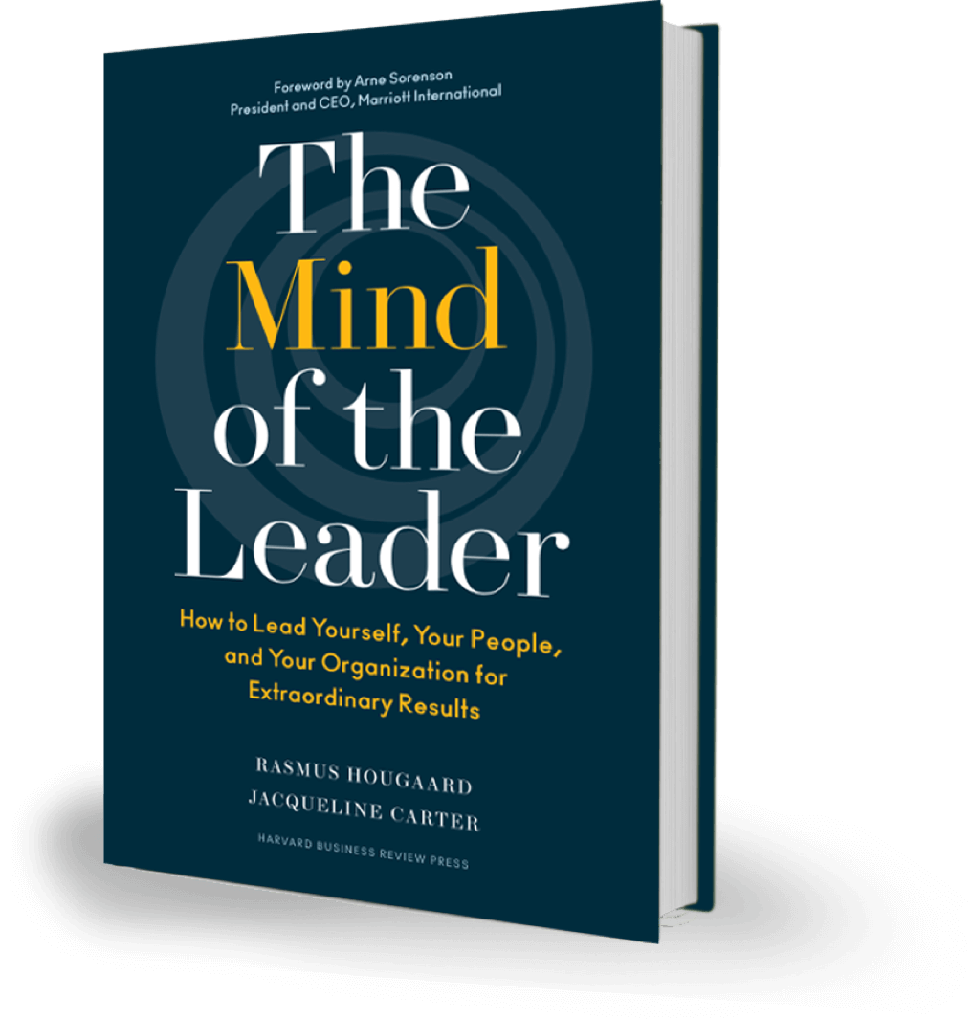
Conscious “MSC” Leadership
“Based on research, we have conclusively found that three mental qualities stand out as being foundational for leaders today: mindfulness (M), selflessness (S), and compassion (C) Together, we call these foundational skills MSC leadership.”
Hougaard, R., & Carter, J. (2018). The mind of the leader: How to lead yourself, your people, and your organization for extraordinary results.

Slide 12
Definition of Conscious Business
In the context of "conscious business," being conscious generally refers to an approach to business that takes into consideration the direct and indirect impacts of business practices on all stakeholders, including employees, customers, the environment, and society at large.
Being conscious in the context of conscious business also involves cultivating a culture of mindfulness and awareness among employees, promoting collaboration and empathy, and encouraging personal and professional growth and development.
Ultimately, conscious business aims to create a more equitable, resilient and flourishing world by using the power and resources of business to contribute to the greater good.
Key Source:
Kofman, F. (2008). Conscious business: How to build value through values (Vol. 1). ReadHowYouWant. Com.

Slide 13
The Four Tenets of Conscious Business
Based on Conscious Capitalism Principles

Slide 14
The Four Tenets of Conscious Business
Interconnected and mutually reinforcing
Foundational, not tactics or strategies
Represent the essential elements of an integrated business philosophy that must be understood holistically to be effectively manifested
Stakeholder integration
Conscious leadership
Higher purpose
Conscious culture and management
Source: Mackey, Sisodia (2013)
Notes:
Teaching note
Explain the „Four Tenets of Conscious Business“ and put a focus on the three bullet points.
Input for the explanation:
Higher purpose: Conscious Business emphasizes the importance of having a higher purpose beyond profit, such as making a positive impact on society or the environment.
Stakeholder orientation: Conscious Business recognizes that businesses have a responsibility to all stakeholders, not just shareholders. This includes employees, customers, suppliers, the environment, the broader community, and more.
Conscious leadership: Conscious Business requires leaders who are committed to the higher purpose and who prioritize the well-being of all stakeholders.
Conscious culture: Conscious Business emphasizes the importance of creating a culture of trust, transparency, and accountability.
For a detailed background about Raj Sisodia‘s introduction to Conscious Capitalism listen to the „Conscious Capitalists“ episode1 #1 Part 1 https://www.theconsciouscapitalists.com/podcast/episode/49e16fa6/episode-1-introducing-the-conscious-capitalists-podcast
Students can listen to this episode as homework.

Slide 15
Higher Purpose, Vision and Mission
What matters
What we aspire to
What drives us
What guides us
IMPACT
Vision
What?
How?
Why?
Mission
Purpose
Identity / Values
Notes:
Teaching note
Strategy / tactics vs. purpose: long term (!) success (=purpose)
For a detailed background about Raj Sisodia‘s introduction to the concept of Higher Purpose listen to the „Conscious Capitalists“ episodes #2 and #3 Part 1 https://www.theconsciouscapitalists.com/podcast/episode/4d47c29f/episode-2-purpose-at-work Part 2 https://www.theconsciouscapitalists.com/podcast/episode/4b665b5c/episode-3-purpose-at-work-part-2
Students can listen to these two episodes as homework.

Slide 16
Benefits and concerns of “Conscious Capitalism”
Possible Benefits (selection)
Possible Concerns (selection)
Enhanced reputation
Greater employee engagement
Improved customer loyalty
Increased innovation and creativity
Increased resilience due higher openness for innovation
Consideration of long-term impacts
Better risk management due to stakeholder orientation (e.g. external shock due to climate change in the long term)
Enhanced employee well-being
Implementation challenges
Lack of clarity due to holistic approach
Perceived hypocrisy (if done wrong #purposewashing)
Leadership mindset which assumes decreasing profitability
Lack of accountability due to missing clear metrics
Complex stakeholder management
Resistance to change among stakeholders
Notes:
Conscious Capitalism can be equated to Conscious Business – same benefits and concerns

Slide 17
Conscious Leaders are SELFLESS (Raj Sisodia)
Strength
Energy and enthusiasm
Spiritual intelligence
Long-term orientation
System intelligence
Flexibility
Emotional intelligence
Love and care
Notes:
Teaching note
For a detailed background about Raj Sisodia‘s suggestion of a SELFLESS leader listen to the „Conscious Capitalists“ episodes #8 and #9 Part 1: https://www.theconsciouscapitalists.com/podcast/episode/4a43ad8e/episode-8-conscious-leadership-part-1 Part 2: https://www.theconsciouscapitalists.com/podcast/episode/4c75a950/episode-9-conscious-leadership-part-2
Students can listen to these two episodes as homework.

Slide 18
Relating Conscious Leadership to the Other Three Tenets of Conscious Business
Higher Purpose
Stakeholder Integration (orientation)
Conscious Culture
How does each tenet relate to conscious leadership?
Can you have conscious business if you have conscious leadership without the other three tenets?
Notes:
Class discussion facilitated by instructor
If students are not relating to organisations or business, you can use more relevant examples for undergrads such as sports clubs, orchestra, choir, band, church, etc.
How does each tenet relate to conscious leadership?
Conscious leaders know how to clearly envision and communicate a higher purpose to the organisation. The organisation's activities, strategies, and goals all align with the higher purpose. In other words, the purpose statement isn't just something you see posted on the wall or website. It is woven into every aspect of the organisations policies, procedures, and actions. Leaders must demonstrate that their decisions and actions are aligned with the higher purpose.
Conscious leaders’ conversations and decisions take into consideration the impacts to all stakeholders, not just shareholders and executive management.
Conscious leaders endeavor to create a conscious culture within the organisation. In a conscious culture, shared values are practiced – people throughout the organisation walk their talk, ethical practices are woven into business activities, and there is open communication and trust - people can be authentically themselves.
Can you have conscious business if you have conscious leadership without the other three tenets?
The answer is “no.”
Conscious leaders are authentic, transparent, and humble. They seek to develop and grow everyone within the organisation, including themselves. Conscious leaders encourage open, multi-directional communication throughout the organisation.
Encourage students to think of examples where one of the other three tenets is missing.

Slide 19
Conscious Leadership
Self-awareness & self-mastery
Integrated awareness of others
Presence & mindful action
Principles:
Self-awareness & Self-mastery
Integrated Awareness of Others (all stakeholders)
Presence & Mindful Action
Notes:
We will refer to these three basic principles of Conscious Leadership throughout the course. Note the overlap between principles in the Venn diagram, because many of the aspects included in each principle could belong to one of the other principles.
Question for class discussion: Why are these three principles important to being a conscious leader?
Self-awareness & self-mastery
Emotional and social intelligence
Mindfulness
Inner compass
Complexity awareness
Sensemaking
Perspective
Authenticity & integrity
Integrated awareness of others (all stakeholders)
Empathy & compassion
Appreciation
Connectedness
Humility
Trust
Co-creation skills
Presence & mindful action
Presence
Long-term orientation & visioning
Courage
Creativity
Optimism
Perseverance

