Slide 1


Slide 2






CONSCIOUS BUSINESS CURRICULUM
 | Business Strategy & Entrepreneurship | Operations & Marketing | Finance & Value Management | Organization & Leadership
Bachelor | Introduction to Conscious Capitalism | Conscious Marketing and Communications | Integrated Reporting | Conscious Organizations
 |  |  |  | Cross-cultural Management and Leadership
 |  |  |  | Conscious Leadership Principles
Graduate | The 4 Tenets of Conscious Capitalism | Conscious Brand Leadership | Sustainable Finance | Conscious Organizations and Transformation
 | Performance and Progress | Conscious Logistics and Supply Chain Management | Financial Management | Conscious Leadership
 | Impact Assessment through Theory of Change |  | Impact Investing | Integrative Law
 | Conscious Entrepreneurship |  | Values-based Banking
 | Impact Entrepreneurship
 | Strategic Risk and Governance; An ethical approach
 | The Empirics of Conscious Business
 | Essence of Graduate Courses with real life examples and conscious business cases
Organization & Leadership
Presented by Prof. Jaroslava Kubatova, PhD, Palacký University
& Dorianne Cotter-Lockard, PhD, Saybrook University & Munich Business School
Executive Education
Notes:
Dr. Jaroslava Kubatova
Deputy Head of Department of Economic and Managerial Studies,
Palacký University Olomouc, Czech Republic
Associate Professor in Management and Economics
Ph. D. in Political Science
Primarily focus on human capital management.
Research on business with a positive social impact
Teaches Human capital management, cross-cultural management
Dozens of scholarly articles, chapters, and books.
Dorianne Cotter-Lockard
Core Faculty at Saybrook University and faculty at Munich Business School
PhD in Human and Organizational Systems, MBA
Research on team collaboration, leadership, spirituality in the workplace, coaching, and music education.
Teach theories and applications of Mindful leadership, Ethics in healthcare and creativity at work
Served as C-suite executive of a Fortune 100 company, and consultant for many years before moving to academia
Publications: Authentic Leadership and Followership, several scholarly articles and chapters

Slide 3
The Four Tenets of Conscious Business
Foundation for both Bachelor and Graduate Courses
Stakeholder integration
Conscious leadership
Higher purpose
Conscious culture and management
Source: Mackey, Sisodia (2013)

Slide 4


How would you use this content?
What training or support would you need to teach this content?
Notes:
Engage the audience whether/which/how they teach a conscious CB course
Engage the audience how they propose/wish/expect to use our course material

Slide 5
Bachelor: Conscious Leadership Principles
Graduate: Conscious Leadership
Course Overview for Virtual Conference on Conscious Business Education
10-11 January 2024
Dorianne Cotter-Lockard, PhD, Saybrook University & Munich Business School

Slide 6
Foundation for both Bachelor and Graduate Courses
Self-awareness & self-mastery
Integrated awareness of others
Presence & mindful action
Conscious Leadership Principles:
Self-awareness & Self-mastery
Integrated Awareness of Others (all stakeholders)
Presence & Mindful Action
Notes:
We will refer to these three basic principles of Conscious Leadership throughout the course. Note the overlap between principles in the Venn diagram, because many of the aspects included in each principle could belong to one of the other principles.

Slide 7

Conscious Leadership Principles &
Conscious Leadership
Common to Both Courses (spice):
Students embark on a learning journey through reflection, mindful listening, and self-assessments.
Experiential activities to develop deeper self-awareness and build skills
Based on Inner Development Goals which support the UN's Sustainable Development Goals.

Slide 8

(Related to the United Nations’ SDG’s)
The Inner Development Goals (IDGs)
Being – Relationship to Self | Thinking – Cognitive Skills | Relating – Caring for Others and the World | Collaborating – Social Skills | Acting – Driving Change
Inner Compass | Critical thinking | Appreciation | Communication skills | Courage
Authenticity and Integrity | Complexity awareness | Connectedness | Co-creation skills | Creativity
Openness and learning mindset | Perspective skills | Humility | Inclusive mindset and Intercultural competence | Optimism
Self-awareness | Sense-making | Empathy and Compassion | Trust | Perseverance
Presence | Long-term orientation and visioning |  | Mobilization skills
Self-awareness & self-mastery
Integrated awareness of others
Presence & mindful action

Slide 9

Mindful Listening
Rules for Mindful Listening
Listen with your full attention
Listen with an open heart and compassion, and without judgement
Do not give advice
Do not talk about yourself during your partner’s sharing time.
Keep confidential everything your partner shares with you
Photo by Harli Marten on Unsplash
Notes:
This will likely be a new skill for many students. The are several slides detailing the mindful listening process to ensure psychological safety. The activity is highly structured.

Slide 10

What Influences one’s worldview?
Cultures: family, ethnic, nationality, organizational
Religious Belief System
Historical Context
Psychology/
Personality
Life Events
Physiology
Socio-economic
experiences
Image by Gerd Altmann from Pixabay
Identity: gender, race, ethnicity, sexual orientation

Slide 11
Modules
Bachelor: Conscious Leadership Principles
(1 ECTS)
Introduction to Conscious Leadership Principles
Self-awareness & Self-mastery
Integrated Awareness of Others (All stakeholders)
Presence & Mindful Action
1
2
3
4

Slide 12

Overview - Bachelor:
Conscious Leadership Principles (1 ECTS)
4 Modules, 4 seminars
Two 2-hour seminars (Modules 1 & 3)
Two 3-hour seminars (Modules 2 & 4)
Assignments
1 EQ self-test (not graded)
Several journal reflections (not graded)
3 assessed assignments
Assessments
Reflection paper - (25% of grade)
Personal stakeholder map and reflection - (25% of grade)
Final presentation – 1 slide - (25% of grade)
Class participation in small groups, pairs, and plenary exercises and discussions (All Modules) - (25% of grade)

Slide 13

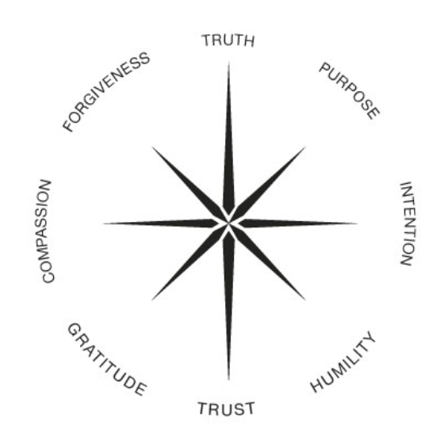
Bachelor:
Conscious Leadership Principles
The Bachelor Course is Unique Because:
Students reflect on and develop different aspects of the Inner Compass (Truth, Purpose, Intention, Humility, and Trust)
Students define their personal values and a personal purpose statement.
1 ECTS – designed to fit into existing courses.

Slide 14
Modules
Graduate: Conscious Leadership
(3 ECTS)
Foundations of Conscious Leadership
Leadership Models & Self-mastery
Stakeholder Theory & Relationship Building
Presence & Mindful Action
1
2
3
4

Slide 15

Overview - Graduate:
Conscious Leadership (3 ECTS)
Four Modules, Ten 3-hour Seminars
  Module 1: Three seminars
  Module 2: Two seminars
  Module 3: Three seminars
  Module 4: Two seminars
Assignments
  3 Self-assessments (not graded)
  Several journal reflections (not graded)
  Daily mindfulness practice (not graded)
  3 assessed assignments
Assessments
  Module 2 Paper: Applying a leadership theoretical framework (30% of grade)
  Class participation and engagement (30% of grade)
  Module 4 Final paper (40% pf grade)
This Photo by Unknown Author is licensed under CC BY

Slide 16
Graduate:
Conscious Leadership
The Graduate Course is Unique Because:
Students deepen their learning journey through a daily mindfulness practice.
​Application of content and personal reflections to leadership frameworks.
​Introduction of concepts such as VUCA (Volatile, Uncertain, Complex, Ambiguous) and approaches such as Polarity Management to address VUCA environments.
3 ECTS
Photo by Gennady Zakharin on Unsplash

Slide 17
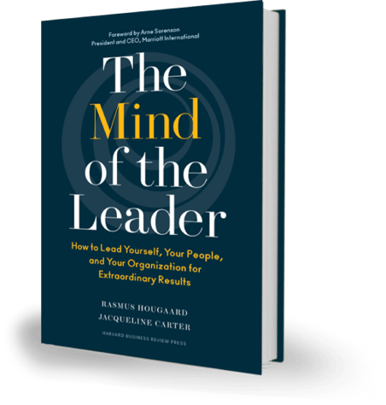
Conscious Leadership
“Based on research, we have conclusively found that three mental qualities stand out as being foundational for leaders today: mindfulness (M), selflessness (S), and compassion (C) Together, we call these foundational skills MSC leadership.”​
​
Hougaard, R., & Carter, J. (2018). The mind of the leader: How to lead yourself, your people, and your organization for extraordinary results.​
Notes:
This is the main textbook for the course

Slide 18
Experience in Teaching/Facilitating this material
The content as assembled in these courses has not been taught in this form.
However,
I and my colleagues have taught & facilitated the lectures and workshops with some of this content as part of other courses
And,
I developed much of the content for executive and leadership development education.

Slide 19
Teaching/Facilitating this material
The philosophy of conscious education is for teachers to see themselves as facilitators of learning, rather than instructors.
Facilitation skills to lead workshops and experiential activities.
A regular mindfulness, meditation, or contemplative practice. Ability to facilitate a few minutes of simple centering or breathing at the beginning of each class session.
Thorough understanding of the concepts presented in the course: consciousness, authentic leadership, servant leadership, adaptive leadership, VUCA, worldviews, emotional and social intelligence, mindfulness.

Slide 20
How would you use this content?
What training or support would you need to teach this content?
Feedback Welcome
Notes:
Engage the audience whether/which/how they teach a conscious CB course
Engage the audience how they propose/wish/expect to use our course material

Slide 21
Cross-cultural
Management and Leadership
Course Overview for Virtual Conference on Conscious Business Education
10-11 January 2024
Professor Jaroslava Kubatova, PhD, Palacký University

Slide 22
Bachelor: Conscious Organizations
Graduate: Conscious Organizations & Transformation
Course Overview for Virtual Conference on Conscious Business Education
10-11 January 2024
Dorianne Cotter-Lockard, PhD, Saybrook University & Munich Business School

Slide 23
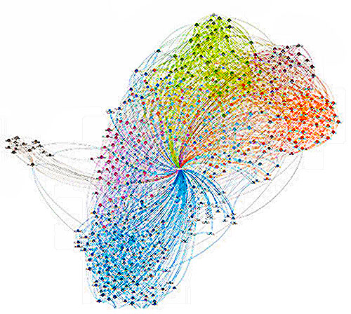
Bachelor: Conscious Organizations
Grad: Conscious Organizations & Transformation
Common to both courses (spice):
Learning journey through co-creating a conscious culture within the classroom.
Co-create a purpose for the course and values within self-managing teams.
Experiential activities, including mind-mapping and world café
UN's Sustainable Development Goals applied to team projects
Students deepen their conscious awareness through workshops, and team plus personal reflections.
This Photo by Unknown Author is licensed under CC BY

Slide 24
Bachelor: Conscious Organizations
This Course is Unique Because:
Team activities and assignments, culminating in poster presentations.
2 ECTS
Graduate: Conscious Organizations & Transformation
This Course is Unique Because:
Team activities and assignments, including Pecha Kucha presentations.
Students experience a “merger” and transformation of group culture through Appreciative Inquiry in a workshop experience with self-managing teams.
3 ECTS
This Photo by Unknown Author is licensed under CC BY

Slide 25

Concepts Introduced
Self-Managing Teams
The Learning Organisation
Systems Thinking
This Photo by Unknown Author is licensed under CC BY-SA-NC

Slide 26
Bachelor
Conscious Organizations
Modules
(2 ECTS – expandable to 3 ECTS)
Introduction to Conscious Organizations
Qualities and Values of Conscious Cultures
Conscious Leadership & Management
Organizations as Living Systems
1
2
3
4

Slide 27
Bachelor
Conscious Organizations
4 Modules (2 ECTS – expandable to 3 ECTS)
  Module 1: One 3-hour seminar
  Module 2: Two 3-hour seminars
  Module 3: Two 3-hour seminars
  Module 4: One 3-hour seminar
Assignments
  Journal reflections (not graded)
  3 assessed assignments
Assessments
  ​​​Written assignment - Module 2 (40% of grade): Research Scribe Media or Zappos. Include answers to the questions posed in the assignment in the paper.
  ​Reflection paper - Module 3 (20% of grade): Reflection on exploring the student’s worldview and cultural lens.
  ​Final group poster presentation - Module 4 (40% of grade)​
This Photo by Unknown Author is licensed under CC BY

Slide 28
Conscious Organizations - Bachelor:
Team Project
Work with your team to create a poster to present to the class about your chosen SDG:
Create a visual representation of the SDG
Find 1 inspirational organisation that has an initiative to address the SDG – learn all you can about the organisation and the initiative.
Create a visual representation of the organisation and the initiative
Express why this organisation and initiative are inspiring to you

Slide 29
Modules
(3 ECTS)
Graduate
Conscious Organizations & Transformation
Conscious Organizations and Conscious Culture
Qualities and Values of Conscious Cultures
Conscious Leadership & Management
Organizations as Living Systems
Organisational Change
Transforming Organizations
1
2
3
4
5
6

Slide 30
Graduate
Conscious Organizations & Transformation
6 Modules
  Ten 3-hour seminars
Assignments
  4 assessed assignments
Assessments
  Individual assignment 1 (20% of grade) – Module 2: Research a benefit corporation. Include answers to the questions posed in the assignment in the paper.
  Group assignments A & B (40% of grade)
    Module 3: Self-managing teams present the values the team developed during Module 2, their chosen SDG initiative and related mission and goals.
    Module 4: Self-managing teams present a stakeholder map and analysis of their SDG initiative, using the Pecha Kucha format.
  Individual assignment 2 (40% of grade) – Module 6: Research paper which explores one of the listed topics in-depth, using scholarly literature as sources for the paper.
This Photo by Unknown Author is licensed under CC BY
Notes:
Final paper – Choose one of the following concepts to explore in-depth in a 10-page paper (not including title page or references): organisational learning, Appreciative Inquiry, Bridges & Bridges’ Managing Transitions process, Kegan & Lahey’s Immunity to Change, or Boonstra’s Organizational Change as Collaborative Play, or the Teal organisation. Include at least 5 references from current scholarly literature (within the past 7 years).

Slide 31
Experience in Teaching/Facilitating this material
The content as assembled in these courses has not been taught in this form.
However,
I and my colleagues have taught & facilitated the lectures and workshops with some of this content as part of other courses
And,
I developed much of the content for executive and leadership development education.

Slide 32
Teaching/Facilitating this material
The philosophy of conscious education is for teachers to see themselves as facilitators of learning, rather than instructors.
Facilitation skills to lead workshops and experiential activities, such as World Café, Appreciative Inquiry, and mind-mapping.
A regular mindfulness, meditation, or contemplative practice. Ability to facilitate a few minutes of simple centering or breathing at the beginning of each class session.
Thorough understanding of the concepts presented in the course: consciousness, conscious organisations, developing core values, self-managing teams, VUCA, the learning organisation, systems thinking, triple-loop learning, organisational change, and mindfulness.

Slide 33
How would you use this content?
What training or support would you need to teach this content?
Feedback Welcome
Notes:
Engage the audience whether/which/how they teach a conscious CB course
Engage the audience how they propose/wish/expect to use our course material

