Slide 2
Workshop: Developing Shared Values
The class will develop a set of shared values to guide our way of being with each other throughout the course.
Notes:
See Workshop facilitator guidelines in the Instructor’s Notes and in the document, "Shared Core Values Guidelines Handout" in the Toolbox. The handout can be used for a whole class or for individual teams within a class.

Slide 3
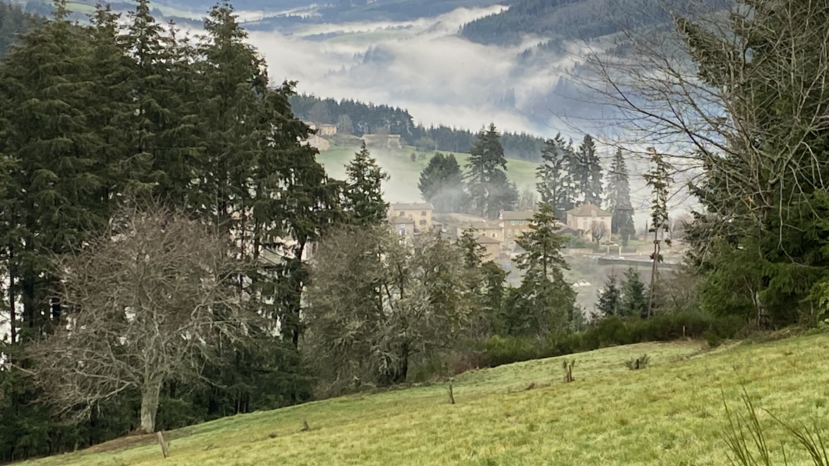
Centering Moment of Mindfulness
Photo credit: Dorianne Cotter-Lockard

Slide 4
Shared Values
“The purpose of establishing a set of values is to create a code of behavior that builds a cohesive culture and supports the vision and mission. The values provide a framework within which every member of the organization can operate with responsible freedom. When individuals fully embrace the organization’s values, everyone becomes mutually accountable. Values that are shared build trust and create community. They also create cohesion and unity.”
Richard Barrett: Liberating the Corporate Soul – Building a Visionary Organization and Building a Values Driven Organization – A Whole System Approach
This Photo by Unknown Author is licensed under CC BY-SA-NC
Notes:
Read the quote.
The words in the word cloud on the right lists examples of values

Slide 5
Activity: Defining Shared Values
We need 2 scribes: 1 to write in front of class, 1 to enter into the Excel template.
Brainstorm a short list of 5-7 values.
Everyone votes for their top three. Pick the three with most votes.
Process for Defining Shared Core Values:
Definition - What does this value mean for us?
Describe why this is our core value. What must this team, class, or organization do specifically to demonstrate this value?
What individual behavior demonstrates this value? How would this value be reflected in the way individuals relate to each other?
Notes:
Review the process.
Instructor facilitates the process.
Ask for a volunteer person to be the “scribe” who will write the results of the process in table form on a white-board or flip chart. Ask for a second scribe who will enter the resulting values from the workshop into a spreadsheet template.
Brainstorm a short list of 5-7 values.
Everyone votes for their top three. Pick the three with most votes.
Process for Defining Shared Core Values:
Definition - What does this value mean for us?
Describe why this is our core value. This is the underlying reason for discerning that this is one of the core values of the team or organization. Take time to fully explore this question. Talk through scenarios and apply the core value in each scenario as part of the exploration.
What must this team or organization do specifically to demonstrate this value?
What individual behavior demonstrates this value? How would this value be reflected in the way individuals relate to each other?

Slide 6
Shared Values
Core Value | Rationale (Why) | Organizational Actions | Individual Behaviors
Value | Why is this one of our core values? What is the rationale? | What must we do as a team or community do to demonstrate this value? | What individual behavior demonstrates this value? How would this value be reflected in the way individuals relate to each other?
Respectful Communication
Definition: To be free to speak honestly AND be heard without judgment & with receptivity, to be mindful & respectful of ALL | To understand each other more deeply. A way to demonstrate compassion. To allow authentic freedom of expression. To help people get their needs met. To express love. Provide the safety to be real. Respectful communication is an avenue for forgiveness. | Create opportunities for empowerment. Encourage people to express ideas, emotions, and perspectives. Model acceptance and respect. Provide platforms and structures to support respectful communication. Provide opportunities to learn. Continue the Appreciative Inquiry process | Be open to new ideas, express curiosity Participate actively in dialog and communication processes. Practice active listening. Be non-judgmental. Practice acceptance, honor and respect in all relationships Be receptive to each person’s ideas, emotions, and perspectives. Practice generosity.
Definition - What does this value mean for us?
Describe why this is our core value. This is the underlying reason for discerning that this is one of the core values of the team or organization.
What must this team or organization do specifically to demonstrate this value?
What individual behavior demonstrates this value? How would this value be reflected in the way individuals relate to each other?
Notes:
Walk through the example, which is also in the handout
Facilitate the process with the class. Ask the scribe to save and share the Excel spreadsheet with the class
Add the core values with definitions on the extra slide at the beginning of each seminar – make it a practice to revisit the core values at the beginning of each class.

Slide 7
Class Shared Values
Add the shared values with their definitions here – re-presence at each class session. Example:
Respectful Communication
To be free to speak honestly AND be heard without judgment & with receptivity, to be mindful & respectful of ALL
Notes:
This slide should be added at the beginning of each seminar so the instructor can re-presence the shared values at each class

