Slide 1


Slide 2
Conscious Organisations
Seminar 4, Module 3: Conscious Leadership & Management

Slide 3
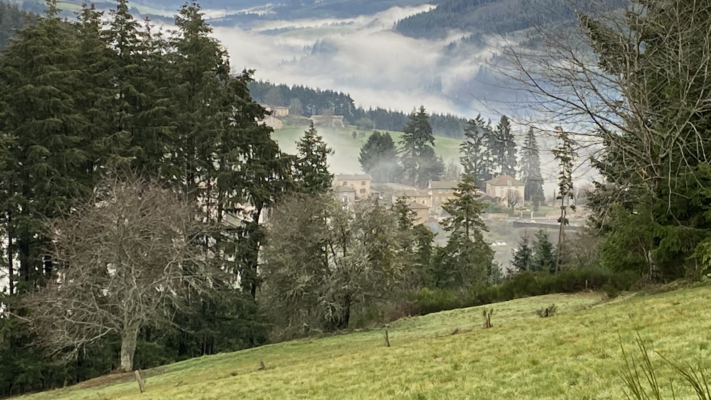
Centering Moment of Mindfulness
Photo credit: Dorianne Cotter-Lockard
Notes:
If the instructor is not trained in mindfulness practices, the following two apps provide “how to” videos and guided meditations:
https://insighttimer.com/
https://www.headspace.com/
Alternatively, choose one of these simple mindfulness practices (each takes less than 3 minutes):
Breathing
Invite students to breath in for 4 counts, hold 4 counts, breath out 4 counts, and hold 4 counts. Count slowly to guide the process. Repeat the cycle 2 – 3 times.
Listening in Silence
Invite students to sit in silence listen to the sounds around them. If there is a clock ticking in the room, they can focus on that first. After 30 seconds invite them to listen to the sounds outside the room. After an additional 30 seconds invite them to listen to the sounds of their breathing or other sounds within their bodies. Finally invite them to be open to hearing all sounds within and around them.

Slide 4

Conscious Leadership & Management
“The role of management in a conscious business … managers must create, sustain, and strengthen the conditions whereby team members operate primarily from intrinsic motivation.”
Mackey & Sisodia (2014, p. 236). Conscious capitalism: Liberating the heroic spirit of business.
This Photo by Unknown Author is licensed under CC BY-NC-ND
Notes:
Opening quote to center the class.

Slide 5
Class Purpose
Add the class purpose here – revisit each class session

Slide 6
Conscious Organisations
Agenda Seminar 4, Module 3:
Conscious Management
Workshop: Worldviews - Seeing Through Our Cultural Lenses
Activity: Mind-mapping an SDG (UN Sustainable Development Goal)
Group Reflection in Self-Managing Teams

Slide 7
Workshop: Seeing Through Our Cultural Lenses
Participants will learn what goes into a worldview, then reflect on their individual cultural lenses.

Slide 8
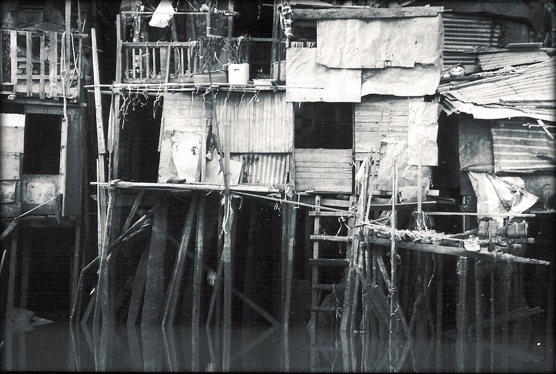
Workshop: Worldviews – seeing through our cultural lenses
"You never really understand a person until you consider things from his point of view … until you climb into his skin and walk around in it.”
~ Atticus Finch, in To Kill a Mockingbird by Harper Lee
CC BY 2.0 <https://creativecommons.org/licenses/by/2.0>, via Wikimedia Commons
Notes:
Refer to the “Facilitator Guide – Understanding Worldviews” located in the Toolbox for detailed guidance on facilitating this workshop.
The ability to understand our own worldview and the worldviews of others are two essential competencies of the SQ21: 21 Skills of Spiritual Intelligence by Cindy Wigglesworth. This workshop is based on Wigglesworth’s developmental model and addresses the development of these two skills. See Wigglesworth's book for further understanding of these skills.

Slide 9

What do you see?
(From openclipart.org)
Notes:
Invite students to stand in a circle
Place an asymmetrical 3D object in the middle of the circle
Ask students at different points of the circle to describe what they see of the object
Now ask everyone to step three steps to their right.
Ask the same students as before to describe what they see of the object
Invite students to reflect and comment on their experience
[Their view and understanding of the object depends on where they stand in the circle. In the same way, how we see and understand the world varies with our “position” in relation to the world. Our “position” is our worldview]

Slide 10

What Influences one’s worldview?
Notes:
Invite students to think of what could influence a person’s worldview, then show next slide with list of influences.

Slide 11

What Influences one’s worldview?
Cultures: family, ethnic, nationality, organizational
Religious Belief System
Historical Context
Psychology/
Personality
Life Events
Physiology
Socio-economic
experiences
Image by Gerd Altmann from Pixabay
Identity: gender, race, ethnicity, sexual orientation
Notes:
This slide is animated so you can speak to a few aspects at a time.

Slide 12
What Influences one’s worldview?
Cultures: family, ethnic, nationality, organizational
Culture:
Conscious/Objective Culture – Experienced through the five senses: from our music, art, TV, movies, architecture, jewelry, clothing, books, food, family traditions
Unconscious/Implicit Culture Beliefs – Unseen and mostly unspoken: Values, Beliefs, Patterns of Behavior, Group and Organization Norms
Image by Gerd Altmann from Pixabay
Notes:
This slide is animated so you can speak to a few aspects at a time.

Slide 13

Self-awareness exercise
Write down the answers to these questions
What country or countries did I grow up in, and what languages do I speak fluently? How has this affected the way I see the world?
What is my historical context? What local or world events have I lived through, and how have they affected the way I see the world?
What other aspects of my life, such as gender identity, sexual orientation, religion, race, and ethnic identity affect the way I see the world?
Notes:
Self-Awareness Exercise:
Spend 5 minutes to write down answers to the following questions:
What country or countries did I grow up in, and what languages do I speak fluently? How has this affected the way I see the world?
What is my historical context? What local or world events have I lived through, and how have they affected the way I see the world?
What other aspects of my life, such as gender identity, sexual orientation, religion, race, and ethnic identity affect the way I see the world?
[Have partners talk through their answers with each other, 3 minutes each]
Debrief:
[Discuss each question – ask for examples from participants, 4 minutes]
Point out how each person in the room may have had different experiences and therefore see the world differently than their friend or colleague.

Slide 14
How does each person’s worldview affect an organisation’s culture?
Notes:
Additional question for the class:
How do you incorporate awareness of your own worldview and other’s worldviews to create a conscious culture?

Slide 15
Activity: Exploring an SDG
Each self-managing team will use the mind-mapping technique to explore one of the SDG’s. The results from the workshop will feed into the final group project.
Notes:
See details on facilitating this activity in the Teaching Notes

Slide 16
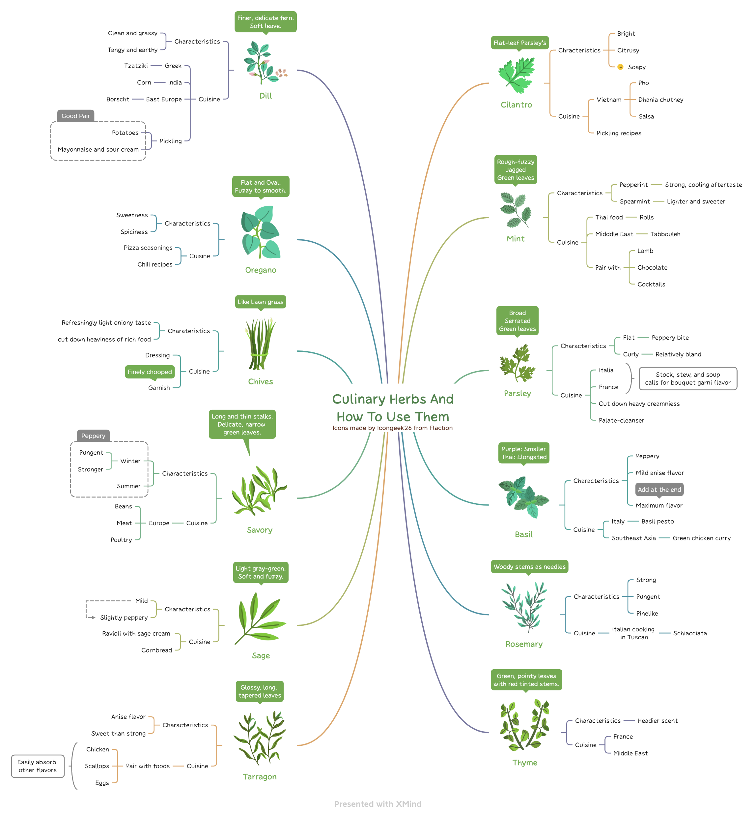
Mindmapping
“A mind map is a graphical way to represent ideas and concepts. It is a visual thinking tool that helps structuring information, helping you to better analyze, comprehend, synthesize, recall and generate new ideas. … In a mind map, as opposed to traditional note taking or a linear text, information is structured in a way that resembles much more closely how your brain actually works.”
~ Luciano Passeullo
Passuello, L. (n.d.). What is Mindmapping. [Blog]. LiteMind. https://litemind.com/what-is-mind-mapping/
Notes:
Demonstrate how to create a mindmap. You can play the first 1.5 minutes of this video for students: https://youtu.be/FMkK8g3UQN8
Choose a topic such as plan my vacation, class outing, etc. to co-create a simple map with the class

Slide 17

Notes:
Explain the UN’s sustainable development goals.
History (from https://sdgs.un.org/goals#history ):
The 2030 Agenda for Sustainable Development, adopted by all United Nations Member States in 2015, provides a shared blueprint for peace and prosperity for people and the planet, now and into the future.
At its heart are the 17 Sustainable Development Goals (SDGs), which are an urgent call for action by all countries - developed and developing - in a global partnership.
They recognize that ending poverty and other deprivations must go hand-in-hand with strategies that improve health and education, reduce inequality, and spur economic growth – all while tackling climate change and working to preserve our oceans and forests.
The SDGs build on decades of work by countries and the UN
You can go to https://sdgs.un.org/ - scroll down to the 17 SDGs on the home page and hover the mouse over selected SDGs to provide examples of each SDG

Slide 18
ACTIVITY
Nominate a new team facilitator and a new scribe for this process (in other words, rotate roles).
Start with re-presencing your team values. Each person on the team shares one value that is important to them as you work together today.
Choose one of the SDGs to work on for your final group project. Mindmap answers to these questions:
Why did you choose this SDG? Why is it important to you?
What are some ideas to address this SDG?
What organizations are currently doing something to address this SDG?
Nominate a team member to present a 2-minute summary of your brainstorming session to the class.
Notes:
See detailed instructions in the Instructor’s Notes.
Give pre-existing self-managing teams 25 minutes for the activity. This activity feeds into the final group project.
When teams return, give them 2 minutes each to provide a summary of their exploration, showing their mindmap to the class.

Slide 19
Activity: Team Reflection
Return to your self-managing team to reflect on the mind-mapping process:
What did you learn about working together in this process?
What did you learn about yourself as a member of a self-managing team?
How did you demonstrate your shared values as a team?
What is one thing you would do differently next time working together?
Notes:
Allocate 10 minutes for the activity
Reporting back to the plenary is not needed.

Slide 20
Homework: Final Team Poster Presentation
Begin working with your team to create a poster to present to the class about your chosen SDG:
Create a visual representation of the SDG on the poster
Find 1 inspirational organisation that has an initiative to address the SDG – learn about the organisation and the initiative.
Create a visual representation of the organisation and the initiative on the poster
Be able to provide background about the organisation, describe their initiative, and express why this organisation and initiative are inspiring.
Present the poster to the class, taking no more than 6 minutes for the presentation
Notes:
Begin working with your group to explore an initiative to address your chosen SDG: Identify an inspirational organization that has an initiative to address your chosen SDG. See assignment in Module 4 for further instructions.

Slide 21
Homework: Reflection Paper
Write a short reflection on what you learned about your worldview.
What are some of the key aspects of your life experiences, historical context, and identity that influence the lens through which you see the world?
Draw a picture of the lens. What colour(s) is the lens?
What colours do you see through the lens?
How does the lens modify what you see in the world?
Notes:
Homework assignment can be guided with a handout document which lists various possible elements that influence a person’s worldview (included in “Facilitator Guide – Understanding Worldviews” in the Toolbox)

