Slide 2
Conscious Organisations
Seminar 3, Module 2: Qualities and Values of Conscious Cultures

Slide 3
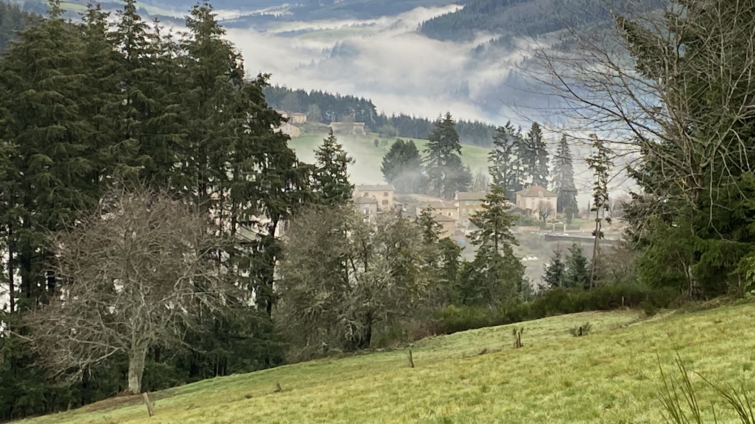
Centering Moment of Mindfulness
Photo credit: Dorianne Cotter-Lockard
Notes:
If the instructor is not trained in mindfulness practices, the following two apps provide “how to” videos and guided meditations:
https://insighttimer.com/
https://www.headspace.com/
Alternatively, choose one of these simple mindfulness practices (each takes less than 3 minutes):
Breathing
Invite students to breath in for 4 counts, hold 4 counts, breath out 4 counts, and hold 4 counts. Count slowly to guide the process. Repeat the cycle 2 – 3 times.
Listening in Silence
Invite students to sit in silence listen to the sounds around them. If there is a clock ticking in the room, they can focus on that first. After 30 seconds invite them to listen to the sounds outside the room. After an additional 30 seconds invite them to listen to the sounds of their breathing or other sounds within their bodies. Finally invite them to be open to hearing all sounds within and around them.

Slide 4
Conscious Culture
Structures of Culture
Patterns of Beliefs
Values
Assumptions
Behavioral Norms
“The best conceived, purpose-motivated strategy can come to naught if the organization’s culture is incompatible with it or is infused with fear, distrust, and hostility.”
Mackey & Sisodia (2014). Conscious capitalism: Liberating the heroic spirit of business (p. 217).
Notes:
Opening quote for the class to consider. Related to the famous quote of Peter Drucker “Culture eats strategy for breakfast”

Slide 5
Class Purpose
Add the class purpose here – revisit each class session

Slide 6
Conscious Organisations Agenda Seminar 3, Module 2: Qualities and Values of Conscious Cultures
Introduce Concepts: VUCA & Self-Managing Teams
Workshop: Developing Shared Values
Activity: Team Reflection

Slide 7
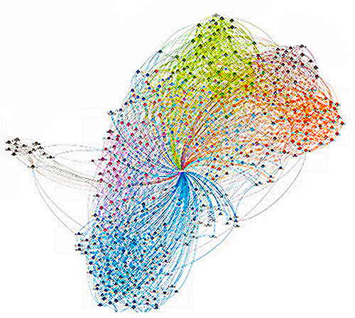
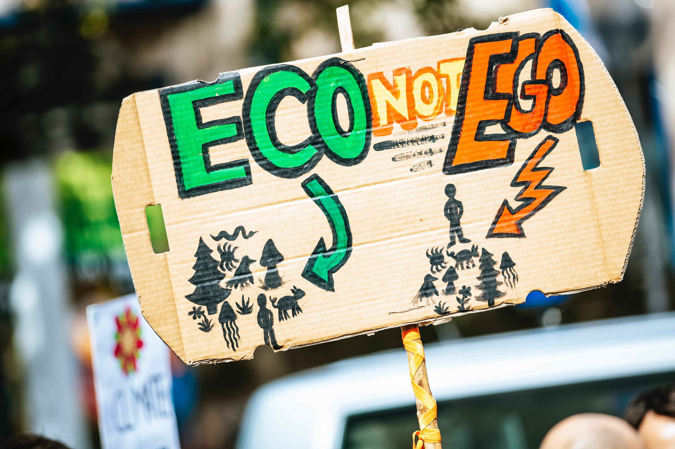
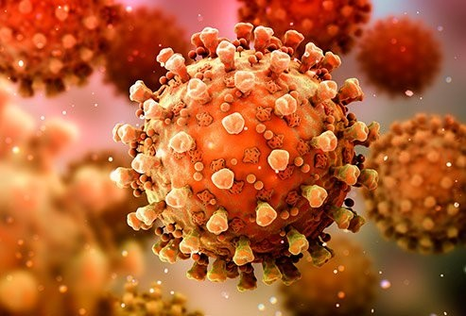
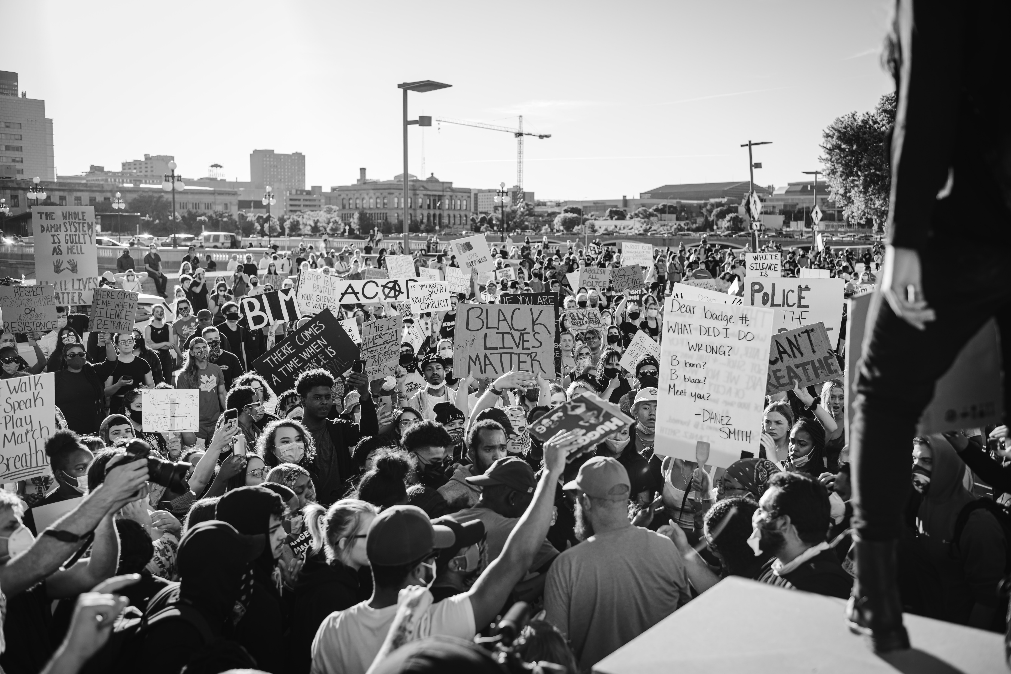
VUCA: Volatile, Uncertain, Complex, Ambiguous
Photo by Timo Volz on Unsplash
This Photo by Unknown Author is licensed under CC BY
Photo by Markus Spiske on Unsplash
This Photo by Unknown Author is licensed under CC BY
Photo by Lee Chinyama on Unsplash
Photo by Dustan Woodhouse on Unsplash
This Photo by Unknown Author is licensed under CC BY
Notes:
We live in a VUCA world
Give examples and ask for examples of each:
Volatile: social and political unrest, wars such as Russian invasion of Ukraine, economic volatility
Uncertain: COVID pandemic, climate change impacts, supply chain interruptions, technology employment
Complex: solving climate change, global workforce, implications of recent AI advances
Ambiguous: decision-making in a complex environment, no single best solutions
VUCA is increasing at an accelerated rate.
Yet, we need to find ways to adapt and flourish in this environment.

Slide 8
Self-Managing Teams
Empowered
Set own goals
Responsible for self-management
Collaborate
Choose own working methods
Review own performance
This Photo by Unknown Author is licensed under CC BY-SA-NC
Notes:
Instructor to facilitate dialog:
What is a self-managing team?
Empowered - responsible for a ‘whole’ work process which delivers a product or service
Responsible for managing themselves
Work together to improve operations, to handle day-to-day problems, and to plan and control their work.
Set their own goals
Choose their own working methods
Manage their own schedule
Review their own performance

Slide 9
Workshop: Developing Shared Values
Each self-managing team will develop a set of shared values which align with the shared purpose of this class.
Notes:
See Workshop facilitator guidelines in the Instructor’s Notes and in the document, "Shared Core Values Guidelines Handout" in the Toolbox. Provide copies of the handout to all students at this workshop.
Pre-define self-managing teams of 4 people each. These self-managing teams will stay together during the course and continue to work together on the final project.
In this workshop, each self-managing team will develop a set of shared values which align with the shared purpose of this class.

Slide 10
Shared Values
“The purpose of establishing a set of values is to create a code of behavior that builds a cohesive culture and supports the vision and mission. The values provide a framework within which every member of the organization can operate with responsible freedom. When individuals fully embrace the organization’s values, everyone becomes mutually accountable. Values that are shared build trust and create community. They also create cohesion and unity.”
Richard Barrett: Liberating the Corporate Soul – Building a Visionary Organization and Building a Values Driven Organization – A Whole System Approach
This Photo by Unknown Author is licensed under CC BY-SA-NC
Notes:
Read the quote.
The words in the word cloud on the right lists examples of values

Slide 11
Activity: Defining Shared Values
Nominate a person to be the facilitator for this process.
Nominate a person to be the “scribe” who will write the results of the process in table form on a white-board or in a spreadsheet.
Brainstorm a short list of 5-7 values. If you have more than 7, ask each team member to rate each value on a scale of 1-5, where 1 is not important and 5 is most important. Total up the ratings for each value. The 5 values which have the highest totals are selected for the team.
Process for Defining Shared Core Values:
Definition - What does this value mean for us?
Describe why this is our core value. This is the underlying reason for discerning that this is one of the core values of the team or organization. Take time to fully explore this question. Talk through scenarios and apply the core value in each scenario as part of the exploration.
What must this team or organization do specifically to demonstrate this value?
What individual behavior demonstrates this value? How would this value be reflected in the way individuals relate to each other?
(Be prepared to report back to the class the value and definitions – nominate a person to report back – 2 minutes)
Notes:
Review the process.
Teams have 45 minutes to define their shared core values.

Slide 12
Shared Values
Core Value | Rationale (Why) | Organizational Actions | Individual Behaviors
Value | Why is this one of our core values? What is the rationale? | What must we do as a team or community do to demonstrate this value? | What individual behavior demonstrates this value? How would this value be reflected in the way individuals relate to each other?
Respectful Communication
Definition: To be free to speak honestly AND be heard without judgment & with receptivity, to be mindful & respectful of ALL | To understand each other more deeply. A way to demonstrate compassion. To allow authentic freedom of expression. To help people get their needs met. To express love. Provide the safety to be real. Respectful communication is an avenue for forgiveness. | Create opportunities for empowerment. Encourage people to express ideas, emotions, and perspectives. Model acceptance and respect. Provide platforms and structures to support respectful communication. Provide opportunities to learn. Continue the Appreciative Inquiry process | Be open to new ideas, express curiosity Participate actively in dialog and communication processes. Practice active listening. Be non-judgmental. Practice acceptance, honor and respect in all relationships Be receptive to each person’s ideas, emotions, and perspectives. Practice generosity.
Definition - What does this value mean for us?
Describe why this is our core value. This is the underlying reason for discerning that this is one of the core values of the team or organization.
What must this team or organization do specifically to demonstrate this value?
What individual behavior demonstrates this value? How would this value be reflected in the way individuals relate to each other?
Notes:
Walk through the example, which is also in the handout

Slide 13
Shared Values
Core Value | Rationale (Why) | Organizational Actions | Individual Behaviors
Value | Why is this one of our core values? What is the rationale? | What must we do as a team or community do to demonstrate this value? | What individual behavior demonstrates this value? How would this value be reflected in the way individuals relate to each other?
Respectful Communication
Definition: To be free to speak honestly AND be heard without judgment & with receptivity, to be mindful & respectful of ALL | To understand each other more deeply. A way to demonstrate compassion. To allow authentic freedom of expression. To help people get their needs met. To express love. Provide the safety to be real. Respectful communication is an avenue for forgiveness. | Create opportunities for empowerment. Encourage people to express ideas, emotions, and perspectives. Model acceptance and respect. Provide platforms and structures to support respectful communication. Provide opportunities to learn. Continue the Appreciative Inquiry process | Be open to new ideas, express curiosity Participate actively in dialog and communication processes. Practice active listening. Be non-judgmental. Practice acceptance, honor and respect in all relationships Be receptive to each person’s ideas, emotions, and perspectives. Practice generosity.
Present each value and its associated definition (not the rationale, actions or behaviors)
2 minutes per team
Notes:
Remind students to take a photo of their resulting core values and definitions so team members have a copy. They will revisit these values as teams continue to work together throughout the course.

Slide 14
Activity: Team Reflection
Return to you self-managing team to reflect on the shared values process:
What did you learn about working together in this process?
What aspects of this process were easy?
What aspects of this process were challenging?
What did you learn about yourself as a member of a self-managing team?
What are the strengths of your team?
What is one thing you would do differently next time working together?
(Be prepared to report back to the class a short summary – 2 minutes – of key learnings from the reflection)
Notes:
Give students 10-15 minutes to return to their self-managing teams to reflect on the team’s interactions during this process.

Slide 15
Sharing Team Reflection
Provide a short summary to the class of key learnings from the reflection
– 2 minutes per team
Notes:
If there is time have teams share their key learning from the reflection.

