Slide 2
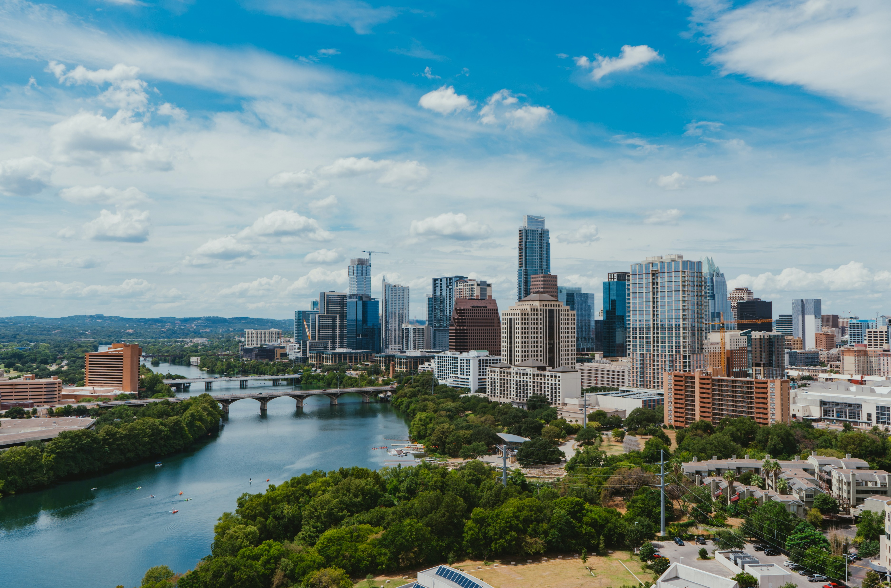
Conscious Business “The U in You” – Leading from the future

Slide 3
What is the “within” in leadership? “The blind spot in leadership”
Bill O’Brian, former CEO of Hanover Insurance, in an interview with Otto Scharmer (MIT):
“The success of an intervention [corporate change] depends on the interior condition of the intervenor.”
In other words: “The success of our actions as change-makers does not depend on What we do or How we do it, but on the Inner Place from which we operate.”
→ It’s about letting go of the past in order to connect with and learn from emerging future possibilities
Source: https://www.u-school.org/
Notes:
Teaching note
https://www.u-school.org/ provides a lot of additional information as well as resources about presencing, Theory U, system change, etc.

Slide 4
Three perspectives on the leader’s work
The source dimension of leadership is often invisible and functions as a “blind spot” in the process of social reality formation and transformational change.
RESULTS
What
PROCESS
How
SOURCE
Who
Blind spot: Inner place from which we operate
Source: https://www.u-school.org/
Notes:
Teaching note
https://www.u-school.org/ provides a lot of additional information as well as resources about presencing, Theory U, system change, etc.

Slide 5
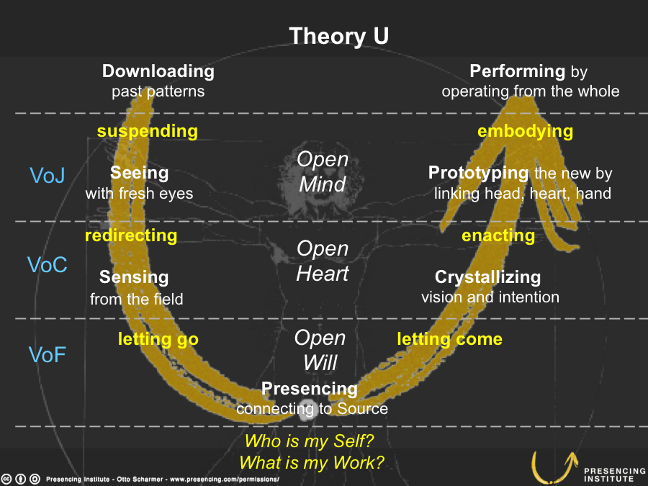
Source: https://www.u-school.org/theory-u
Notes:
Teaching note
https://www.u-school.org/ provides a lot of additional information as well as resources about presencing, Theory U, system change, etc.

Slide 6
“Presencing”: planning from the future not based on the past
Presencing: To sense, tune in, and act from one’s highest future potential—the future that depends on us to bring it into being. Presencing blends the words “presence” and “sensing” and works through “seeing from our deepest source.”
Source: https://www.u-school.org/
Notes:
Teaching note
https://www.u-school.org/ provides a lot of additional information as well as resources about presencing, Theory U, system change, etc.

Slide 7
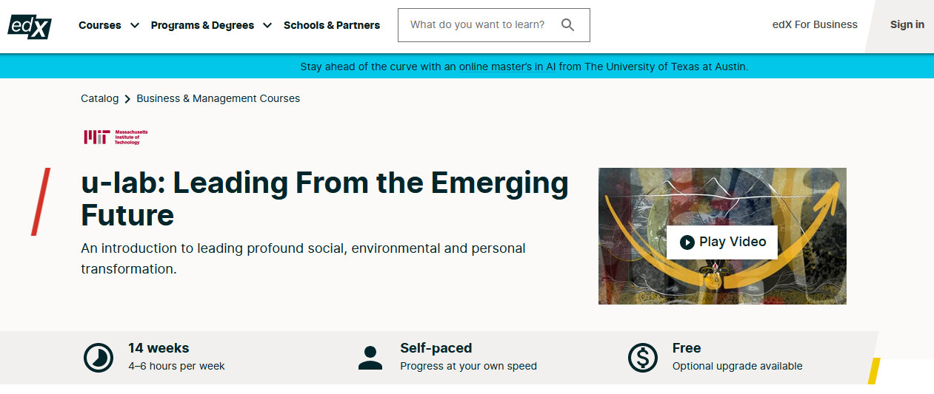
MITx edX MOOC
https://www.edx.org/course/ulab-leading-from-the-emerging-future
Notes:
Teaching note
Point out that there is a MOOC on edX provided by MITx which is taught by Otto Scharmer et al. For those students who are interested in getting deeper into system change and Theory U

Slide 8
Guided journaling session
Please write
CONTINOUS text
not bullet points
All questions are available at https://www.u-school.org/journaling (formerly https://www.presencing.com/tools/guided-journaling)
Notes:
Teaching note
Explain the purpose of journaling to the students: Journaling means thinking through writing –writing is the thought process. one thinks and writes instead of first reflecting and then writing down the reflection. Instruct participants to write simply start and see what comes up. (https://www.presencing.com/tools/guided-journaling)
More instructions from https://www.u-school.org/journaling:
People & Place Journaling Practice can be used in groups of any size. The exercise follows the co-sensing phase meaning that participants have already moved through the left side of the U-Process. It is important that the room is quiet and no noises or other distractions in the environment interrupt the participants.
Time A minimum of 45 minutes is required. Depending of the context this journaling process can take up to 60-90 min.
Materials Pen and paper for each participant.

Slide 9
Guided journaling questions
1.
Challenges: Look at yourself from outside as if you were another person: What are the 3 or 4 most important challenges or tasks that your life (work and non-work) currently presents?
Herausforderungen: Betrachten Sie sich selbst von Außen wie eine andere Person: Was sind die 3 bis 4 wichtigsten Herausforderungen oder Aufgaben, die sich Ihnen aktuell im Leben (Arbeitsleben oder privat) stellen?
Notes:
Teaching note
The questions can be found at https://www.u-school.org/journaling
Read one question after the other; invite the participants to journal guided by the respective question. Go one by
one through the questions. Move to the next question when you sense that the majority of the group is ready (usually 1.5 to 2 min.).
Don’t give participants too much time. It is important to get into a flow and not to think too much.
Delete the questions in German if not needed for mixed classes

Slide 10
Guided journaling questions
2.
Self: Write down 3 or 4 important facts about yourself. What are the important accomplishments you have achieved or competencies you have developed in your life (examples: raising children; finishing your education; being a good listener)?
Selbst: Schreiben Sie die 3 oder 4 wichtigsten Fakten über sich selbst auf. Was sind die wichtigsten Dinge, die Sie in Ihrem Leben erreicht haben oder Kompetenzen, die Sie entwickelt haben? (Beispiele: Kinder großziehen, Ausbildung abschließen, ein guter Zuhörer sein)

Slide 11
Guided journaling questions
3.
Emerging Self: What 3 or 4 important aspirations, areas of interest, or undeveloped talents would you like to place more focus on in your future journey (examples: writing a novel or poems; starting a social movement; taking your current work to a new level)?
Erwachendes/ auftauchendes Selbst: Was sind die 3 oder 4 wichtigsten Ziele/Sehnsüchte, Interessensgebiete oder unentwickelten Talente, auf die Sie mehr Aufmerksamkeit auf Ihrem zukünftigen Lebensweg richten wollen? (Beispiele: Eine Kurzgeschichte oder ein Gedicht schreiben, eine soziale Bewegung initiieren, in Ihrer Arbeit einen Entwicklungssprung machen)?

Slide 12
Guided journaling questions
4.
Frustration: What about your current work and/or personal life frustrates you the most?
Frustration: Was frustriert Sie am meisten an Ihrer aktuellen Arbeit und/oder in Ihrem persönlichen Leben?

Slide 13
Guided journaling questions
5.
Energy: What are your most vital sources of energy? What do you love?
Energie: Was sind Ihre größten Energiequellen? Was lieben Sie?

Slide 14
Guided journaling questions
6.
Inner resistance: What is holding you back? Describe 2 or 3 recent situations (in your work or personal life) when you noticed one of the following three voices kicking in, preventing you from exploring the situation you were in more deeply:
a. Voice of Judgment: shutting down your open mind (downloading instead of inquiring)
b. Voice of Cynicism: shutting down your open heart (disconnecting instead of relating)
c. Voice of Fear: shutting down your open will (holding on to the past or the present instead of letting go)

Slide 15
Guided journaling questions
6.
Innerer Widerstand: Was hält Sie zurück? Beschreiben Sie 2 oder 3 Situationen der jüngeren Vergangenheit, (aus Ihrer Arbeit oder Ihrem privaten Leben) wo Sie eine der folgenden drei Stimmen so aktiv in sich wahrnehmen konnten, dass diese Sie dann davon abhielt, die Situation, in der Sie sich befanden, gründlicher zu untersuchen:
Die Stimme der Bewertung: Die Offenheit im Verstand beenden (Downloaden und Bewerten, statt Fragen / Erkunden)
Die Stimme des Zynismus: Das offene Herz schließen (Abtrennen, statt in Verbindung zu gehen)
Die Stimme der Angst: Den offenen Willen schließen (festhalten an Vergangenheit oder Status quo statt loszulassen)

Slide 16
Guided journaling questions
7.
The crack: Over the past couple of days and weeks, what new aspects of your Self have you noticed? What new questions and themes are occurring to you now?
Der Riss: Welche neuen Aspekte in und von sich selbst haben Sie in den letzten Tagen und Wochen wahrgenommen? Welche neuen Fragen und Themen sind Ihnen begegnet bzw. aufgetaucht?

Slide 17
Guided journaling questions
8.
Your community: Who makes up your community, and what are their highest hopes in regard to your future journey? Choose three people with different perspectives on your life and explore their hopes for your future (examples: your family; your friends; a parentless child on the street with no access to food, shelter, safety, or education). What might you hope for if you were in their shoes and looking at your life through their eyes?
Ihre Gemeinschaft: Welche Menschen bilden Ihre Gemeinschaft und was sind ihre größten Hoffnungen in Bezug auf Ihren zukünftigen Lebensweg? Wählen Sie drei Menschen mit verschiedenen Perspektiven auf Ihr Leben und untersuchen Sie ihre Hoffnungen/Wünsche für Ihre Zukunft (Beispiele: Ihre Familie, Ihre Freunde, ein elternloses Kind auf der Straße ohne Essen, Schutz oder Bildung). Was könnte ihre Hoffnung sein, wenn Sie auf Ihre Zukunft durch ihre Augen schauen?

Slide 18
Guided journaling questions
9.
Helicopter: Watch yourself from above (as if in a helicopter). What are you doing? What are you trying to do in this stage of your professional and personal journey?
Hubschrauber: Betrachten Sie sich selbst wie von einem Hubschrauber aus: Was machen Sie? Was versuchen Sie zu tun zu diesem Zeitpunkt Ihrer professionellen und persönlichen Reise?

Slide 19
Guided journaling questions
10.
Imagine you could fast-forward to the very last moments of your life, when it is time for you to pass on. Now look back on your life’s journey as a whole. What would you want to see at that moment? What footprint do you want to leave behind on the planet? What would you want to be remembered for by the people who live on after you?
Fußstapfen: Stellen Sie sich vor, Sie könnten vorspulen zu den letzten Momenten Ihres Lebens, wenn es für Sie Zeit ist zu gehen. Schauen Sie nun zurück auf Ihren Lebensweg als Ganzes. Was würden Sie gerne in diesem Moment sehen? Welche Fußabdrücke würde Sie gerne auf dem Planeten zurücklassen? Womit/wofür wollen Sie bei den Menschen, die weiterleben, in Erinnerung bleiben ?

Slide 20
Guided journaling questions
11.
From that (future) place, look back at your current situation as if you were looking at a different person. Now try to help that other person from the viewpoint of your highest future Self. What advice would you give? Feel and sense what the advice is and then write it down.
Hilfe: Schauen Sie von diesem zukünftigen Ort zurück auf Ihre gegenwärtige Situation, als würden Sie auf eine andere Person schauen. Nun versuchen Sie, mit dieser Person mitzufühlen und ihr zu helfen aus der Perspektive ihres höchsten, zukünftigen Selbst (Potentials). Welchen Rat würden Sie geben? Fühlen Sie sich ein und spüren Sie, was der Hinweis/Rat ist – und schreiben Sie ihn dann auf.

Slide 21
Guided journaling questions
12.
Now return again to the present and crystallize what it is that you want to create: your vision and intention for the next 3-5 years. What vision and intention do you have for yourself and your work? What are some essential core elements of the future that you want to create in your personal, professional, and social life? Describe as concretely as possible the images and elements that occur to you.
Intention: Nun kehren Sie zurück zur Gegenwart und kristallisieren (verfeinern) Sie, was es ist, was Sie kreieren wollen: Ihre Vision und Absicht für die nächsten 3-5 Jahre. Welche Vision und Intention haben Sie für sich selbst und Ihre Arbeit? Was sind die essentiellen Kernelemente der Zukunft, die Sie in ihrem persönlichen, professionellen und sozialen Leben verwirklichen wollen? Beschreiben Sie so konkret wie möglich die Bilder und Elemente, die Sie damit verbinden.

Slide 22
Guided journaling questions
13.
Letting-go: What would you have to let go of in order to bring your vision into reality? What is the old stuff that must die? What is the old skin (behaviors, thought processes, etc.) that you need to shed?
Loslassen: Was würden Sie loslassen müssen, um Ihre Vision umzusetzen und ins Leben zu bringen? Was ist das alte Zeug, was gehen muss? Aus welcher alten Haut (Gewohnheiten, Gedanken, Abläufe, etc.) müssen Sie sich pellen?

Slide 23
Guided journaling questions
14.
Seeds: What in your current life or context provides the seeds for the future that you want to create? Where do you see your future beginning?
Samen: Was in Ihrem aktuellen Leben oder Ihrer Umgebung enthält die Samen für die Zukunft, die Sie erschaffen wollen? Wo, an welchem Ort sehen Sie den Beginn ihrer Zukunft?

Slide 24
Guided journaling questions
15.
Prototyping: Over the next three months, if you were to prototype a microcosm of the future in which you could discover “the new” by doing something, what would that prototype look like?
Einen Prototypen bilden: Wenn Sie in den nächsten drei Monaten einen Prototyp für die Zukunft, die Sie entdecken wollen, entwickeln – als Mikrokosmos - und darin das Neue dadurch entdecken, dass Sie etwas tun – wie würde dieser Prototyp aussehen?

Slide 25
Guided journaling questions
16.
People: Who can help you make your highest future possibilities a reality? Who might be your core helpers and partners?
Menschen: Wer kann Ihnen dabei helfen, dass Ihre höchst mögliche Zukunft Realität wird? Wer könnten die wesentlichen Helfer und Partner dabei sein?

Slide 26
Guided journaling questions
17.
Action: If you were to take on the project of bringing your intention into reality, what practical first steps would you take over the next 3 to 4 days?
Aktionen: Welche ersten praktischen Schritte könnten Sie in den nächsten 3 bis 4 Tagen unternehmen, um Ihre Absicht in die Realität umzusetzen?

Slide 27
Source: https://www.u-school.org/theory-u

Slide 28
Dyad
9 minutes for a 1:1 conversation.
Each person talks for 3 minutes. The aim is to share without self-critique. The other listens mindfully and without commenting.
Don’t plan, edit or overthink—stream of consciousness works best here.
End with 3 minutes of normal conversation to reflect on what emotions arose, what you said and how you said it.
Source: https://siyli.org/
Notes:
Teaching note
Apply this dyad to let students share in pairs how they experienced the journaling exercise.
Make sure that students understand that they are only asked to share what they feel comfortable with. They don‘t have to share what they found out during the exercise but should at least share how they experienced it.

Slide 29
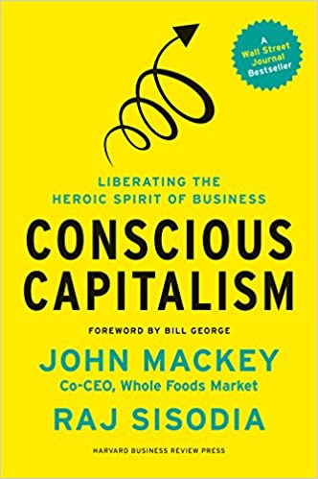
John Mackey, Rajendra Sisodia
Paperback : 368 pages
ISBN-10 : 1625271751
ISBN-13 : 978-1625271754
Publisher: Harvard Business Review Press; 1st Edition (January 7, 2014)

Slide 30
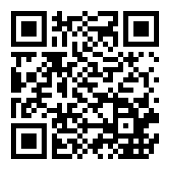
Nicolas Stahlhofer, Christian Schmidkonz, Patricia Kraft
Publisher: Springer; 1st ed. 2018 edition (November 25, 2017)
Series: CSR, Sustainability, Ethics & Governance
Hardcover: 122 pages
Language: English
ISBN-10: 3319697382
ISBN-13: 978-3319697383

Slide 31
Paul Polman, Andrew Winston
Publisher: ‎ Harvard Business Review Press (5 Oct. 2021)
Hardcover ‏ : ‎ 352 pages
ISBN-10 ‏ : ‎ 1647821304
ISBN-13 ‏ : ‎ 978-1647821302

Slide 32
Books:
Barrett, Richard (2014): The Value-Driven Organization – Unleashing Human Potential for Performance and Profit, Oxon
Birkinshaw, J., Foss, N.J. and Lindenberg, S.: Combining Purpose with Profits, MIT Sloan Management Review, Spring 2014, p. 49-56
Chouinard, Yvon (2006): Let My People Go Surfing: The Education of a Reluctant Businessman, New York
Frankl, Viktor F. (2021): Man’s Search for Meaning, London
Hurst, Aaron (2014): The Purpose Economy – How Your Desire for Impact, Personal Growth and Community Is Changing the World, Boise
Kahneman, Daniel (2011): Thinking, fast and slow, New York
Kofman, Fred (2006): Conscious Business – How to Build Value Through Values, Boulder
Mackey, John and Raj Sisodia (2014): Conscious Capitalism – Liberating the Heroic Spirit of Business, Boston
Polman, Paul and Andrew Winston (2021): Net Positive – How Courageous Companies Thrive By Giving More Than They Take, Boston
Reiman, Joey (2013): The Story of Purpose – The Path to Creating a Brighter Brand, a Greater Company, and a Lasting Legacy, New Jersey
Scharmer, Otto and Katrin Kaufer (2013): Leading from the Emerging Future – From Ego-System to Eco-System Economies, San Francisco
Sinek, Simon (2009): Start With Why – How Great Leaders Inspire Everyone to Take Action, London
Sisodia, Raj, David Wolfe and Jag Sheth (2014): Firms of Endearment – How World-Class Companies Profit from Passion and Purpose, Upper Saddle River
Tate, Carolyn (2015): Conscious Marketing – How to create an awesome business with a new approach to marketing, Milton
Stahlhofer, Nicolas, Christian Schmidkonz and Patricia Kraft (2018): Conscious Business in Germany, Cham
Tindell, Kip (2014): Uncontainable – How Passion, Commitment, and Conscious Capitalism Built a Business Where Everyone Thrives, New York

Slide 33
Prof. Dr. Christian Schmidkonz
Munich Business School
Elsenheimerstraße 61 80687 München GERMANY
Phone: +49 (0)89 54 76 78 - 14 Fax: +49 (0)89 54 76 78 - 29
Christian.Schmidkonz@munich-business-school.de www.munich-business-school.de LinkedIn: http://de.linkedin.com/in/schmidkonz/

