Slide 2
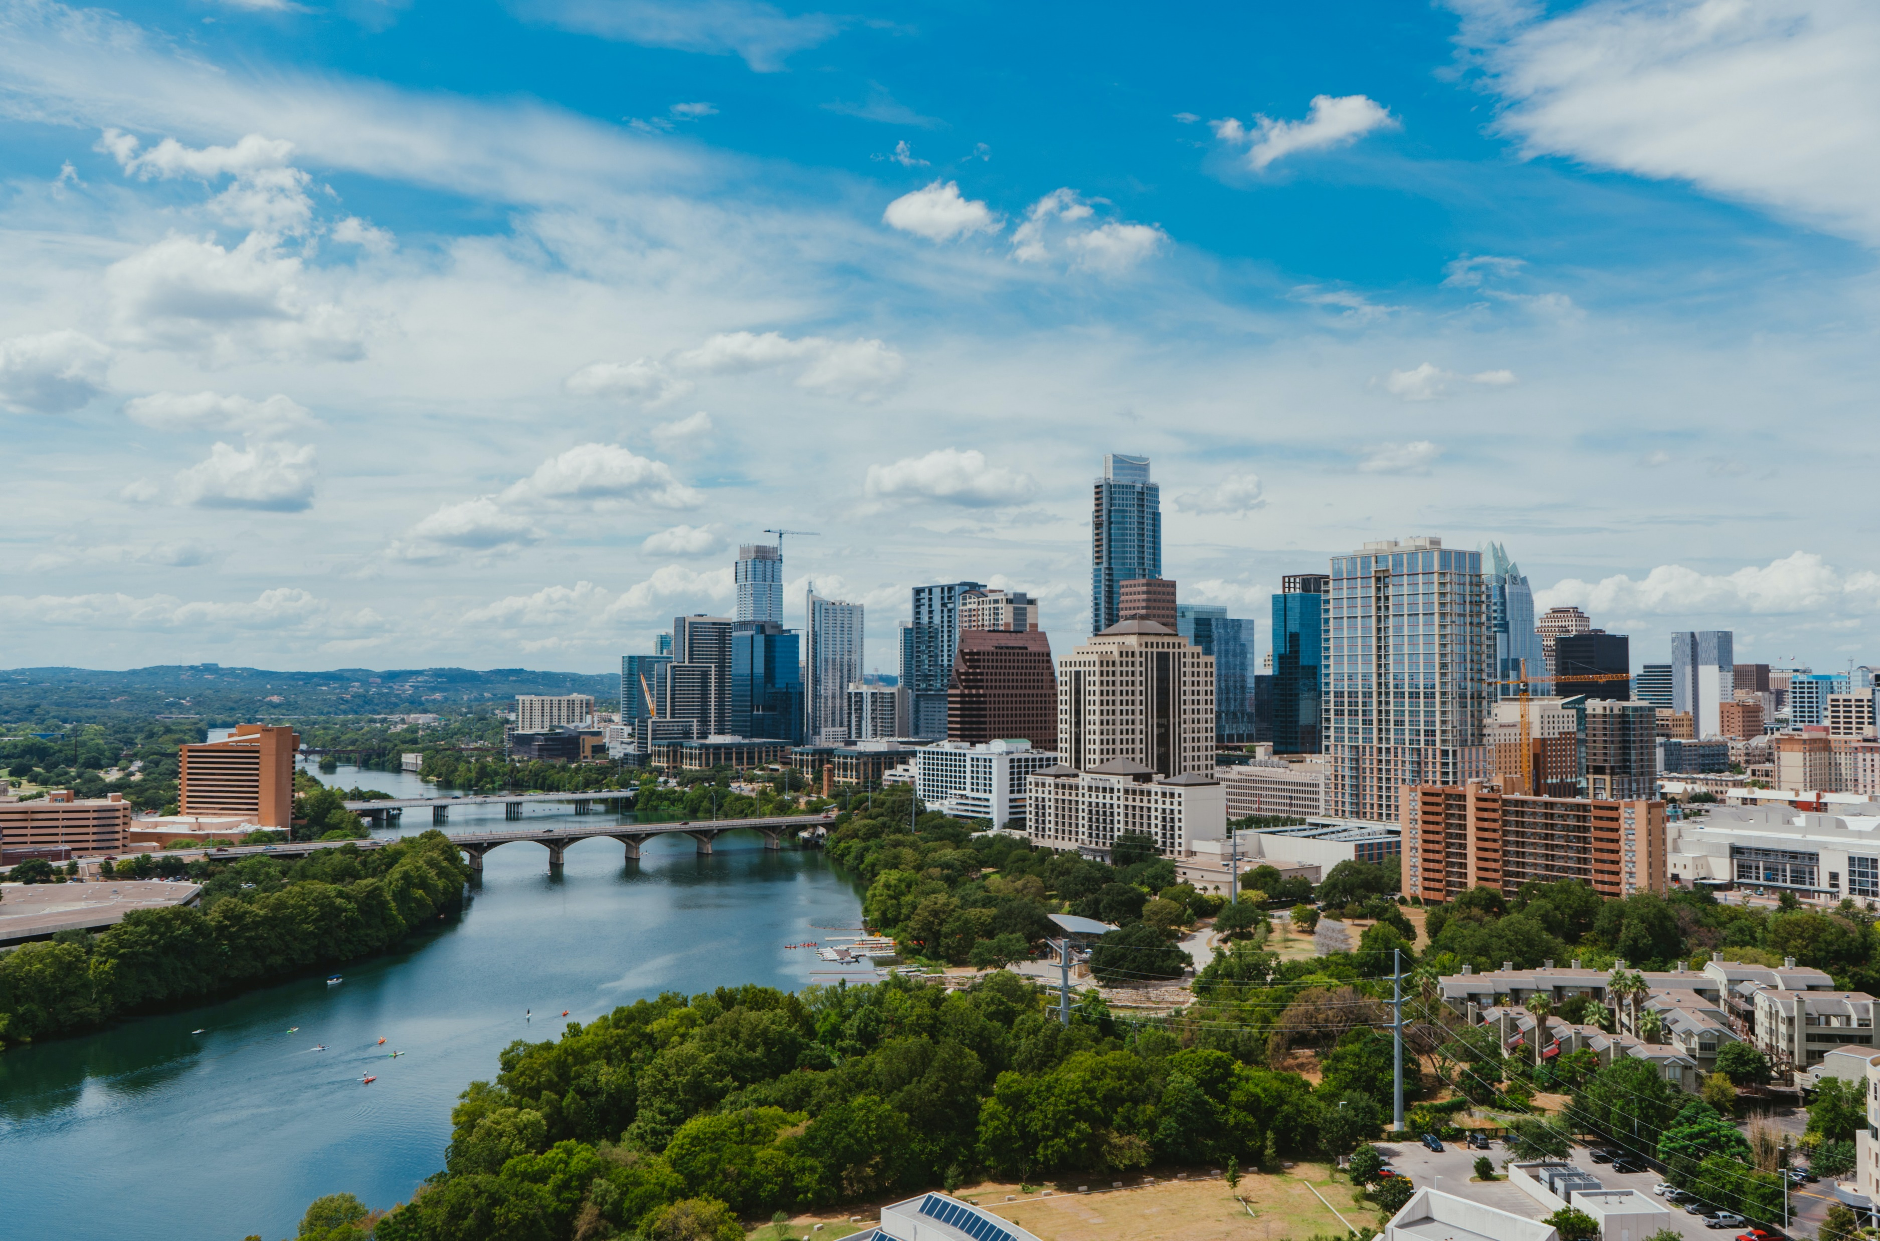
Conscious Business Four tenets of conscious capitalism

Slide 3
Teaching note for inner journey
In order to experience “consciousness” make sure to start each class with one of the exercises from the toolbox:
Selective attention test
Stroop test
Attentional blink deficit
Koan
Mindful check-in at beginning of class
…

Slide 4
This is a
Digital Detox
Analogue
Zone
Notes:
Teaching note
Turn the classroom into a digital detox zone. With this #framing students tend to put away their smartphones as well as laptops much easier than with the request to “put away your phones”.

Slide 5
Transition / Introduction
The four tenets of conscious capitalism
1st tenet: Higher Purpose
2nd tenet: Conscious Leadership
3rd tenet: Stakeholder integration
4th tenet: Conscious culture and management
Summary: Key questions
Reading recommendations and contact

Slide 6
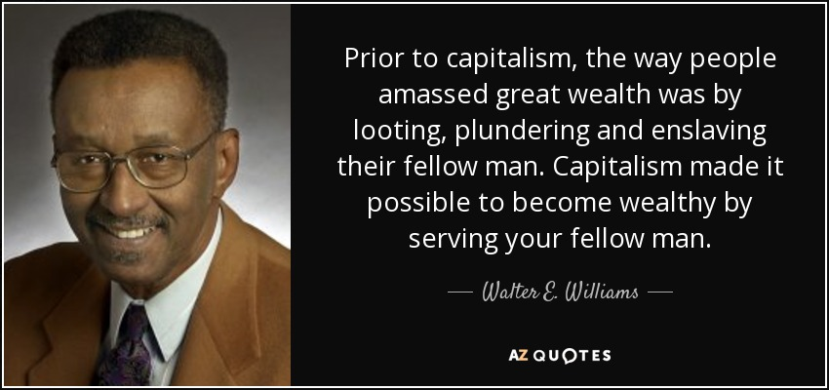
Source: https://www.azquotes.com/quote/500242
Notes:
Teaching note
Discuss this statement in class. Ask students, if and to what extend they agree with the statement.
Walter Edward Williams (March 31, 1936 – December 1, 2020) was an American economist

Slide 7
Be in business to express yourself and serve others. Not to serve yourself and use others. (Raj Sisodia)
Notes:
Teaching note
Discuss this statement in class. Ask students to give examples.

Slide 8
The “Conscious Capitalism Credo”
?
Source: https://www.consciouscapitalism.org/philosophy
Notes:
Teaching note
Read and discuss the „Conscious Capitalism Credo“ in class

Slide 9
Conscious Companies and consumers
96% have a more positive image of a conscious company than one without socially responsible practices
94% will be more likely to trust that company
93% will be more loyal to the company (i.e., continue buying products or services)
91% of global consumers are likely to switch brands to one that supports a good cause, given similar price and quality
92% would buy a product with a social and/or environmental benefit if given the opportunity, and 67% have done so in the past 12 months
Source: https://minutehack.com/opinions/the-benefits-of-conscious-capitalism, https://www.conecomm.com/
Notes:
Teaching note
Not all students might be convinced at this stage of the course that “conscious” and “business” is a promising fit. Share these points from a consumers’ perspective.

Slide 10
Transition / Introduction
The four tenets of conscious capitalism
1st tenet: Higher Purpose
2nd tenet: Conscious Leadership
3rd tenet: Stakeholder integration
4th tenet: Conscious culture and management
Summary: Key questions
Reading recommendations and contact

Slide 11
The foundations of conscious businesses
“A conscious business promotes mindfulness for all of its stakeholders. Employees are encouraged to investigate the world with rigorous scientific reasoning, and to reflect on their role in it with equally rigorous moral reasoning. They are invited to contemplate their own selves, finding what it means to live with virtue, meaning, and happiness. They are also asked to think of their colleagues as human beings, rather than as “human resources.” Finally, they are required to understand their customers, offering them products and services that support their growth and well-being. A conscious business fosters peace and happiness in individuals, respect and solidarity in the community, and mission accomplishment in the organization.”
Source: Kofman 2006
Notes:
Teaching note
Read this statement by Fred Kofman sentence by sentence and discuss with the students.

Slide 12
The four tenets (Grundsätze) of Conscious Capitalism
Interconnected and mutually reinforcing
Foundational, not tactics or strategies
Represent the essential elements of an integrated business philosophy that must be understood holistically to be effectively manifested
Stakeholder integration
Conscious leadership
Higher purpose
Conscious culture and management
Source: Mackey, Sisodia (2013)
Notes:
Teaching note
Briefly introduce the four tenets of conscious capitalism and make sure that students understand the additional points on the right.

Slide 13
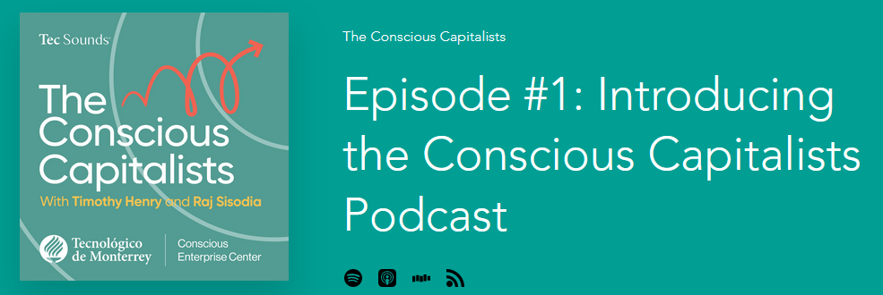
Listen to
Liste at https://www.theconsciouscapitalists.com/podcast/episode/49e16fa6/episode-1-introducing-the-conscious-capitalists-podcast

Slide 14
Transition / Introduction
The four tenets of conscious capitalism
1st tenet: Higher Purpose
2nd tenet: Conscious Leadership
3rd tenet: Stakeholder integration
4th tenet: Conscious culture and management
Summary: Key questions
Reading recommendations and contact

Slide 15
A Key question:
What are the two most important days in your life? (here: Richard Leider; most likely not Mark Twain)
The day you were born.
2. The day you realize why you were born.
Notes:
Teaching note
Often times this question is attributed to Mark Twain. Since there are doubts about that we use Richard Leider (https://richardleider.com/) as the originator.

Slide 16
Vision, mission and purpose are not the same
What matters
What we aspire to
What drives us
What guides us
IMPACT
Vision
What?
How?
Why?
Mission
Purpose
Identity / Values
Notes:
Teaching note
Strategy / tactics vs. purpose: long term (!) success (=purpose)

Slide 17
Three types of purpose
Personal Purpose
“Doing things we love, attempt new challenges, and express our voice to the world.”
Social Purpose
“Relationships matter more than anything else – they reinforce our sense of value, require us to engage, and ultimately help us grow.”
Societal Purpose
“We have done something that we believe matters – to others, to society, and to ourselves.”
“At its foundation the Purpose Economy creates purpose for people. It serves the critical need for people to develop themselves, be part of a community, and affect something greater than themselves.”
Source: Aaron Hurst
Notes:
Teaching note
In an education setting you can refer “personal purpose” to the individual student, “social purpose” to a team work project and “societal purpose” to the impact the student makes e.g. in social projects and/or after graduating.
“Societal purpose” can be referred to as “higher purpose” where the actor becomes part of something that is bigger than herself/himself.

Slide 18
Fundamental questions addressed by a conscious business with a higher purpose
A firm’s purpose is the glue that holds the organization together.
Why do we exist?
Why do we need to exist?
What is the contribution we want to make?
Why is the world better because we are here?
Would we be missed if we disappeared?
Source: Mackey, Sisodia (2013)
Notes:
Teaching note
Make sure students understand that they should apply these questions to the companies they are assigned to.

Slide 19
Example for multiple higher purposes: Wholefoods 2011
Wholefoods executive leadership 2011:
“We want to help evolve the world’s agricultural system to be both efficient and sustainable. This includes a much higher level of livestock animal welfare, seafood sustainability, and upgraded efficiency and productivity of organic agriculture.”
“We want to raise the public’s collective awareness about the principles of healthy eating: a diet that is centered on whole foods, is primarily plant based, is nutrient dense, and includes mainly healthy fats (minimal animal fats and vegetable oils). We believe this diet will radically improve the health of millions of people by helping prevent and reverse the lifestyle diseases that are killing so many of us— heart disease, stroke, cancer, diabetes, and obesity.”
“Through the Whole Planet Foundation, we want to help end poverty around the world by making microcredit working-capital loans to millions of impoverished people to help them create and improve their businesses.”
“We want to help make Conscious Capitalism the dominant economic and business paradigm in the world to spread human flourishing.”
Source: Mackey, Sisodia (2013)
Notes:
Teaching note:
Start with only showing the bullet points one by one and let students think about what company the statement could belong to. Point out that the statements gives an answer to the “Why” but not necessarily to the “What” and “How”

Slide 20
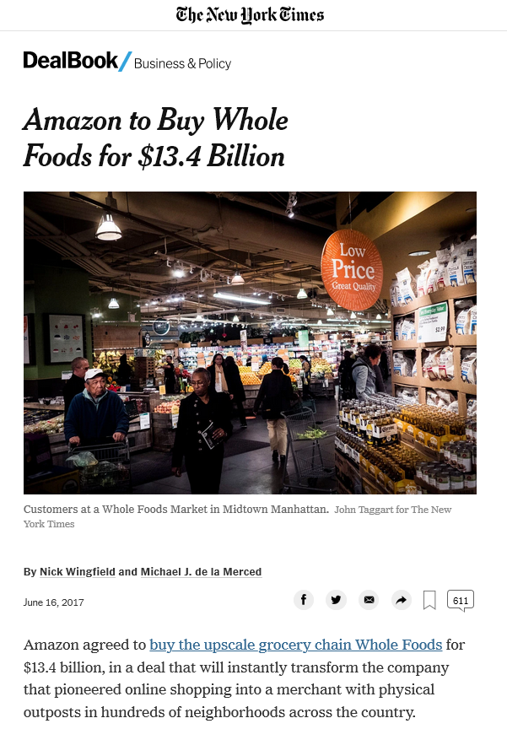
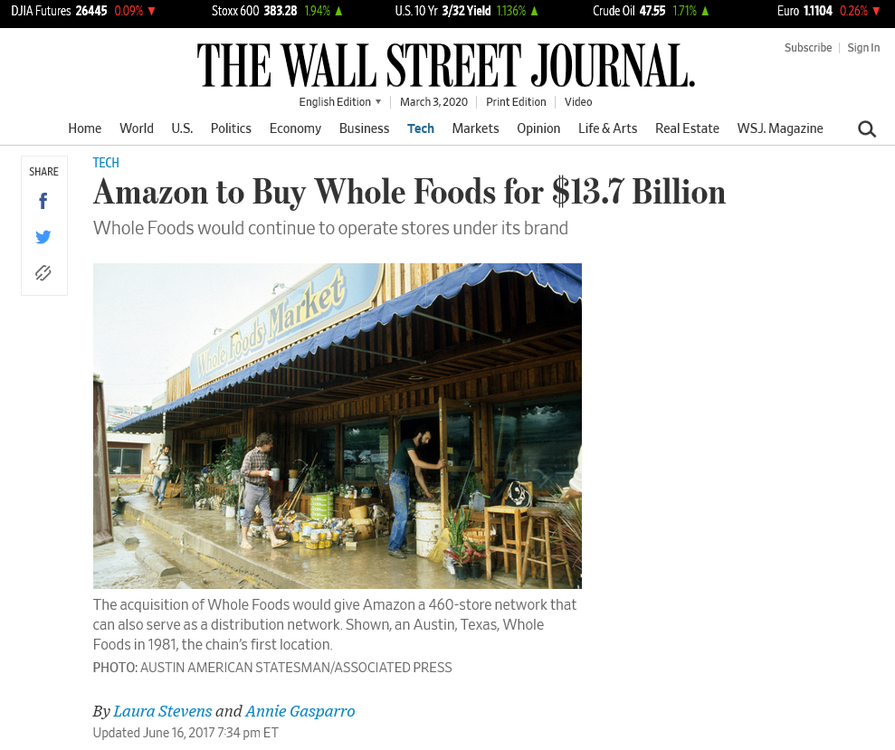
Source: https://www.nytimes.com%2F2017%2F06%2F16%2Fbusiness%2Fdealbook%2Famazon-whole-foods.html&usg=AOvVaw32v2V77aD36nHvjRPeiAal and https://www.wsj.com%2Farticles%2Famazon-to-buy-whole-foods-for-13-7-billion-1497618446&usg=AOvVaw2kjfVzcfRG9KMV3ZxTFq4O
Notes:
Teaching note:
Examples of the corporate value that can be created with a focus on doing business based on values.
Btw: point out that the difference in the headline is behind the “.” – but still $300m…

Slide 21
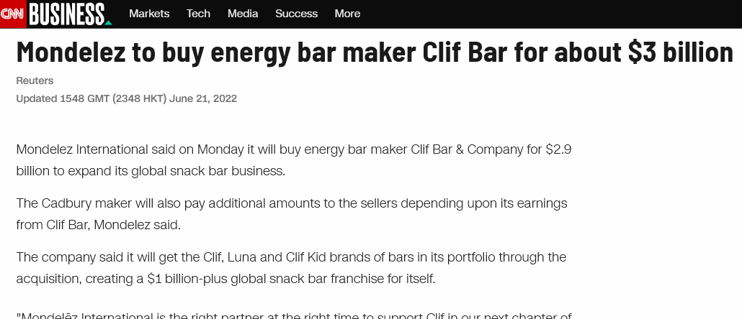
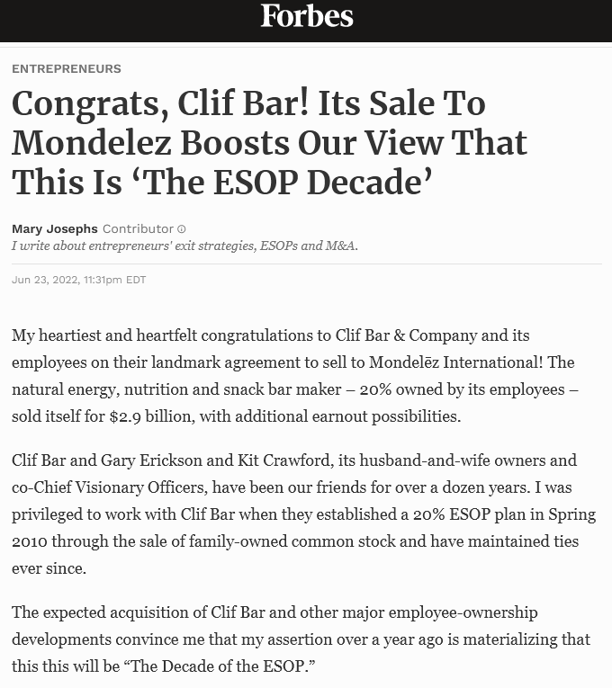
Source: https://edition.cnn.com/2022/06/21/business/mondelez-clif-bar/index.html
Source: https://www.forbes.com/sites/maryjosephs/2022/06/23/congrats-clif-bar-its-sale-to-mondelez-boosts-our-view-that-this-is-the-esop-decade/
*ESOP = Employee Stock Ownership Plan
Source: https://www.foodbusinessnews.net/articles/21904-mondelez-wraps-deal-for-clif-bar
Notes:
Teaching note
"We’re working to run a different kind of company: The kind of place we’d want to work, that makes the kind of food we’d like to eat, and that strives for a healthier, more sustainable world – the kind of world we’d like to pass on to our children. And those aren’t just words. They’re our mission statement.“ (Kit Crawford - https://www.clifbar.com/who-we-are)

Slide 22
Benefits of defining higher purpose
Motivation: People want to be recognized, to grow and to have made a difference. They want to maximize purpose – not profit. Purpose driven motivation is intrinsic – and therefor much more effective than extrinsic financial incentives.
Happiness: Happiness cannot be pursued; it ensues as the result of living a life of meaning and purpose. (Viktor Frankl – Man’s Search for Meaning) Pursuing happiness directly may result in short-term hedonistic pleasure, but it doesn’t lead to authentic, soul-satisfying happiness; that only comes from living a life of meaning and purpose. (Mackey, Sisodia)
Impact
Sustainable business performance – by not directly aiming for profits but making purpose the primary goal of the business.
Notes:
Teaching note:
Ask students what the benefits of defining/having a higher purpose can be and collect the answers.

Slide 23
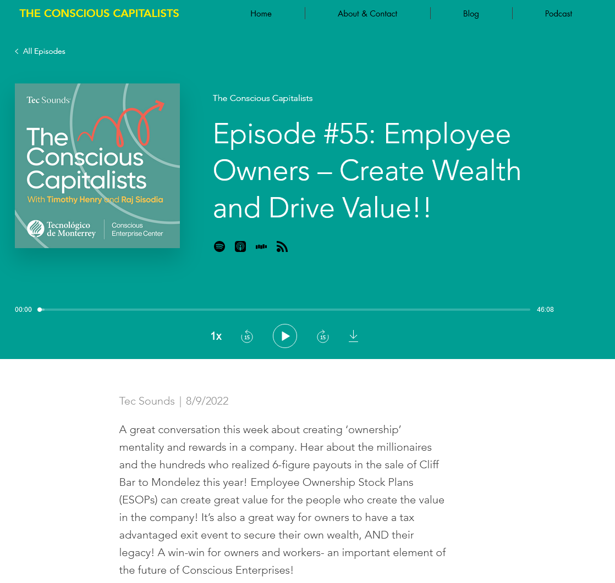
Homework
Source: https://www.theconsciouscapitalists.com/podcast/episode/1d846094/episode-55-employee-owners-create-wealth-and-drive-value
Notes:
Teaching Note
Listening to this podcast episode could be given as homework

Slide 24
Purpose in business practice!

Slide 25
Purpose statement:
“We’re in business to save our home planet.”
Notes:
Teaching note:
Start with only showing the statement and let students think about what company the statement could belong to. Point out that the statement gives an answer to the “Why” but not necessarily to the “What” and “How”

Slide 26
Patagonia purpose statement: “We’re in business to save our home planet.”
Source: https://www.patagonia.com/company-info.html
Notes:
Teaching note
Show the “solution” to the quiz on the slide before.

Slide 27
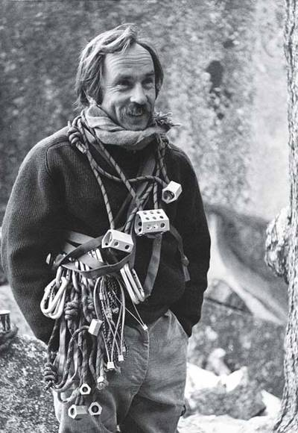
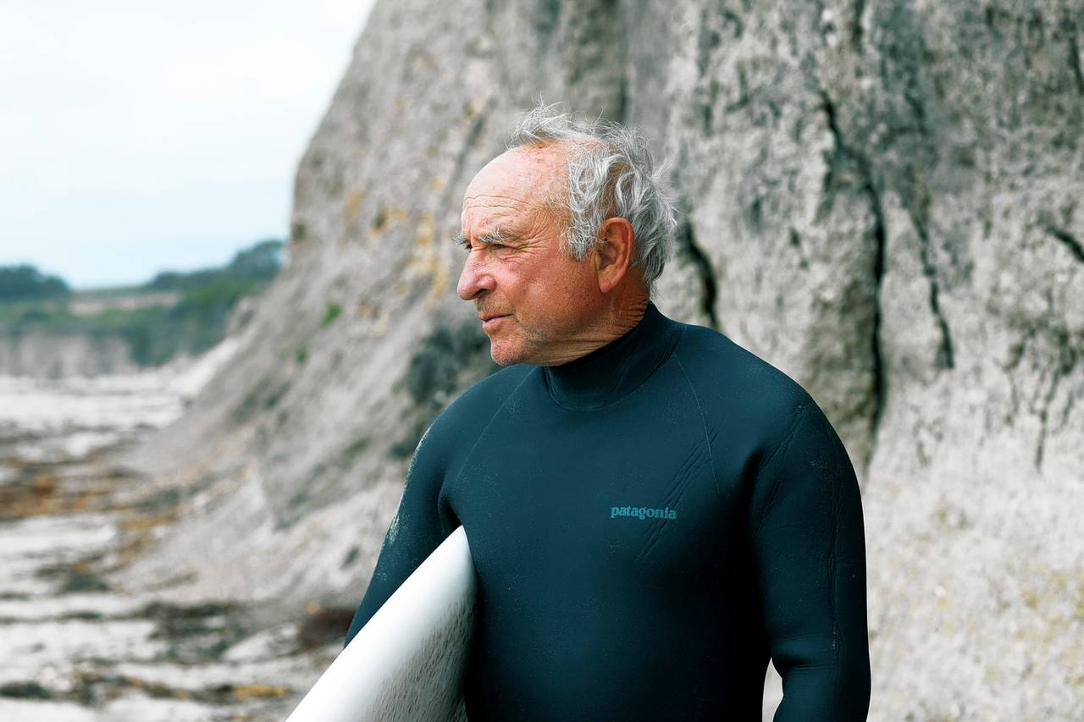
Yvon Chouinard, founder of Patagonia
Source: https://en.wikipedia.org/wiki/Yvon_Chouinard and https://www.lifegate.com/yvon-chouinard-2
Notes:
Teaching note
Introduce Yvon Chouinard, the founder of Patagonia and a “reluctant businessman” (self description).
Use the article https://www.inc.com/magazine/201303/liz-welch/the-way-i-work-yvon-chouinard-patagonia.html as reading material for the students and discuss in class.

Slide 28
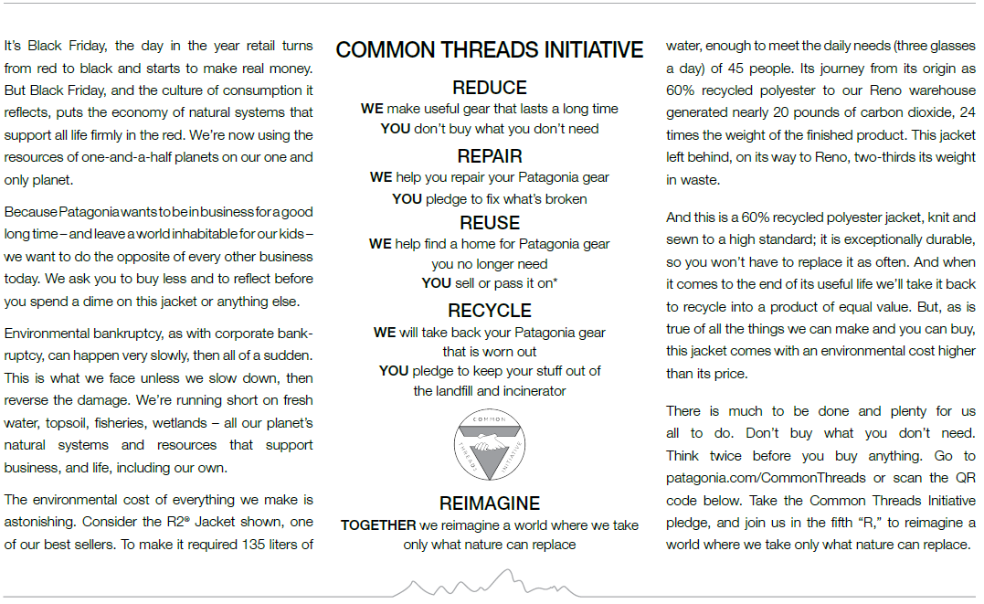
New York Times on Black Friday November, 25, 2011
Source: https://eu.patagonia.com/de/de/stories/dont-buy-this-jacket-black-friday-and-the-new-york-times/story-18615.html
Notes:
Teaching note
Introduce and discuss the „Don‘t Buy This Jacket“ campaign from Black Friday 2011 by Patagonia in the context of environmental consciousness. More info at https://eu.patagonia.com/de/de/stories/dont-buy-this-jacket-black-friday-and-the-new-york-times/story-18615.html

Slide 29
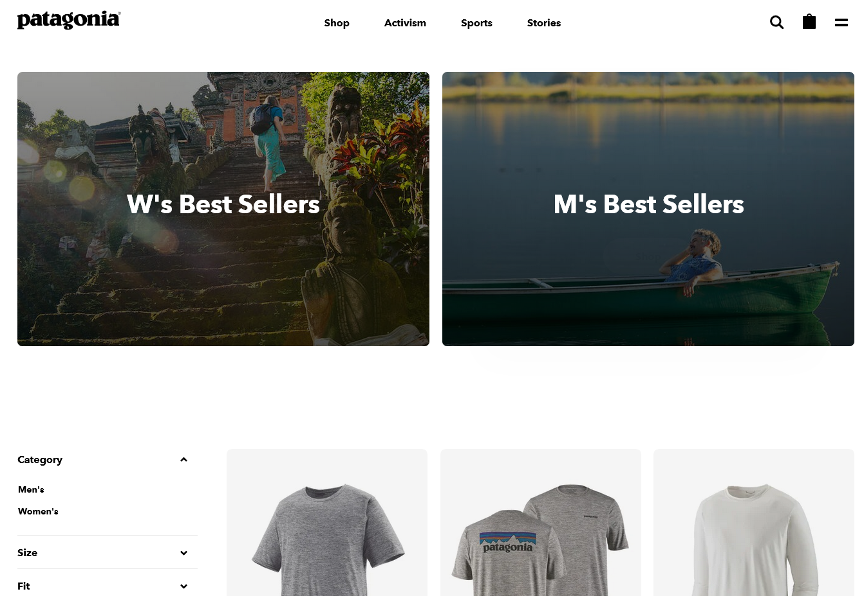
Source: https://www.patagonia.com/home/
Notes:
Teaching note
Point out the category “Activism” right next to “Shop” (https://www.patagonia.com/home/)

Slide 30
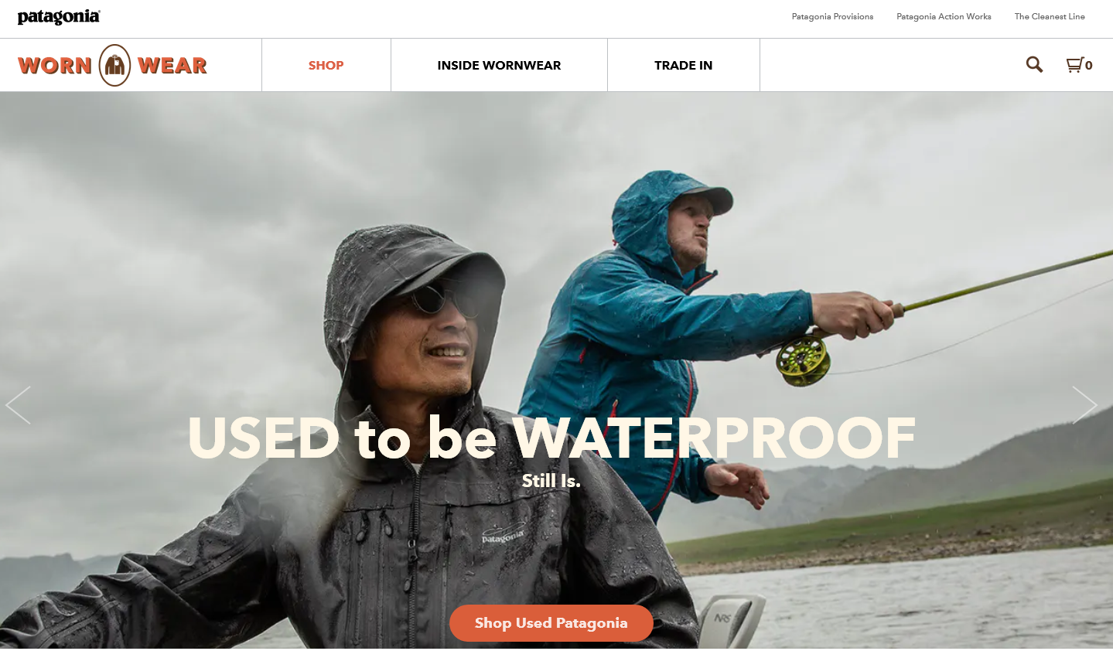
Source: https://wornwear.patagonia.com/
Notes:
Teaching note
Introduce the concept of “Worn Wear” to the students (https://wornwear.patagonia.com/)

Slide 31
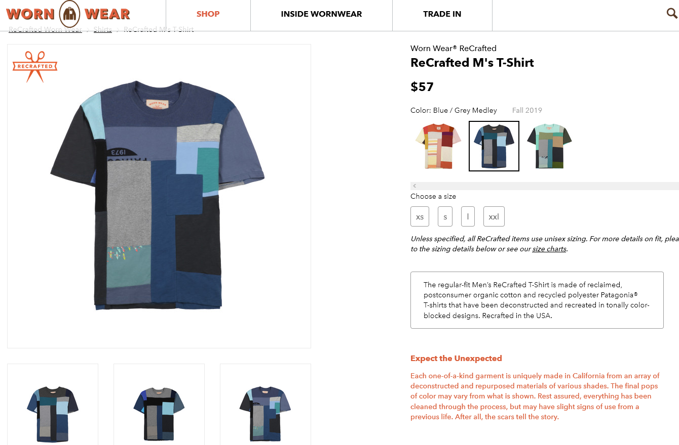
Source: https://wornwear.patagonia.com/
Notes:
Teaching note
Introduce this example of a shirt made out of many old, non usable shirts and sold on Patagonia Worn Wear. Each shirt is unique.

Slide 32
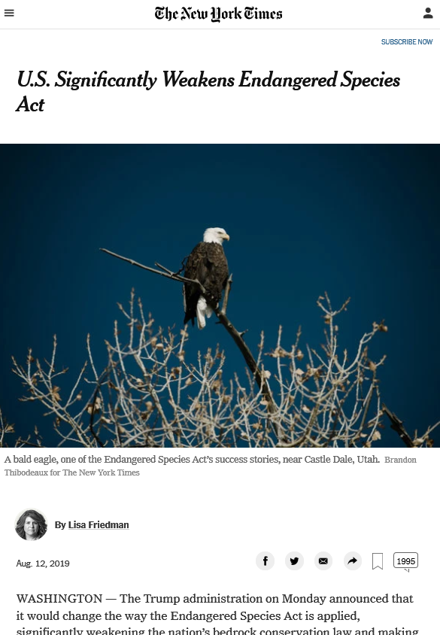
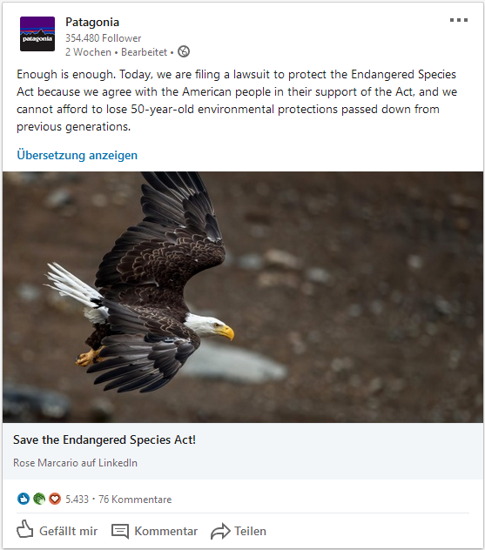
Source: https://www.nytimes.com%2F2019%2F08%2F12%2Fclimate%2Fendangered-species-act-changes.html&usg=AOvVaw2pUtBfybljdARxtGHmyinF and https://www.linkedin.com/company/patagonia_2/
Notes:
Teaching note
Patagonia calls itself an “activist company”. Discuss in class by e.g. using this example from 2019 (during DJT presidency).

Slide 33
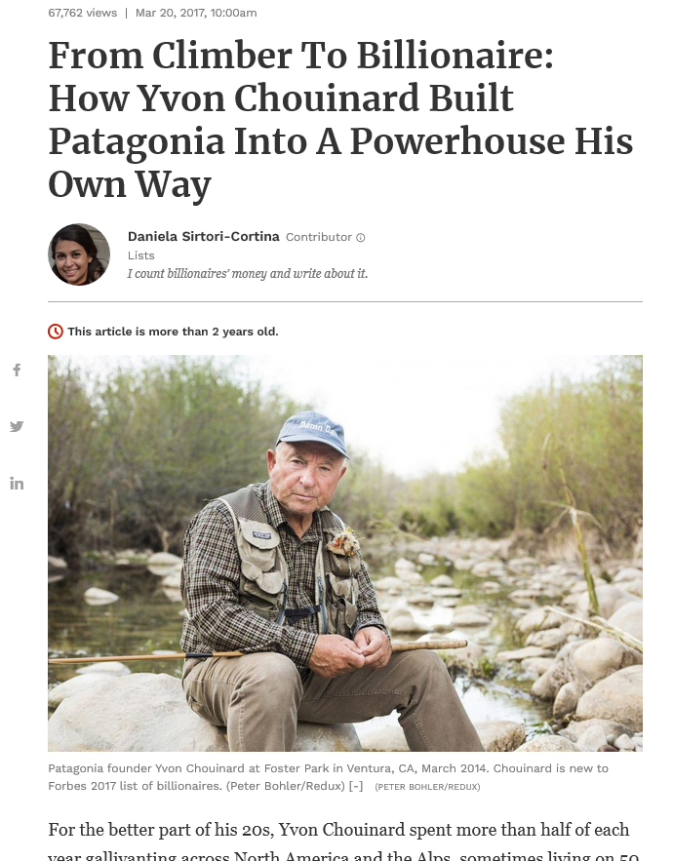
Source: https://www.forbes.com%2Fsites%2Fdanielasirtori%2F2017%2F03%2F20%2Ffrom-climber-to-billionaire-how-yvon-chouinard-built-patagonia-into-a-powerhouse-his-own-way%2F&usg=AOvVaw1LcdmrwQlvZjRZdC7_tfdh
Notes:
Teaching note
Show as another example of how strict adherence to running a values-based business can lead to the creation of financial values.

Slide 34
Instead of “going public,” you could say we’re “going purpose.” (14.09.2022)
Source: https://www.patagonia.com/ownership/
Notes:
Teaching note
Read and discuss with the students in class Yvon Chouinard‘s message at https://www.patagonia.com/ownership/

Slide 35
Source: https://www.patagoniaworks.com/press/2016/9/6/let-my-people-go-surfing
Notes:
Teaching note
Encourage the students to read this book.

Slide 36
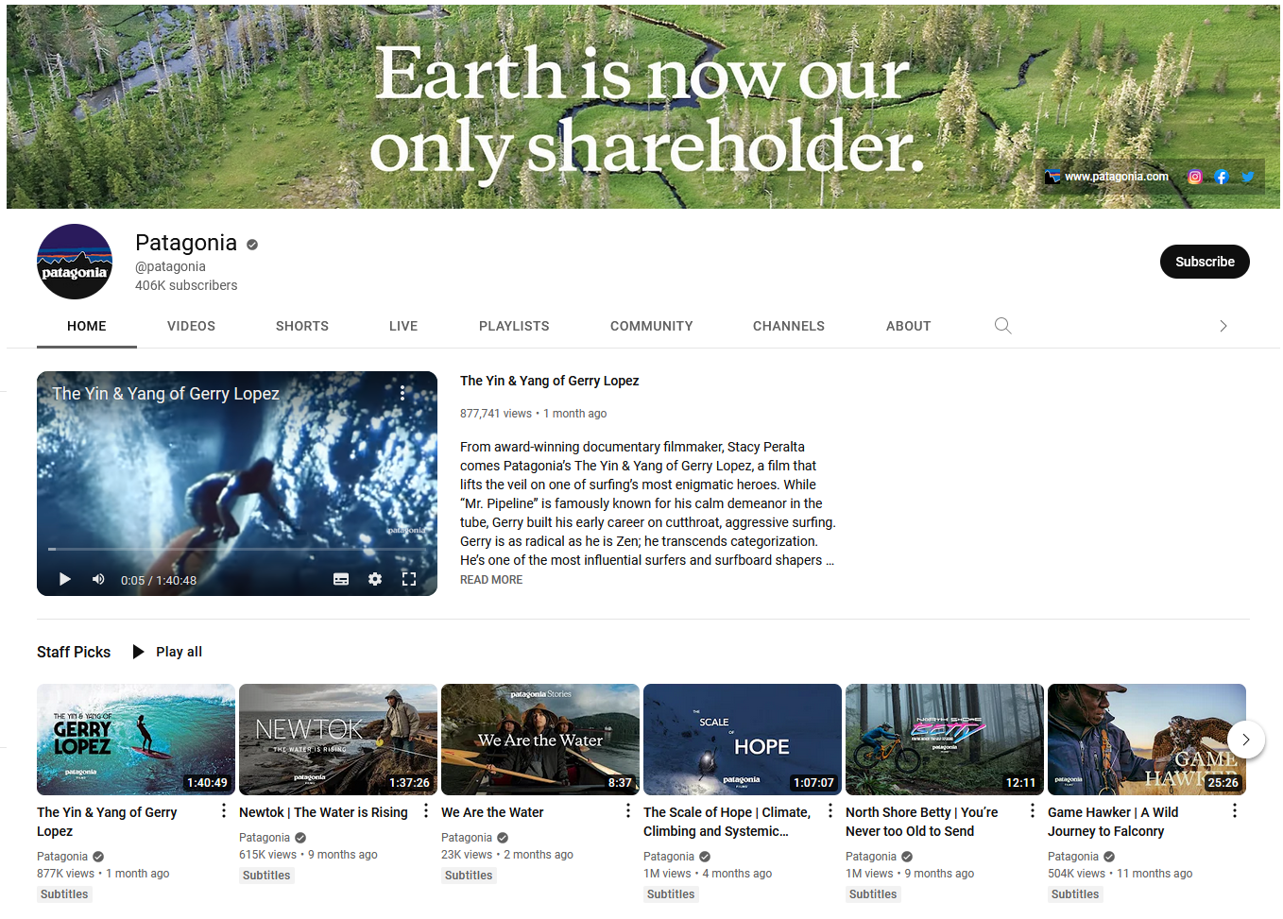
Source: https://www.youtube.com/@patagonia
Notes:
Teaching note
Encourage the students to watch a Patagonia film at https://www.youtube.com/@patagonia

Slide 37
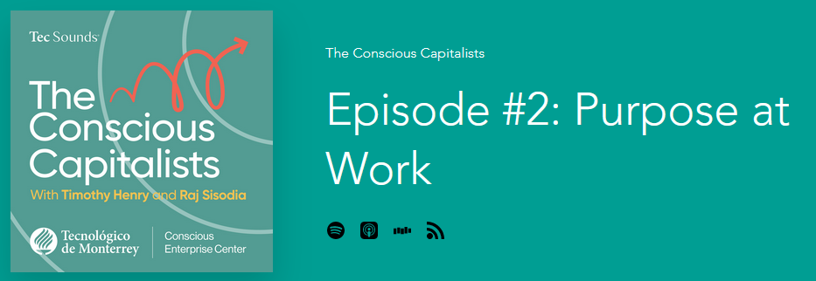
Listen to
Part 1 https://www.theconsciouscapitalists.com/podcast/episode/4d47c29f/episode-2-purpose-at-work
Part 2 https://www.theconsciouscapitalists.com/podcast/episode/4b665b5c/episode-3-purpose-at-work-part-2
Notes:
Teaching note
Homework

Slide 38
Case – Ecosia search

Slide 39
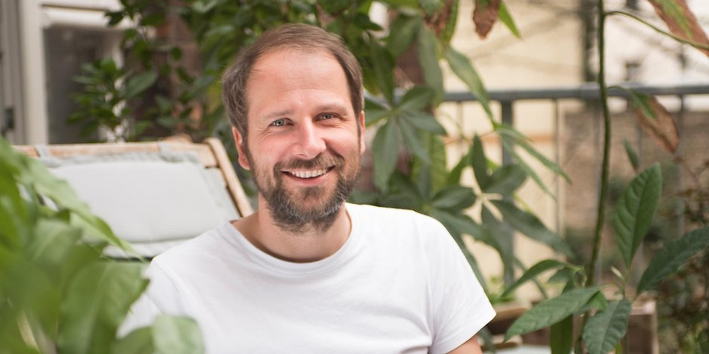
The Ecosia Story
Founded 2009 in Berlin by Christian Kroll (and Tim Schumacher as investor)
Revenue 2019: 9.1M€
80% of profits (ca. 50% of income) used to support tree planting projects
26,446 trees alone on Jan 23rd 2020 in Australia through “ReForest Now“
Offered 1M€ to buy Hambach Forest from RWE AG
Privacy: Encrypted searches, not permanently stored, data not sold to third-parties
Certified B Corp
Source: https://www.deutschlandfunkkultur.de/oeko-unternehmer-christian-kroll-wir-wollen-eine-milliarde-100.html
Notes:
Teaching note
Introduce the founder‘s story of Ecosia, the “search engine that plants trees”.

Slide 40
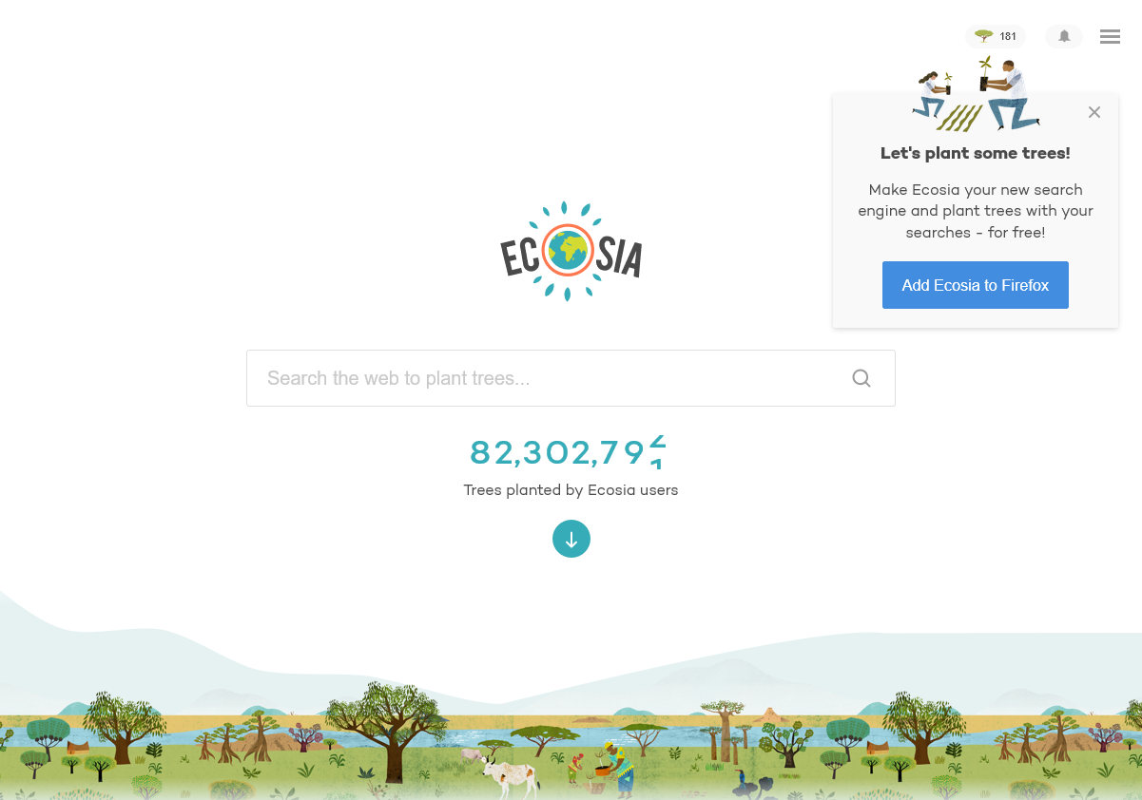
www.ecosia.org
Notes:
Teaching note
Go to https://www.ecosia.org/ and demonstrate the features of Ecosia. Enter e.g. “Allbirds” to see the search result with the leaf symbol, enter e.g. “Shell” in order to see a search result with a factory symbol.

Slide 41
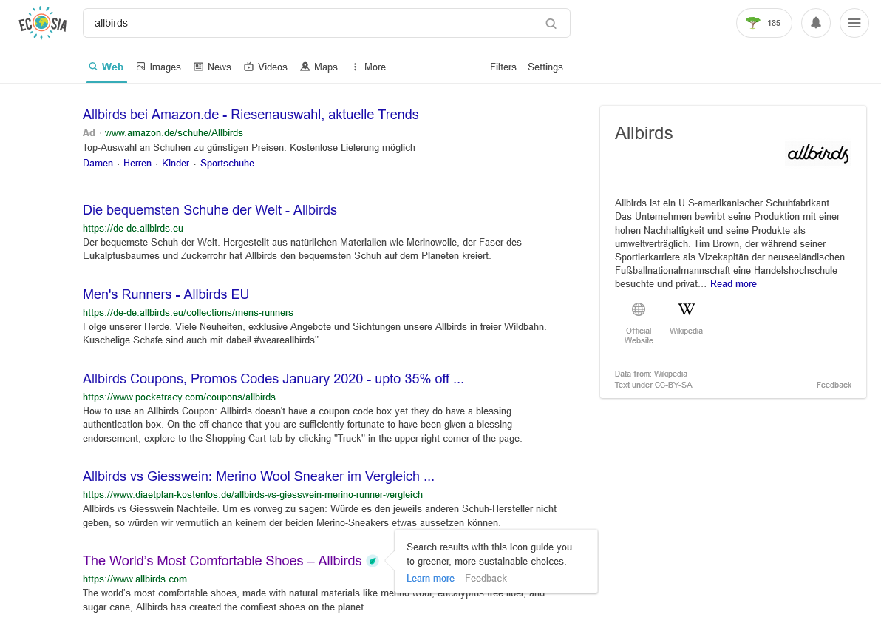
Notes:
Teaching note
Go to https://www.ecosia.org/ and demonstrate the features of Ecosia.

Slide 42
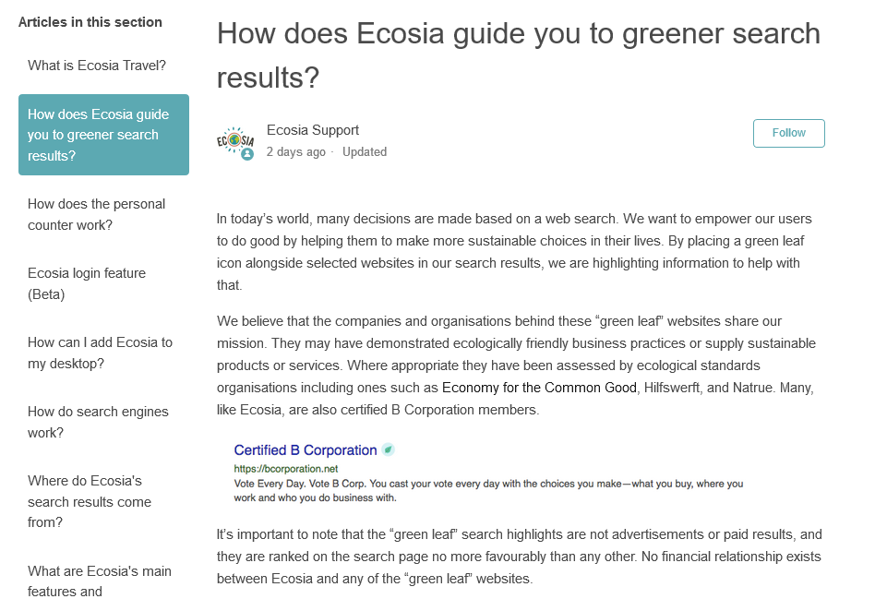
Source: https://ecosia.zendesk.com/hc/en-us/articles/360013117973-How-does-Ecosia-guide-you-to-greener-search-results-
Notes:
Teaching note
Share more information about how Ecosia works.

Slide 43
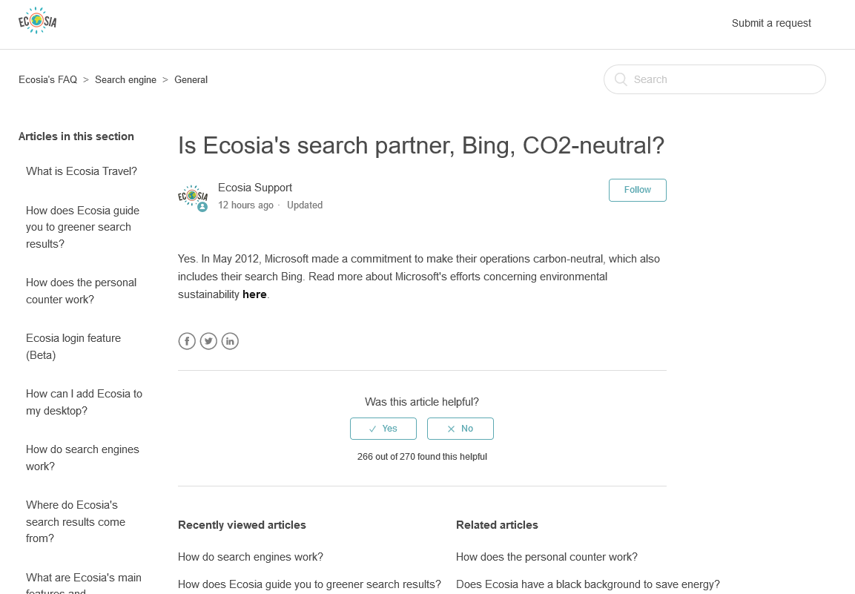
Source: https://ecosia.zendesk.com/hc/en-us/articles/204798431-Is-Ecosia-s-search-partner-Bing-CO2-neutral-
Notes:
Teaching note
Share more information about how Ecosia works.

Slide 44
The math behind planting a tree through search – and a carbon negative (!) business model
0.005 EUR per search x 45 searches = 0.225 EUR = 1 tree planted by partners
Average per search based on the fact that users click on a paid ad every x times
The CO2 footprint of an average search is estimated at 0.2 grams. On average, each tree planted removes 50 kg of CO₂ during an expected 15 year lifetime.
1 tree supports 250,000 searches
= 1 tree
= ca. 50 kg of CO₂ removal
= 1 kg CO₂ removal per search
If Ecosia was as big as Google, it could absorb 15% of all global CO₂ emissions – every year! That’s enough to offset vehicle emissions worldwide.
Carbon negative search!
Source: https://ecosia.zendesk.com/hc/en-us/articles/201531072-How-does-Ecosia-neutralize-a-search-s-CO2-emissions-
Notes:
Teaching note
Share more information about how Ecosia works.

Slide 45
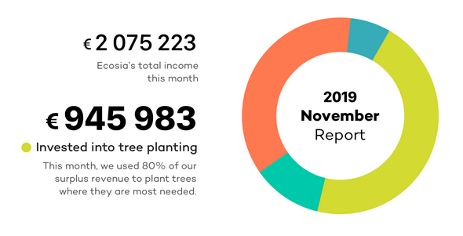
Money and transparency: Ecosia Financial Report (11/2019 – I)
Source: https://blog.ecosia.org/ecosia-financial-reports-tree-planting-receipts/
Notes:
Teaching note
Go to https://blog.ecosia.org/ecosia-financial-reports-tree-planting-receipts/ and go through the latest financial report together with the students. Make sure to point out the high degree of transparency.

Slide 46
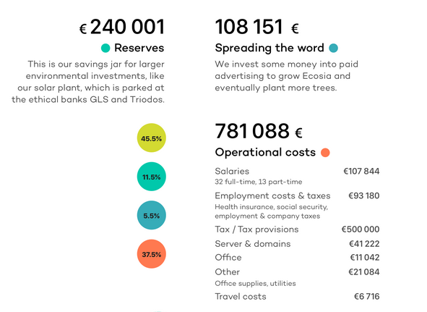
Money and transparency: Ecosia Financial Report (11/2019 – II)
Source: https://blog.ecosia.org/ecosia-financial-reports-tree-planting-receipts/
Notes:
Teaching note
Go to https://blog.ecosia.org/ecosia-financial-reports-tree-planting-receipts/ and go through the latest financial report together with the students. Make sure to point out the high degree of transparency.

Slide 47
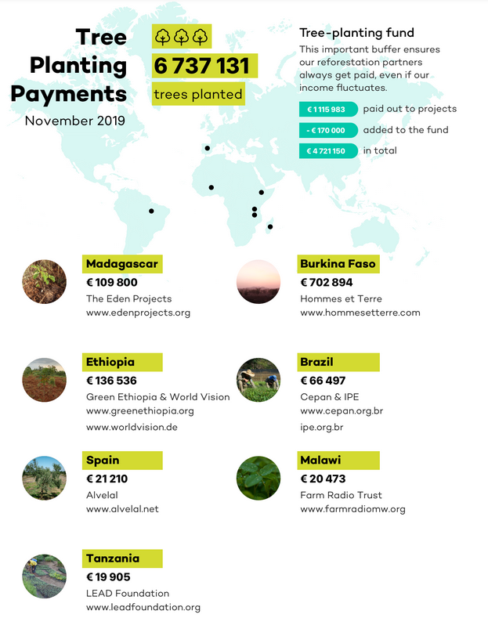
Money and transparency: Ecosia Financial Report (11/2019 – III)
Source: https://blog.ecosia.org/ecosia-financial-reports-tree-planting-receipts/
Notes:
Teaching note
Go to https://blog.ecosia.org/ecosia-financial-reports-tree-planting-receipts/ and go through the latest financial report together with the students. Make sure to point out the high degree of transparency.

Slide 48
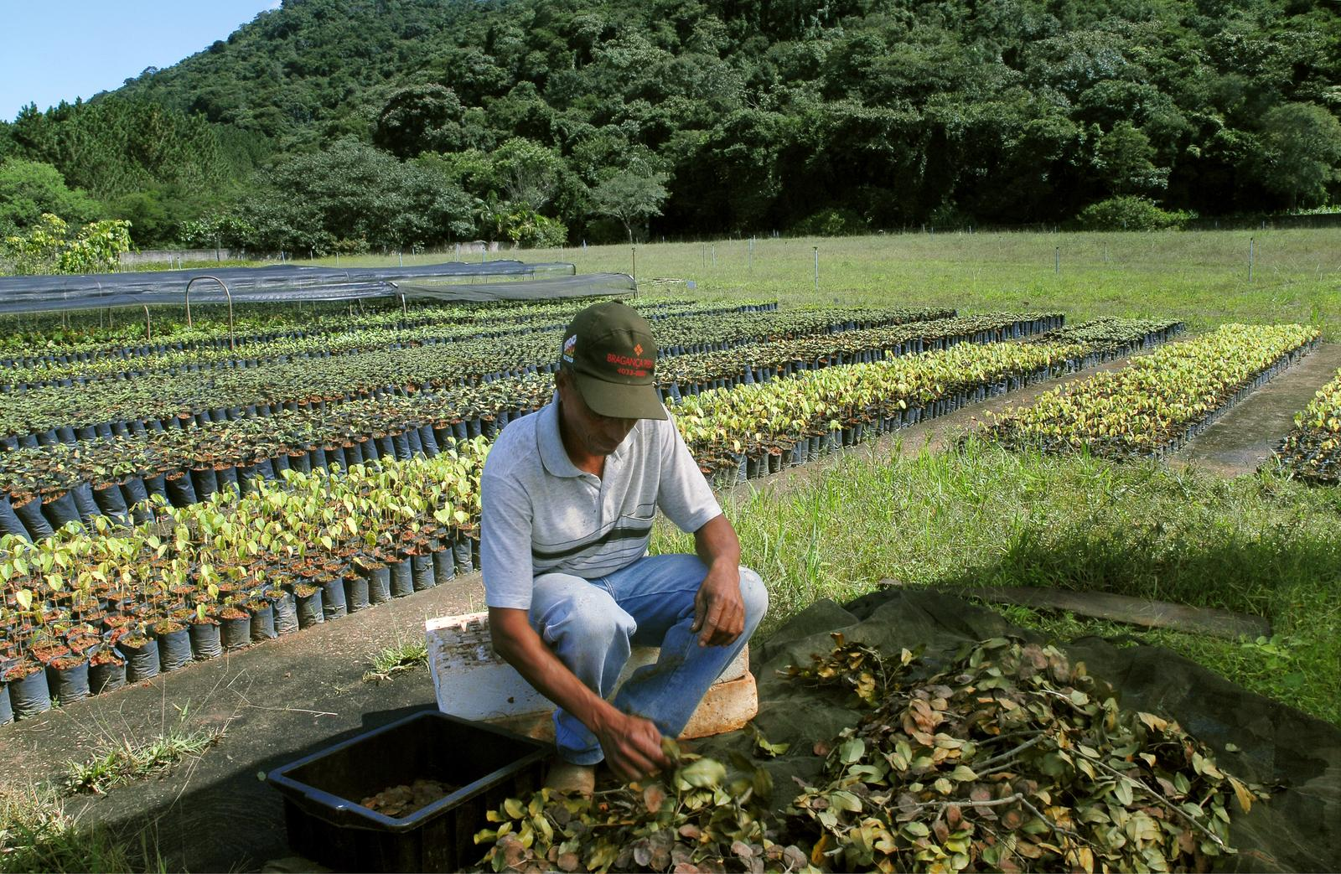
Organisations supported by Ecosia
Alvelal Eden Reforestation projects FairVentures Worldwide Foundation Green Ethiopia Friends of the Usambara Society Fundacion DIA Hommes et Terre Pacto Mata Atlantica Pur Projet Sumatran Orang-Utan Society (SOS) The Greenbelt Movement High Atlas Foundation The Jane Goodall Institute The Nature Conservancy TreeAid Ghana Trees for the Future
Source: https://ecosia.zendesk.com/hc/en-us/articles/115002296049-Does-Ecosia-accept-donations- and https://de.blog.ecosia.org/baeume-fuer-den-regenwald/
Notes:
Teaching note
You can ask the students to check out some of the supported organisations and share what they found out in the class.

Slide 49
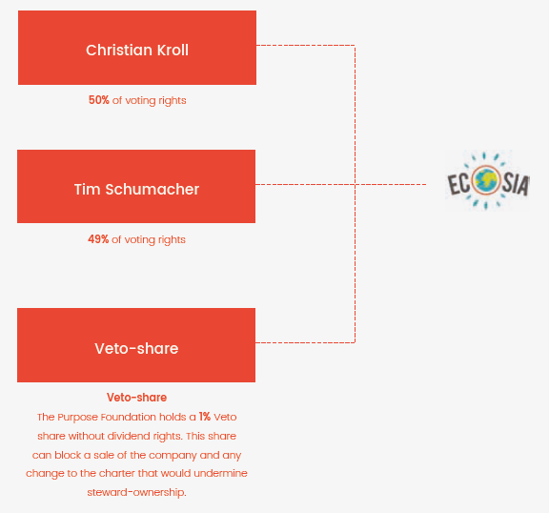
Ecosia’s Golden Share Steward Ownership model: separation of voting rights and dividend rights
Steward shares represent voting rights, but not dividend rights.
In the event that the founders leave the company, their steward-shares must be passed on to new team members.
One B-share was issued to “The Purpose Foundation”. The veto-share holder is responsible for vetoing any attempted sale of the company, along with any changes to the structure of Ecosia’s charter that would undermine its steward-ownership structure.
Source: Purpose Foundation
Notes:
Teaching note
Explain, how steward ownerships works (more at https://purpose-economy.org/en/) and why, therefor, there will never be a start-up exit for Ecosia. Discuss with the students what this means for Ecosia, the employees at Ecosia, the founders, users and other stakeholders.

Slide 50
Purpose in business practice?

Slide 51
Source: https://www.youtube.com/watch?v=-grjIUWKoBA
Notes:
Teaching note
Watch Nike‘s “30th anniversary” commercial and discuss with the students what they think of it and how authentic it is in their eyes (https://www.youtube.com/watch?v=-grjIUWKoBA)

Slide 52
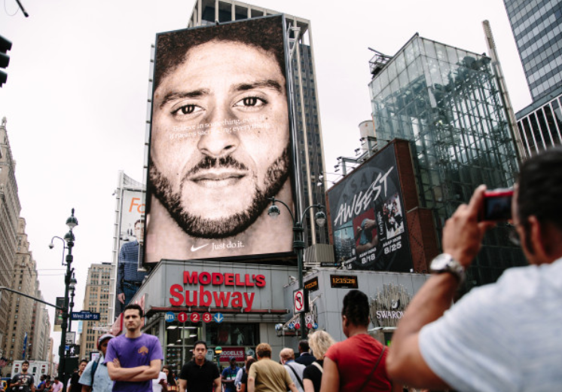
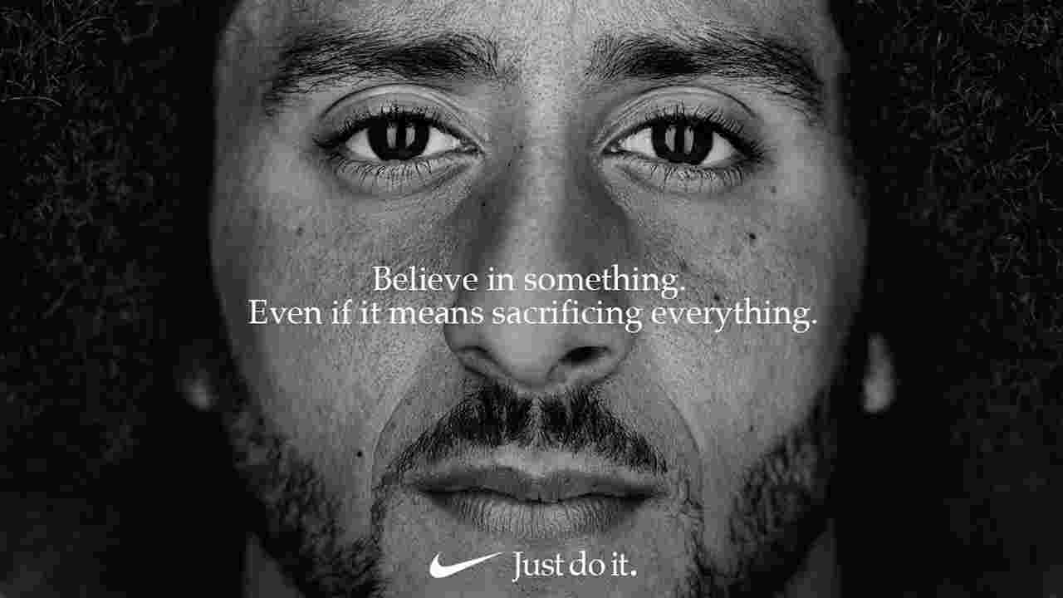
Nike 30th anniversary ad
Source: https://www.elle.com/fashion/a22968834/nike-campaign-colin-kaepernick/ and https://www.buzzfeednews.com/article/leticiamiranda/colin-kaepernicks-controversial-ad-campaign-gave-nike-a-big
Notes:
Teaching note
Colin Kaepernick – Nike 2018 (former quarterback for the San Francisco 49ers)
Give background information about the financial success of the campaign: “Nike's stock reached an all-time high by mid-September. The athletics-gear company also saw hefty gains in sales revenue throughout the month.”

Slide 53
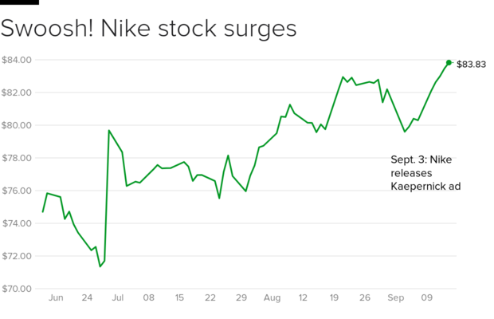
Result: Not only 170,000 new Instagram followers but also…
Source: https://www.cbsnews.com/news/nike-stock-price-reaches-all-time-high-despite-colin-kaepernick-ad-boycott/
Notes:
Teaching note
“The Kaepernick campaign, however, is resonating with the company's core customer base, such as millennial and Generation Z men, "in a way that is authentic, culturally relevant, experiential and emotionally engaging, […]” (https://www.cbsnews.com/news/nike-stock-price-reaches-all-time-high-despite-colin-kaepernick-ad-boycott/)

Slide 54
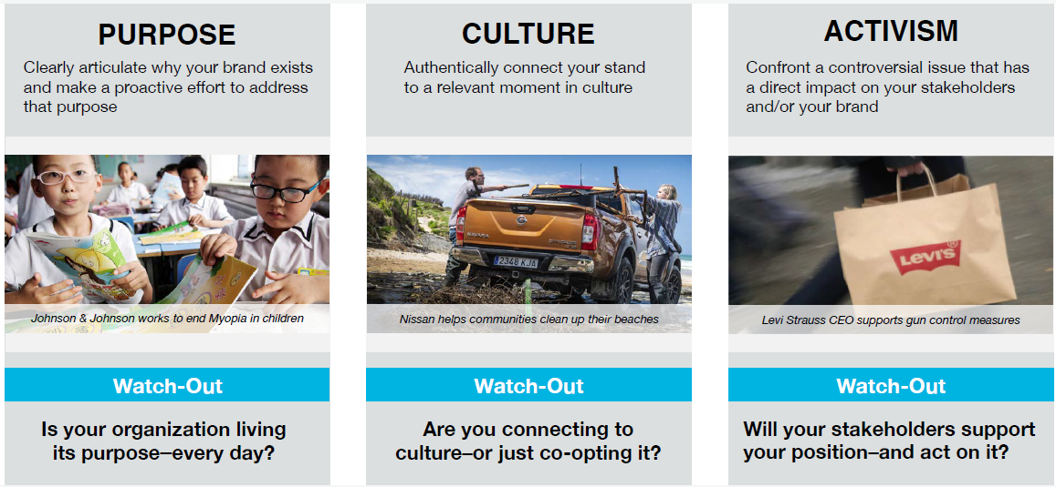
The brand stand spectrum (according to Edelman)
Source: Edelman Earned Brand 2018
Notes:
Teaching note
Discuss with the students what the difference between (authentic) purpose and activism is. You might also want to include business culture. For more background information check https://www.edelman.com/earned-brand

Slide 55
Notes:
Teaching note
Discuss what students think of this organic tomato and what it has to do with doing business in a conscious way – or not.

Slide 56
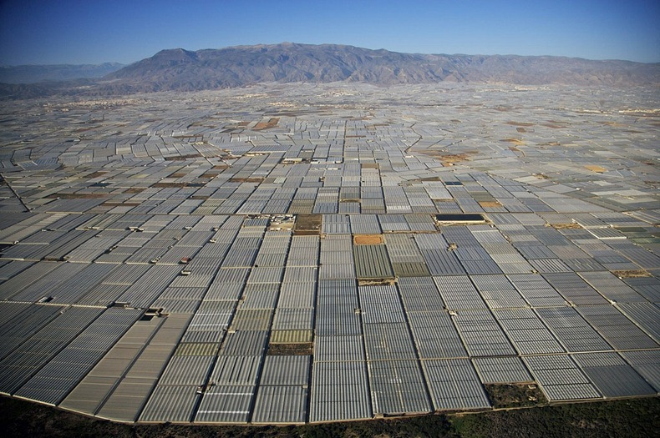
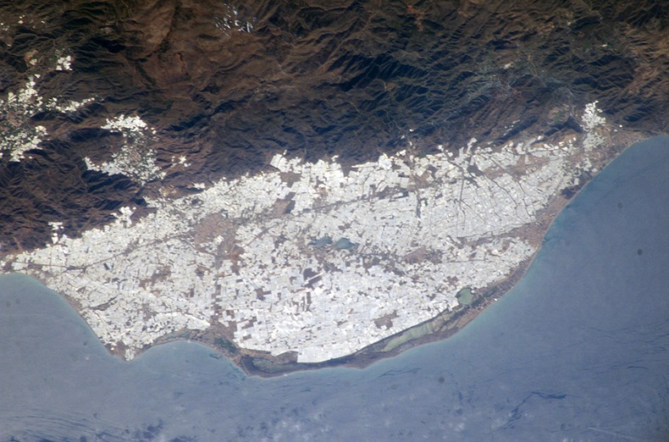
Source: https://www.amusingplanet.com/2013/08/the-greenhouses-of-almeria.html
Notes:
Teaching note
The greenhouses of Almeira, Spain, are the largest production facilities for organic tomatoes in Europe. However, the working conditions for often times African immigrants there are not conscious at all and the natural landscape got destroyed. The waters close to the spot are polluted with plastic coverings from the greenhouses. = What looks conscious from the outside is not necessarily conscious inside.

Slide 57
Green washing 2.0 = Purpose washing?
Purpose washing is the practice of making a claim about the benefits of a product, service, technology or company practice based on an unsubstantiated or misleading purpose.
Purpose washing can make a company appear to be more conscious than it really is.
Based on https://searchcrm.techtarget.com/definition/greenwashing
Notes:
Teaching note
The purpose washing definition is based on the following definition of greenwashing: “Greenwashing is the practice of making an unsubstantiated or misleading claim about the environmental benefits of a product, service, technology or company practice. Greenwashing can make a company appear to be more environmentally friendly than it really i.”s (https://searchcrm.techtarget.com/definition/greenwashing)

Slide 58
Beware of fake purpose!
“What does aboalarm stand for?”
We are the good ones!
=
Source: https://www.aboalarm.de
Notes:
Teaching note
(for the German audience) – “aboalarm” (“subscription alarm”) collected subscription data and helped subscribers to cancel their subscription (magazines, mobile phones, fitness studio, gas/water/power, …). The company was bootstrapped and claimed to be “the good ones” supporting customers in cancelling subscriptions. It was then sold ” incl. all customer data to “verivox” – a company that basically sells subscriptions based on price comparisons. The goal of this company is to sell as many subscriptions as possible.

Slide 59
Transition / Introduction
The four tenets of conscious capitalism
1st tenet: Higher Purpose
2nd tenet: Conscious Leadership
3rd tenet: Stakeholder integration
4th tenet: Conscious culture and management
Summary: Key questions
Reading recommendations and contact

Slide 60
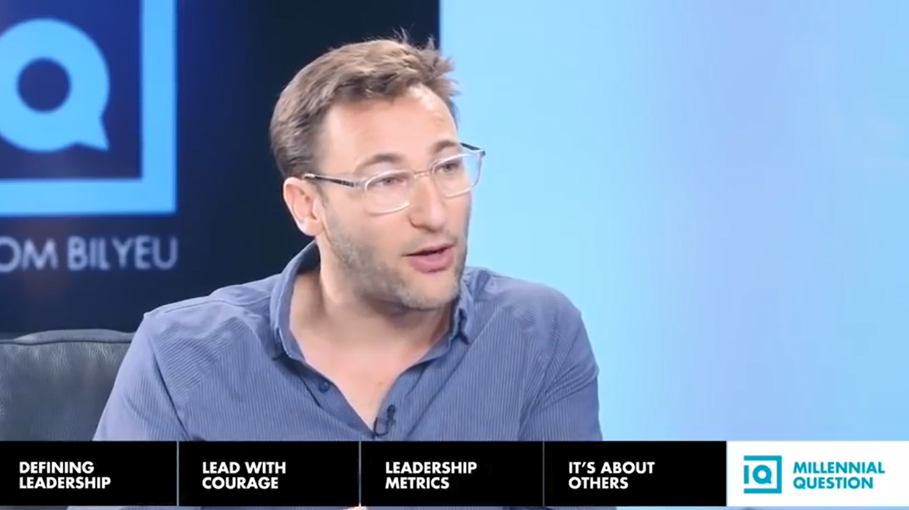
VIDEO - DISCUSSION: Simon Sinek on Millennials in the Workplace
Notes:
Teaching note
Watch/show https://www.youtube.com/watch?v=vudaAYx2IcE&t=16s (15 mins) and discuss with millennial students about what they expect from work and leaders

Slide 61
There are leaders and there are those who lead.
Leaders hold a position of power or influence.
Those who lead inspire us.
Whether individuals or organizations, we follow those who lead not because we have to, but because we want to. We follow those who lead not for them, but for ourselves.
(Simon Sinek – “Start with why”)
Notes:
Teaching note
Introduce these quotes and ask if students had experienced leaders with these qualities in e.g. internships or work

Slide 62
Top management’s main responsibility is to populate the company with “conscious employees”.
Lao Tzu
Leadership is the process by which a person sets a purpose for other persons and motivates them to pursue it with effectiveness and full commitment. Leadership transforms individual potential into collective performance.
Source: Fred Kofman, 2006
Notes:
Teaching note
Introduce these quotes and ask if students had experienced leaders with these qualities in e.g. internships or work

Slide 63
Characteristics of conscious leaders
Make a positive difference
Embed a Shared Purpose
Maintaining the status-quo is not the goal but making a lasting, positive impact on the world.
Inspire people not force people to do things.
Merchants of hope and entrepreneurs of meaning.
Telling the stories of “Who I am”, “Who we are” and “Where we’re going”.
Conscious Leadership
Help People Grow and Evolve
Make Tough Moral Choices
Treating people with respect, regardless of their rank or role.
Appreciation of the uniqueness of talents.
Choice between “right and right”.
Choice based on purpose and core values.
Seek strategies that simultaneously fulfill multiple values.
Source: Mackey, Sisodia (2013)
Notes:
Teaching note
Example for “Make tough moral choices” from Mackey, Sisodia (2013) and Whole Foods Market: selling meat – 1st educate about meat and health + increase animal welfare then 2nd sell

Slide 64
Conscious leaders are SELFLESS (Raj Sisodia)
Strength
Energy and enthusiasm
Spiritual intelligence
Long-term orientation
System intelligence
Flexibility
Emotional intelligence
Love and care
Notes:
Teaching note
For detailed background about Raj Sisodia‘s suggestion of a SELFLESS leader listen to the „Conscious Capitalists“ episodes #8 and #9 (https://www.theconsciouscapitalists.com/podcast/episode/4a43ad8e/episode-8-conscious-leadership-part-1 and https://www.theconsciouscapitalists.com/podcast/episode/4c75a950/episode-9-conscious-leadership-part-2).
Students should listen to these two episodes as homework.

Slide 65
VIDEO: How Southwest Airlines built its culture | Herb Kelleher
Hire for attitude,
train for skills,
look for leadership capabilities in every potential employee.
Seeking for employees with a
warrior spirit
servant’s heart
fun loving attitude
Source: https://www.youtube.com/watch?v=8_CeFiUkV7s&t=2s
Notes:
Teaching note
Watch https://www.youtube.com/watch?v=8_CeFiUkV7s&t=2s and discuss – then show the slide as a summary

Slide 66
Listen to
Part 1 https://www.theconsciouscapitalists.com/podcast/episode/4a43ad8e/episode-8-conscious-leadership-part-1
Part 2 https://www.theconsciouscapitalists.com/podcast/episode/4c75a950/episode-9-conscious-leadership-part-2

Slide 67
Transition / Introduction
The four tenets of conscious capitalism
1st tenet: Higher Purpose
2nd tenet: Conscious Leadership
3rd tenet: Stakeholder integration
4th tenet: Conscious culture and management
Summary: Key questions
Reading recommendations and contact

Slide 68
Differences of stakeholder integration between traditional and conscious businesses
Traditional business
Conscious business
Making trade-offs among stakeholders
Managers who make trade-offs advantageous to the investors are seen as good managers
→ Zero-sum thinking
Goal: Making all stakeholders better off
Business is the ultimate positive-sum game – even among competitors
→ Positive-sum thinking
Conscious business: “If we look for trade-offs, we always will find them. If we look for synergies across stakeholders, we can usually find those, too.”
Source: Mackey, Sisodia (2013)

Slide 69
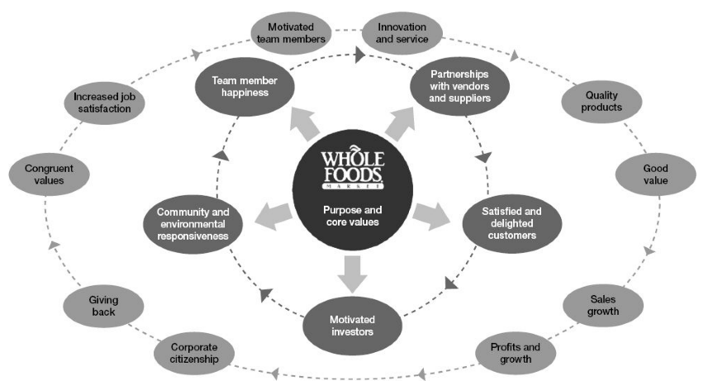
The Whole Foods Market Stakeholder Interdependence Model
The “Wholefoods Declaration of Independence” can be found at http://www.wholefoodsmarket.com/mission-values/core-values/declaration-interdependence
Notes:
Teaching note
Use this Whole Foods Market Stakeholder Map to introduce the concept of stakeholder maps and let the students create their own stakeholder maps for their companies.

Slide 70
Stakeholder relations and dimensions of stakeholder integration
All major stakeholders must be aligned with the purpose of the organization and with each other – and function as organs of a single body (corporate = corpus = body).
Patagonia: “We try to make all our stakeholders feel like they’re part of the tribe.” → team members are passionately engaged, customers are loyal, suppliers are treated as part of the family, investors are happy – so that they reinvest into the company
Loyal, trusting customers
Passionate, inspired team members
Patient, purposeful investors
Collaborative, innovative suppliers
Flourishing, welcoming communities
Healthy, vibrant environment
Source: Mackey, Sisodia (2013)
Notes:
Teaching note
Structure based on Mackey, Sisodia (2013)

Slide 71
Loyal, trusting customers

Slide 72
Developing close customer relationships
Company
Customer
In alignment with
values
PURPOSE
PASSION
Trust
Customers develop closer relationship with company.
Customers invest emotionally into company.
Customers tell the business when they believe it has to change, evolve, learn, …
Easier for company to form authentic customer relationships.
Truly delighted customers market the business for the company.
Source: Mackey, Sisodia (2013)

Slide 73
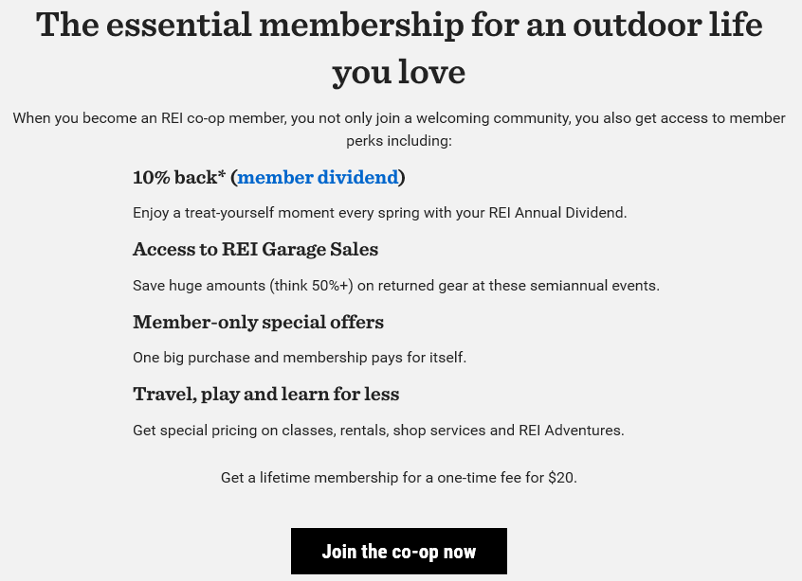
REI – turning customers into members
Source: https://www.rei.com/membership
Notes:
Teaching note
Explain how a special relationship with customers can be created when a “cooperative” is chosen as a company form. Customers then become members of the company with certain rights and benefits.

Slide 74
Loyal, trusting customers
Jeff Bezos: “In a typical company, if you have a meeting, no matter how important it is there is always one party who is not represented: the customer.”
How do you serve customers instead of selling something to customers?
Notes:
Teaching note
Examples for intensifying the customer relationship
Jeff Bezos used to put an empty chair in meetings representing the customer (which is usually not part of a company meeting)
Whole Foods Market: Customers are not customers but friends / guests

Slide 75
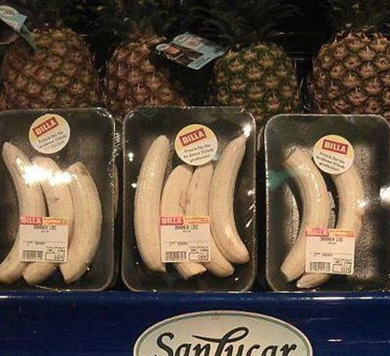
Challenges in creating close customer relationships for conscious businesses
Educating the customer: What if the customer doesn’t want to buy what you think is good for him/her? (e.g. chips and coke instead of organic vegetables)
The educating customer: Social media S***storm because of packed peeled bananas
'If only nature would find a way to cover these fruits!'
Source: Christian Schmidkonz, CC BY-NC
Notes:
Teaching note
Conscious companies sometimes try to educate the customer to make better decisions by e.g. pricing meat with what it really costs and tell the customer to by less meat since its production has negative impacts.
It also works the other way round: customers educate companies by e.g. creating s***storms on social media when a company makes highly questionable packaging decisions (s. photo on the right)
Ultimately the customer decides what to buy – and wants to have this freedom

Slide 76
Passionate, inspired team members

Slide 77
12%
15% / 61% / 24%
450-550 billion US$
Notes:
Teaching note
Start this chapter with showing the plain numbers, which asks students to be alert and guess what these numbers could be for.
- Happy employees are 12% more productive
- Gallup: 15% of emplyees very engaged, 61% engaged, 24% actively disengaged (Germany)
- Yearly loss because of unhappy employees in the U.S.A. estimated to account for 450-550 b US$

Slide 78
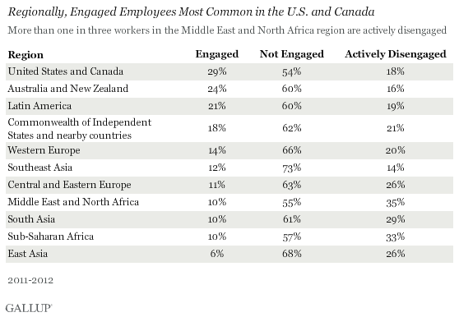
Engagment of employees according to world regions
Source: http://www.gallup.com/poll/165269/worldwide-employees-engaged-work.aspx
Notes:
Teaching note Gallup researchers write: “The bulk of employees worldwide -- 63% -- are "not engaged," meaning they lack motivation and are less likely to invest discretionary effort in organizational goals or outcomes. And 24% are "actively disengaged," indicating they are unhappy and unproductive at work and liable to spread negativity to coworkers. In rough numbers, this translates into 900 million not engaged and 340 million actively disengaged workers around the globe.” See: http://www.gallup.com/poll/165269/worldwide-employees-engaged-work.aspx

Slide 79
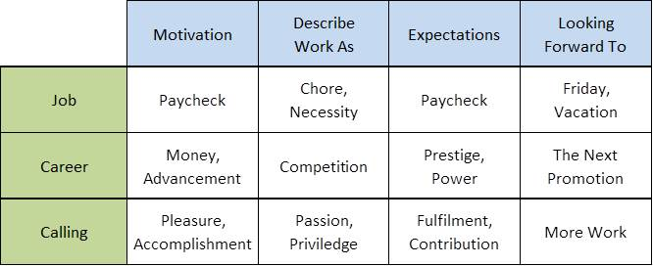
The differences between a job, career and a calling
“What can I do?”
vs.
“What would I like to do?”
Source: Amy Wrzesniewski, 2001
Notes:
http://idealatwork.com/job-calling/

Slide 80
Example: Great Place to Work® rankings
Source: https://www.greatplacetowork.com/best-workplaces
Notes:
Teaching note
Original not available any more (http://reviews.greatplacetowork.com/rankings/2016-best-workplaces-for-millennials)
See the most recent lists at https://www.greatplacetowork.com/best-workplaces

Slide 81
Patient, purposeful investors

Slide 82
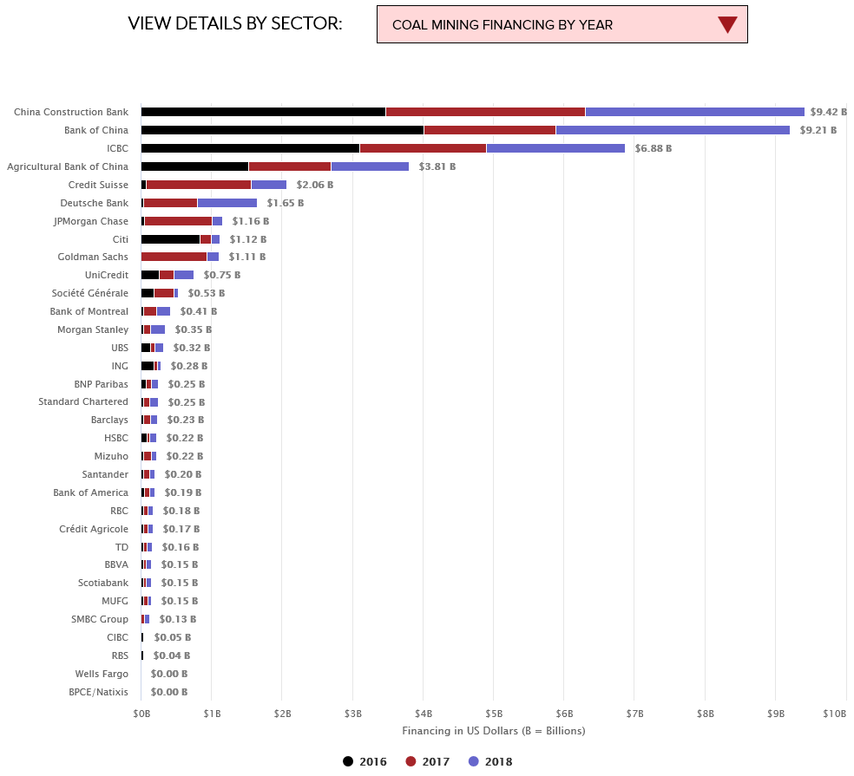
Which bank to choose as a conscious business?
Source: https://www.ran.org/bankingonclimatechange2019/
Notes:
Teaching note:
Discuss with students the impact of business-banks relationships and what choices could be made.

Slide 83
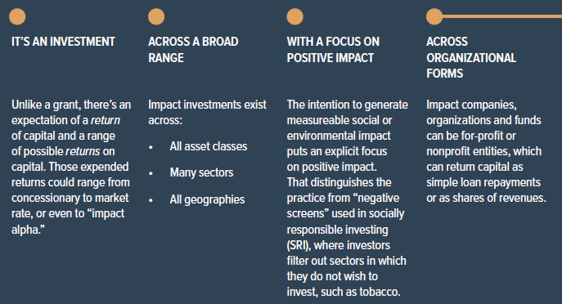
Excursus: An impact investing overview
Source: “A short guide to impact investing” – The Case Foundation, 2015
Notes:
Teaching note:
If applicable, a small intro into Impact Investing could be placed here. This often times can be very well refer to a finance course taught in the same program. Students are then able to see, what is maybe missing in the finance course and reflect on what is taught and potentially missing in corresponding courses.

Slide 84
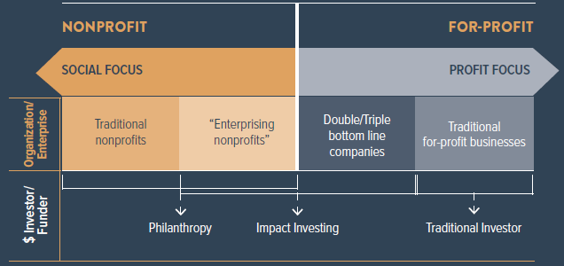
Excursus: Impact investing - definition
“Investments made into companies, organizations, and funds with the intention to generate social and environmental impact alongside a financial return” (Global Impact Investing Network (GIIN))
Source: “A short guide to impact investing” – The Case Foundation, 2015

Slide 85
Investors’ financial return in the case of FoEs vs. S&P 500
Notes: – Company returns are total returns with dividends reinvested and compounded. – a: Companies from Firms of Endearment, updated by authors. – b: Standard & Poor’s index of five hundred U.S. companies
Source: Sisodia, Raj, David Wolfe and Jag Sheth (2014): Firms of Endearment – How World-Class Companies Profit from Passion and Purpose

Slide 86
Collaborative, innovative suppliers

Slide 87
Opportunities to create win-win outcomes with suppliers
Finding opportunities to create value e.g. The Container Store placing orders during suppliers’ slow seasons
Paying on time e.g. Korean steelmaker’s POSCO policy to pay within 3 days
Treating suppliers fairly e.g. saving reputation by fairly treating any supplier
Helping suppliers survive and flourish e.g. REI prepaying small suppliers during economic difficulties
Sharing the wealth e.g. POSCO’s benefit-sharing program for tier one suppliers generating hundreds of innovation
Notes:
Teaching note
POSCO is a multinational steel-making company headquartered in Pohang, South Korea

Slide 88
Flourishing, welcoming communities

Slide 89
Businesses exist within local, national, global as well as virtual communities of common interests.
Corporate Citizenship programs offer a triple benefit: 1. to communities by solving problems on the ground 2. to the individual by providing them with an exemplary form of leadership training and development 3. to the company by developing a new generation of global leaders.
Example for local citizenship: Whole Foods: “5 percent day” – 5 percent of gross sales at one store is donated to local non profit organizations – the local team decides about the recipient.
Example for global citizenship: Planterra Foundation by G Adventures – “To improve people’s lives by creating and supporting social enterprises that bring underserved communities into the tourism value chain.”.

Slide 90
Conscious companies creating win-win-win in communities
Company
providing money, operational expertise, and intellectual capital
Support of community
Nonprofit organization
providing projects, highly motivated workers and relationship networks
Notes:
Teaching note
Win-win-win = Company, NPO/NGO, local Community

Slide 91
Healthy, vibrant environment

Slide 92
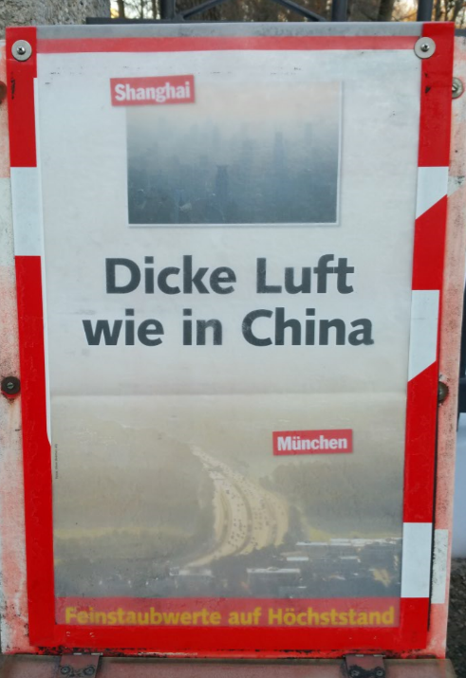
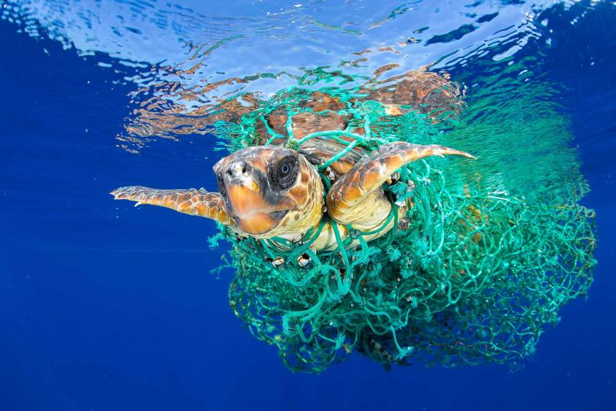
The environment – the silent and ultimate stakeholder
“Thick air – just like in China” Shanghai and Munich in winter
Source: World Press Photo 2017, Francis Pérez, category: nature
Source: Christian Schmidkonz, CC BY-NC
Notes:
Teaching note
Since environmental topics are constantly discussed in this class you can here refer to the examples which were already discussed or start a new discussen e.g. about marine health (left) or point out that there is a lot that should be done at home and you should not always only point to other countries to take care of environmental protection (right)

Slide 93
Part 1 https://www.theconsciouscapitalists.com/podcast/episode/49cab8be/episode-4-stakeholders-part-1
Part 2 https://www.theconsciouscapitalists.com/podcast/episode/47e40d44/episode-5-stakeholders-part-2

Slide 94
Transition / Introduction
The four tenets of conscious capitalism
1st tenet: Higher Purpose
2nd tenet: Conscious Leadership
3rd tenet: Stakeholder integration
4th tenet: Conscious culture and management
Summary: Key questions
Reading recommendations and contact

Slide 95
Corporate Culture – according to Patty McCord, former Netflix Chief Talent Officer (CTO)
A cultural anthropologist’s perspective:
The stories people tell
The way people operate when no one’s looking
The values that you hold dear, that you know your colleagues do as well
The expectations of how people are going to behave
The expectations of what gets punished and what gets rewarded
→ Every company has a somewhat unique culture
Source: http://knowledge.wharton.upenn.edu/article/how-netflix-built-its-company-culture/

Slide 96
Qualities of conscious cultures
TACTILE
Trust
Egalitarianism
Accountability
Conscious culture
Loyalty
Caring
Integrity
Transparency
Source: Mackey, Sisodia (2013)

Slide 97
Qualities of conscious cultures: TACTILE (I)
Trust
High levels of internal and external trust
High levels of vertical trust (leadership – team member)
High level of horizontal trust (within teams and across teams on same levels)
High levels of trust between customers, suppliers, other business partners, communities, investors, and governments.
Elements of trust in a conscious business:
Being truly purpose-motivated (instead of narrow individual and institutional self-interests)
Recognizing that trust is reciprocal
Embracing transparency (reduces fear)
Fostering conscious leadership (see next slide)
Source: Mackey, Sisodia (2013)

Slide 98
Seven qualities that distinguish conscious from unconscious employees: easy to understand, hard to implement
unconditional responsibility
essential integrity
ontological humility
unconditional blame
essential selfishness
ontological arrogance
Character attributes
authentic communication
constructive negotiation
impeccable coordination
manipulative com.
narcissistic negotiation
negligent coordination
Interpersonal skills
Enabling condition
emotional mastery
emotional incompetence
Source: Fred Kofman, 2006

Slide 99
Qualities of conscious cultures: TACTILE (II)
Accountability
Team members are accountable to each others and to customers.
People stick to their commitments.
E.g. suppliers are accountable to the company, and vice versa.
Hand-in-hand with high levels of decentralization and empowerment.
Source: Mackey, Sisodia (2013)

Slide 100
Qualities of conscious cultures: TACTILE (III)
Caring
Conscious cultures are marked by genuine care for all stakeholders.
Caring results in caring.
Thoughtful, authentic, considerate and compassionate behavior.
Elements of caring in a conscious business:
Banishing fear
Creating more care (by hiring people with a high degree of emotional competence)
Using appreciations (by e.g. starting a meeting with a round of appreciations)
Making tough decisions with care.
Source: Mackey, Sisodia (2013)
Notes:
Making tough decisions with care: Downsizing – let teams vote for reducing hours all together instead of letting someone go.

Slide 101
Qualities of conscious cultures: TACTILE (IV)
Transparency
The (business) world is already transparent.
Hiding information is nearly impossible.
Conscious culture includes open financial books, salary information, and strategic plans.
Integrity
Strict adherence to truth telling and honesty.
Conscious companies forgive lapses in judgment, but do not tolerate lapses in integrity.
Set global standards that exceed local governmentally set requirements.
Guided by what is ethically right, not merely by what is legally required or socially acceptable.
Source: Mackey, Sisodia (2013)

Slide 102
Qualities of conscious cultures: TACTILE (V)
Loyalty
All stakeholders are loyal to each other and the company.
Patient and mutual understanding in unusual situations.
Egalitarianism
No class system – everybody treated with respect and dignity.
Salary differential between top and front line is smaller.
Senior executives generally do not enjoy special privileges and perks.
Open door policy enabling informal ways of communication with leadership team.
Source: Mackey, Sisodia (2013)

Slide 103
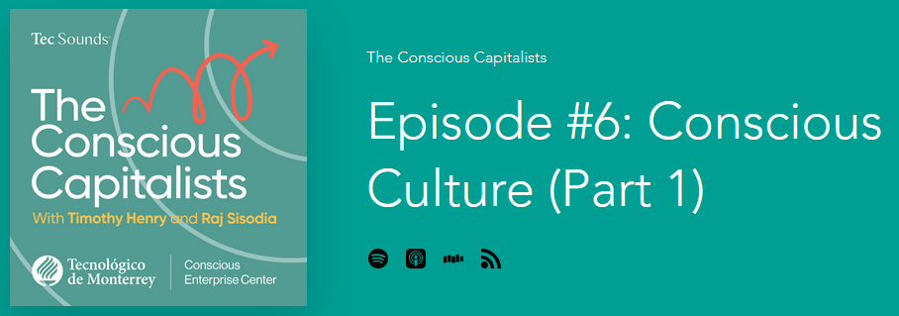
Part 1 https://www.theconsciouscapitalists.com/podcast/episode/4b736c33/episode-6-conscious-culture-part-1
Part 2 https://www.theconsciouscapitalists.com/podcast/episode/4aab0a34/episode-7-conscious-culture-part-2

Slide 104
Transition / Introduction
The four tenets of conscious capitalism
1st tenet: Higher Purpose
2nd tenet: Conscious Leadership
3rd tenet: Stakeholder integration
4th tenet: Conscious culture and management
Summary: Key questions
Reading recommendations and contact

Slide 105
Traditional capitalism to conscious capitalism
From …
… to
Profit focus
Only shareholders win
Short-term
Zero sum
Self-centered
Conflict of interest
Parasitic
Exploitative
Trade-offs
Disliked
Not trusted
Purpose focus
All stakeholders win
Long-term
Win-win-win-win
Holistic
Harmony of Interests
Mutualistic
Creating value
Synergies
Valued / Loved
Trusted
Source: Mackey, Sisodia (2013)

Slide 106
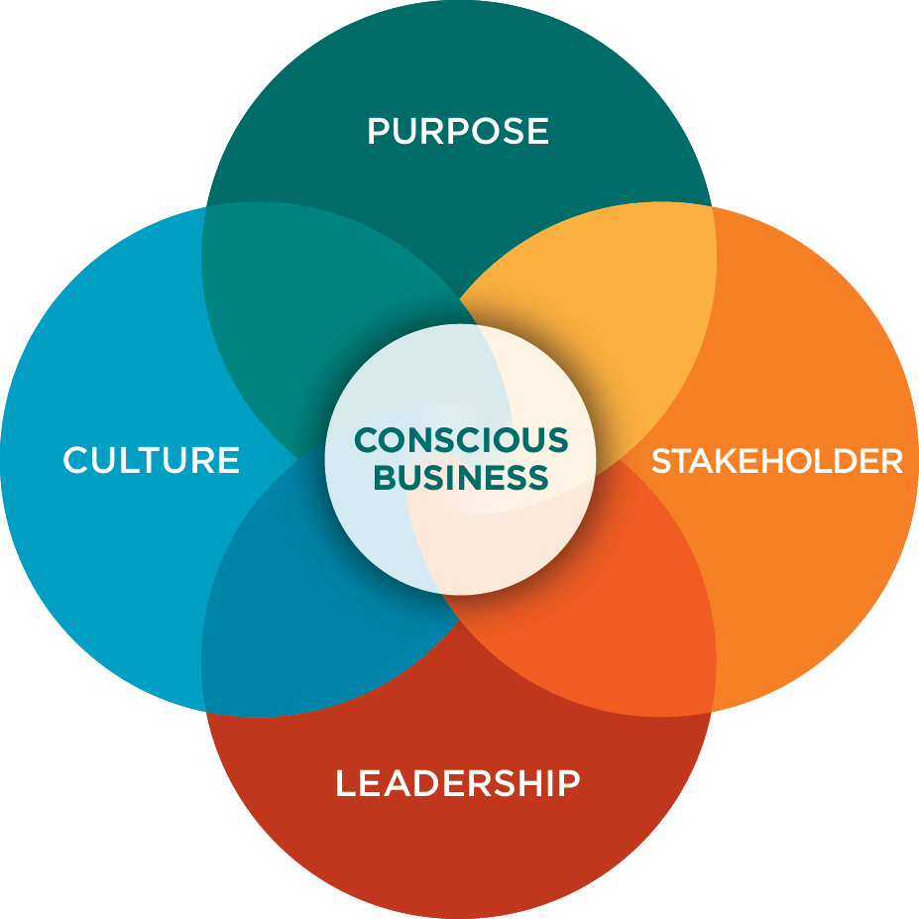
The four tenets of Conscious Capitalism
Source: https://www.consciouscapitalism.org/

Slide 107
The concept of geologic time – and the importance of environmental protection for survival of the human species
http://hereistoday.com/
Notes:
Teaching note
Go to http://hereistoday.com/ and click through the whole animation. Discuss what this perspective means for the impact of humans on life on the planet. Make sure that students understand, that earth doesn‘t need us but we need earth to be able to survive. You could add this article: https://www.linkedin.com/pulse/sustainability-dead-make-room-regenerative-business-schmidkonz/ For a longer read use https://theamericanscholar.org/what-the-earth-knows/

Slide 108
Transition / Introduction
The four tenets of conscious capitalism
1st tenet: Higher Purpose
2nd tenet: Conscious Leadership
3rd tenet: Stakeholder integration
4th tenet: Conscious culture and management
Summary: Key questions
Reading recommendations and contact

Slide 109
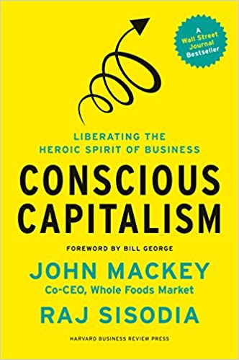
John Mackey, Rajendra Sisodia
Paperback : 368 pages
ISBN-10 : 1625271751
ISBN-13 : 978-1625271754
Publisher: Harvard Business Review Press; 1st Edition (January 7, 2014)

Slide 110
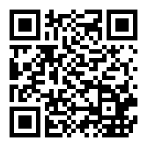
Nicolas Stahlhofer, Christian Schmidkonz, Patricia Kraft
Publisher: Springer; 1st ed. 2018 edition (November 25, 2017)
Series: CSR, Sustainability, Ethics & Governance
Hardcover: 122 pages
Language: English
ISBN-10: 3319697382
ISBN-13: 978-3319697383

Slide 111
Paul Polman, Andrew Winston
Publisher: ‎ Harvard Business Review Press (5 Oct. 2021)
Hardcover ‏ : ‎ 352 pages
ISBN-10 ‏ : ‎ 1647821304
ISBN-13 ‏ : ‎ 978-1647821302

Slide 112
Books:
Barrett, Richard (2014): The Value-Driven Organization – Unleashing Human Potential for Performance and Profit, Oxon
Birkinshaw, J., Foss, N.J. and Lindenberg, S.: Combining Purpose with Profits, MIT Sloan Management Review, Spring 2014, p. 49-56
Chouinard, Yvon (2006): Let My People Go Surfing: The Education of a Reluctant Businessman, New York
Frankl, Viktor F. (2021): Man’s Search for Meaning, London
Hurst, Aaron (2014): The Purpose Economy – How Your Desire for Impact, Personal Growth and Community Is Changing the World, Boise
Kahneman, Daniel (2011): Thinking, fast and slow, New York
Kofman, Fred (2006): Conscious Business – How to Build Value Through Values, Boulder
Mackey, John and Raj Sisodia (2014): Conscious Capitalism – Liberating the Heroic Spirit of Business, Boston
Polman, Paul and Andrew Winston (2021): Net Positive – How Courageous Companies Thrive By Giving More Than They Take, Boston
Reiman, Joey (2013): The Story of Purpose – The Path to Creating a Brighter Brand, a Greater Company, and a Lasting Legacy, New Jersey
Sinek, Simon (2009): Start With Why – How Great Leaders Inspire Everyone to Take Action, London
Sisodia, Raj, David Wolfe and Jag Sheth (2014): Firms of Endearment – How World-Class Companies Profit from Passion and Purpose, Upper Saddle River
Tate, Carolyn (2015): Conscious Marketing – How to create an awesome business with a new approach to marketing, Milton
Stahlhofer, Nicolas, Christian Schmidkonz and Patricia Kraft (2018): Conscious Business in Germany, Cham
Tindell, Kip (2014): Uncontainable – How Passion, Commitment, and Conscious Capitalism Built a Business Where Everyone Thrives, New York

Slide 113
Prof. Dr. Christian Schmidkonz
Munich Business School
Elsenheimerstraße 61 80687 München GERMANY
Phone: +49 (0)89 54 76 78 - 14 Fax: +49 (0)89 54 76 78 - 29
Christian.Schmidkonz@munich-business-school.de www.munich-business-school.de LinkedIn: http://de.linkedin.com/in/schmidkonz/

