Slide 2
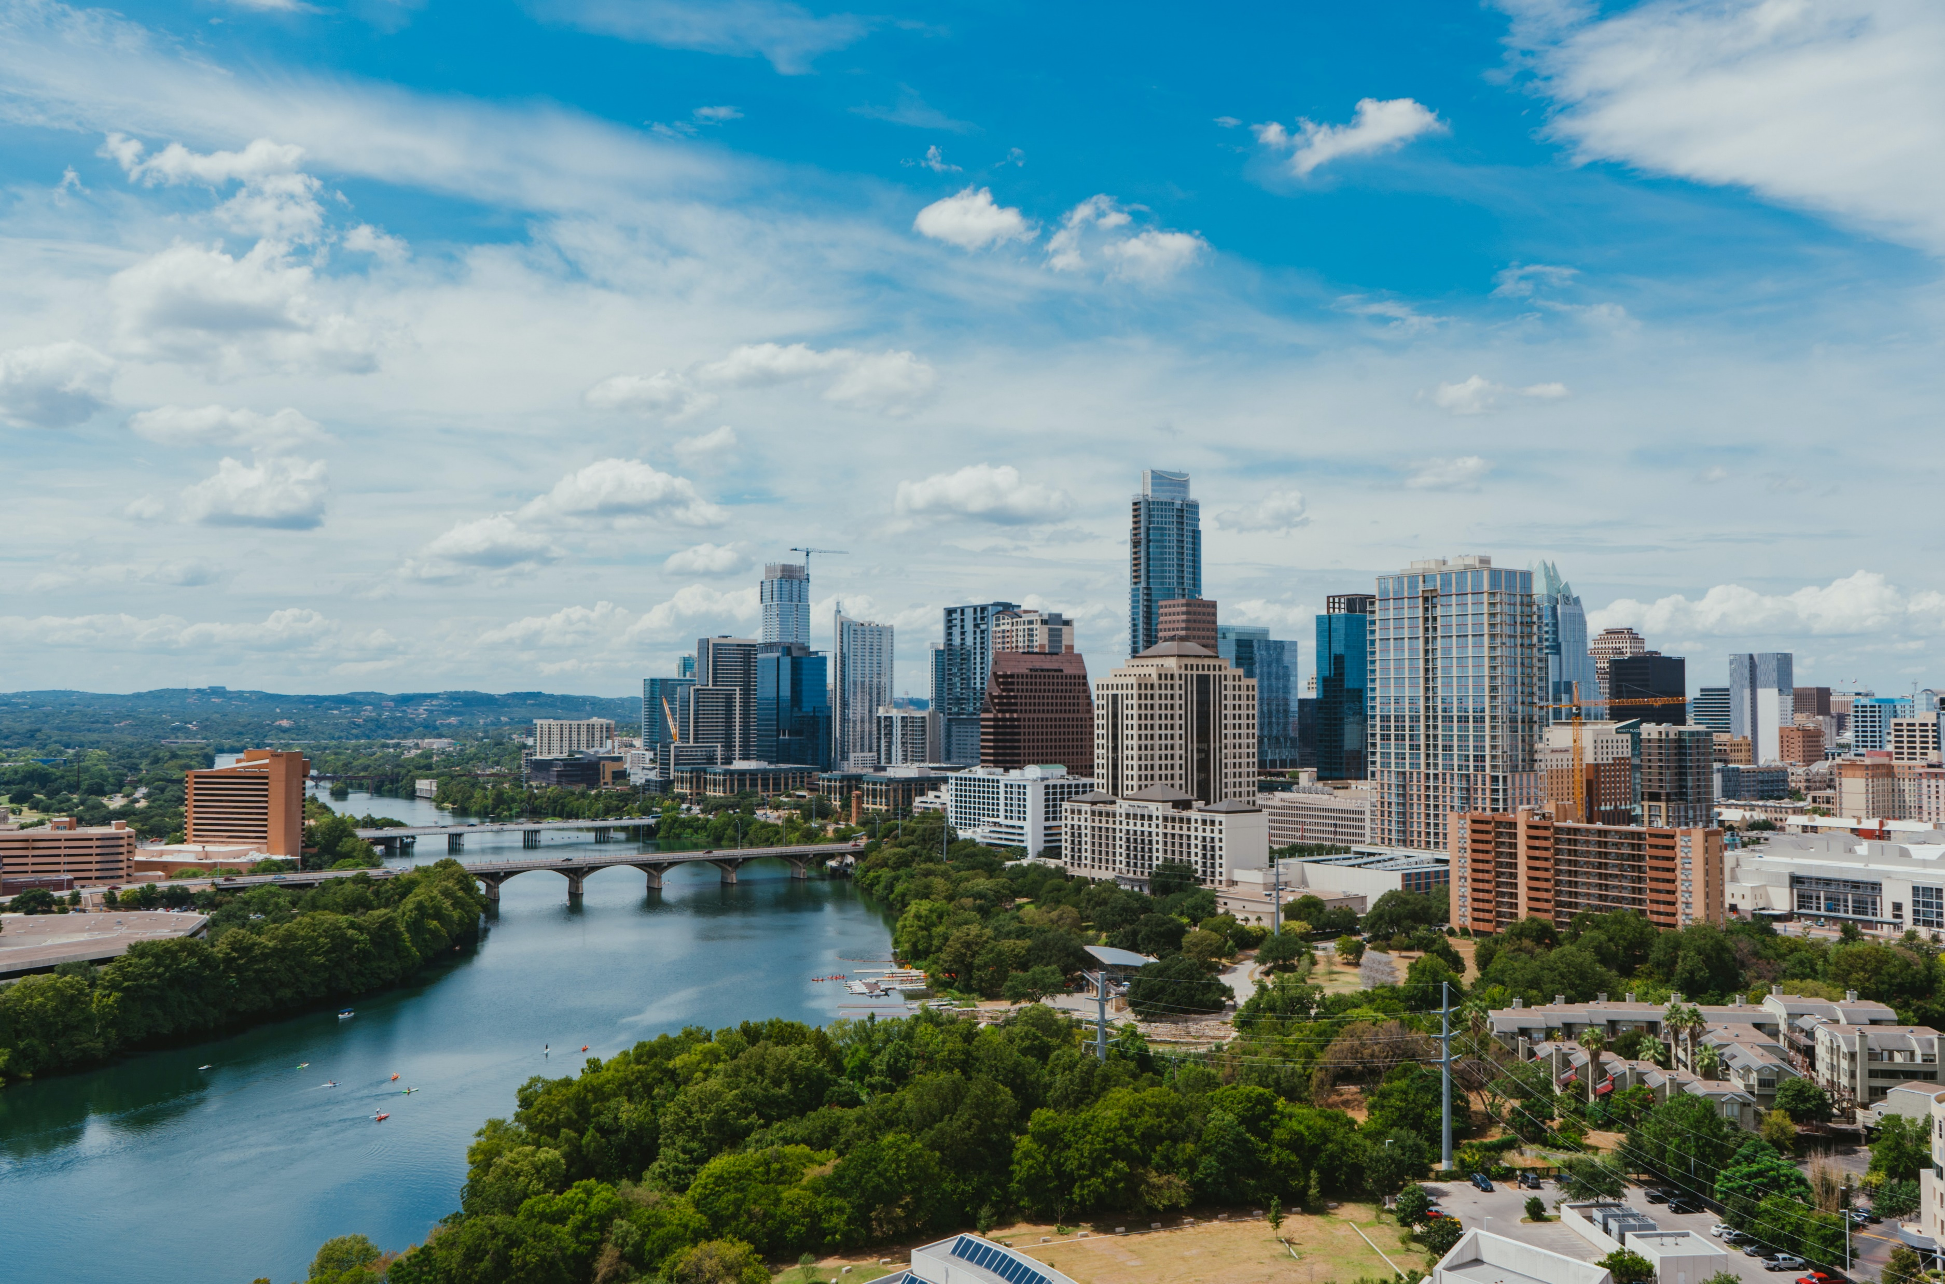
Conscious Business
Introduction

Slide 3
This is a
Digital Detox
Analogue
Zone
Notes:
Teaching note:
Ask students not to use any digital devices during class and put phones etc. away into bags etc.

Slide 4
Notes:
Teaching note:
An inspirational motto from the University of Denver: “Transforming Passion into Purpose” – we try to inspire this mindset and show ways how to do this in this course.

Slide 5
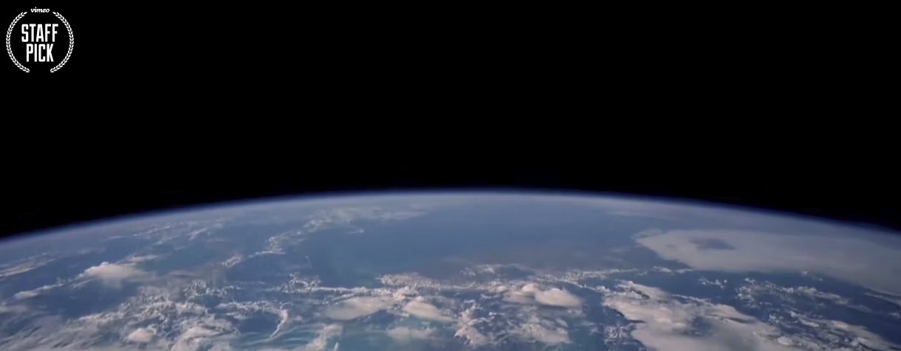
Watch “Overview” at https://vimeo.com/55073825
Notes:
Teaching note:
If time allows watch and discuss the whole “Overview” clip at https://vimeo.com/55073825 (19 min.) You can also cut it short.
The idea here is to take the widest perspective on what the consequences of our actions are as possible.
Background information from the Website:
On the 40th anniversary of the famous ‘Blue Marble’ photograph taken of Earth from space, Planetary Collective presents a short film documenting astronauts’ life-changing stories of seeing the Earth from the outside – a perspective-altering experience often described as the Overview Effect.
The Overview Effect, first described by author Frank White in 1987, is an experience that transforms astronauts’ perspective of the planet and mankind’s place upon it. Common features of the experience are a feeling of awe for the planet, a profound understanding of the interconnection of all life, and a renewed sense of responsibility for taking care of the environment.
‘Overview’ is a short film that explores this phenomenon through interviews with five astronauts who have experienced the Overview Effect. The film also features insights from commentators and thinkers on the wider implications and importance of this understanding for society, and our relationship to the environment.

Slide 6
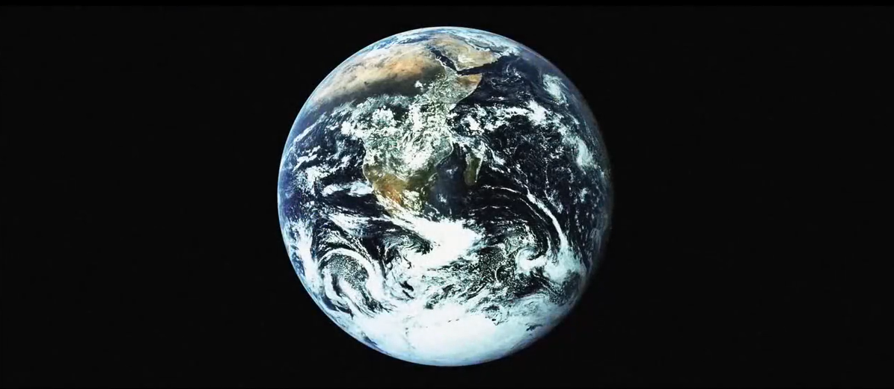
“Turning the camera around”
“Humans might be the first species to knowingly choose self-extinction.” (Matthew Fox)
Notes:
Teaching note:
Use this photo as background during the discussion of the video.

Slide 7
Notes:
Teaching note:
Explanation of the “Overview Effect”

Slide 8
Instructions
You will see 15 words each in different colours for 1 second each.
Call out the colour that you see.
Notes:
Teaching note:
The “Stroop test” from the toolbox can be used as an exercise to demonstrate the students that they are (most likely) fully able to control their brains. They most likely call out wrong colors. Students should become aware of the fact that many of their actions are performed unconsciously. But also these actions have consequences and impacts. Students should become aware of the fact that being conscious is an important skill in daily life and business.
The Stroop test demonstrates the most inner perspective concerning our actions and consequences.

Slide 9
BLUE
GREEN
GREEN
ORANGE
GREEN
BLUE
RED
BLACK
BLUE
PURPLE
RED
ORANGE
BLACK
GREEN
BLUE
Notes:
Teaching note:
Add the “Stroop test” from the toolbox here.

Slide 10
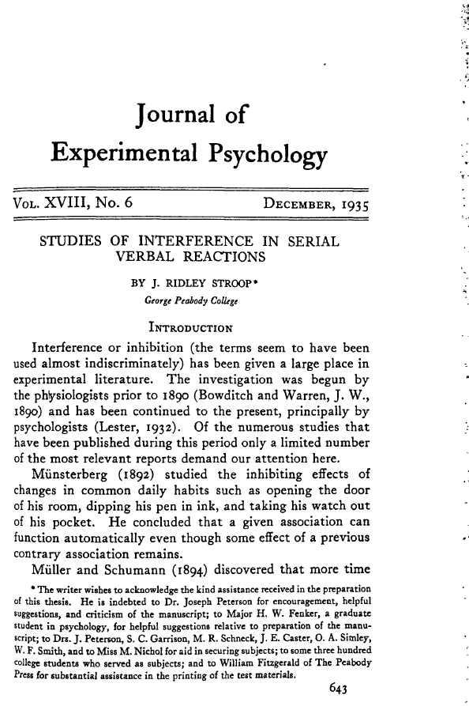
The (John Ridley) Stroop effect (1935)
Based on a series of incongruent stimuli
Two main areas in the brain that are involved in the processing of the Stroop task: dorsolateral prefrontal cortex assists in memory (here: color perception) anterior cingulate cortex is used to select an appropriate response (here: decision which answer to give)
Explanation theories: Automaticity, processing speed, selective attention – recognition of words faster than of colors
Notes:
Teaching note:
You can point out the original scientific paper by John Ridley Stroop and discuss its content if time allows.

Slide 11
Mindfulness ( )
Higher Purpose Impact
Notes:
Teaching note:
This course takes place in-between two of the most popular current topics in business: mindfulness (related to the consciousness of each individual) and higher purpose (related to the impact of ones own actions).

Slide 12
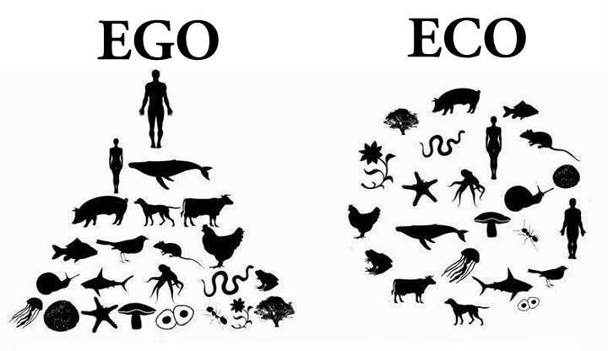
Ego-systems vs. eco-systems thinking
“What’s really needed is a deeper shift in consciousness so that we begin to care and act, not just for ourselves and other stakeholders but in the interests of the entire ecosystem in which economic activities take place.” (Otto Scharmer)
“Systems thinking” asks us to re-evaluate problems more holistically, abandon myopic focus on individual components of ecosystems in isolation, and realize that these components must be thought of as part of a larger, often complex system.
Source: http://neighborhoodeconomics.org/ecosystem-vs-egosystem/
Notes:
Teaching note:
“An ego-system is structured to satisfy shareholder wants and to privatize decision-making. Financial capital is valued above other contributions, costs are not fully disclosed and transactions lack transparency.
In the ecosystem, all stakeholders are committed to the shared wellbeing of the community. All forms of capital are valued, all costs are considered and transactions are transparent.” (http://neighborhoodeconomics.org/ecosystem-vs-egosystem/)

Slide 13
Notes:
Teaching note:
Micro break: Street art by Shepard Fairy in Munich (2022); more about the activist street artist at https://obeygiant.com/
Photo by Christian Schmidkonz

Slide 14
Notes:
Teaching note:
Micro break: Street art by Shepard Fairy in Munich (2022); more about the activist street artist at https://obeygiant.com/
Photo by Christian Schmidkonz

Slide 15
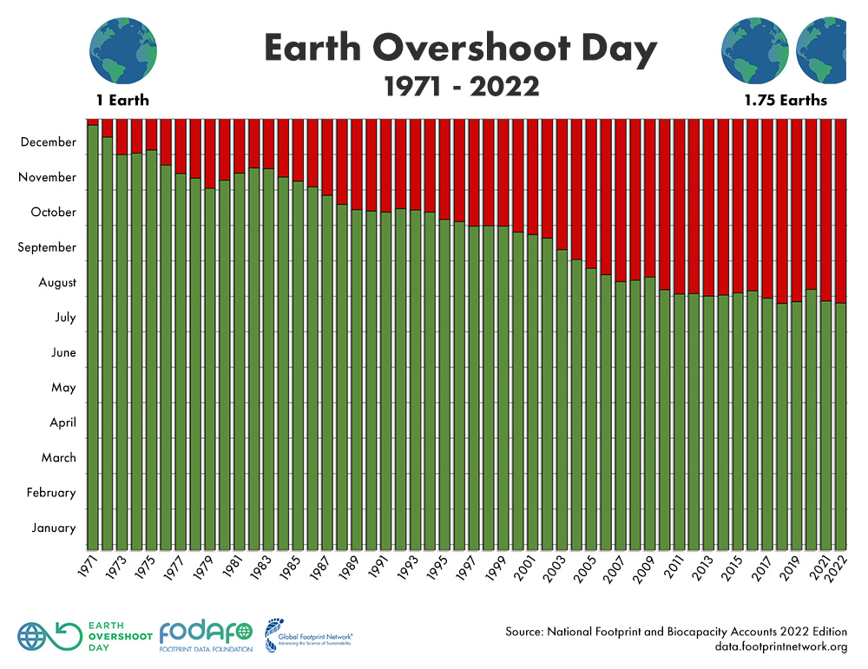
“Earth Overshoot Day marks the date when humanity’s demand for ecological resources and services in a given year exceeds what Earth can regenerate in that year. We maintain this deficit by liquidating stocks of ecological resources and accumulating waste, primarily carbon dioxide in the atmosphere.”
Source: https://www.overshootday.org/
Notes:
Teaching note:
Point out that there was no “Earth Overshoot Day” until ca. 1970. Since then more resources are used up than regenerated by nature. This argument leads to the criticism of the sustainability concept as an insufficient approach to prepare for a save future later in class. Source: https://www.overshootday.org/

Slide 16
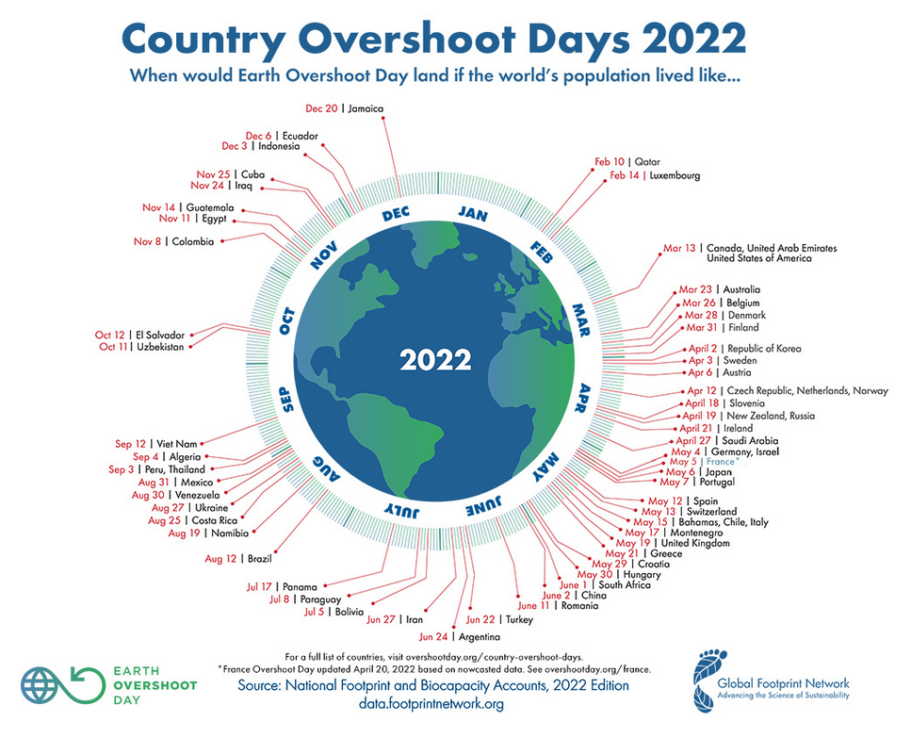
Source: https://www.overshootday.org/newsroom/country-overshoot-days/
Notes:
Teaching note:
Discuss the reasons for different Earth Overshoot Days in different countries. More background information incl. a database can be found at https://www.overshootday.org/

Slide 17
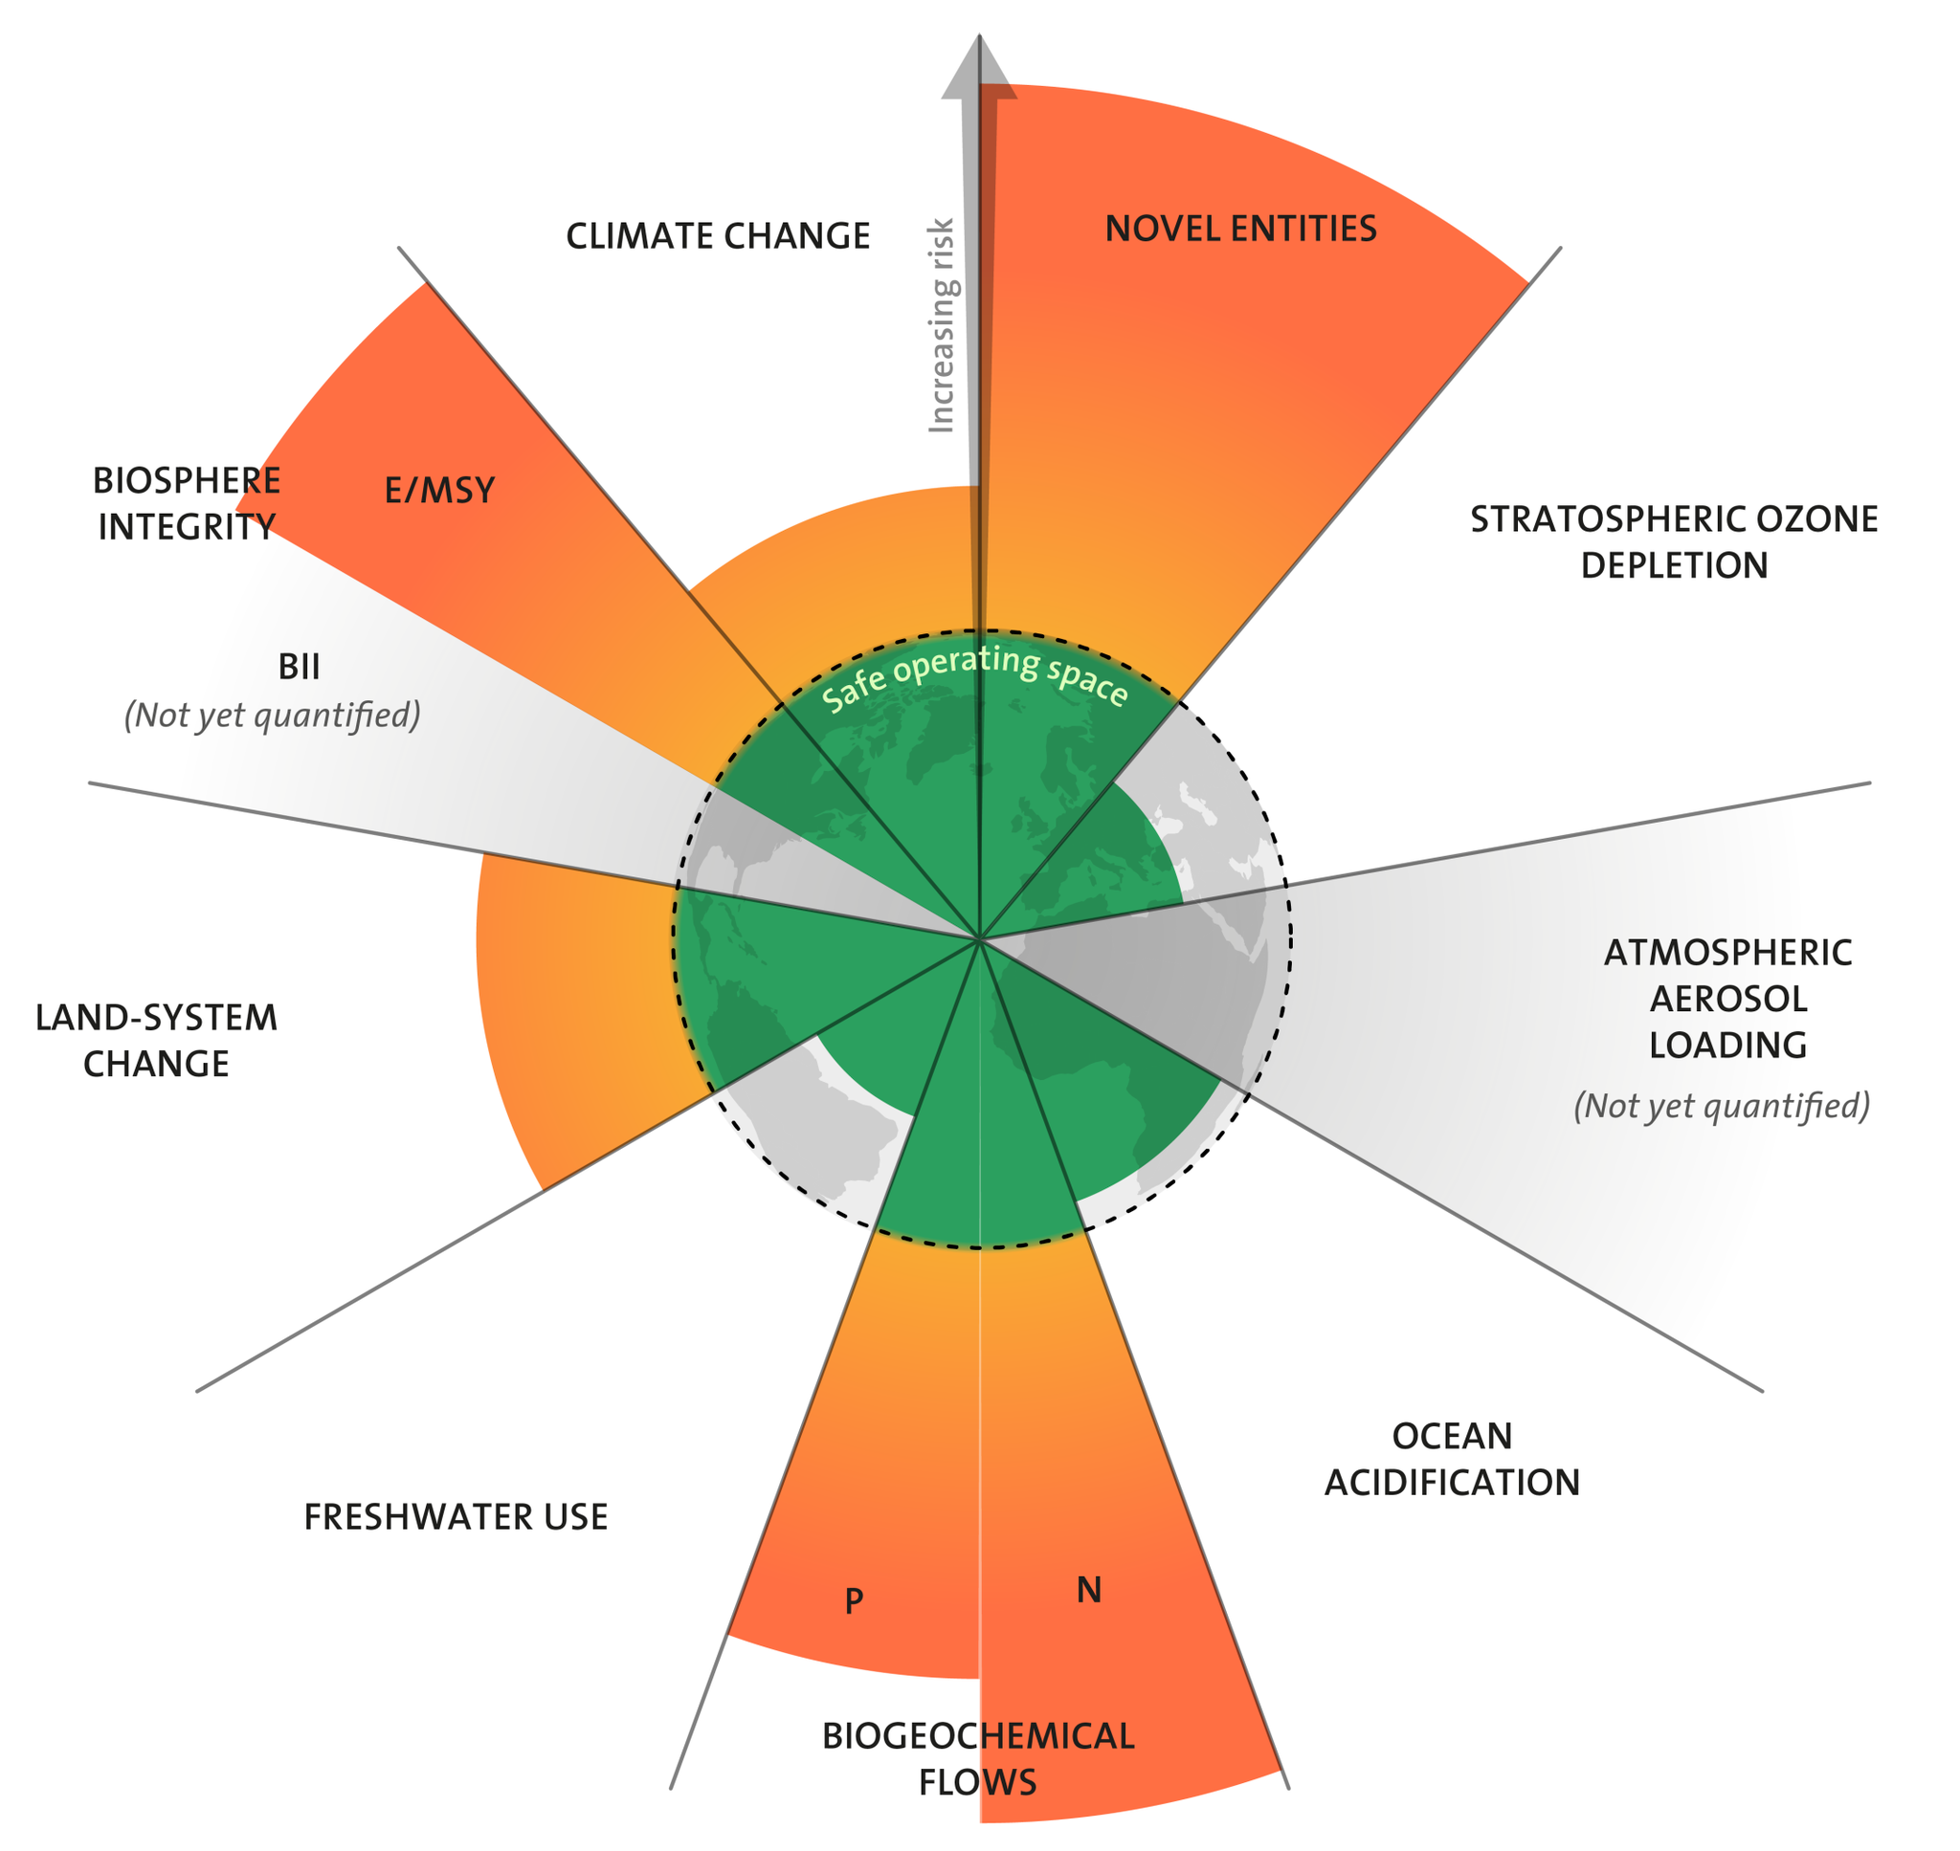
Planetary Boundaries (Stockholm Resilience Centre / Potsdam Institute for Climate Impact Research)
Source: Designed by Azote for Stockholm Resilience Centre, based on analysis in Persson et al 2022 and Steffen et al 2015
Notes:
Teaching note:
The Planetary Boundaries are a second concept that demonstrate why sustainability alone is not sufficient to keep the ecosystem all humans depend on intact. More information can be found at https://www.stockholmresilience.org/research/planetary-boundaries.html
Explanation:
E/MSY: extinctions per million species-years Genetic: less than 10 extinctions per million species-years (E/MSY), (10-100 E/MSY)

Slide 18
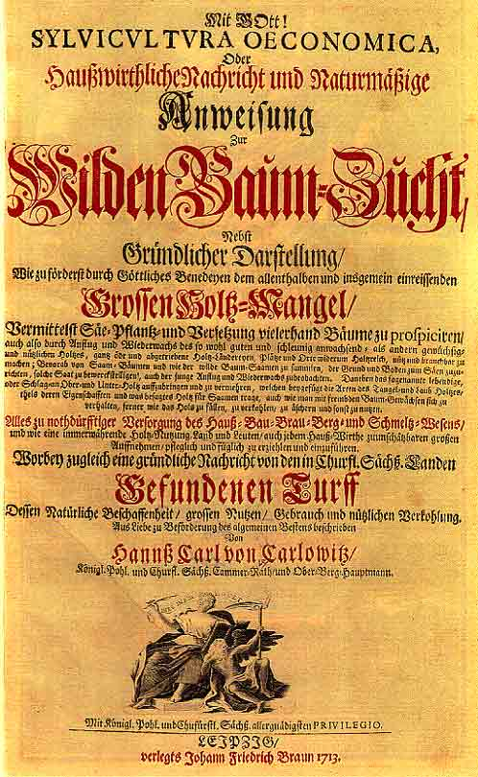
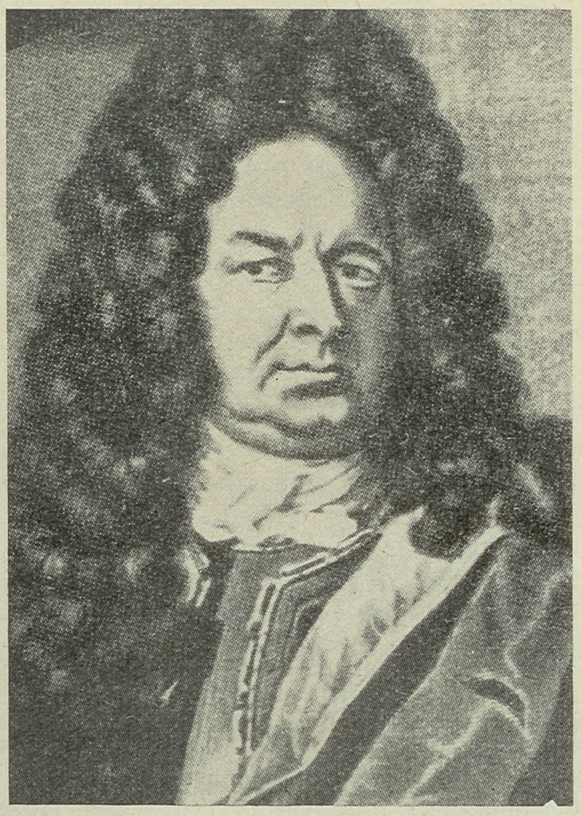
Hans Carl von Carlowitz (*1645 †1714) Kameralist; Sylvicultura Oeconomica
Notes:
Teaching note:
Hans Carl von Carlowitz is often times seen as the “inventor” of the concept of sustainability. In his context it was about taking only as much wood from a forest so that the forest can regenerate itself and therefor can be “manages” sustainably.

Slide 19
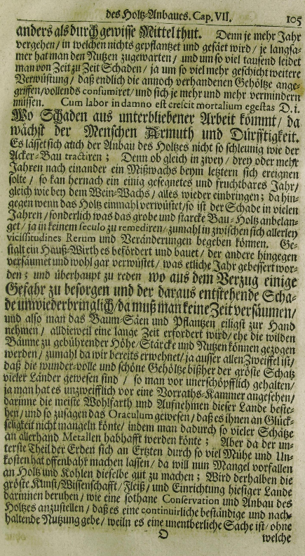
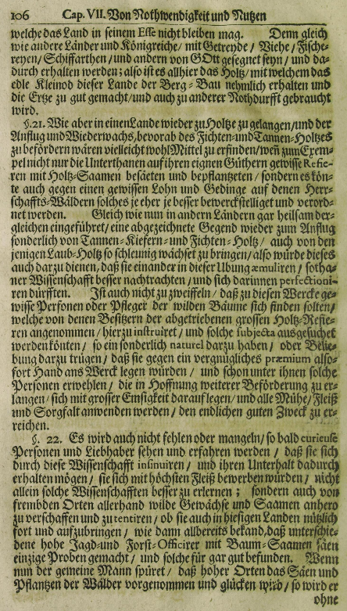
Source: https://digital.slub-dresden.de/werkansicht/dlf/85039/128
Notes:
Teaching note:
The original pages of the first mentioning of the concept of sustainable forestry/sustainability.

Slide 20
Sylvicultura Oeconomica, Oder Haußwirthliche Nachricht und Naturmäßige Anweisung Zur Wilden Baum-Zucht
„Wird derhalben die gröste Kunst / Wissenschafft / Fleiß / und Einrichtung hiesiger Lande darinnen beruhen / wie eine sothane Conservation und Anbau des Holtzes anzustellen / daß es eine continuirliche beständige und nachhaltende Nutzung gebe / weiln es eine unentberliche Sache ist / ohne welche das Land in seinem Esse nicht bleiben mag.“ – Sylvicultura Oeconomica (1713), S. 105–106
Notes:
Teaching note:
The original text in (old) German about sustainability.

Slide 21
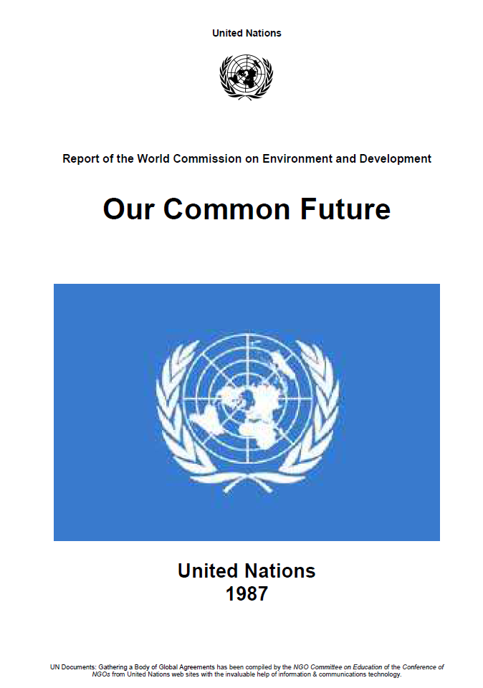
Brundtland Report 1987 (World Commission on Environment and Development (WCED))
Definition sustainable development:
Sustainable development is development that meets the needs of the present without compromising the ability of future generations to meet their own needs.
Notes:
Teaching note:
The “Brundtland report” (named after the former Norwegian president Gro Harlem Brundtland; official title “Our Common Future”) from 1987 is often times seen as including the modern definition of sustainable development. Brundtland headed the “World Commission on Environment and Development” wich was established in 1983.

Slide 22
Patagonia purpose statement: “We’re in business to save our home planet.”
SUSTAINABILITY
Source: https://www.patagonia.com/company-info.html
Notes:
Teaching note:
Patagonia stopped using the term “sustainable” in corporate communication in 2021 as a consequence of honest assessments of the impact of the production of products which is still not sustainable and not even regenerative.

Slide 23
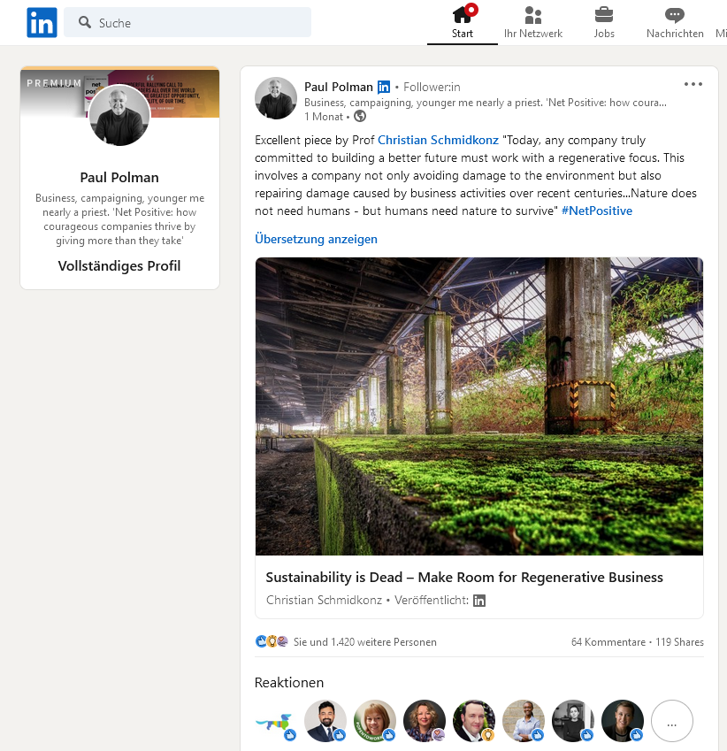
Notes:
Teaching note:
Read as background information and feel free to point out/share and discuss this short post about “Sustainability is Dead – Make Room for Regenerative Business” by Prof. Dr. Christian Schmidkonz at https://www.linkedin.com/feed/update/urn:li:activity:6959778830601351168/ or https://www.munich-business-school.de/insights/en/2022/sustainability-is-dead-make-room-for-regenerative-business/

Slide 24
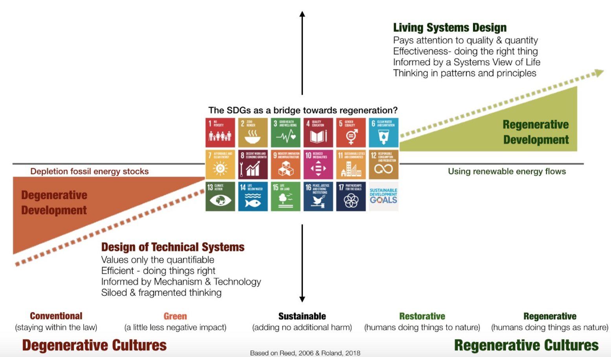
Beyond Sustainability: Designing Regenerative Cultures
Source: https://medium.com/activate-the-future/can-regenerative-economics-mainstream-business-mix-ef2f8aafa8d4
Notes:
Teaching note:
The chart shows the spectrum from (conventional) degenerative (business) cultures to regenerative cultures. It illustrates that sustainability can not be the final goal of “sustainable” practices, but that business activities have to take regenerative aspects into consideration since the damage that has been done until now also needs to be repaired. It is not sufficient to “sustain” a already bad situation and don’t make it worse if the current situation is already bad and not be sufficiently repaired by nature any more.

Slide 25
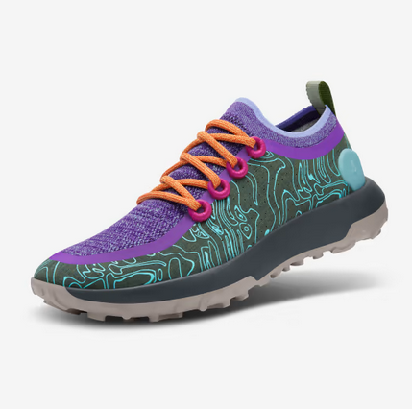
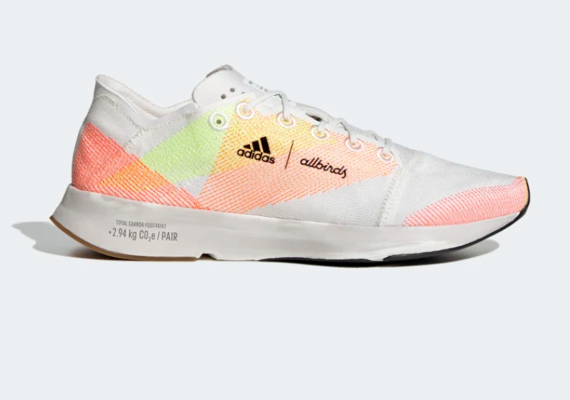
Wood (eucalyptus), sugar and merino wool
Notes:
Teaching note:
Example 1 for a company that is going into the direction of becoming regenerative: Allbirds shoes. (Nearly) All components are made of plants and wool. A 0 CO2 emissions shoe was announced in spring 2023. If done right, Allbirs might be able to repair more than it ever damaged in terms of shoe production and sales.

Slide 26
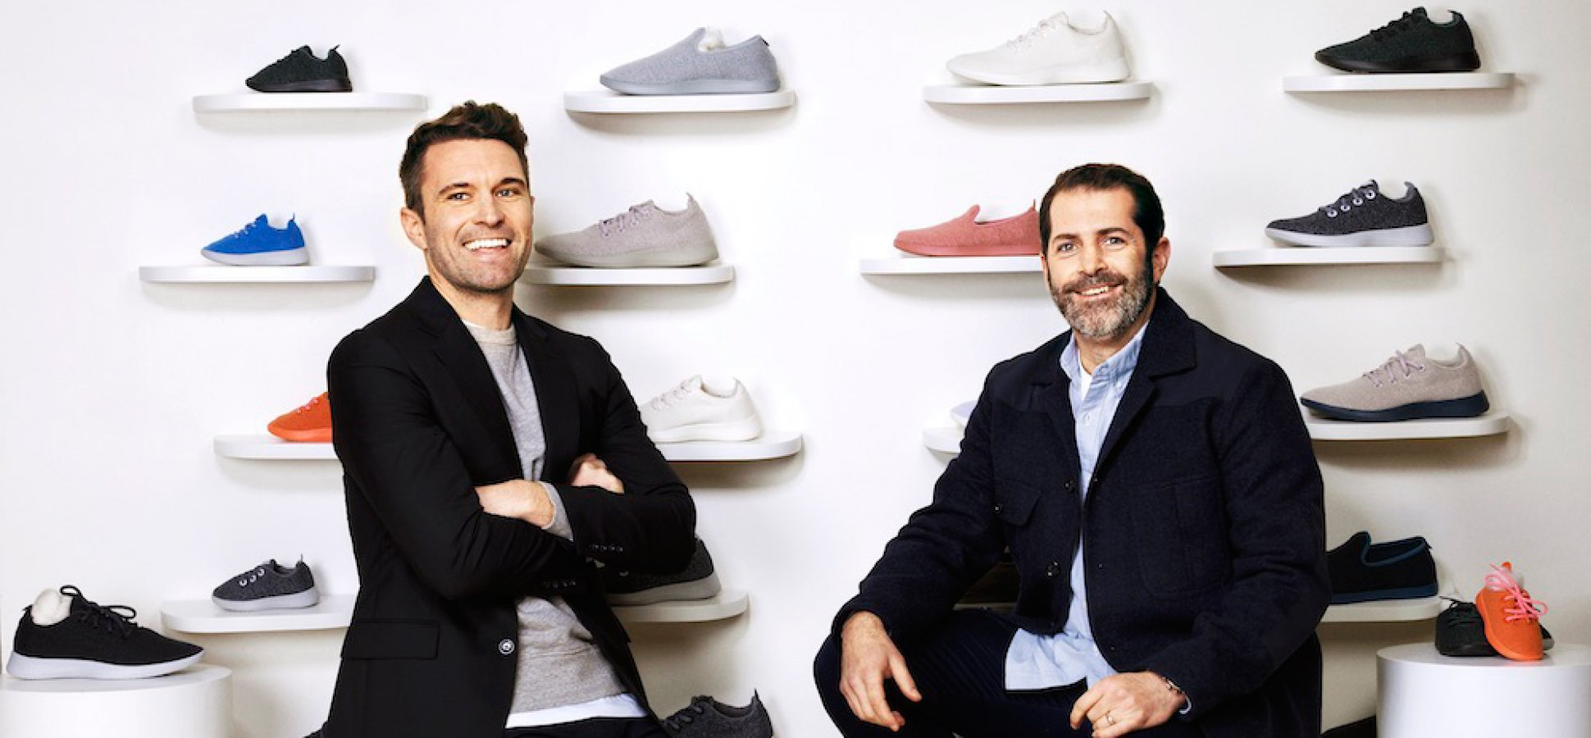
Allbirds – Tim Brown and Joey Zwillinger
https://www.inc.com/magazine/201808/lindsay-blakely/tim-brown-joey-zwillinger-allbirds-sneakers.html?cid=hmhero
Watch: Interview with Joey Zwillinger at https://www.youtube.com/watch?v=-FvgLExCOpc
Notes:
Teaching Note:
As an assignment or in class activity:
Watch Interview with Joey Zwillinger as homework at https://www.youtube.com/watch?v=-FvgLExCOpc (20 min.)
What is the core of Allbird’s business?

Slide 27
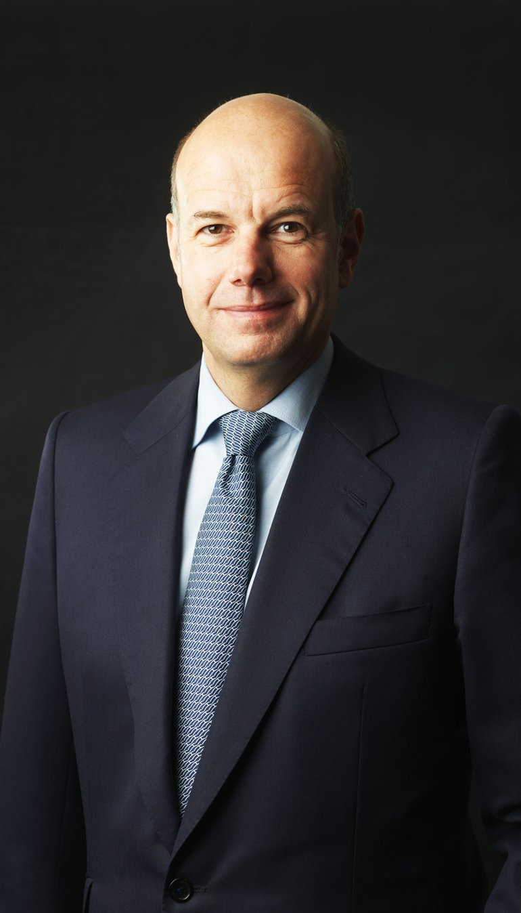
Dr. Hans-Dietrich Reckhaus
Source: https://kulturundoekonomie.ch/de/hans-dietrich-reckhaus/
Notes:
Teaching note:
Hans-Dientrich Reckhaus inherited a pesticide business. He is still running it but with much less dangerous pesticides + he supports planting areas where insects can live. If done right he is able to create areas for more insect than are being killed by the products of his company.

Slide 28
Interface (NASDAQ: TILE)
Mission Zero: “To eventually take nothing from the Earth that is not naturally and rapidly renewable".
Source: https://www.interface.com/US/en-US/more-from-interface/about.html
Notes:
Teaching note:
Introduce Interface as a company that applies biomimicry in its floor designs: https://www.interface.com/US/en-US/more-from-interface/about.html
Biomimicry: Forest floor design = less waste --------- Gecko toes as glue

Slide 29
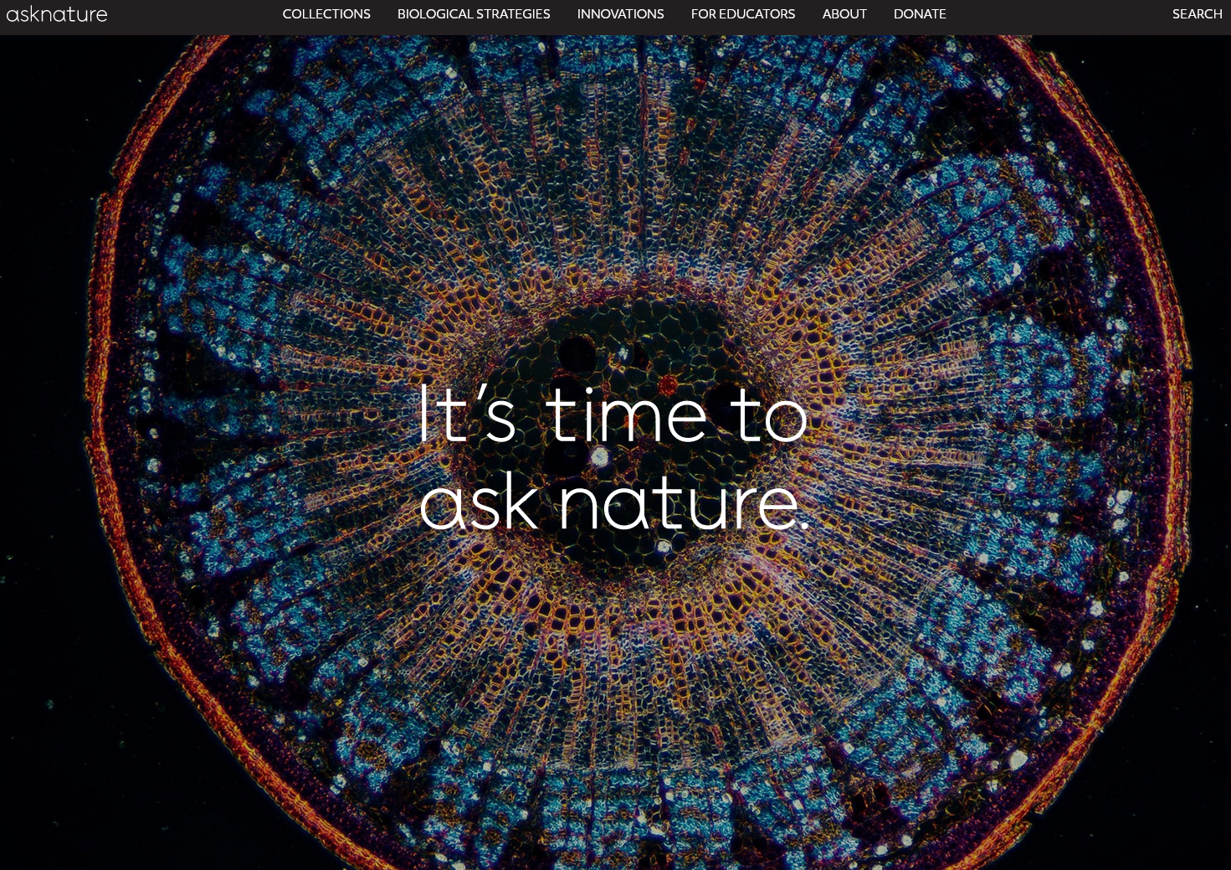
Biomimicry database: https://asknature.org/
Notes:
Teaching note:
Ask students to make themselves familiar with the Asknature database in order to understand the concept of biomimicry. There is also a Scavenger hunt exercise available on the website which can be used as an assignment or in-class exercise.

Slide 30
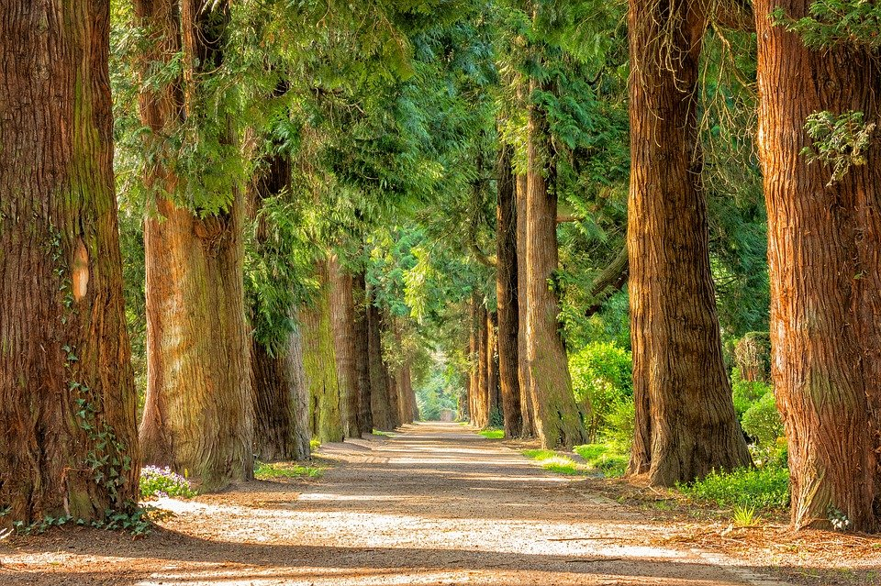
Key concepts of today’s class
Overview effect
Stroop test
Ego-system vs. eco-system
Earth Overshoot Day
Planetary Boundaries
Sustainability
Regenerative business
Biomimicry

Slide 31
Notes:
Teaching note:
Another exercise to make students think about the capacities of their brains: ZEN Koan – “Please imagine the sound that is made when a one-armed man or women is clapping his or her hand”. Discuss briefly the concept of “Nonduality” and what it could mean in the context of this class.

Slide 32
CSR vs. Conscious Business

Slide 33
The (limiting) dimensions or Corporate Social Responsibility (CSR)
Ecological
Social
Corporation
Economic
Notes:
Teaching note:
Briefly introduce the CSR concept and ask for feedback as well as missing elements in this model.

Slide 34
Requirement to include non-financial statements in annual reports since 2018 (Directive 2014/95/EU)
Large public-interest companies with more than 500 employees including
listed companies
banks
insurance companies
other companies designated by national authorities as public-interest entities
Information to be disclosed:
environmental protection
social responsibility and treatment of employees
respect for human rights
anti-corruption and bribery
diversity on company boards (in terms of age, gender, educational and professional background)
Companies may use international, European or national guidelines such as the UN Global Compact, the OECD guidelines for multinational enterprises and ISO 26000.
Notes:
Teaching note:
Discuss with students what this new EU directive means – and what it doesn’t.

Slide 35
Concepts differ in terms of covered dimensions, reporting standards and certification
Initiative Dimension |  | CSR | B Corporations | Economy for the Common Good | Conscious Business
Humanistic Orientation |  |  | x | x | x
Internal | Purpose |  | x | x | x
 | Leadership |  |  |  | x
 | Culture |  |  | x | x
 | Employees | x | x | x | x
 | Profit | x | x | x | x
External | Society | x | x | x | x
 | Environment | x | x | x | x
 | Investors |  | x | x | x
 | Customers |  | x | x | x
 | Suppliers |  | x | x | x
 | Competitors |  |  | x | x
Number of Covered Dimensions |  | 4 | 9 | 11 | 12
Reporting Standards |  | x | x | x
Certification |  |  | x | x
Notes:
Teaching note:
Share this chart in order to demonstrate the limited number of CSR dimensions. Nevertheless, CSR is the most popular “sustainability approach”, but: it is extremely limited. Demonstrate how other concepts have more dimensions and how “conscious business” actually has 12.

Slide 36
The four tenets (Grundsätze) of Conscious Capitalism
Interconnected and mutually reinforcing
Foundational, not tactics or strategies
Represent the essential elements of an integrated business philosophy that must be understood holistically to be effectively manifested
Stakeholder integration
Conscious leadership
Higher purpose
Conscious culture and management
Source: Mackey, Sisodia (2013)
Notes:
Teaching note:
Introduce the “Four tenets of Conscious Capitalism” and make sure to point out the characteristics in the bullet points (contrary to CSR, which is often times a department but not in the DNA of the company).

Slide 37
Shareholders vs. stakeholders in the context of conscious business
Stakeholder: “Any group or individual who can be or is affected by the achievement of a firm’s objectives.”
Distinguishing core value of conscious businesses is service to all stakeholders without favouring one over another.
Best way to create value for shareholders in the long run is by consciously creating value for all stakeholders. → Shareholders can gain more when their interests are aligned with the interests of all other stakeholder groups.
Source: Raj Sisodia (2014)
Notes:
Teaching note:
Introduce the understanding of stakeholders in the conscious business context.

Slide 38
Examples of conscious businesses
Notes:
Teaching note:
Ask students which of these brands they know and what they think about them – and why they could be seen as “Conscious Businesses”. Point out that none of these companies/brands is fully conscious and that there is probably no company in the world that is.
Change logos according to companies from the country this course is held in.

Slide 39
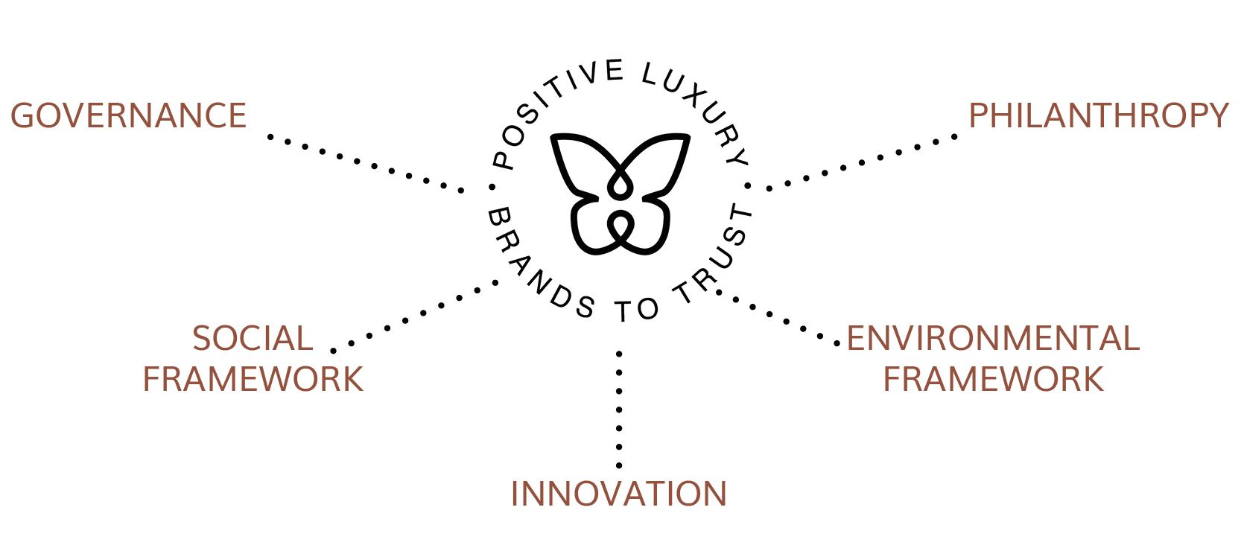
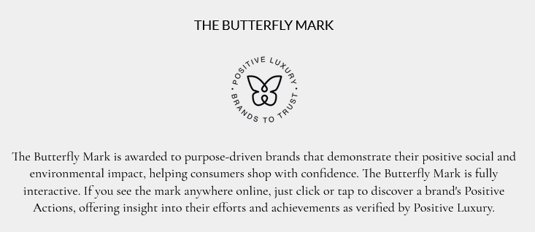
Conscious Business is not limited to a certain industry: “Positive Luxury”
Source: https://www.positiveluxury.com/
Notes:
Teaching note:
Show students that the concept of “Conscious Business” is independent from industry. Here is a related idea from the luxury business industry.

Slide 40
Examples of types of wealth created by business
Financial
Natural
Intellectual
WEALTH
Physical
Social
Cultural
Emotional
Spiritual
Notes:
Teaching note:
Make sure that students understand that wealth is not only financial. Conscious businesses focus on many of the other types of wealth as well.

Slide 41
Why Conscious Capitalism is different from Corporate Social Responsibility (CSR)
Corporate Social Responsibility
Conscious Capitalism
Shareholders must sacrifice for society
Integrates the interest of all stakeholders
Independent of corporate purpose or culture
Incorporates higher purpose and caring culture
Adds an ethical burden to business goals
Reconciles
caring and profitability through higher
synergies
Reflects
a mechanistic view of business
Views business as a complex, adaptive system
Often grafted onto traditional business model,
usually
Social responsibility is
at the core of the business
as a separate department or part of public relations
through the higher purpose and viewing the
community and environment as key stakeholders
Sees limited overlap between business and society,
Recognizes that business is a subset
of society and that
and between business and the planet
society is a subset of the planet
Easy to meet as a charitable gesture; often seen as
Requires genuine transformation through commitment
“green
-
washing”
to the four tenets
Assumes all/any kind of good deeds are desirable
Requires that good deeds also advance the company’s
core purpose and create value for the whole system
Compatible with traditional leadership
Requires conscious leadership
Source: Mackey, Sisodia (2013)
Notes:
Teaching note:
Contrast the CSR and Conscious Capitalism concepts with the help of this table.

Slide 42
“Building value through values”
Notes:
Teaching note:
Let’s change the mindset of what “value” means: Different way of thinking necessary

Slide 43
Values
In sociology values are the ideals and customs of a society toward which the people have an effective regard. Values are a shorthand method of describing what is important to us individually or collectively (as an organization, community or nation) at any given moment in time.
Since values represent what is important to us at any given moment in time (incl. age) they are not fixed. However, there are some unchanging core values.
Values are therefore also a collective representations of what constitutes good life and a good society.
Source: Barrett 2014
Notes:
Teaching note:
Ask students what they know about values already and introduce some main characteristics of values.

Slide 44
Relationship between needs, values, thoughts and behaviours
Your values are always a reflection of what you consider to be your needs.
behaviors and actions
determine
thoughts, feelings and emotions
drive
values and beliefs
drive
needs
Source: Barrett 2014; twitter
Notes:
Teaching note:
Illustrate how our actions (and their impact) are based on our personal individual (and some common) values.

Slide 45
Key concepts of today’s class
Corporate Social Responsibility (CSR)
4 tenets of Conscious Business
Stakeholders vs. shareholders
Values & needs
Koan

Slide 46
Literature and contact

Slide 47
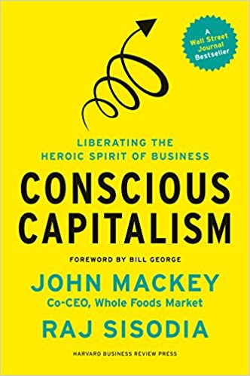
John Mackey, Rajendra Sisodia
Paperback : 368 pages
ISBN-10 : 1625271751
ISBN-13 : 978-1625271754
Publisher: Harvard Business Review Press; 1st Edition (January 7, 2014)

Slide 48
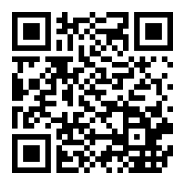
Nicolas Stahlhofer, Christian Schmidkonz, Patricia Kraft
Publisher: Springer; 1st ed. 2018 edition (November 25, 2017)
Series: CSR, Sustainability, Ethics & Governance
Hardcover: 122 pages
Language: English
ISBN-10: 3319697382
ISBN-13: 978-3319697383

Slide 49
Paul Polman, Andrew Winston
Publisher: ‎ Harvard Business Review Press (5 Oct. 2021)
Hardcover ‏ : ‎ 352 pages
ISBN-10 ‏ : ‎ 1647821304
ISBN-13 ‏ : ‎ 978-1647821302

Slide 50
Books:
Barrett, Richard (2014): The Value-Driven Organization – Unleashing Human Potential for Performance and Profit, Oxon
Chouinard, Yvon (2006): Let My People Go Surfing: The Education of a Reluctant Businessman, New York
Hurst, Aaron (2014): The Purpose Economy – How Your Desire for Impact, Personal Growth and Community Is Changing the World, Boise
Kofman, Fred (2006): Conscious Business – How to Build Value Through Values, Boulder
Mackey, John and Raj Sisodia (2014): Conscious Capitalism – Liberating the Heroic Spirit of Business, Boston
Sisodia, Raj, David Wolfe and Jag Sheth (2014): Firms of Endearment – How World-Class Companies Profit from Passion and Purpose, Upper Saddle River
Tate, Carolyn (2015): Conscious Marketing – How to create an awesome business with a new approach to marketing, Milton
Stahlhofer, Nicolas, Christian Schmidkonz and Patricia Kraft (2018): Conscious Business in Germany, Cham
Tindell, Kip (2014): Uncontainable – How Passion, Commitment, and Conscious Capitalism Built a Business Where Everyone Thrives, New York

Slide 51
Prof. Dr. Christian Schmidkonz
Munich Business School
Elsenheimerstraße 61 80687 München GERMANY
Phone: +49 (0)89 54 76 78 - 14 Fax: +49 (0)89 54 76 78 - 29
Christian.Schmidkonz@munich-business-school.de www.munich-business-school.de LinkedIn: http://de.linkedin.com/in/schmidkonz/ LinkedIn Happiness Group: https://www.linkedin.com/groups/8685014/
DISCLAIMER: The information contained in this presentation is based upon or derived from sources that are believed to be reliable; however, no representation is made that such information is accurate or complete in all material respects, and reliance upon such information as the basis for taking any actions is neither authorized nor warranted. This presentation is intended for the use at Munich Business School only. It should not be regarded as a substitute for the exercise by the recipient of their own judgement. The author(s) and/or any person connected with it accepts no liability whatsoever for any direct or consequential loss of any kind arising out of the use of this report or any part of its contents.
It should be noted that a variety of factors, including e.g. changes in prices, shifts in demand, variations in supply, international currency movements, technological developments, governmental actions and/or other factors, including our own misjudgements or mistakes, may cause the statements herein concerning present and future conditions, results and trends to be inaccurate.

