Slide 2
Conscious Business Course work
Poster presentation instructions

Slide 3
Prepare and present a poster in a poster session
Topic: A comparison of a conscious business with a classic business – and what both can learn from each others
Each of you is a “godmother/godfather” of a company.
You work in pairs with a conscious company and a classic company each.
You create the content for one (!) poster presentation (together) “on the fly” during the semester.
Apply what you learned in the Conscious Business class.
Find your company and partner at and poster presentation date on the overview sheet uploaded to Microsoft Teams.
Notes:
Teaching note
Try to create pairs of companies in a similar/the same industry, which makes comparison and learnings from each others easier. Creating the pairs of students by the lecturer gives also a good opportunity to build teams of students who do not regularly work with each others or are generally more diverse.
Make sure that students understand that they need to apply the Conscious Capitalism framework! Sometimes they tend to drift off into CSR or related classes and leave topics from the Conscious Business class (completely) out.
Each student will have 5 minutes to present her/his part of the poster that they need to create together. Usually students cover all 4 tenets within these five minutes. You could also ask to present the most prominent 2 or 3 tenets which include the best examples.

Slide 4
How to create a poster
Free form, no templates provided – feel free to surprise with your creativity
Posters: min. size DIN A1 --- max. size DIN A0
Work and develop the poster synchronously together.
Notes:
Teaching note
Important: The posters must be created on paper (only if online teaching is required (#COVID19), posters can also be created as a digital document).
The ideal size is two flip chart sheets.

Slide 5
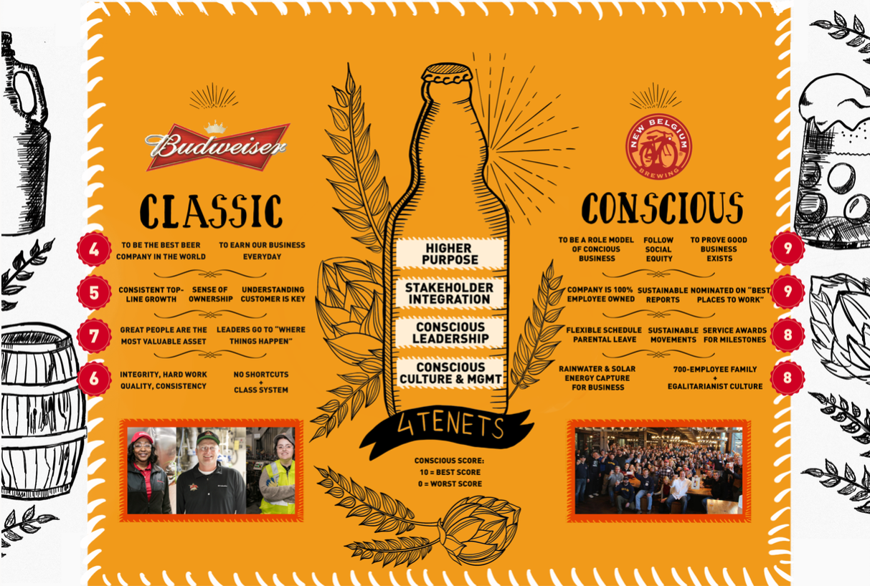
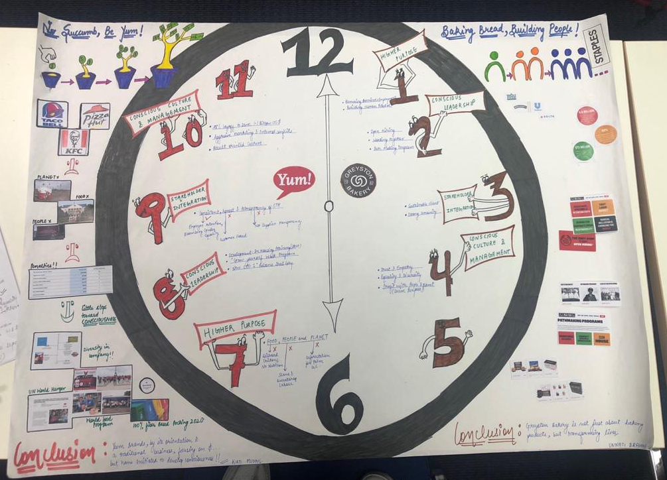
Example posters by students
Notes:
Teaching note
These posters are some creative examples of posters that students enjoyed making and enjoyed during the poster presentation. They are less in the style of acadmic posters for conferences and more entertaining. Guidance can be adjusted according to level of students and learning goal.

Slide 6
How to create a poster
Free form, no templates provided – feel free to surprise with your creativity
Posters: min. size DIN A1 --- max. size DIN A0
You can make use of the following tips, however they should not limit your creativity!
Ten Simple Rules for a Good Poster Presentation (rule 4 not applicable) https://www.ncbi.nlm.nih.gov/pmc/articles/PMC1876493/
Tips for creating a research poster (strict rules not applicable) http://guides.nyu.edu/posters

Slide 7
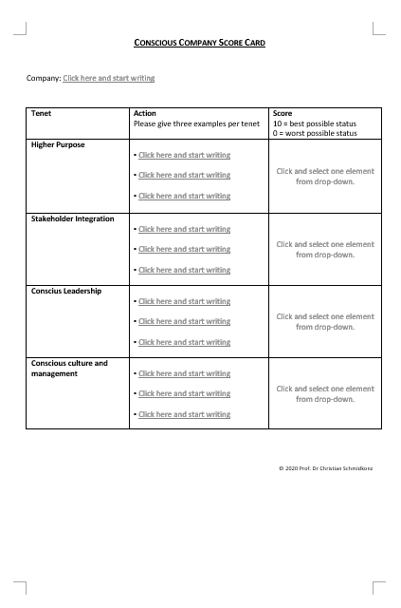
Introducing the “Conscious Business Score Card”
Notes:
Teaching note
Upload/share the template for the score card and let each students fill it out. Collect all score cards and share all score cards with all students. By doing so students have a collection of all actions that companies take discussed during the poster presentation for later reference in their lives.
The score card includes three actions per tenet as examples for what measures a (conscious or classic) company takes in each tenet. The score is highly subjective and given by the student. Students really enjoy giving and revealing the scores.

Slide 8
Poster presentation and due date for score card
Posters must be put up in the classroom before the start of the class.
A photo of the poster must be uploaded to Microsoft Teams before the beginning of the class.
Max. time to present the poster: 10 minutes
Poster presentation dates: XYZ
Notes:
Teaching note
Let the students get up and walk from poster to poster for the presentations.

Slide 9
Rubric for poster presentation
Criteria | Rating |  |  |  | Points
Content | 60 pts Exemplary All objectives were identified, evaluated, and completed. A sophisticated synthesis and application of the course content incl. The application of methodologies was demonstrated. All critical points were covered with the appropriate depth. | 50 pts Proficient / Meets Standards The presentation exhibits a solid response to the assigned task, but one or more objectives are not identified, evaluated and/or completed. Some points made lack depth. | 35 pts Approaching Standards/Developing The presentation lacked application of class content and/or depth in the analysis and synthesis. Most ponts were superficially presented and proofed a lack of understanding of the assigned task. | 25 pts Below standard The content of the presentation was inaccurate and/or incomplete. Course content was not applied. Details in the poster have little or nothing to do with the main topic. | 60
Design | 20 pts Exemplary The design supported the understanding of the topics and make it easier to understand them. The presenter demonstrated a high degree of creativity. Parts of the poster were interactive. The desing is clear and clean. No spelling mistakes. | 16 pts Proficient / Meets Standards The design of the poster supports the presentation. It doesn't show any exceptional creativity but demonstrates a solid understanding of visualizing the content of the presentation. No spelling mistakes. | 12 pts Approaching Standards/Developing The design suggested that the poster was designed with little time and effort. The structure doesn't support the presentation content. Might even include some spelling mistakes. | 8 pts Below standard The poster was apparently created in a rush with little to no effort. The presenter didn't put any reasonable effort in thinking about the structure of the poster. The poster doesn't support what is presented. Might include spelling mistakes. | 20
Presentation | 20 pts Exemplary The narration was engaging, not hurried or too slow and the presenter established eye contact with the audience. The presenter was overall confident and professional. | 16 pts Proficient / Meets Standards The naration was not particularly engaging and slightly too fast or too slow. Presentation and demonstration of understanding was acceptable. Some weaknesses in capability to express oneself. | 12 pts Approaching Standards/Developing The narration was too fast or too slow and/or not engaging. Oral communication skills son't allow to fully transport the content of the presentation. | 8 pts Below standard The presenter was poorly prepared and not able to communicate the relevant topics of the presentation. The presentation was clearly too long or too short. The presenter wasn't able to keep eye contact with the audience. | 20
Q&A | 10 pts Exemplary The presenter was able to give concrete answers to the questions asked and was able to add significantly to the content that was presented. The answers were not too long and not too short. | 8 pts Proficient / Meets Standards The presenter was able to answer the questions asked but the answers were too long or too short and/or lacked some substance. Overall, the presenter was able to add additional value to the presentation. | 6 pts Approaching Standards/Developing The presenter was able to answer questions but the answers to the questions revealed that there is only limited additional knowledge that the presenter could add. Answers were significantly too short or long and/or without only very little substance. | 4 pts Below standard The presenter was not able to answer questions and add to the presented content. The answers completely lacked substance and/or were unrelated to the questions asked and/or the presented content. | 10
Total Points: |  |  |  |  | 100

Slide 10
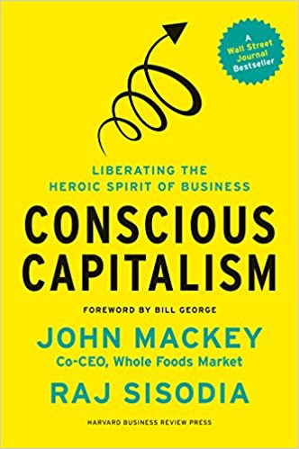
John Mackey, Rajendra Sisodia
Paperback : 368 pages
ISBN-10 : 1625271751
ISBN-13 : 978-1625271754
Publisher: Harvard Business Review Press; 1st Edition (January 7, 2014)

Slide 11
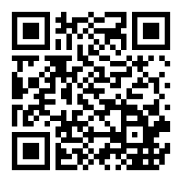
Nicolas Stahlhofer, Christian Schmidkonz, Patricia Kraft
Publisher: Springer; 1st ed. 2018 edition (November 25, 2017)
Series: CSR, Sustainability, Ethics & Governance
Hardcover: 122 pages
Language: English
ISBN-10: 3319697382
ISBN-13: 978-3319697383

Slide 12
Paul Polman, Andrew Winston
Publisher: ‎ Harvard Business Review Press (5 Oct. 2021)
Hardcover ‏ : ‎ 352 pages
ISBN-10 ‏ : ‎ 1647821304
ISBN-13 ‏ : ‎ 978-1647821302

Slide 13
Books:
Barrett, Richard (2014): The Value-Driven Organization – Unleashing Human Potential for Performance and Profit, Oxon
Birkinshaw, J., Foss, N.J. and Lindenberg, S.: Combining Purpose with Profits, MIT Sloan Management Review, Spring 2014, p. 49-56
Chouinard, Yvon (2006): Let My People Go Surfing: The Education of a Reluctant Businessman, New York
Frankl, Viktor F. (2021): Man’s Search for Meaning, London
Hurst, Aaron (2014): The Purpose Economy – How Your Desire for Impact, Personal Growth and Community Is Changing the World, Boise
Kahneman, Daniel (2011): Thinking, fast and slow, New York
Kofman, Fred (2006): Conscious Business – How to Build Value Through Values, Boulder
Mackey, John and Raj Sisodia (2014): Conscious Capitalism – Liberating the Heroic Spirit of Business, Boston
Polman, Paul and Andrew Winston (2021): Net Positive – How Courageous Companies Thrive By Giving More Than They Take, Boston
Reiman, Joey (2013): The Story of Purpose – The Path to Creating a Brighter Brand, a Greater Company, and a Lasting Legacy, New Jersey
Sinek, Simon (2009): Start With Why – How Great Leaders Inspire Everyone to Take Action, London
Sisodia, Raj, David Wolfe and Jag Sheth (2014): Firms of Endearment – How World-Class Companies Profit from Passion and Purpose, Upper Saddle River
Tate, Carolyn (2015): Conscious Marketing – How to create an awesome business with a new approach to marketing, Milton
Stahlhofer, Nicolas, Christian Schmidkonz and Patricia Kraft (2018): Conscious Business in Germany, Cham
Tindell, Kip (2014): Uncontainable – How Passion, Commitment, and Conscious Capitalism Built a Business Where Everyone Thrives, New York

Slide 14
Prof. Dr. Christian Schmidkonz
Munich Business School
Elsenheimerstraße 61 80687 München GERMANY
Phone: +49 (0)89 54 76 78 - 14 Fax: +49 (0)89 54 76 78 - 29
Christian.Schmidkonz@munich-business-school.de www.munich-business-school.de LinkedIn: http://de.linkedin.com/in/schmidkonz/

