Slide 1
Educating business Students to do business more consciously –
The humanistic leadership approach
Michael Pirson
James A.F. Stoner Chair of Sustainable Business and Professor of Humanistic Management, Fordham University
June 28, 2023
Conscious Business Education
Barcelona

Slide 2
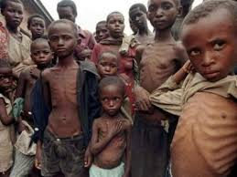
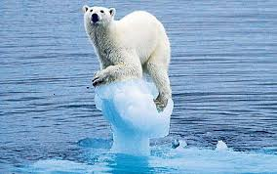
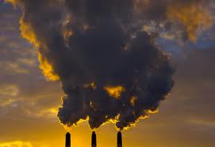
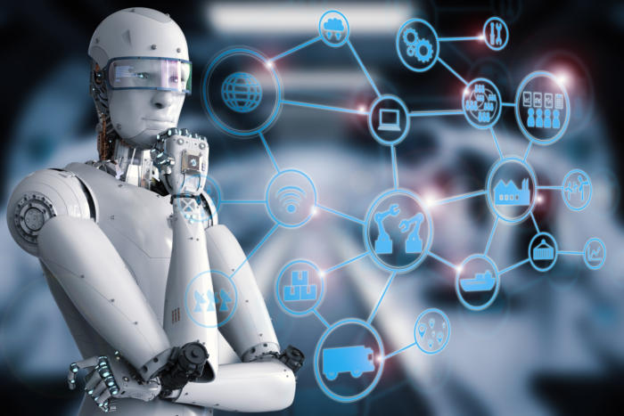
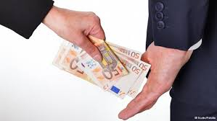
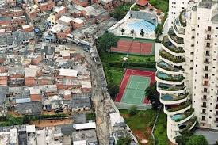
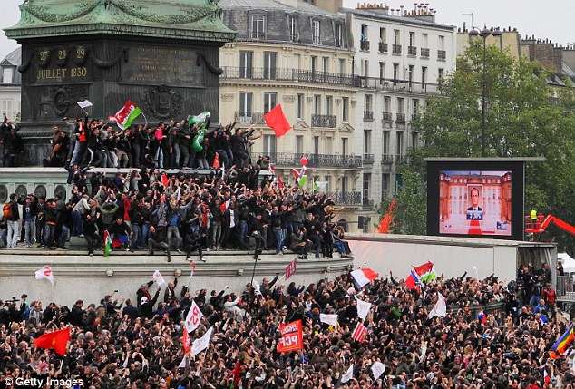
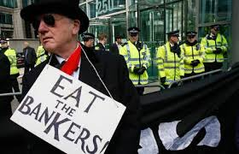
1. Current Situation
Manifold Challenges

Slide 3
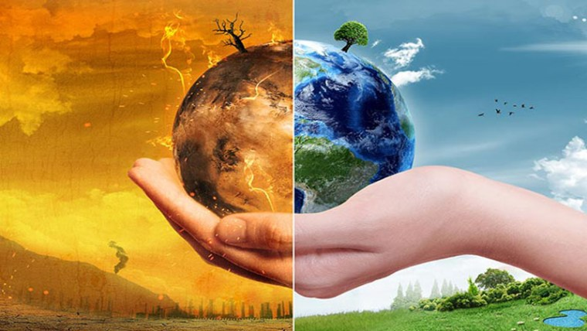
1. Current Situation
Near term Human Extinction?
Humans need Nature
Nature does not need Humans

Slide 4
1. Current Situation
Are we organizing for survival?

Slide 5
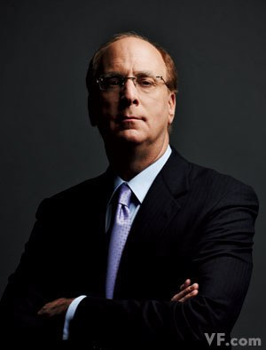
1. Current Situation
Do we need better leadership?
Different Leadership Needed

Slide 6
1. Current Situation
Do we need a new operating system?

Slide 7
1. Current Situation
Or a New Kernel?
User Interface
Application Level
Operating System
Kernel

Slide 8
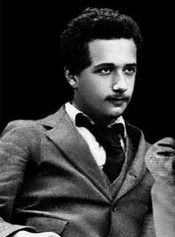
2. Change Mindsets
Current problems require a new perspective
“Problems cannot be solved with the
same mind set that created them.”
(Albert Einstein)
Steve Jobs:
We need to replace the Operating System built on a new Kernel for the mobile computing- Nix Flash

Slide 9
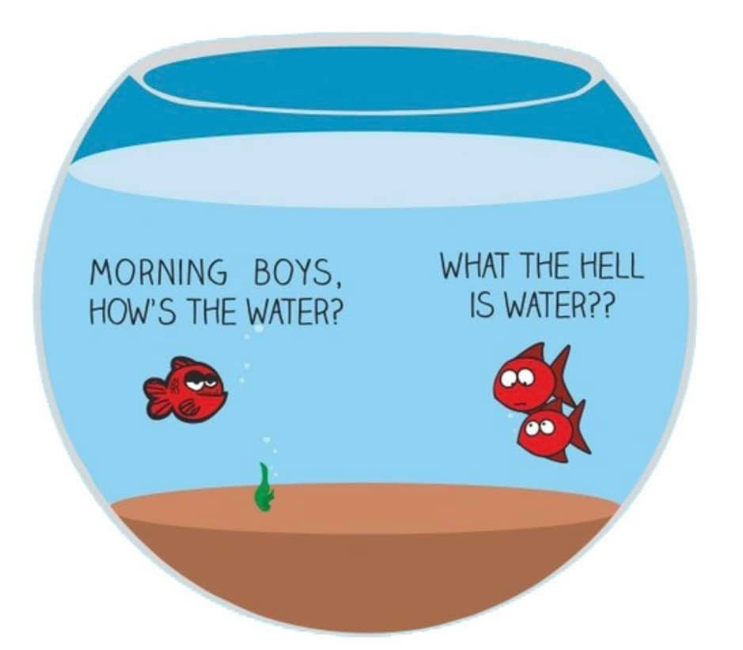
2. Change Mindsets
The water we swim in
What is the Operating System?
What is the Kernel?
What are the applications?
We need better Programmers, Leaders, Educators!

Slide 10
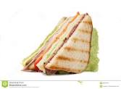
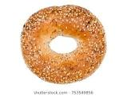
2. Change Operating System
Economistic Model Humanistic Model: Responsibility as Maximization Responsibility as: Staying or getting in the Safe and Just Operating Zone
Planetary Boundaries
Responsibility for Maximization
Safe and Just Operating Zone
Dignity

Slide 11
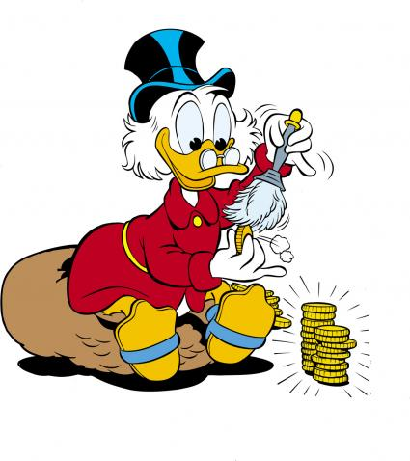
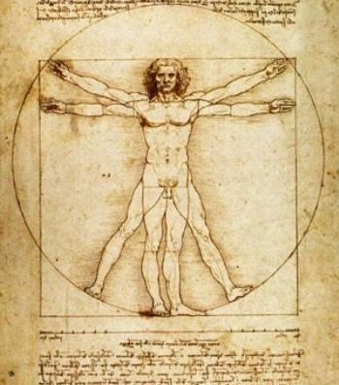
2. Change Kernel
Two background Narratives- human nature
Economistic story Humanistic story
(homo oeconomicus) (homo sapiens)

Slide 12
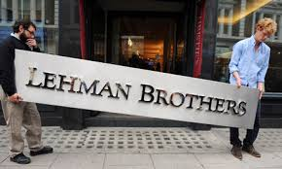
2. Dominant Mindset
Economistic Narrative- Responsibility from Outside-In
Nature of organizations – economistic story
Corporation as person – a psychopath (Bakan, 2000)
Responsibility a cost
An external requirement
Enlightened perspective:
responsibility as business opportunity
“ a means to the end of profit”

Slide 13
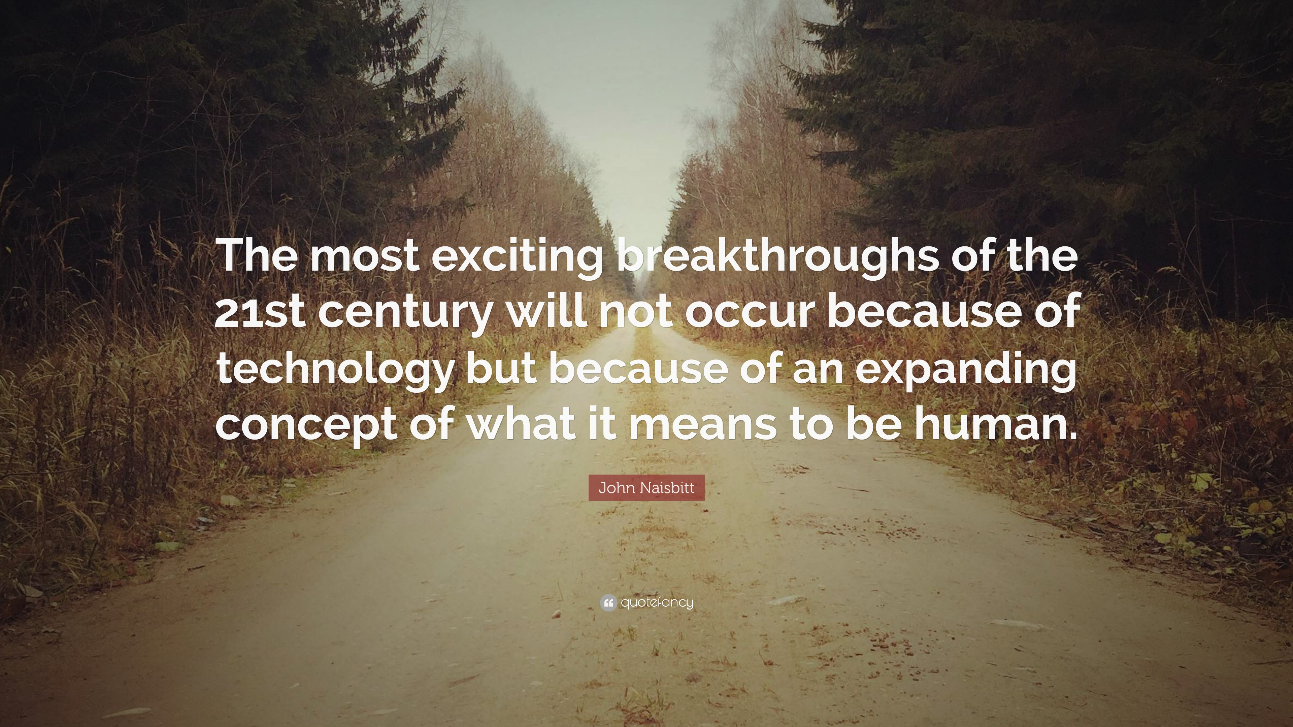
3. Human Nature
Need for a new story- a new kernel
To explain why people are motivated by more than profit
Why responsibility is relevant
To be able to survive in and with nature

Slide 14
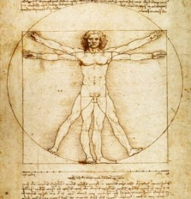
3. Human Nature
Humanistic Perspective allows better leadership
Evolution towards homo sapiens- an evolutionary account (evidence based)
dC
dB
dA/dD

Slide 15
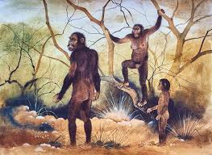
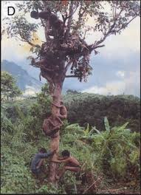
3. Human Nature
From Homo Habilis to Homo Erectus

Slide 16
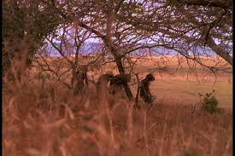
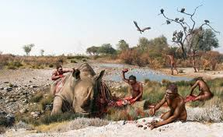
3. Human Nature
From Homo Habilis to Homo Erectus

Slide 17
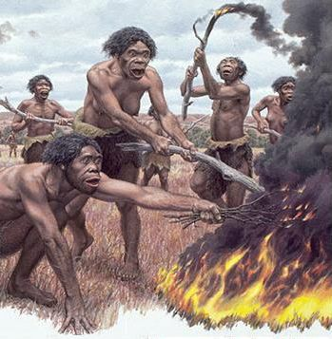
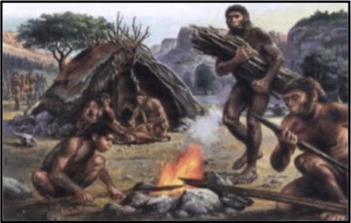
3. Human Nature
From Homo Habilis to Homo Erectus

Slide 18
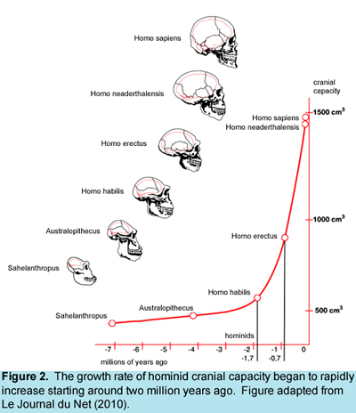
3. Human Nature
Humanistic Perspective allows better leadership

Slide 19
3. Human Nature
Emergence of an Independent Drive to BOND
Homo Erectus
Survival chances are improved by:
Fire
Bigger prey
Bigger brain
Nuclear family
Tribal bonding: independent drive to bond (dB)

Slide 20
3. Human Nature
From Homo Erectus to Homo Sapiens- Drive to Comprehen
Evolution towards homo sapiens- an evolutionary account (evidence based)
dC
dB
dA/dD

Slide 21
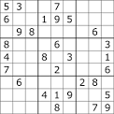
3. Human Nature
From Homo Erectus to Homo Sapiens- Drive to Comprehend

Slide 22
3. Human Nature
From Homo Erectus to Homo Sapiens- Drive to Comprehend
HOMO SAPIENS
Survival chances are improved by:
Abstract Thinking (supports innovation)
Story telling (supports learning)
Creating Shared meaning (i.e. religion)
We ask the question WHY
Meaning Making: independent drive to comprehend (dC)

Slide 23
3. Human Nature
Balance of 4 drives not Maximization
Independent drives (neuro circuits)
Objective: Balance
dA/dD
dB
dC

Slide 24
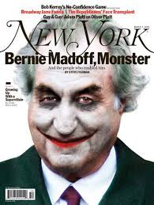
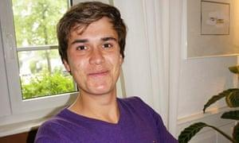
3. Human Nature
Humanistic perspective
When Imbalance Occurs: Drive to Acquire
.
Flourishing
Goldman Sachs restricts intern workday to 17 hours in wake of burnout death: (The Guardian, 2015)
https://www.theguardian.com/business/2015/jun/17/goldman-sachs-interns-work-hours
Goal: Maximization of Wealth and Power
Michael Pirson
Michael Pirson
24
24

Slide 25
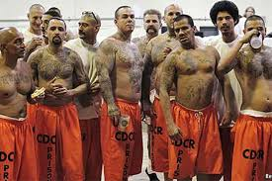
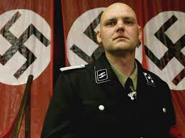
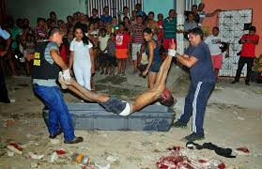
3. Human Nature
Humanistic perspective
When Imbalance Occurs: Drive to Bond
.
Flourishing
Goal: Maximization of Bonding within Tribe / Ingroups
Michael Pirson
Michael Pirson
25
25

Slide 26
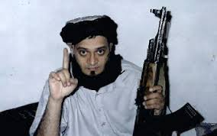
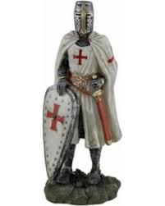
3. Human Nature
Humanistic perspective
When Imbalance Occurs: Drive to Comprehend
.
Flourishing
Goal: Maximization of Ideological Alignment (worldviews)
Michael Pirson
Michael Pirson
26
26

Slide 27
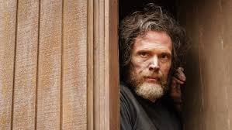
3. Human Nature
Humanistic perspective
When Imbalance Occurs: Drive to Defend
.
Flourishing
Goal: Maximization of Security/Insecurity
Michael Pirson
Michael Pirson
27
27

Slide 28
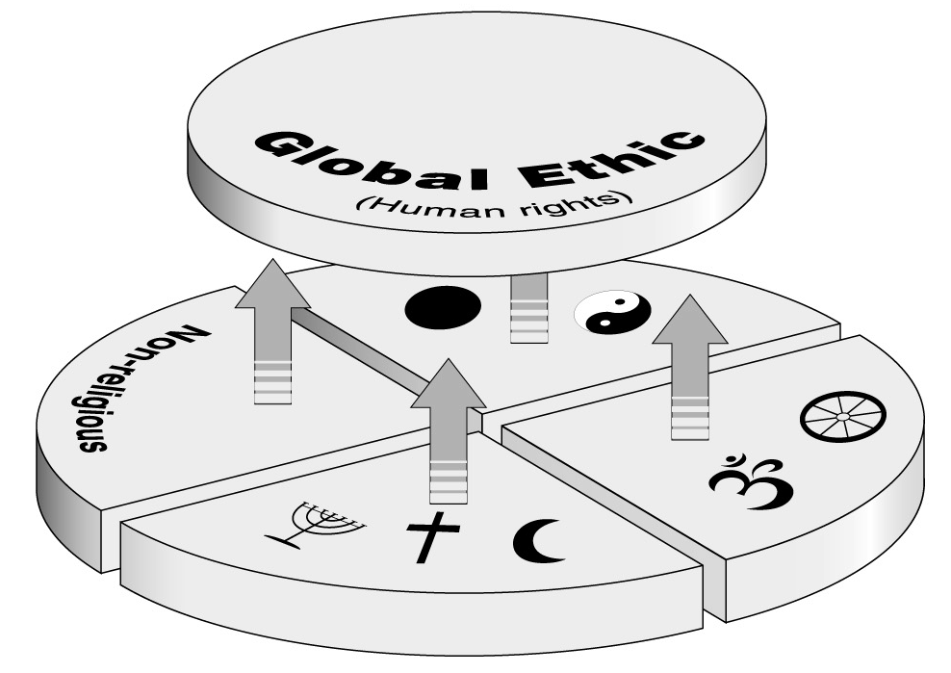
3. Human Nature
Humanistic Perspective- Consilience of knowledge
Humanistic perspective: human nature
Philosophy: Zoon politicon (Aristotle): Social animal endowed with reason
Natural Sciences:
Darwin (morality a survival mechanism)
Theology: Religions (shared universal values) (Kueng)

Slide 29
Dignity and the Operating System
Dignity
Economistic perspective: (we are all whores…)
Michael Jensen (1998) opined…we all have a price: “Like it or not, individuals are willing to sacrifice a little of almost anything we care to name, even reputation or morality, for a sufficiently large quantity of other desired things; and these things do not have to be money or even material goods.”
Humanistic perspective:
Kant, however, famously noted that―”everything has either a price or a dignity. Whatever has a price can be replaced by something else as its equivalent; on the other hand, whatever is above all price, and therefore admits of no equivalent, has a dignity (Kant, 1785).”

Slide 30
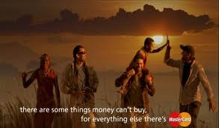
4. Cornerstone of Humanistic Leadership
Dignity- Kant 2.0

Slide 31
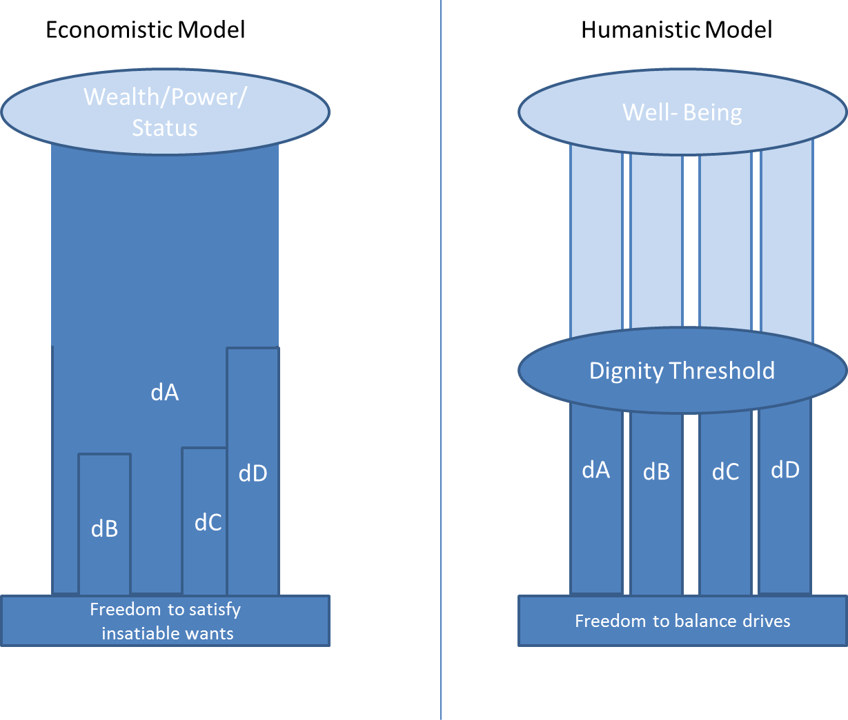
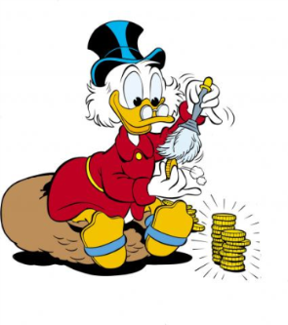
4. Humanistic Leadership and Flourishing
Economistic vs. Humanistic Perspective

Slide 32
5. Towards Humanistic Paradigm
Reality proves possibility: Humanistic Leadership in Practice
Goal: Maximization of Wealth and Power

Slide 33
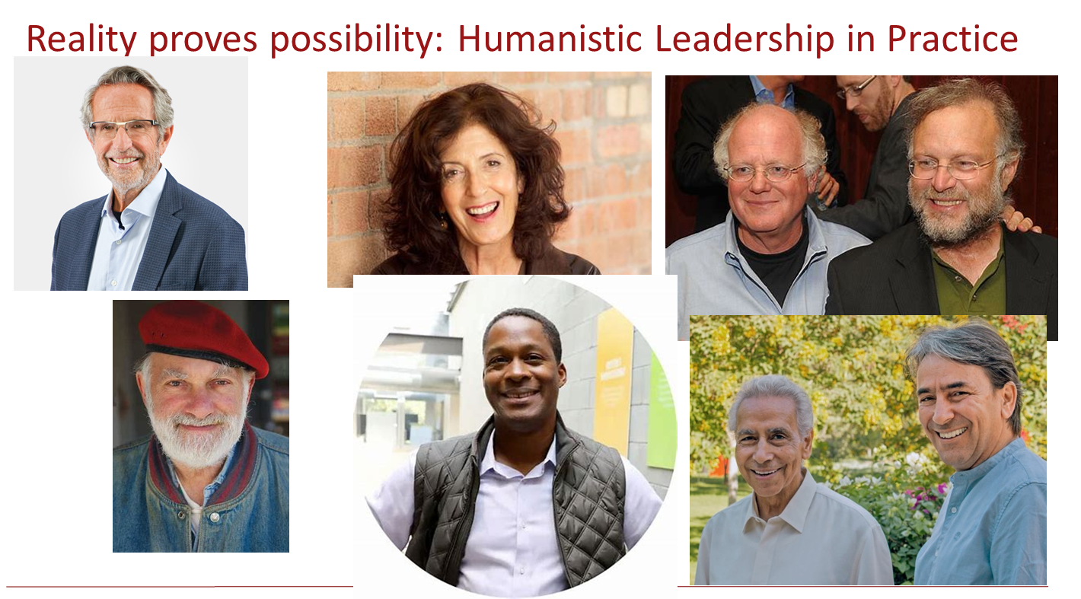
Humanistic Leadership in Practice

Slide 34
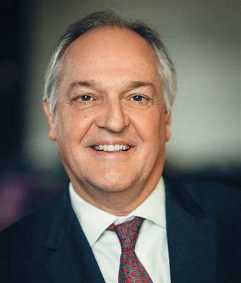
Humanistic Leadership in Practice
Paul Polman, Former CEO Unilever

Slide 35
Invitation
Join the Humanistic Leadership Academy Workshops
We need better Programmers, Leaders, Educators!
Connect with the International Humanistic Management Association:
www.humanisticmanagement.international
www.Humanisticleadership.org
Contact: Michael Pirson: pirson@fordham.edu

